Slide 1


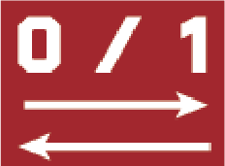
HVG selection method for
Genotype batch dataset
Youngchul Oh, Ohbin Kwon
P.I. : Heetak Lee
2024. 8. 19
B.I. team, CGE, IBS
Notes:
Good afternoon, I am youngchul oh from CGE, IBS. And my teammate, Ohbin Kwon is over there. Today Im gonna talk about our hackaton project, HVG selection method for genotype batch dataset.

Slide 2
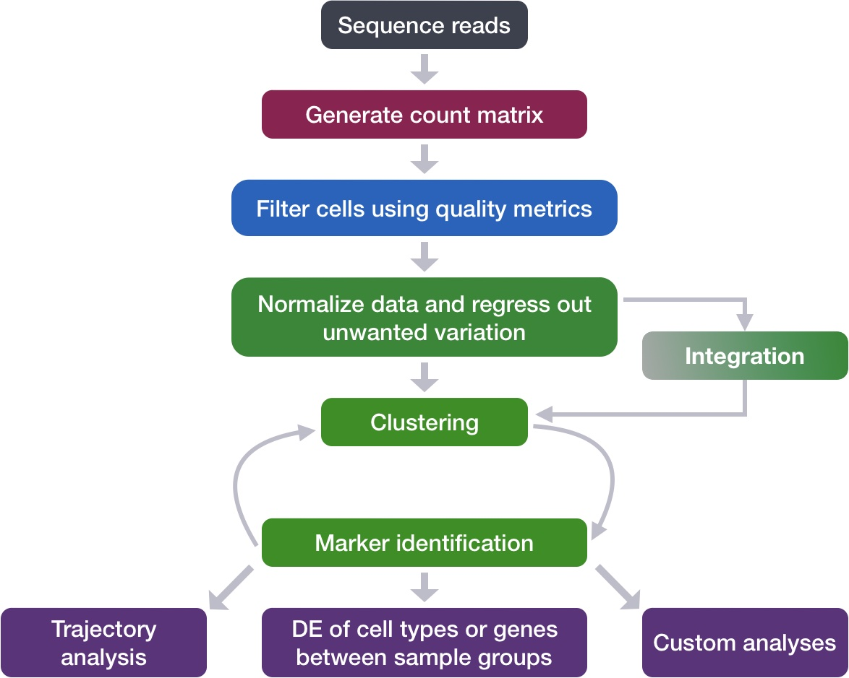
HVG selection in scRNA seq analysis
Clustering method – may include genes that are not actually cluster-informative
Integration – In some cases, need to select HVGs (anchoring method, cell projection)
FindVariableFeatures
HVG selection affects all downstream analyses
→ HVGs should be carefully selected according to the biological context
https://hbctraining.github.io/scRNA-seq_online/lessons/06_integration.html
Notes:
This is the pipeline I saw a lot when I study single cell analysis.
There is a very important part missing here, the highly variable gene HVG selection part.
This part is actually very important, because dimension reduction and clustering are performed through HVG, so the shape on UMAP is determined. It also affects downstream analysis.
In single cell data, a large number of genes have similar expression levels, but since some genes are highly expressed in specific cells, it is common to determine variance by looking at the variance.
However, this method may include genes that are not actually informative when taken for clustering.
Additionally, HVG is used when integrating two samples with batch effects, and this also affects batch effect removal depending on how the HVG is selected.
Therefore, we need to choose HVG more carefully according to our sample.

Slide 3
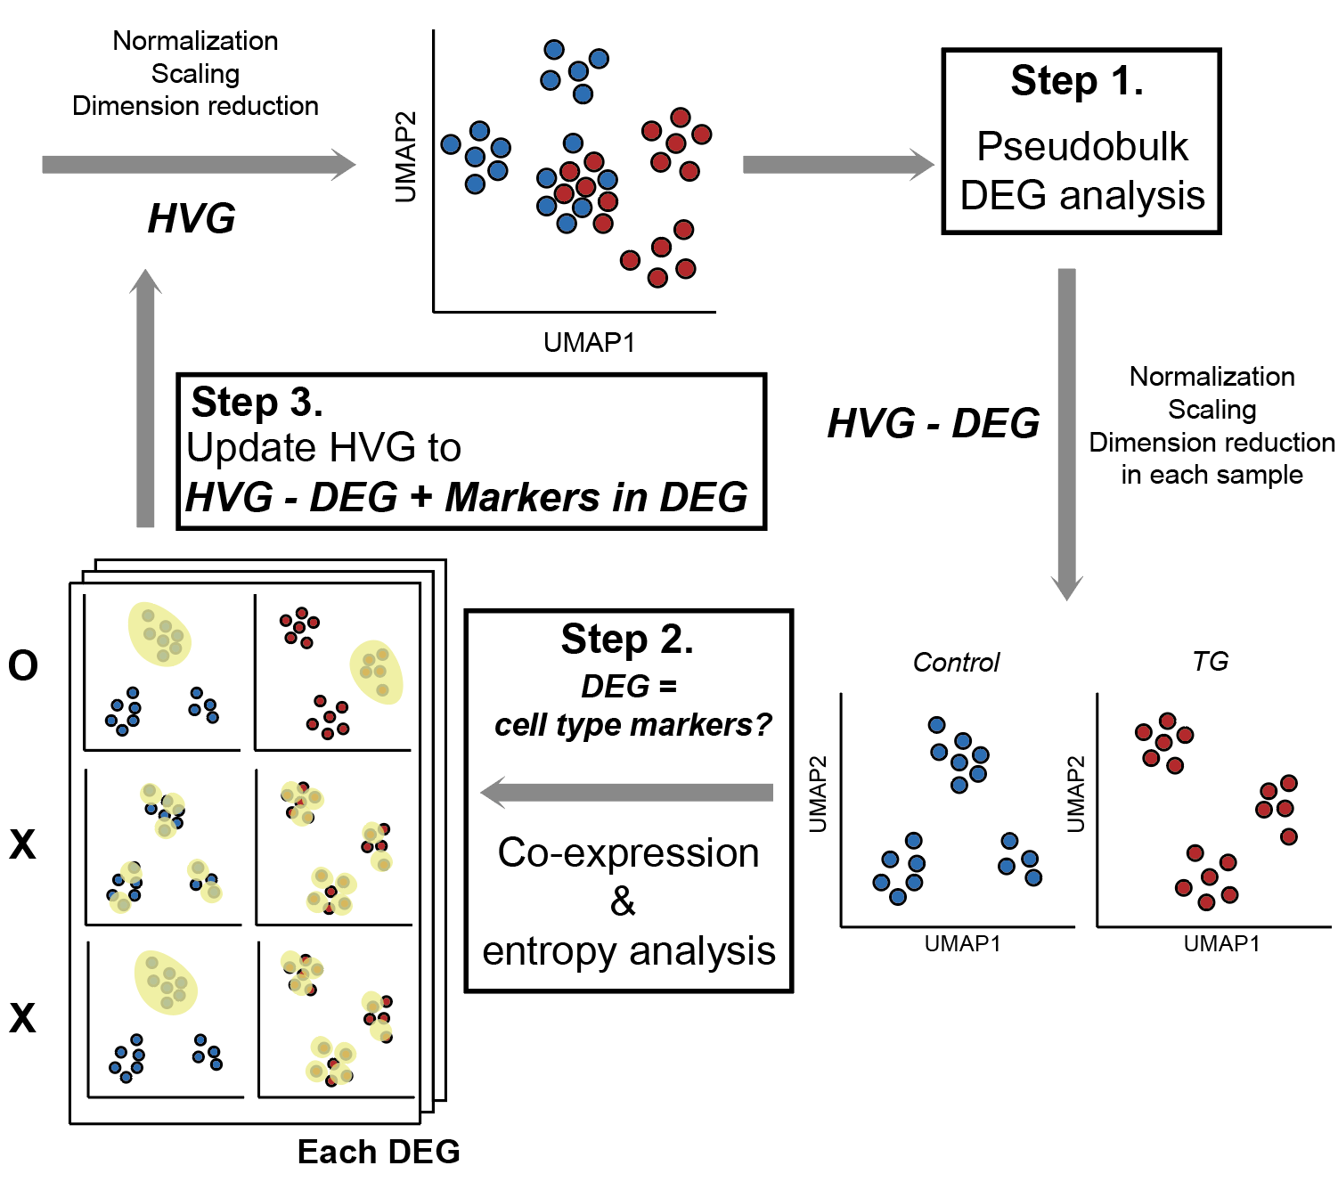
HVG selection between genotype differences
KO or KI
sample
Control
1. Genotype (Biological batch)
2. Cell composition
Main strategy :
Remove genotype batch effect
&
rescue cell composition info.
Notes:
Suppose we are dealing with two datasets with different genotypes. Here is the control sample and here is the KO or KI sample.
If there are no technical batches of these two, what is the cause of the difference in expression level?
First, there will be biological batches resulting from differences in genotype. If a specific gene is KO or KI, genes with the same pathway as that gene will be affected.
Additionally, there will be differences in expression levels caused by different cell types.

Slide 4
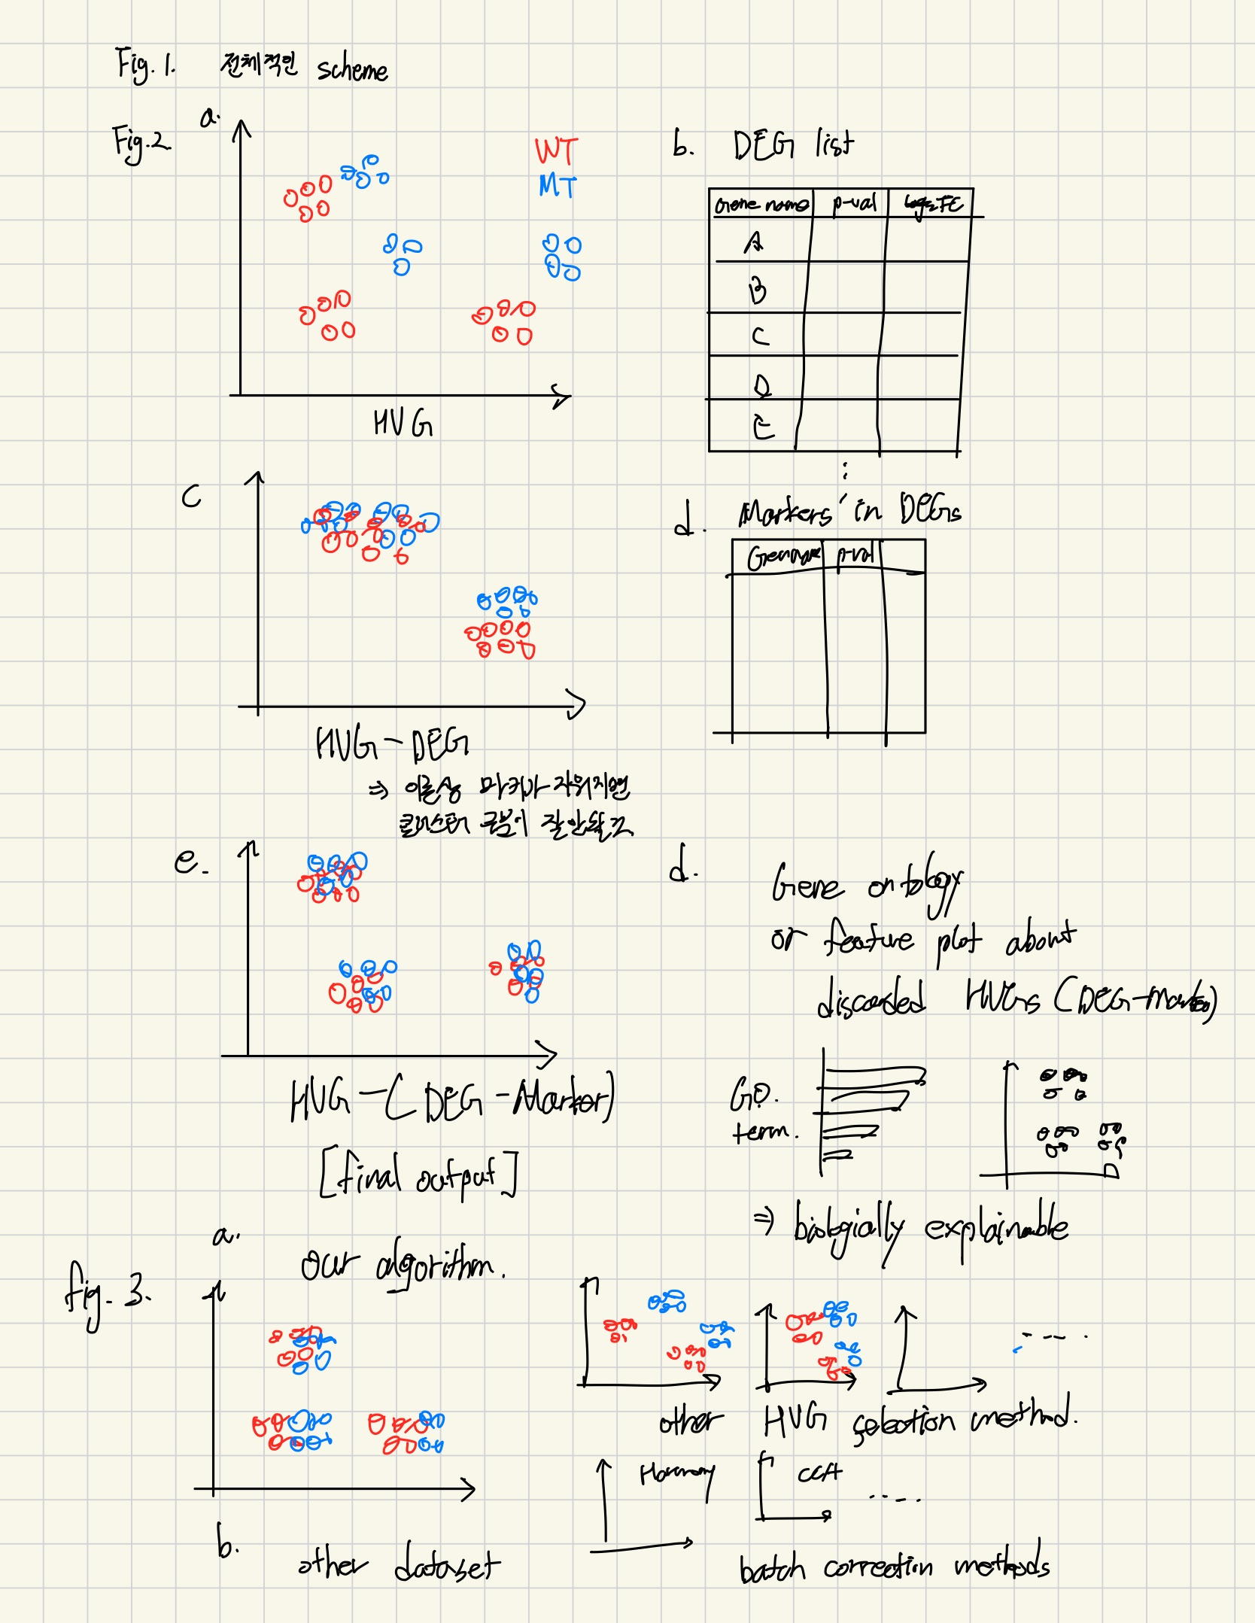
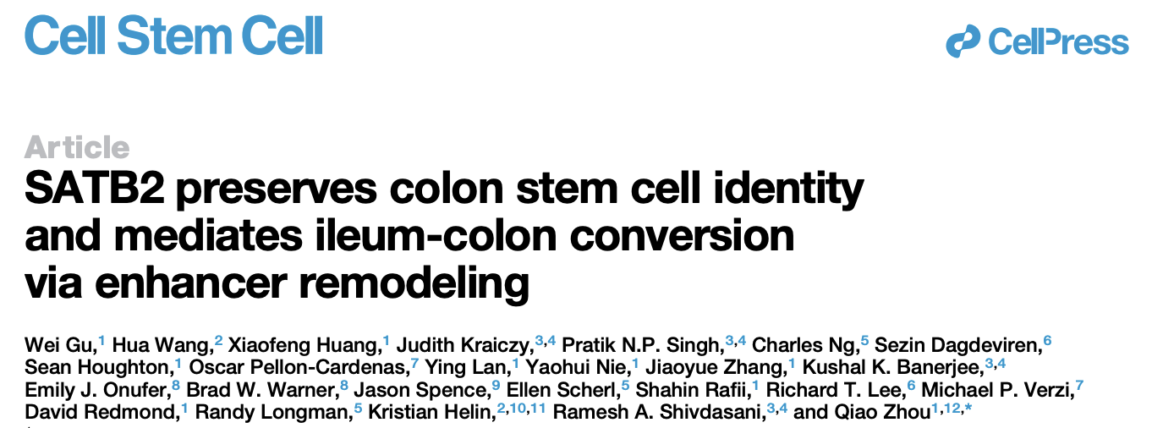
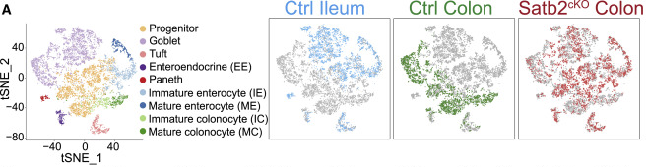
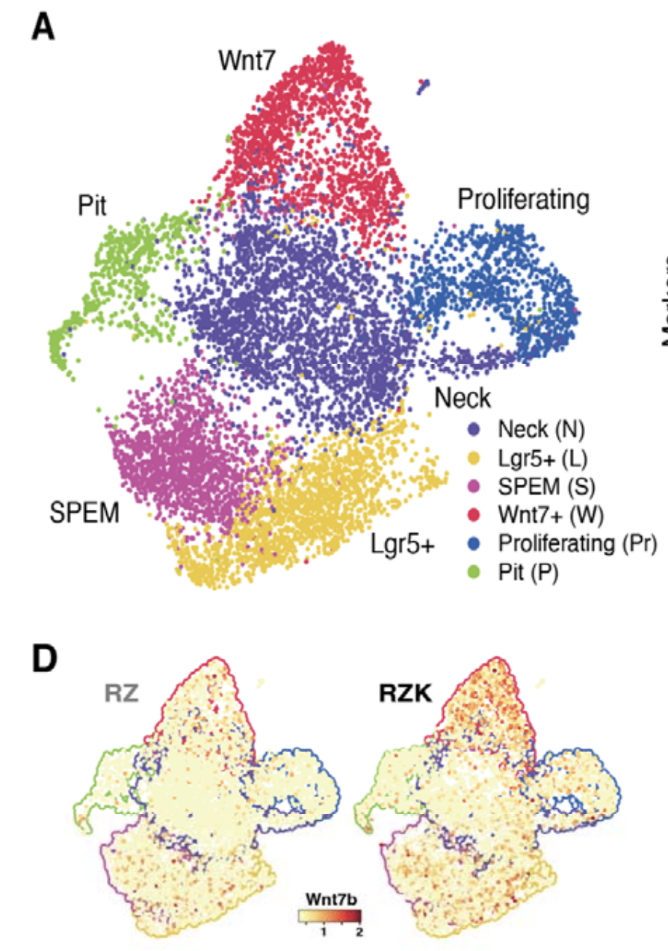

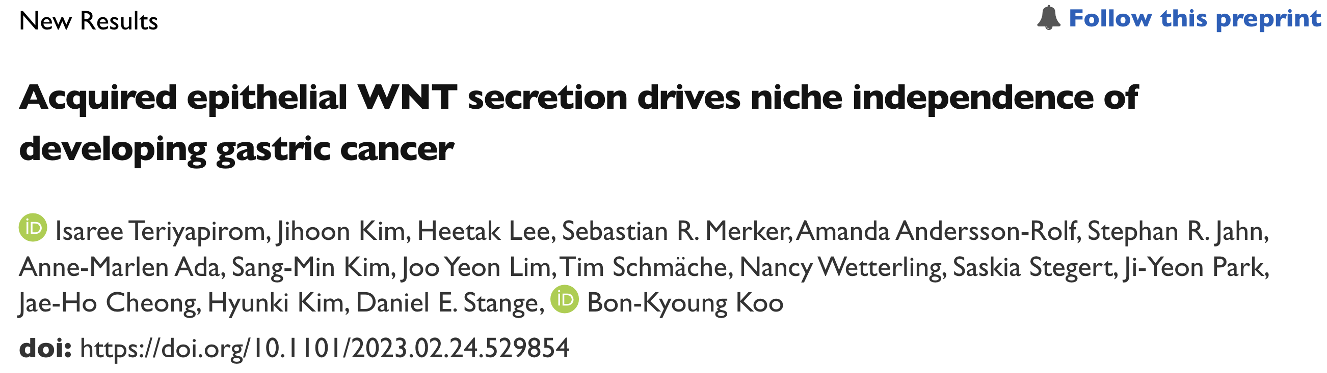
Dataset
# 1 Genotypic changes, Rare cell population occurs
# 2 Genotypic changes, similar cell populations but with different proportions

