Slide 1

2025 SCSOK Hackathon
Abyot Melkamu Mekonnen
Hyeonmin Kim
Junseong Bae
Sohui Kim
Yejin Kwak
Yuhui Jeong
Prof. Dr. Jeongbin Park

Slide 2
2 goals
Best Practices for ST Data Analysis
2. Spatial Cell-type Classifier

Slide 3
2 goals
Best Practices for ST Data Analysis
2. Spatial Cell-type Classifier

Slide 4





Best Practices for ST data analysis
Documentation of analysis workflow
SpatialData
squidpy
napari
cell2location
SPAPROS
+
Baysor, ClusterMap (Imaging-based)
SCS, FICTURE (NGS-based)
Evaluating the performance of ST analysis methods
Baysor, ClusterMap, SCS, FICTURE
Workflow
napari

Slide 5
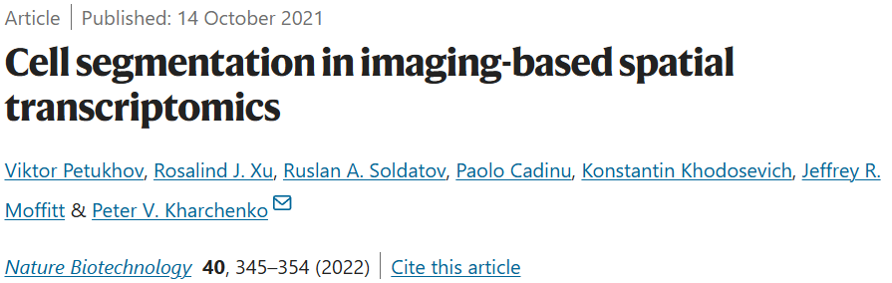
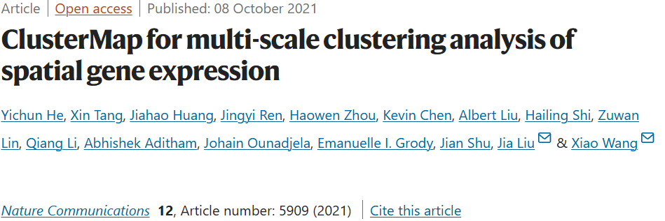
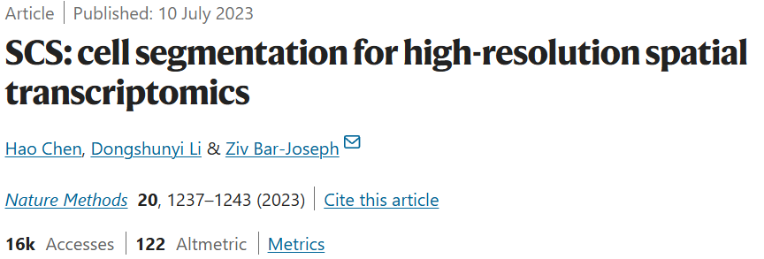
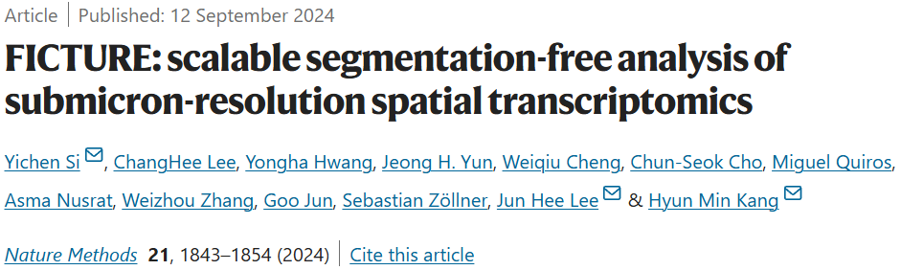
Best Practices for ST data analysis
Documentation of analysis workflow
SpatialData
squidpy
napari
cell2location
SPAPROS
+
Baysor, ClusterMap (Imaging-based)
SCS, FICTURE (NGS-based)
Evaluating the performance of ST analysis methods
Baysor, ClusterMap, SCS, FICTURE
Baysor
ClusterMap
SCS
FICTURE

Slide 6
2 goals
1. Best Practices for ST Data Analysis
2. Spatial Cell-type Classifier

Slide 7

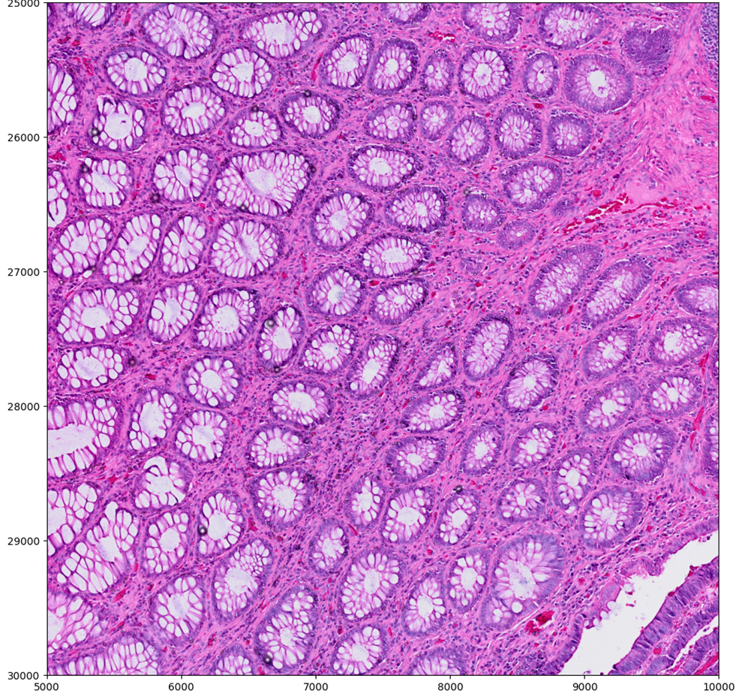
Preprocessing count matrix

Slide 8
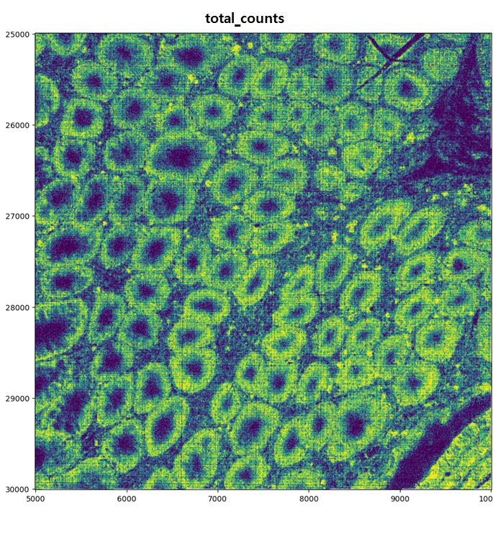
Preprocessing count matrix

Slide 9

Preprocessing count matrix
1. Quantile normalization (Bin2cell flavor)

Slide 10
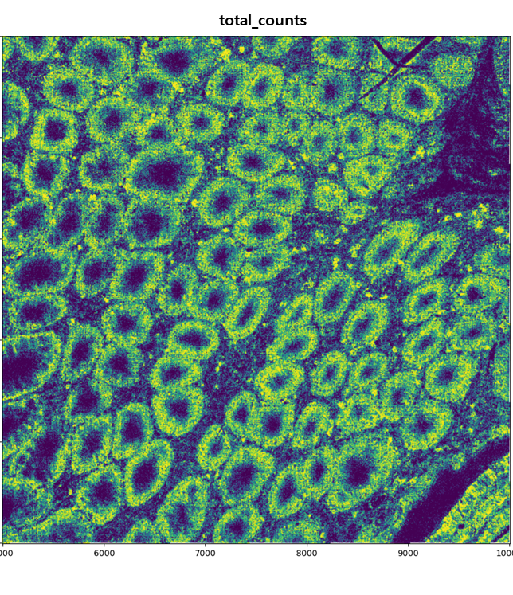
Preprocessing count matrix
1. Quantile normalization (Bin2cell flavor)

Slide 11
Preprocessing count matrix
1. Quantile normalization (Bin2cell flavor)
2. Gaussian smoothing

Slide 12
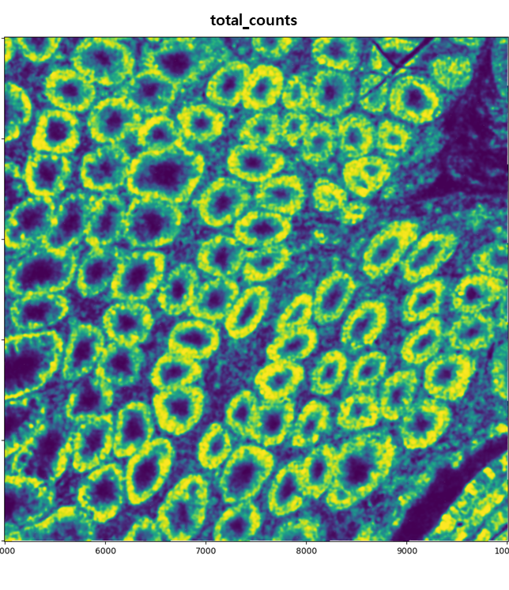
Preprocessing count matrix
1. Quantile normalization (Bin2cell flavor)
2. Gaussian smoothing

Slide 13
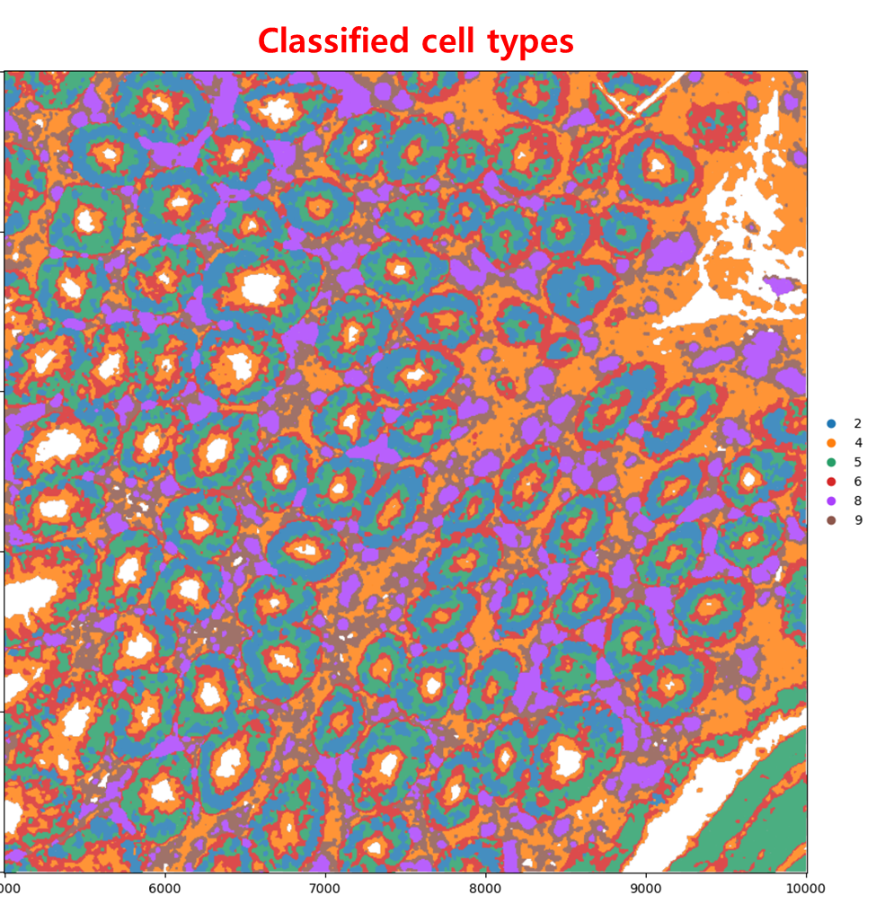
Adversarial Autoencoder

Slide 14
Adversarial Autoencoder
To Do
✓ Ensure consistency of results
✓ Determine a evaluation metrics of the performance

