Slide 1



Best Practices for pseudobulk analysis
in scRNA-seq
2025. 02. 21
Youngchul Oh, Yeongjun Kim

Slide 2
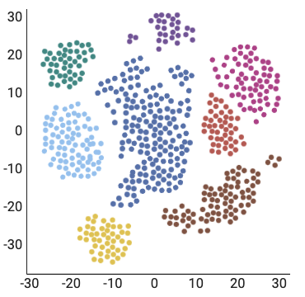
What is Pseudobulk ?

Slide 3
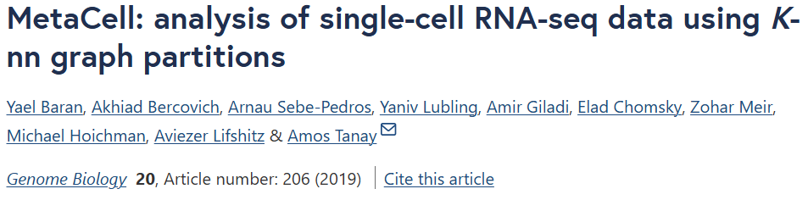
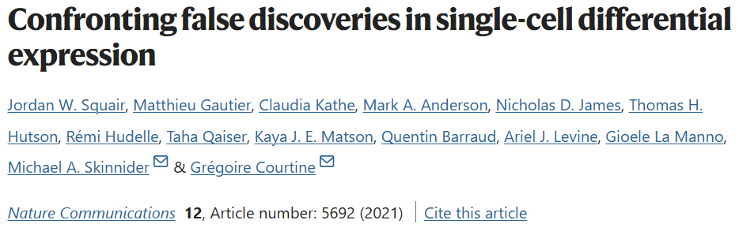
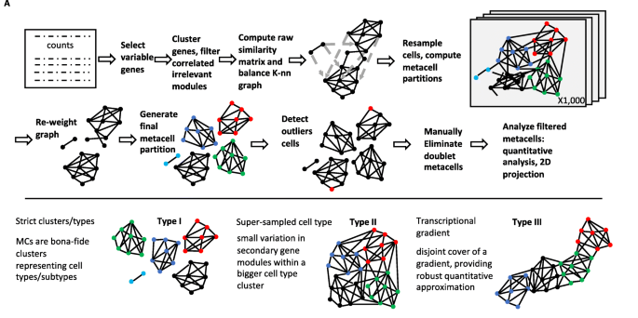
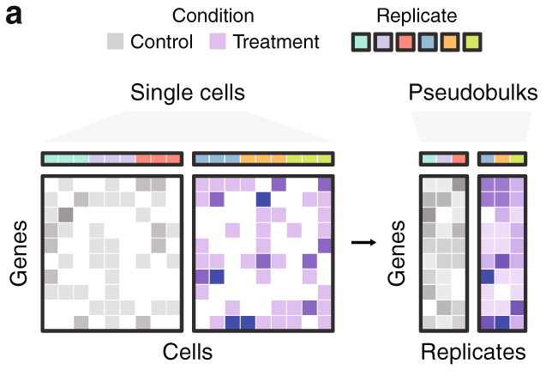
Various Methods for Generating Pseudobulk Samples
Select cells from same cluster
Pseudobulk sample

Slide 4
Parameters for Generating Pseudobulk Samples
1. Change the size of Pseudobulk samples
2. Change the number of Pseudobulk samples
…

Slide 5
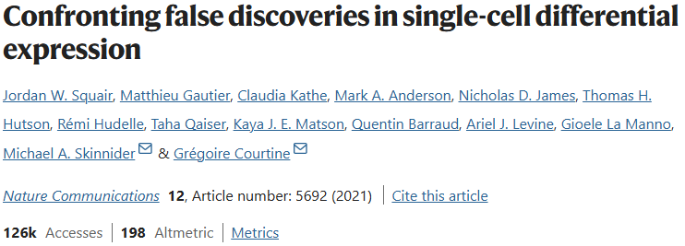
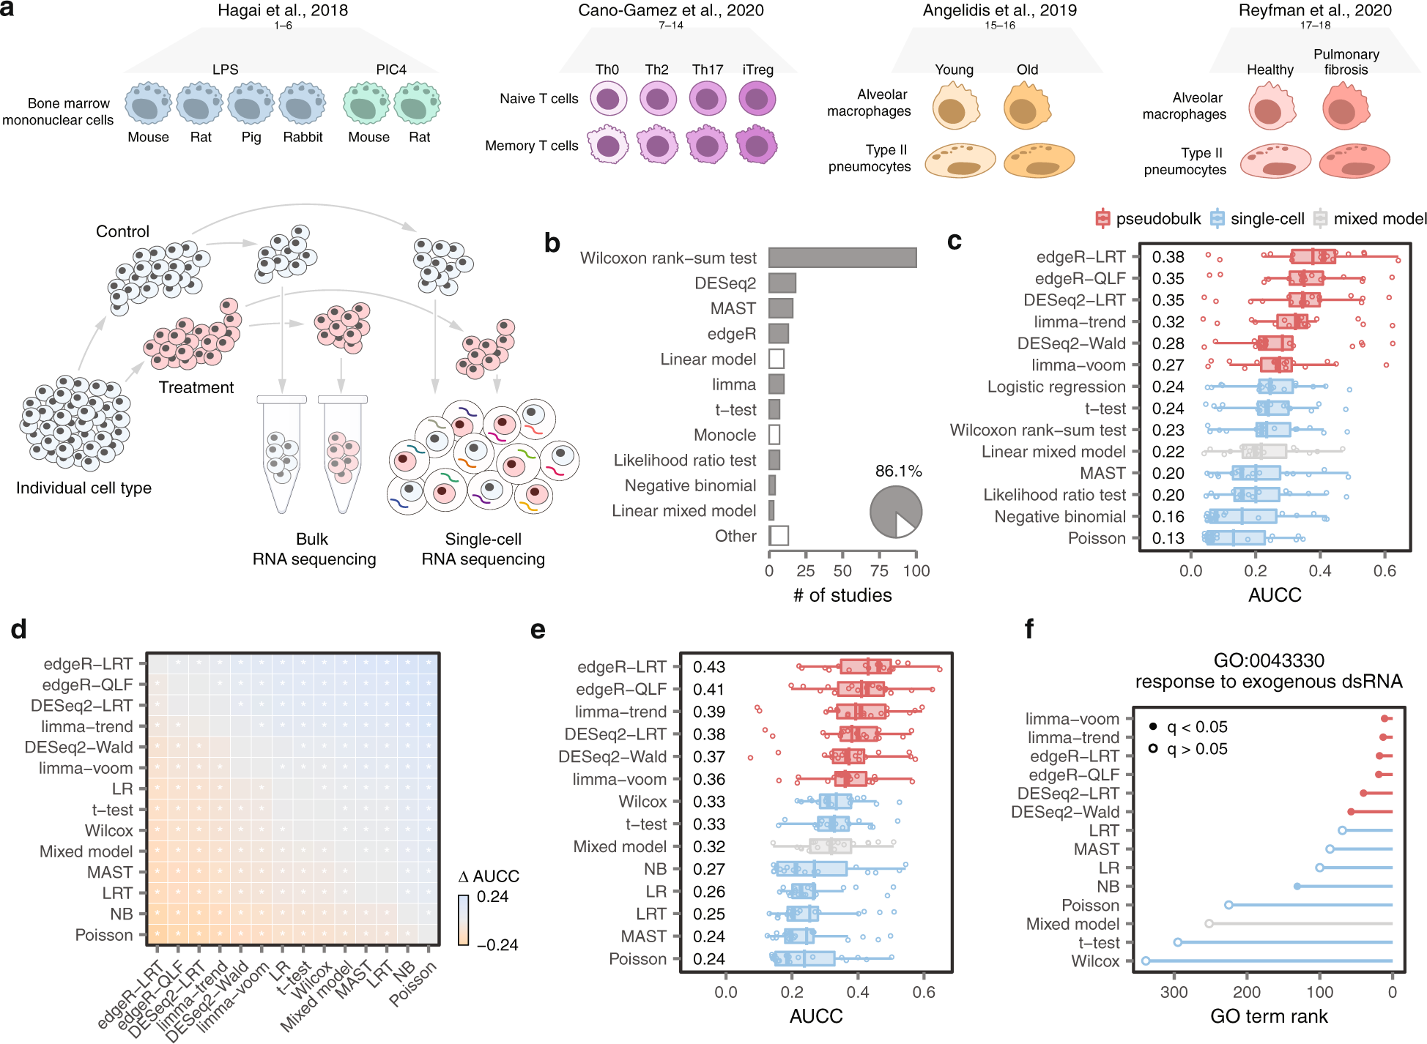
Gold standard datasets for our analysis
16 Comparisons

Slide 6
Comparison of Overlapping DEGs Between Pseudobulk Data and Bulk RNA Sequencing Data
Truth (Bulk RNA seq’s result)
: Bulk RNA sequencing analysis
: Single cell RNA seq analysis
 | DEGs | Non DEGs
DEGs | TP | FP
Non DEGs | FN | TN
Young
DEGs
Predicted (Single cell RNA seq’s result)
Type II pneumocytes
Old
DEGs
Threshold for DEG: abs(log2FC) >=1, p_adj < 0.05

Slide 7
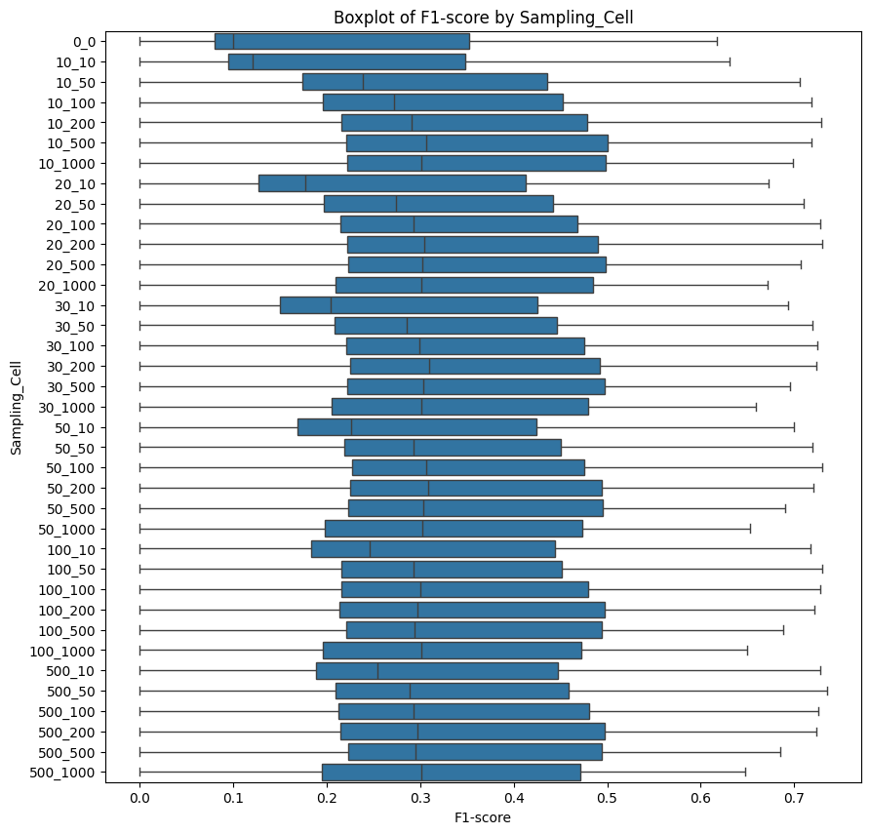
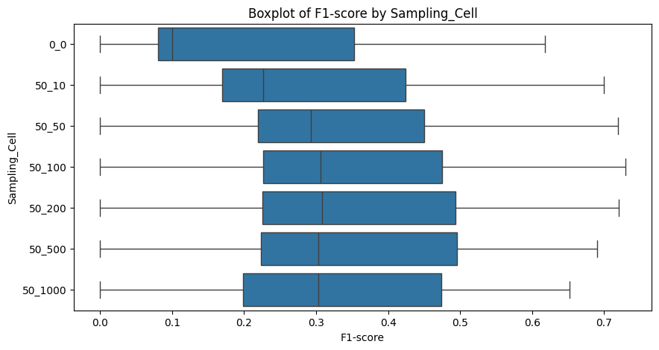
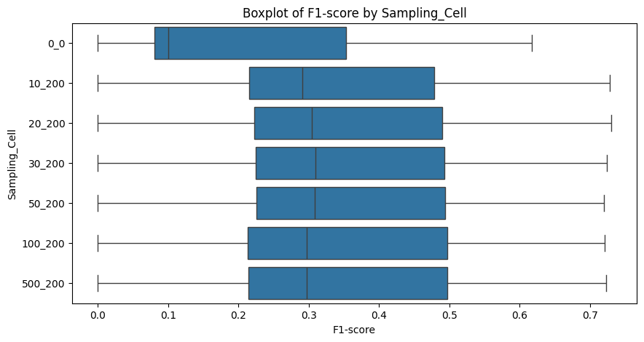
Result: Larger Sample Size Improves DEG Detection
Fix count of Pseudobulk sample (50)
Single cell
Single cell
Fix size of Pseudobulk sample (200)
Single cell

Slide 8
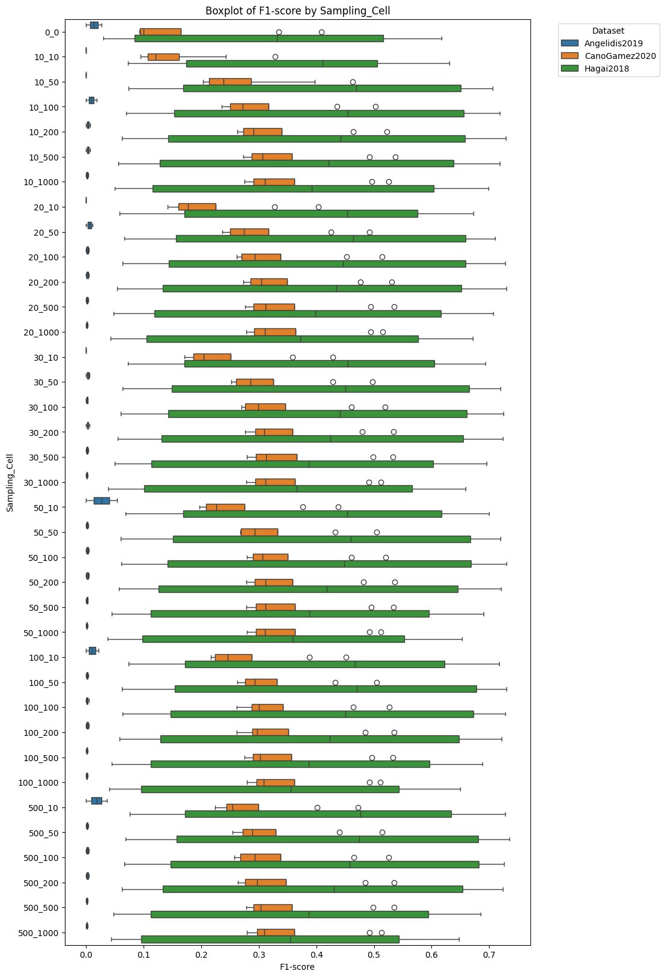
Result: F1-score Across Datasets
Single cell
Single cell

Slide 9
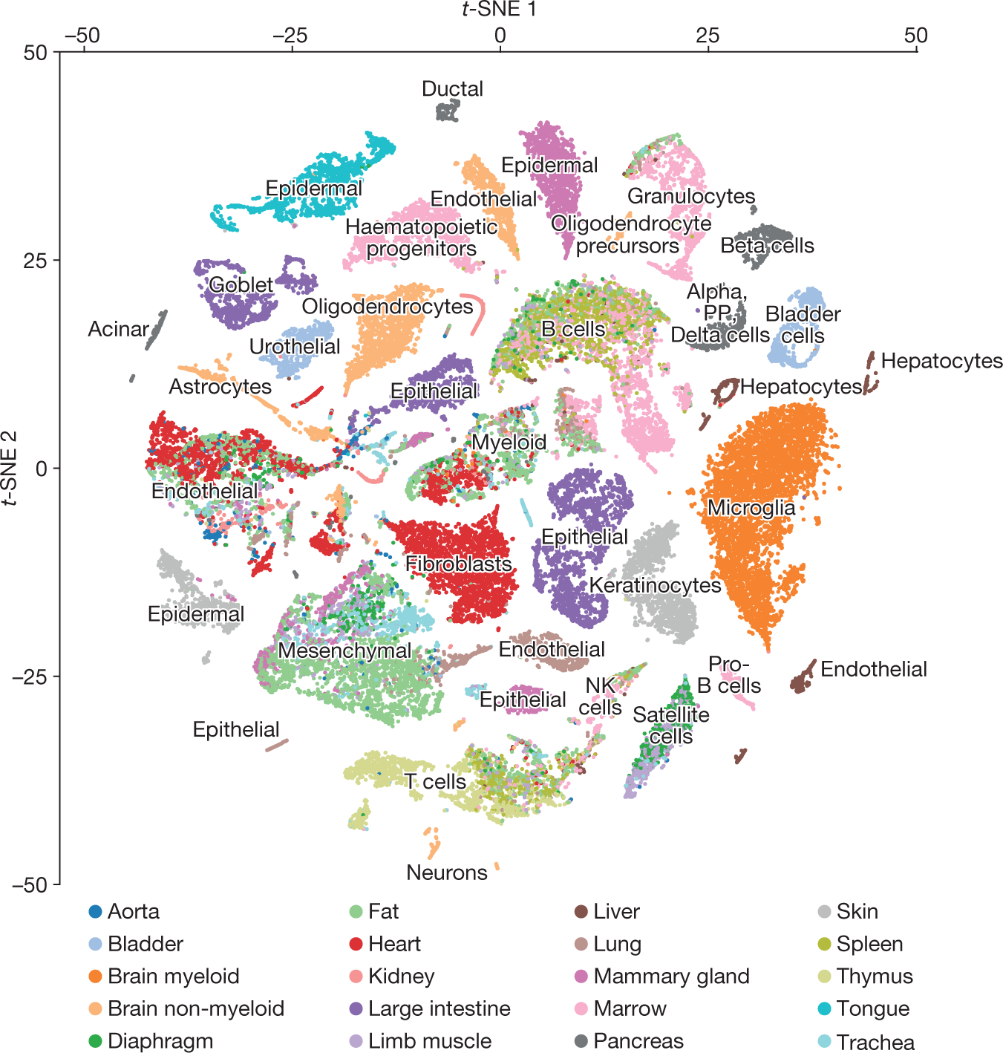
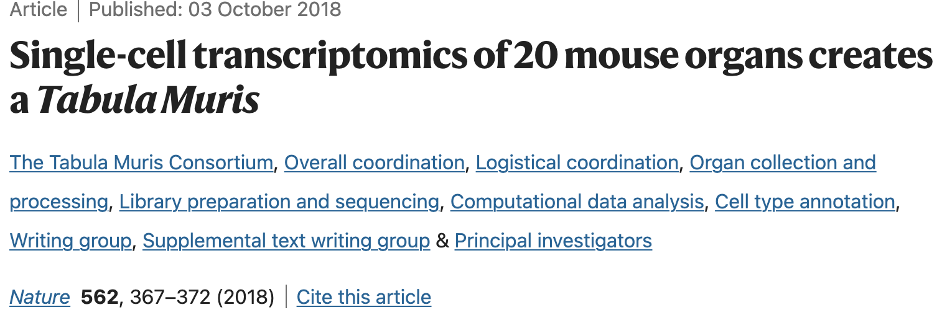
What about DEG between clusters in one sample?
Dataset : Tabula muris – mouse cell atlas

Slide 10

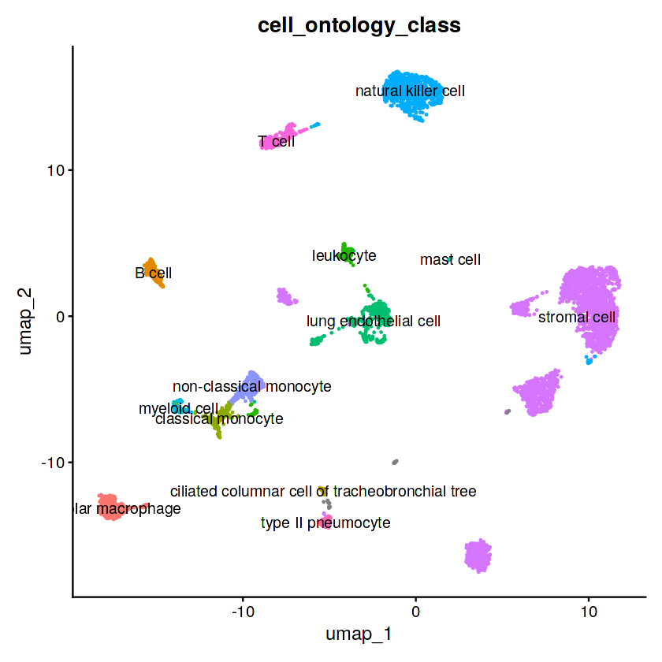
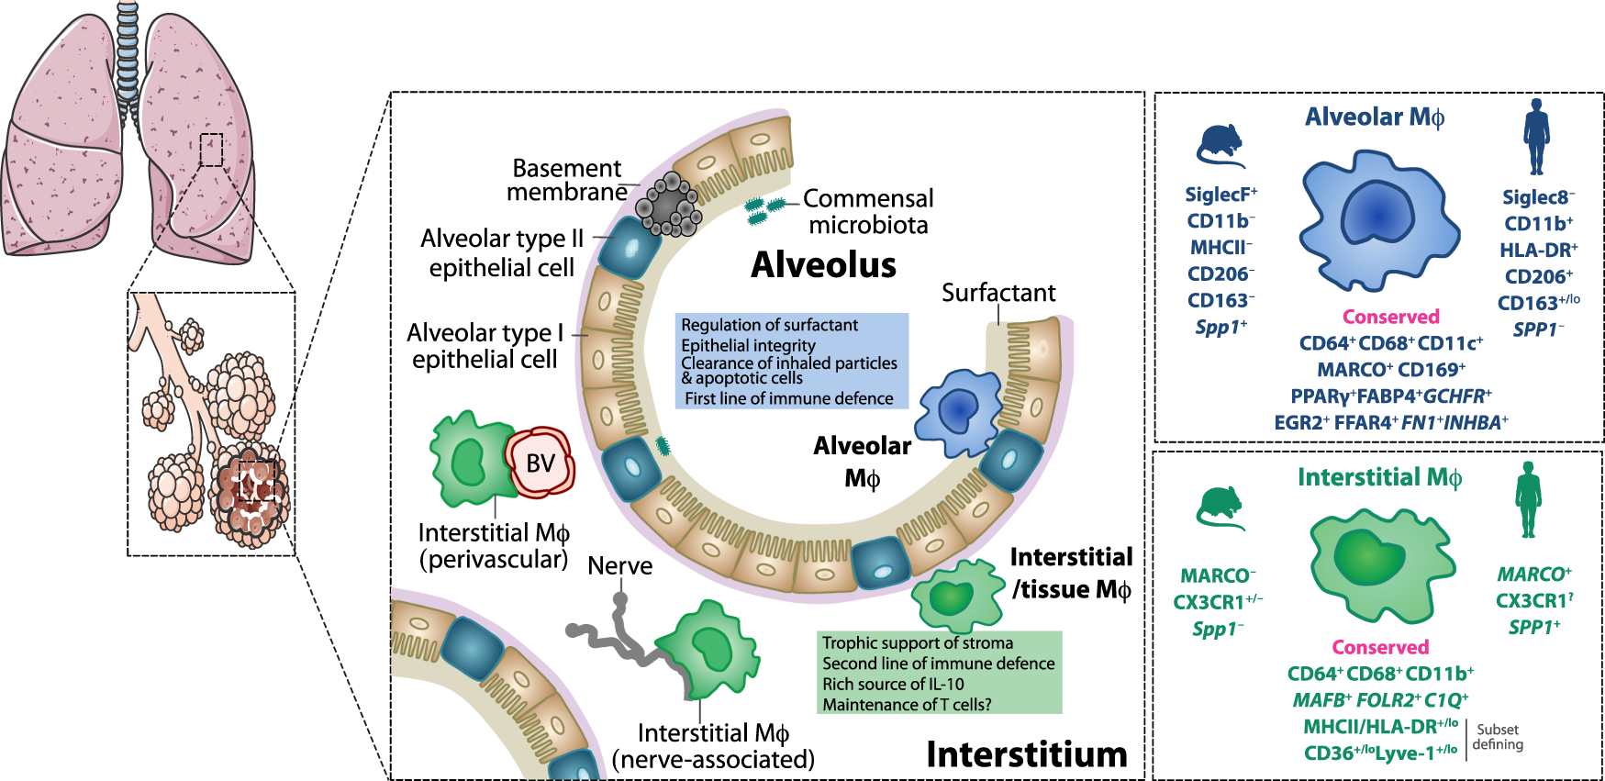
Alveolar macrophage
Marker gene : Cd68, Marco, Pparg, Fabp4, Gchfr, Egr2, Fn1, Inhba, Spp1

Slide 11
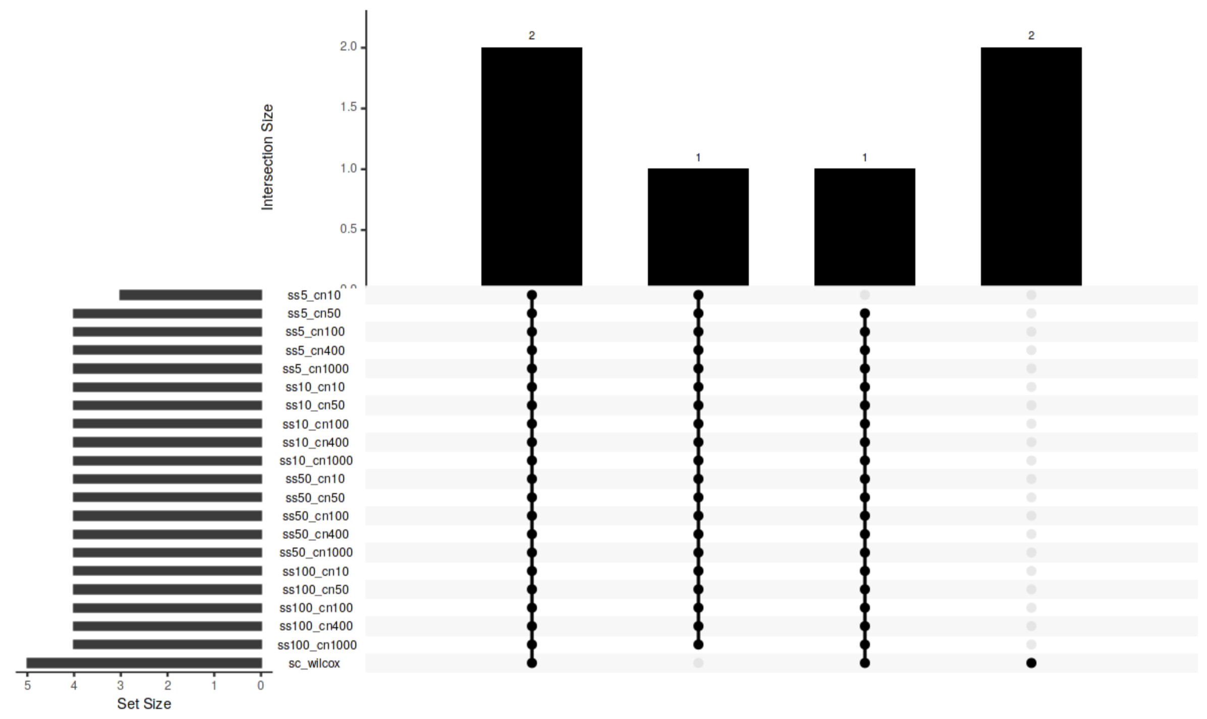
Result: Larger Sample Size Improves DEG Detection
Cd68, Fabp4
Marco, Pparg
Spp1
Egr2
ss : number of pseudosample cn : pseudosample size sc : single cell(without pseudobulk)

Slide 12
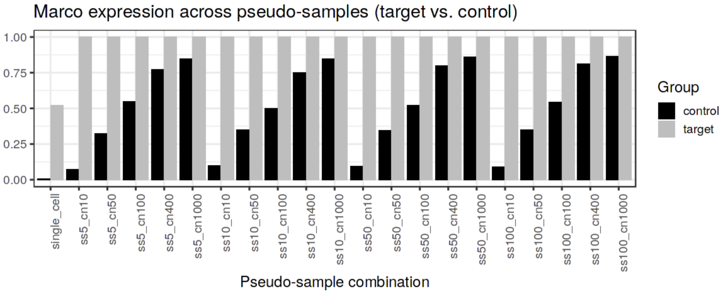
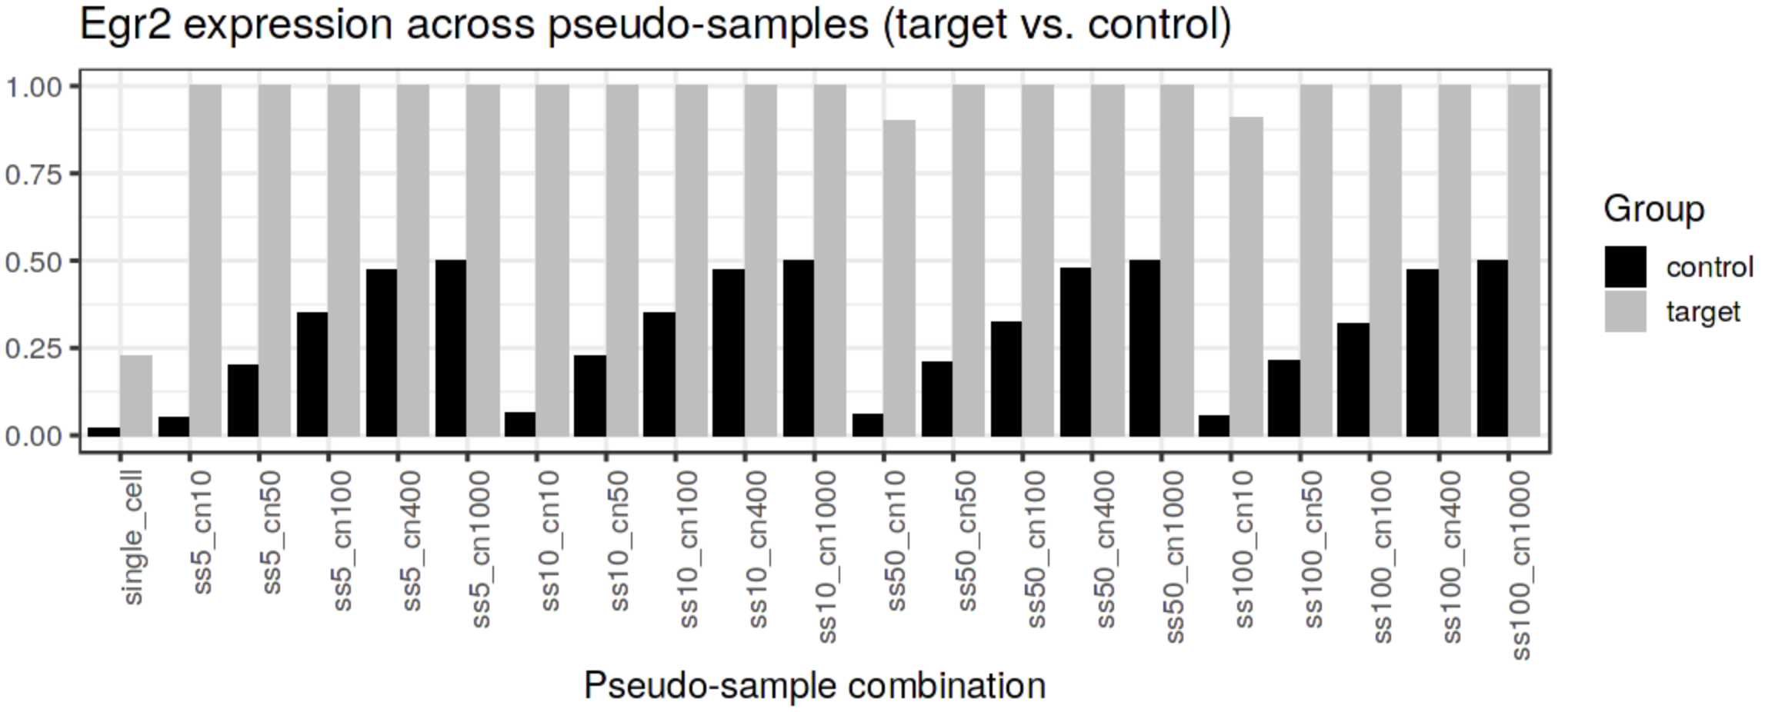
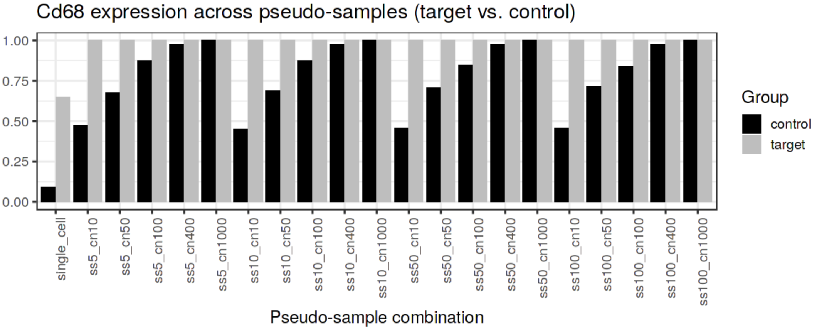
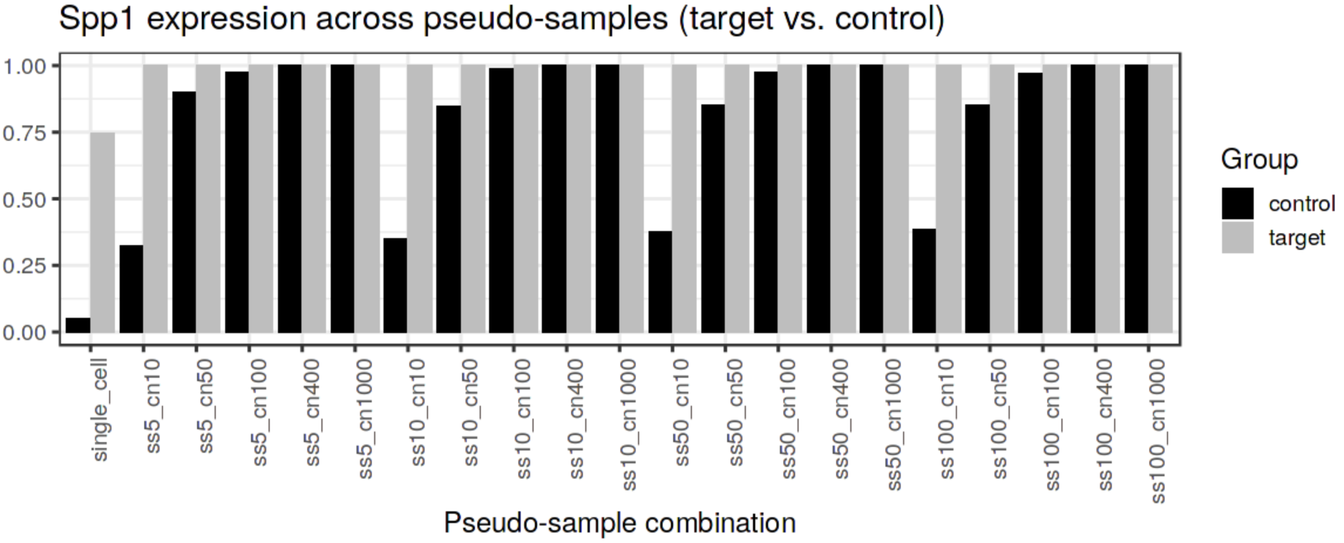
Percentage of expressed cell/pseudosample
Target : Alveolar macrophage
Control : others
Notes:
1. 그래도 해당 세포에서 발현한다는

Slide 13
Summary & Further plan
The quality of DEG is related to the size of the pseudo-sample.
Using pseudobulk, we can recover the dropout event to some extent.
As the sample size increases, non-zero control pseudosample is also increases,
but it shows a tendency to continue to be taken as DEG.
<Further plan>
We still don't know why Pseudo-sample size produces high performance.
We should check percentage of expressed cells in that datasets.
Correlation between F1 score and number of cells in each cell type?
2. Find out why genes that appeared in single cell DEGs did not appear in pseudobulk DEG.
3. Test another tissue type in Tabula muris. (Or find other golden set)
4. Let's see if introducing K-nn leads to better performance.

