Slide 1

Human Heart cell analysis
Systems Physiology Laboratory (SPL)
College of Pharmacy, Chungnam National University (CNU)

Slide 2

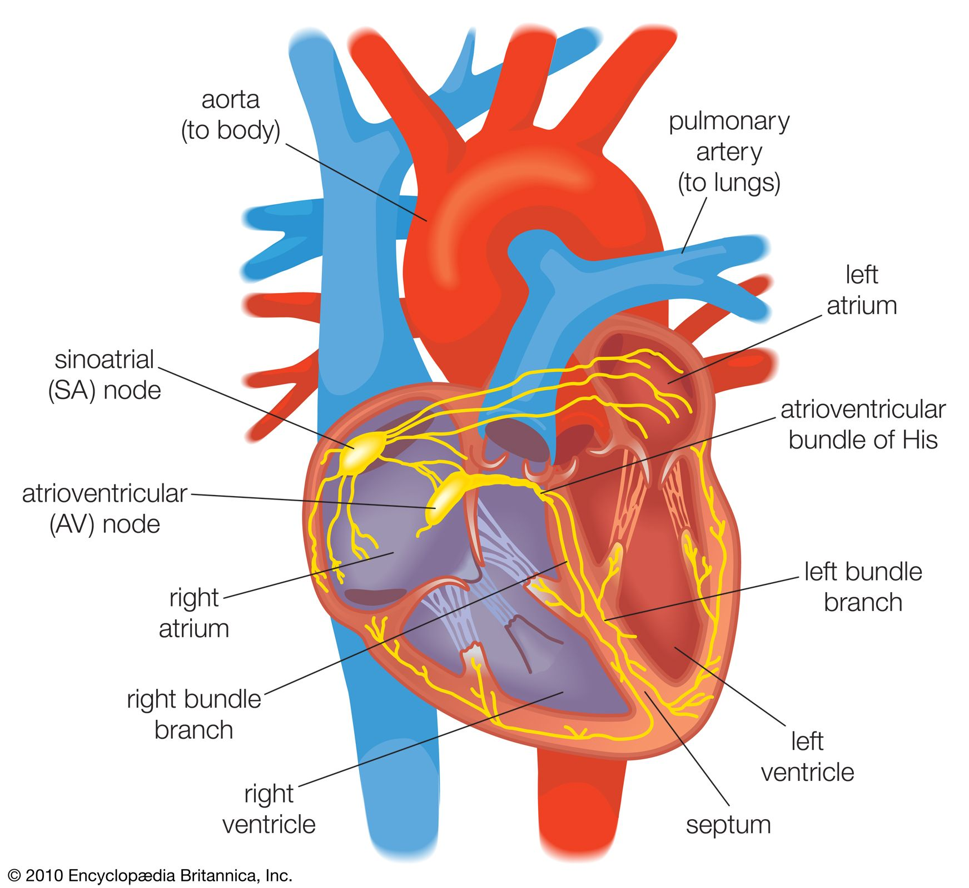
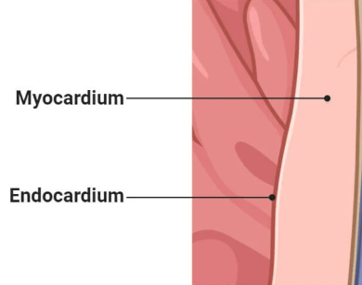
Goal
Goal
Myocardium close to Endocardium vs Myocardium far from Endocardium
Endocardium vs Myocardium Comparative Analysis
Right ventricle vs Left ventricle comparison of Endocardium, Myocardium
Identify genes associated with Shear Stress
Identify genes associated with inflammation

Slide 3
Goal
Goal
Myocardium close to Endocardium vs Myocardium far from Endocardium
Endocardium vs Myocardium Comparative Analysis
Right ventricle vs Left ventricle comparison of Endocardium, Myocardium
Identify genes associated with Shear Stress
Identify genes associated with inflammation

Slide 4
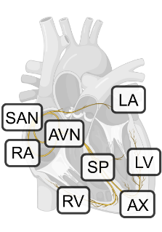
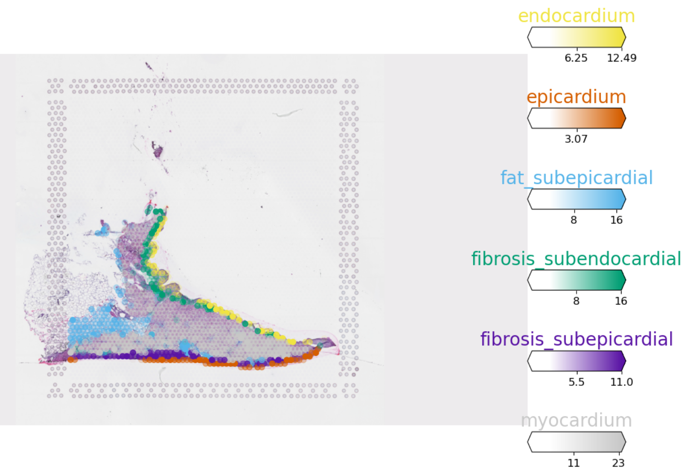
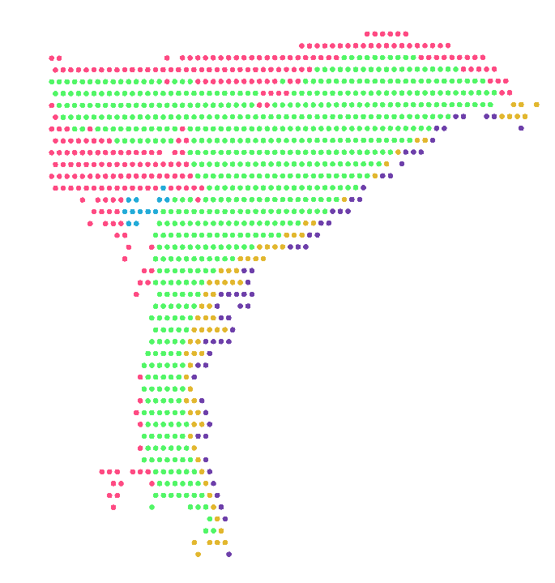
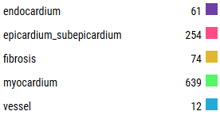
Myocardium close to Endocardium vs Myocardium far from Endocardium
Sample ID | HCAHeartST8795935 (LA)
SEX | Female
AGE | 65~70

Slide 5
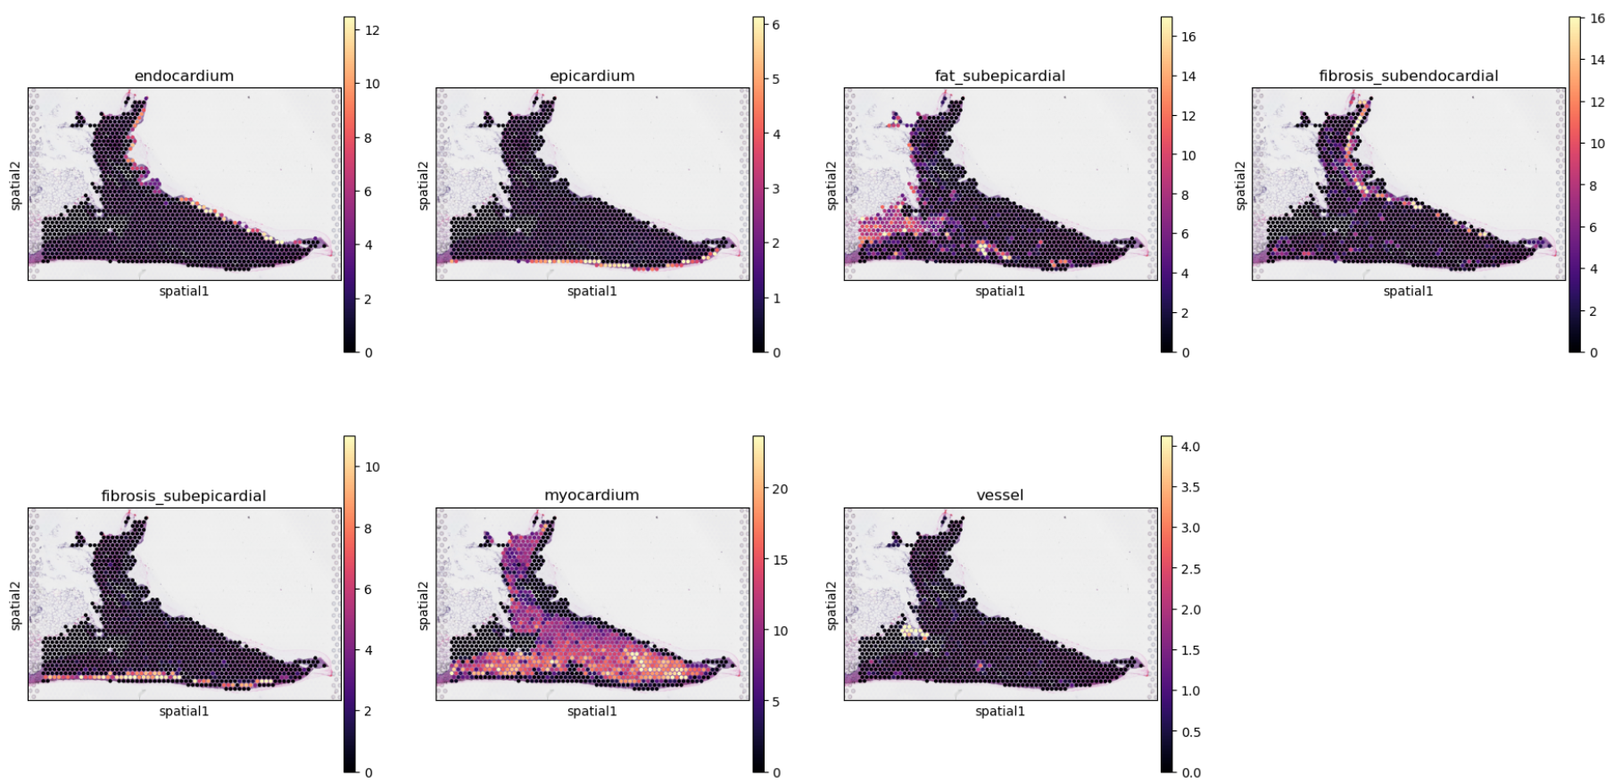
Myocardium close to Endocardium vs Myocardium far from Endocardium

Slide 6
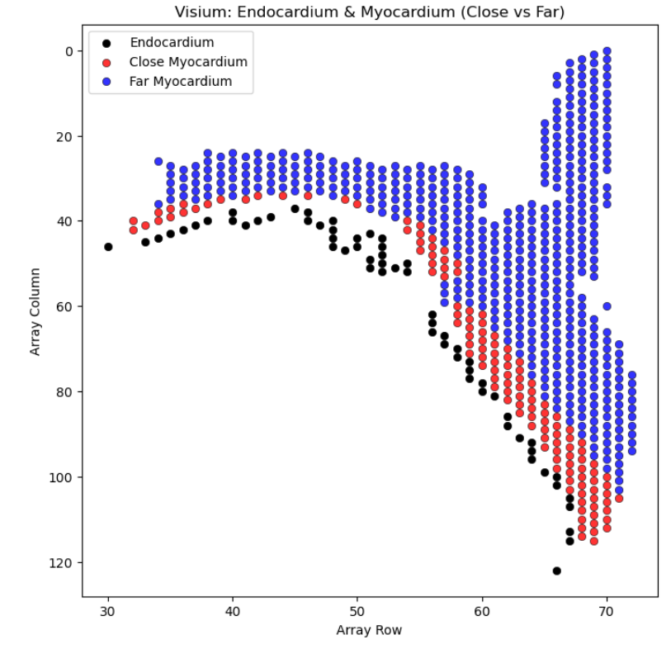
Myocardium close to Endocardium vs Myocardium far from Endocardium

Slide 7
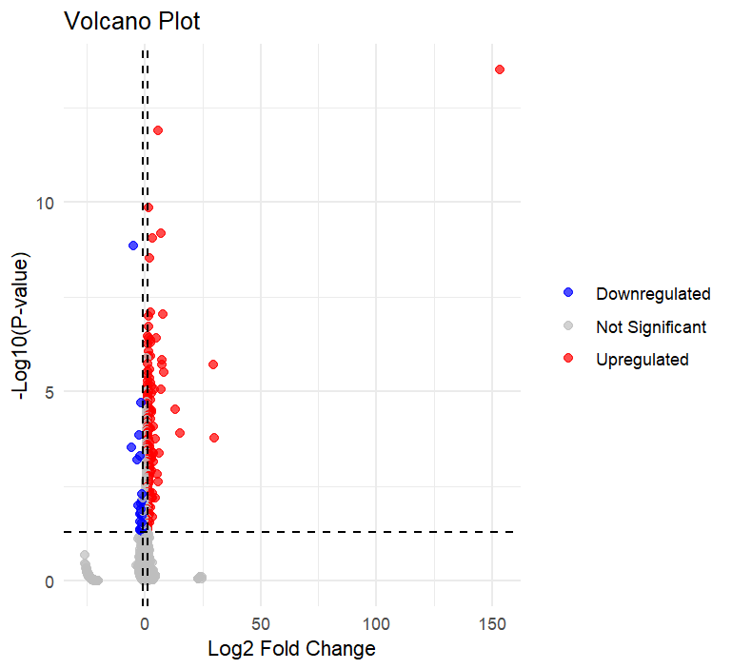
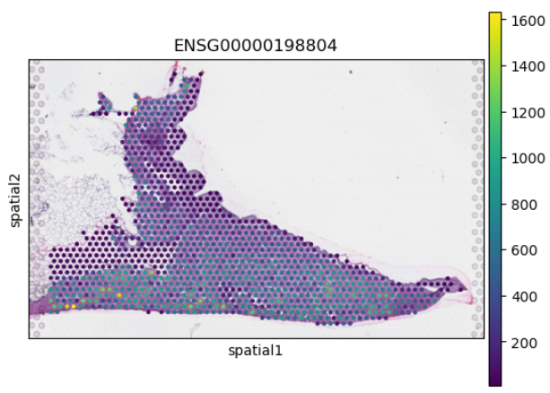
Myocardium close to Endocardium vs Myocardium far from Endocardium
Upregulation Top 5
NPPA is a cardiac signaling molecule that helps regulate blood pressure, fluid balance, and energy metabolism.
gene | logfoldchanges | pvals | pvals_adj
NPPA | 153.54 | 3.17E-14 | 1.06E-09
MYL7 | 30.09 | 1.64E-04 | 5.02E-02
MYH6 | 29.79 | 1.88E-06 | 2.31E-03
ACTC1 | 15.28 | 1.28E-04 | 4.38E-02
MB | 13.30 | 2.92E-05 | 1.63E-02
GAPDH | 8.22 | 3.09E-06 | 3.34E-03
NPPA

Slide 8
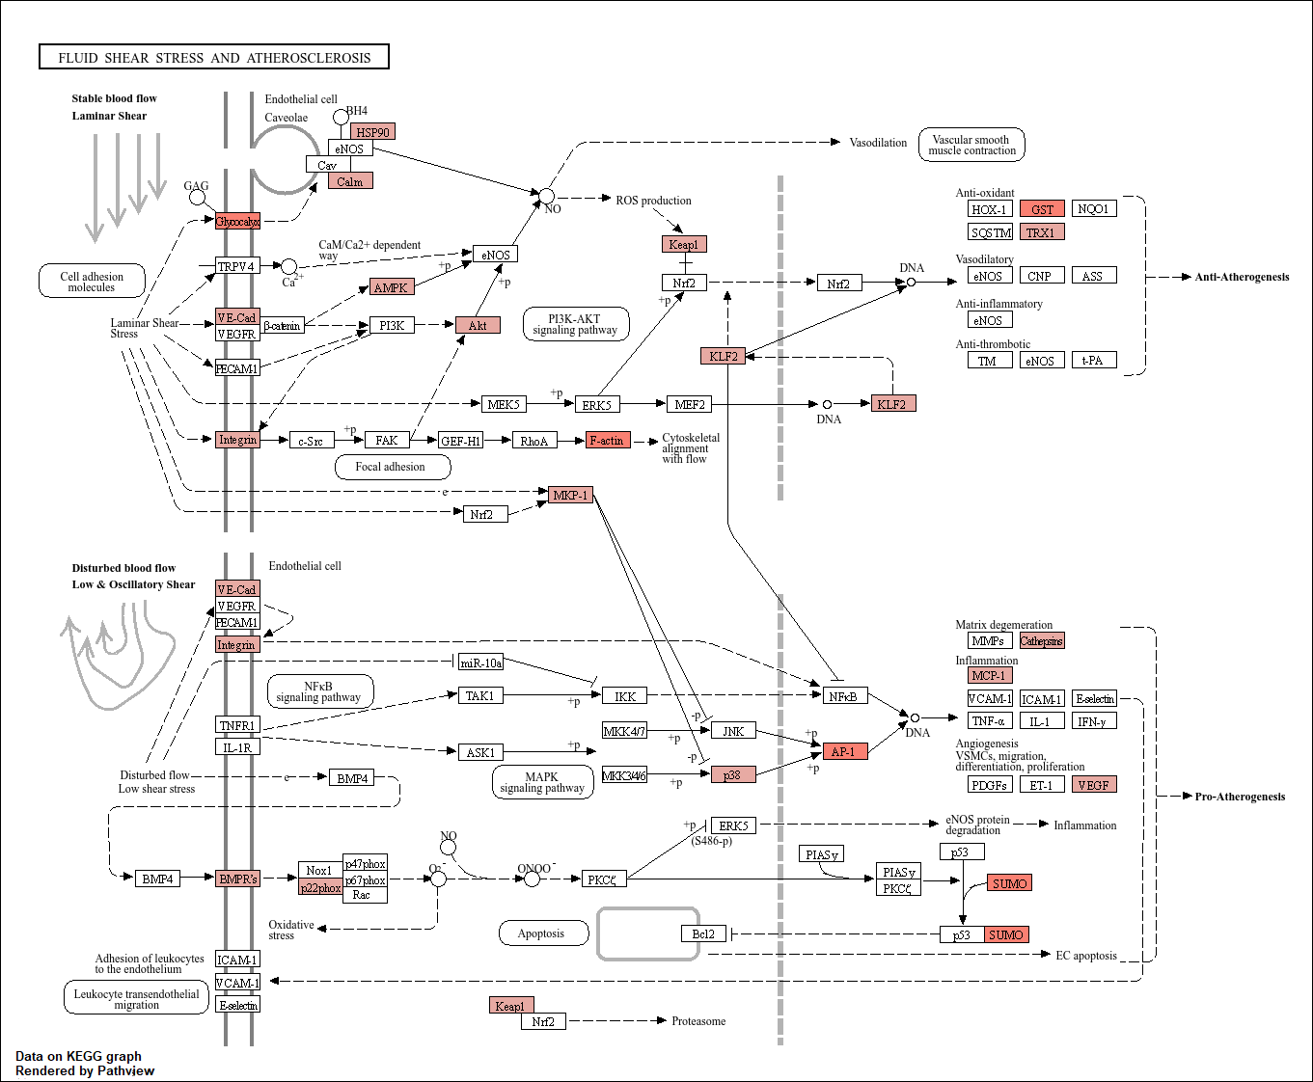

Slide 9
Goal
Goal
Myocardium close to Endocardium vs Myocardium far from Endocardium
Endocardium vs Myocardium Comparative Analysis
Right ventricle vs Left ventricle comparison of Endocardium, Myocardium
Identify genes associated with Shear Stress
Identify genes associated with inflammation

Slide 10
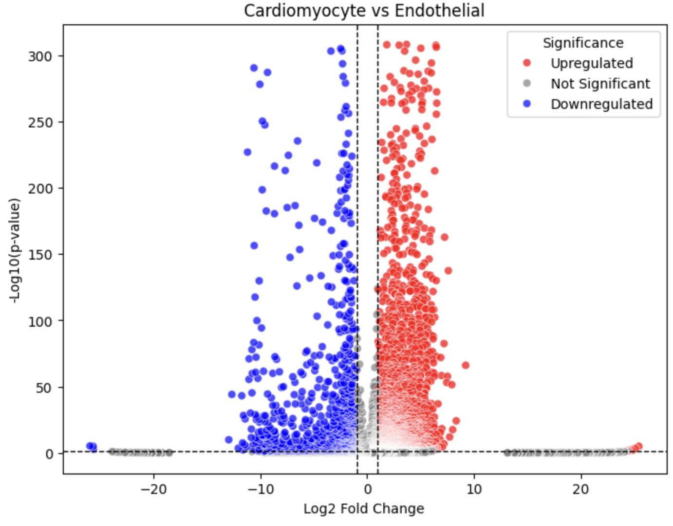
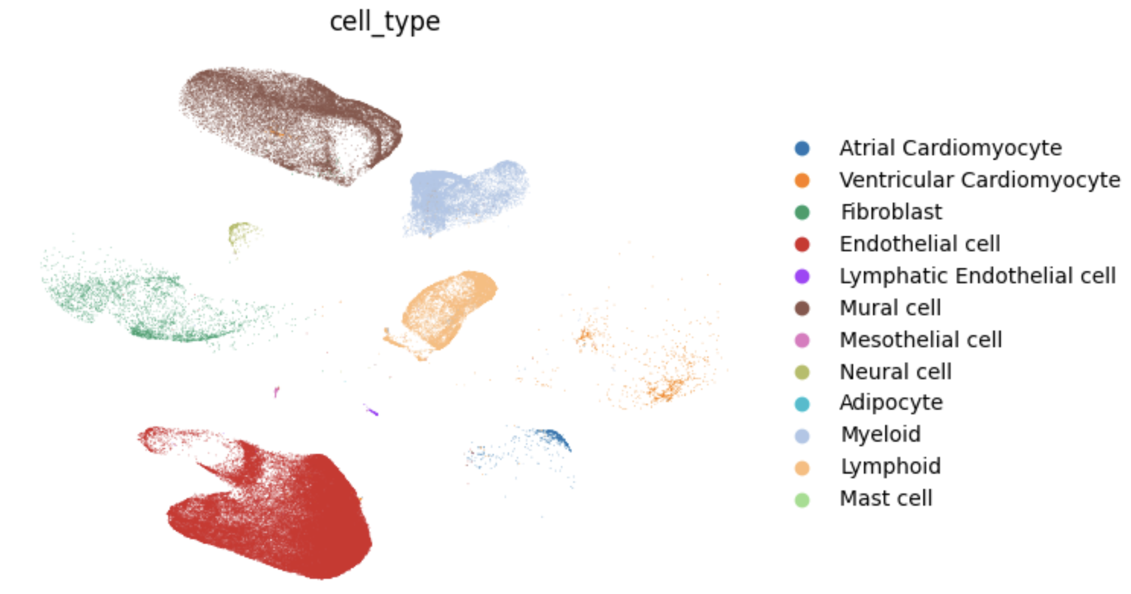
Endocardium vs Myocardium Comparative Analysis
Endothelial cell vs Cardiomyocyte
Myocardium
4457 genes
1069 genes
Endothelial cell

Slide 11
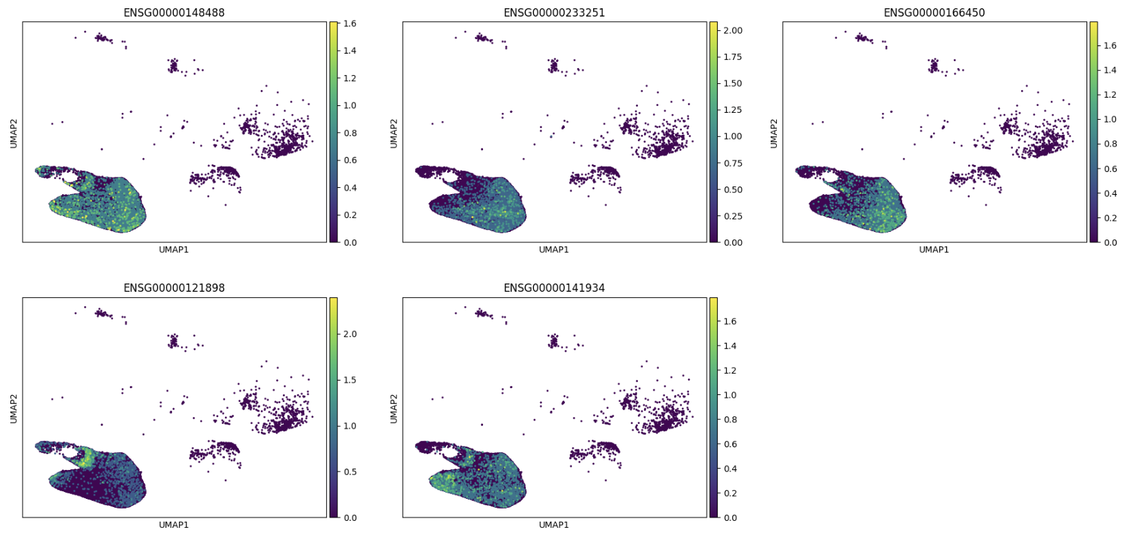
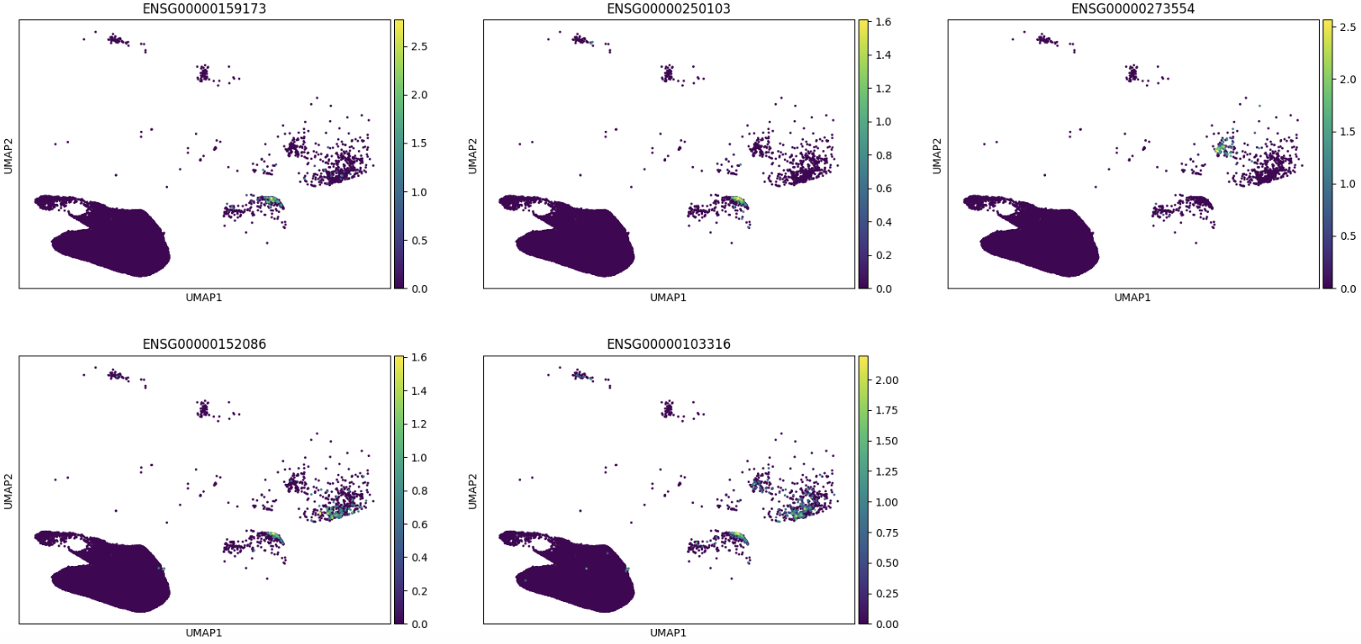
Endocardium vs Myocardium Comparative Analysis
ST8SIA6
AC007743.1
PRTG
CPXM2
PLPP2
Endothelial cells
TNNI1
PANCR
AC136616.1
TUBA3E
CRYM
Myocardium cells

Slide 12
Goal
Goal
Myocardium close to Endocardium vs Myocardium far from Endocardium
Endocardium vs Myocardium Comparative Analysis
Right ventricle vs Left ventricle comparison of Endocardium, Myocardium
Identify genes associated with Shear Stress
Identify genes associated with inflammation

Slide 13
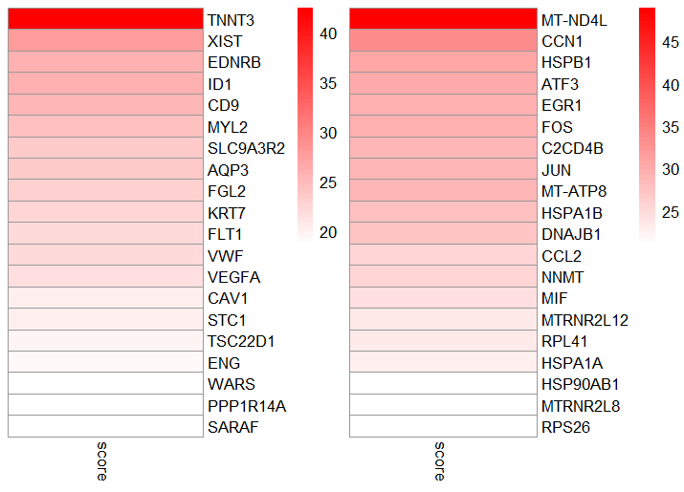
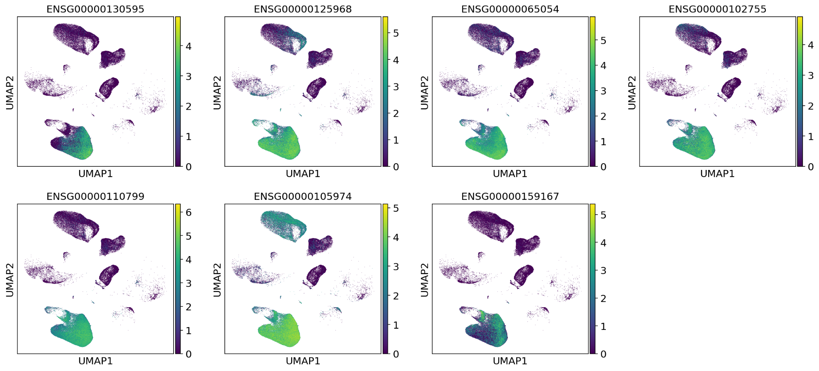
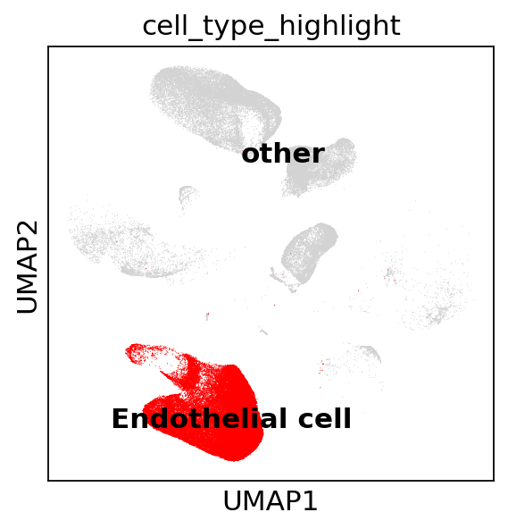
Right ventricle vs Left ventricle comparison of Endocardium, Myocardium
Endo LV/RV UP
TNNT3
ID1
SLC9A3R2
FLT1
VWF
CAV1
WARS
z-score
Angiogenesis
Inflammatory response
Increased expression of genes that maintain a more developed vascular system in response to higher blood pressure and oxygen demand in the LV
Vascular homeostasis
Cell type specific

Slide 14
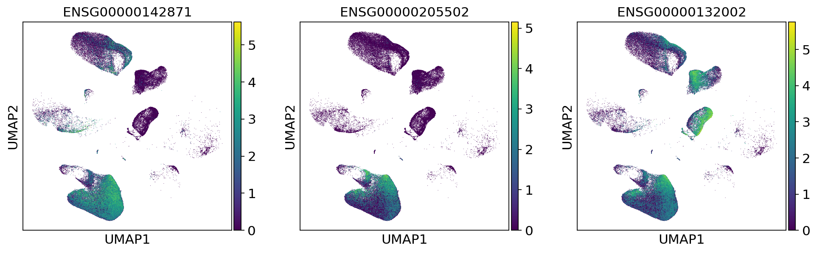
Right ventricle vs Left ventricle comparison of Endocardium, Myocardium
Endo RV/LV UP
CCN1
C2CD4B
DNAJB1
z-score
The RV of the endocardium has increased expression of genes related to the cardiac stress response because the cells are less oxygenated and
more subject to stress responses compared to the LV.
Cardiac stress
Cell type specific

Slide 15
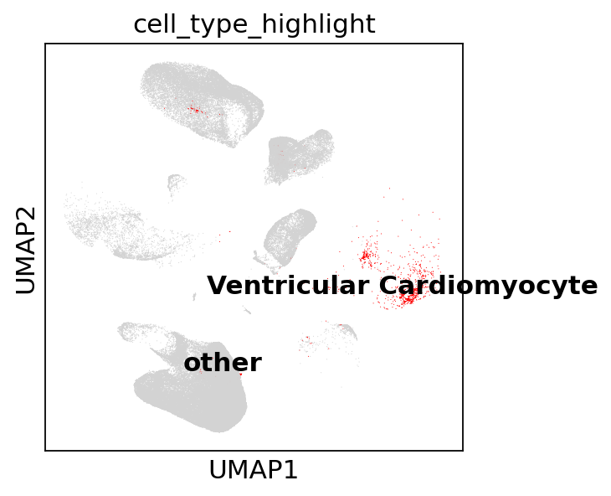
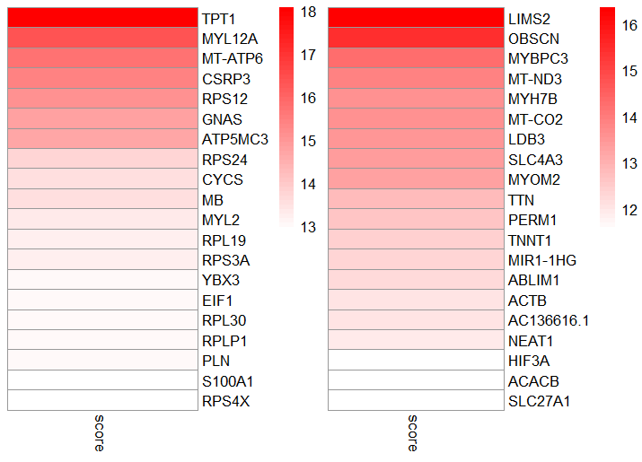
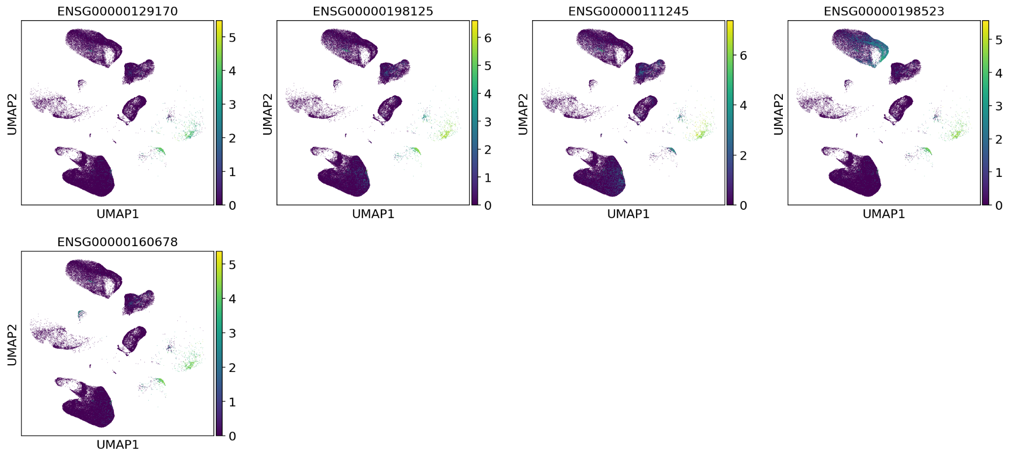
Right ventricle vs Left ventricle comparison of Endocardium, Myocardium
Myo LV/RV UP
CSRP3
MB
MYL2
PLN
S100A1
z-score
Genes related to energy metabolism and muscle contraction are highly expressed in the LV due to its stronger contractile force and higher
oxygen demand than the RV
Muscle contraction control
Cell type specific

Slide 16
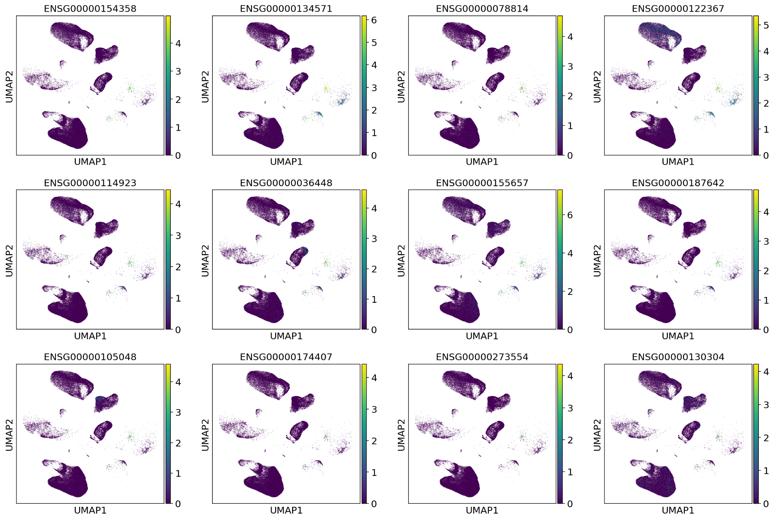
Right ventricle vs Left ventricle comparison of Endocardium, Myocardium
Myo RV/LV UP
OBSCN
MYBPC3
MYH7B
LDB3
SLC4A3
MYOM2
TTN
PERM1
TNNT1
MIR1-HG
AC136616
SLC27A1
z-score
Muscle organization
Structural stability is important because the RV has a lower contractile force than the LV and must constantly regulate blood flow.
Cell type specific

Slide 17
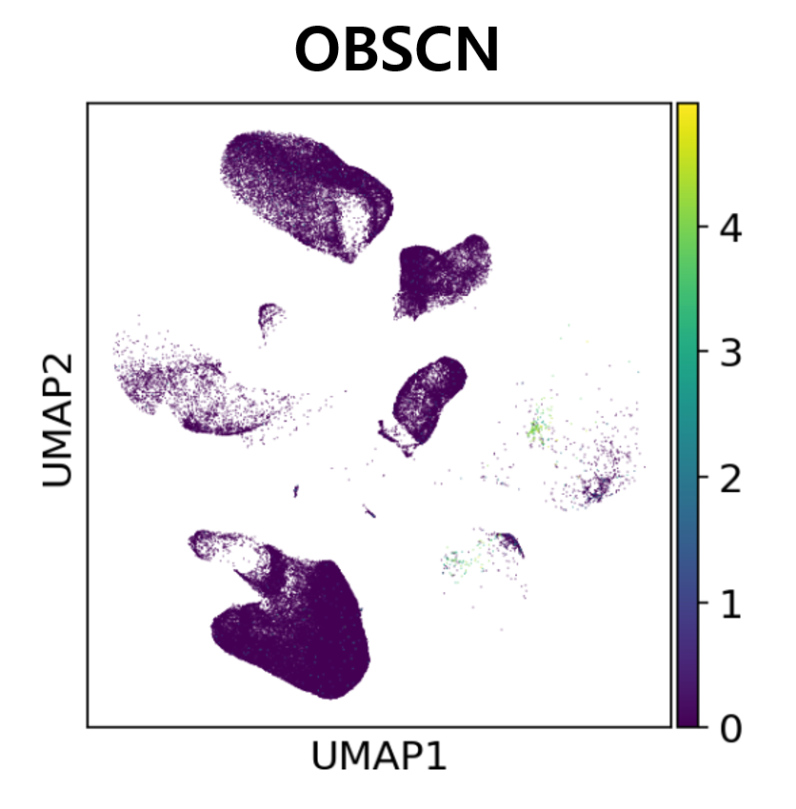
Right ventricle vs Left ventricle comparison of Endocardium, Myocardium
Myo RV/LV UP
OBSCN
MYBPC3
MYH7B
LDB3
SLC4A3
MYOM2
TTN
PERM1
TNNT1
MIR1-HG
AC136616
SLC27A1
z-score
Muscle organization
Structural stability is important because the RV has a lower contractile force than the LV and must constantly regulate blood flow.
Cell type specific

Slide 18
Right ventricle vs Left ventricle comparison of Endocardium, Epicardium, Myocardium
Cell type | Vertical | Gene | Function
Endothelial cell | Left | TNNT3, ID1, SLC9A3R2, FLT1, VWF, CAV1, WARS | Angiogenesis, Inflammatory response, Vascular homeostasis
 | Right | CCN1, C2CD4B, DNAJB1 | Cardiac stress
Cardiomyocytes | Left | CSRP3, MB, MYL2, PLN, S100A1 | Muscle contraction control
 | Right | OBSCN, MYBPC3, MYH7B, LDB3, SLC4A3, MYOM2, TTN, PERM1, TNNT1, MIR1-HG, AC136616, SLC27A1 | Muscle organization
The LV is important for its strong pumping power and vascular network, while the RV is important for resistance maintenance and stress response.
Even in the normal population, the LV and RV exhibit gene expression patterns that reflect structural and functional differences.
This data can be utilized to track changes in heart disease (e.g. pulmonary hypertension, heart failure).

Slide 19
Thank You for Listening

Slide 20
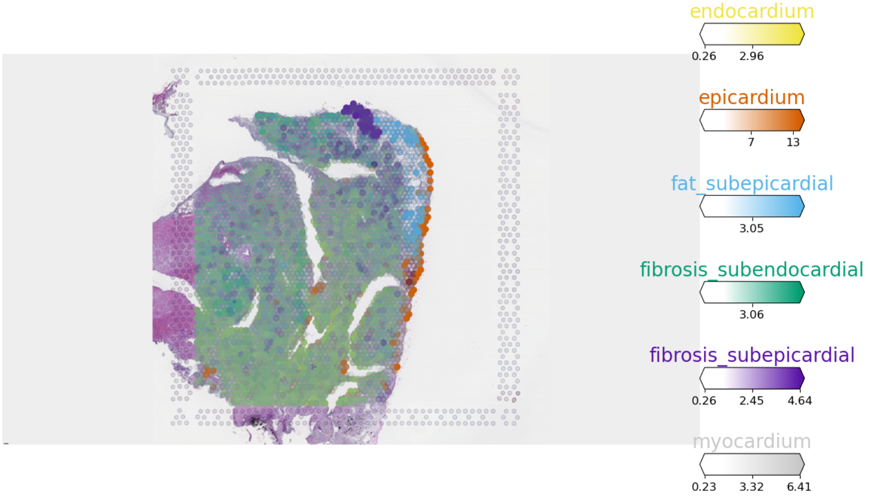
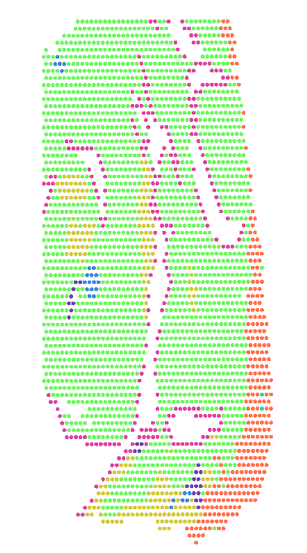
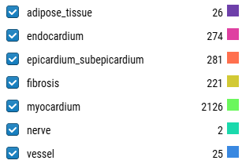
Myocardium close to Endocardium vs Myocardium far from Endocardium
Sample ID | HCAHeartST8795937 (RA)
SEX | Female
AGE | 65~70

Slide 21
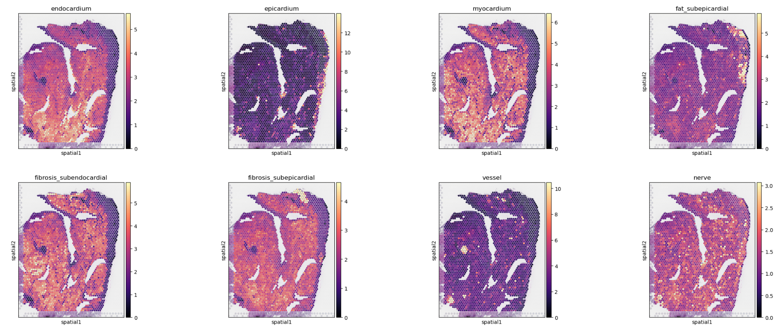
Myocardium close to Endocardium vs Myocardium far from Endocardium

Slide 22
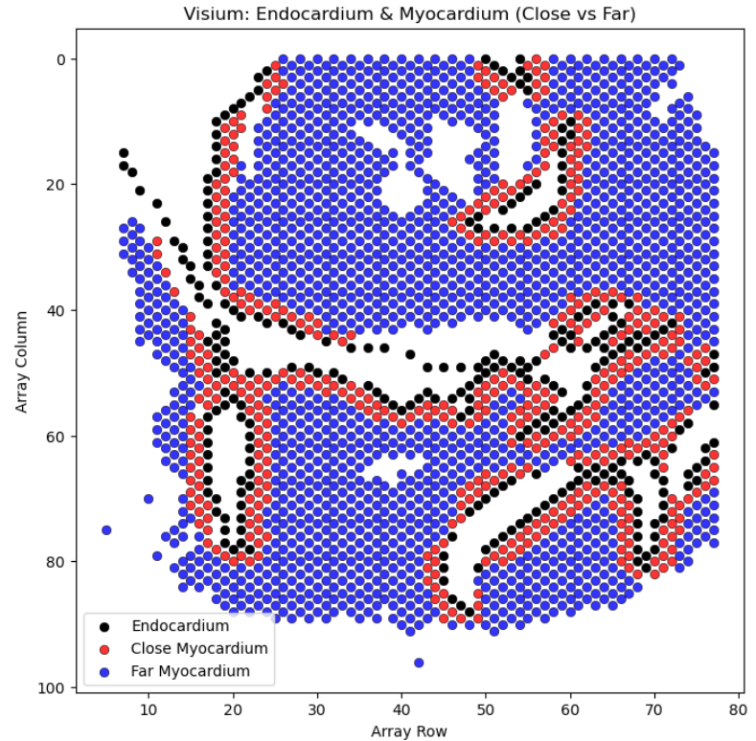
Myocardium close to Endocardium vs Myocardium far from Endocardium

Slide 23
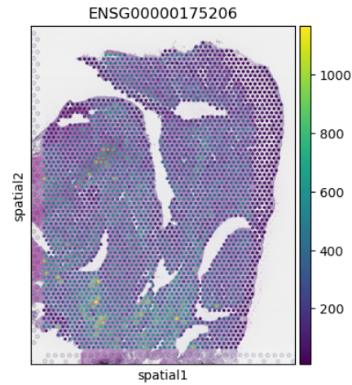
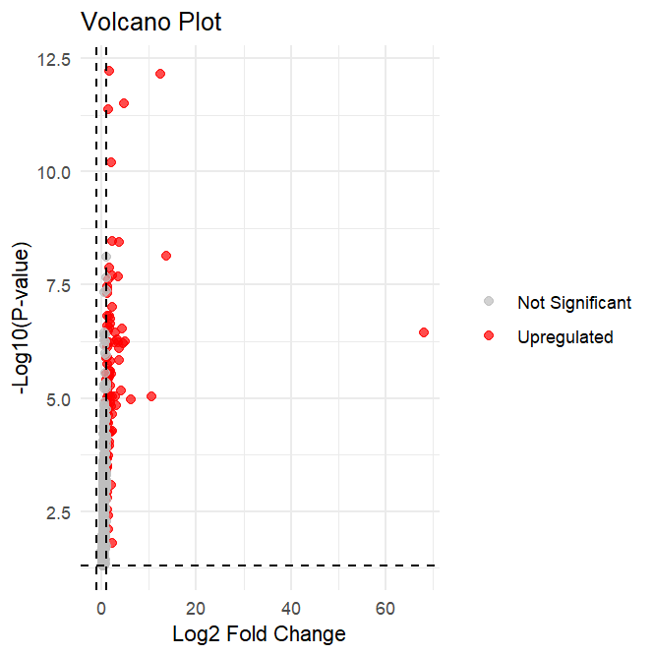
Myocardium close to Endocardium vs Myocardium far from Endocardium
gene | logfoldchanges | pvals | pvals_adj
NPPA | 68.05 | 3.52E-07 | 1.13E-04
MYH6 | 13.58 | 7.29E-09 | 7.50E-06
ACTC1 | 12.52 | 7.12E-13 | 3.59E-09
MYL7 | 10.60 | 9.32E-06 | 1.12E-03
MB | 6.15 | 1.09E-05 | 1.28E-03

Slide 24
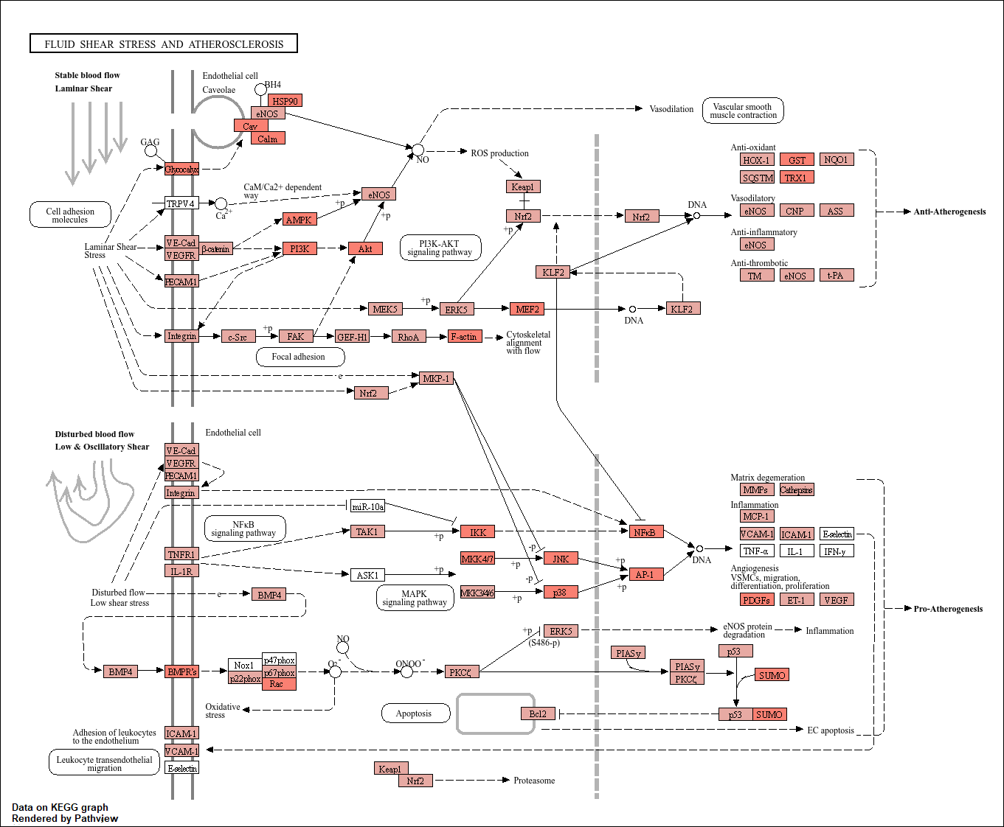

Slide 25
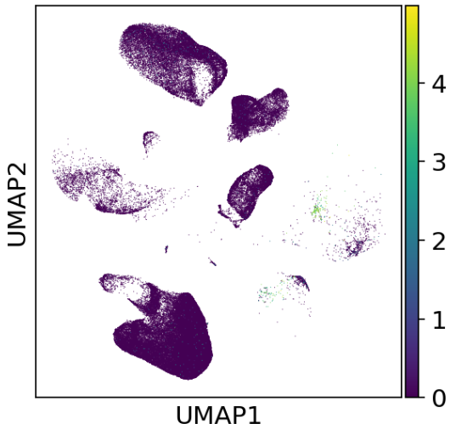
OBSCN

