Slide 1
Best Practices for pseudobulk analysis
in scRNA-seq
Youngchul Oh, Yeongjun Kim

Slide 2
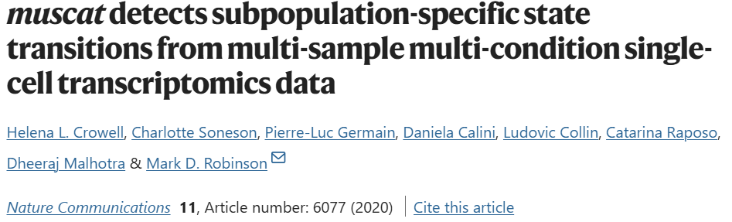
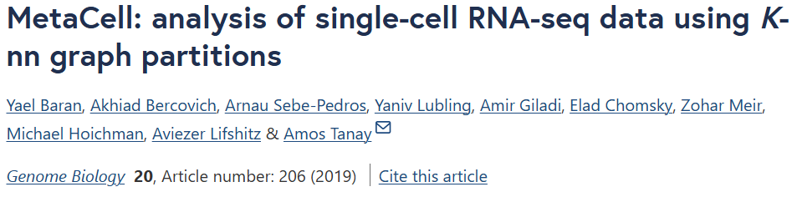
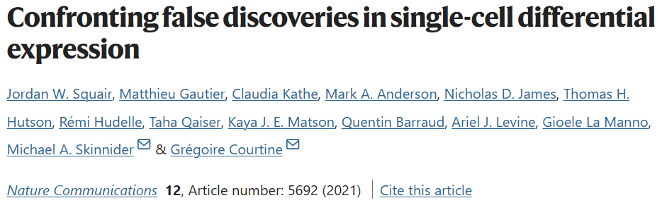
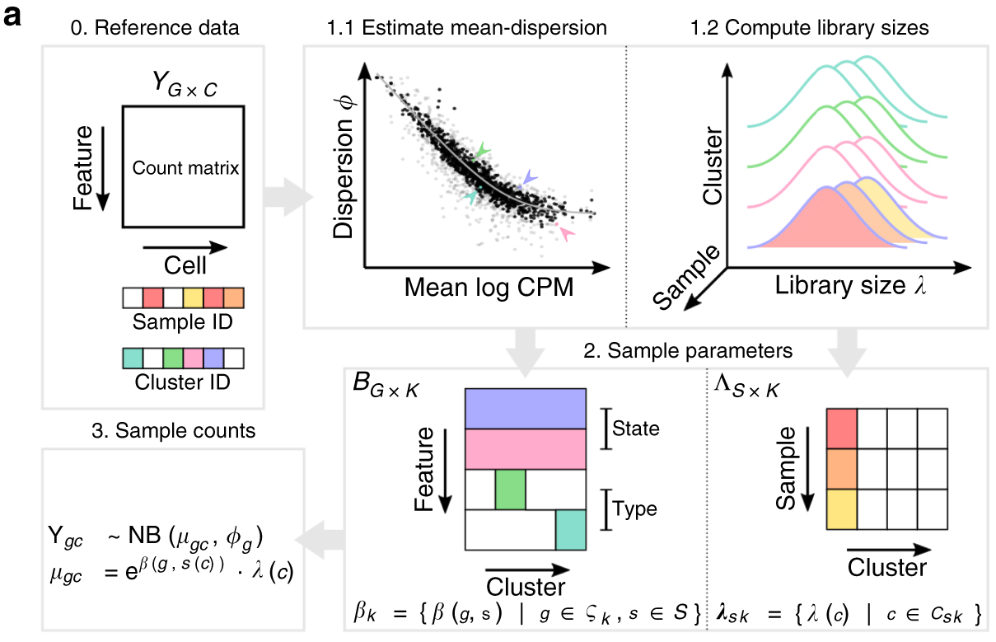
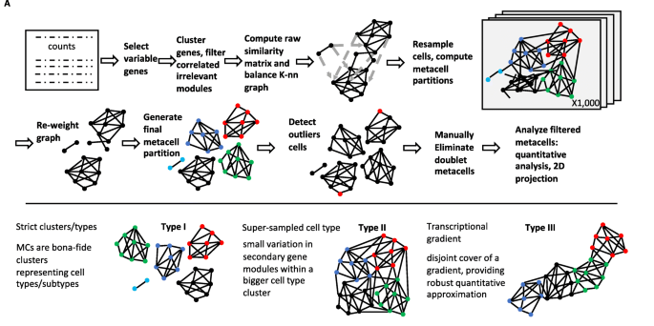
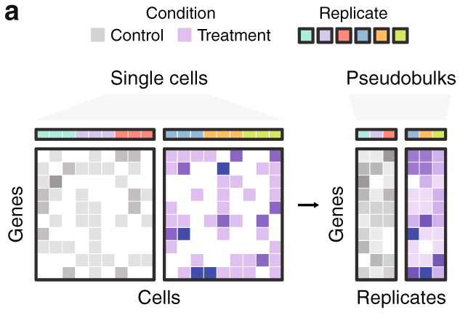
Various pseudo-bulk RNA sequencing methods
1. Muscat
2. MetaCell
3. Pseudobulks
…

Slide 3
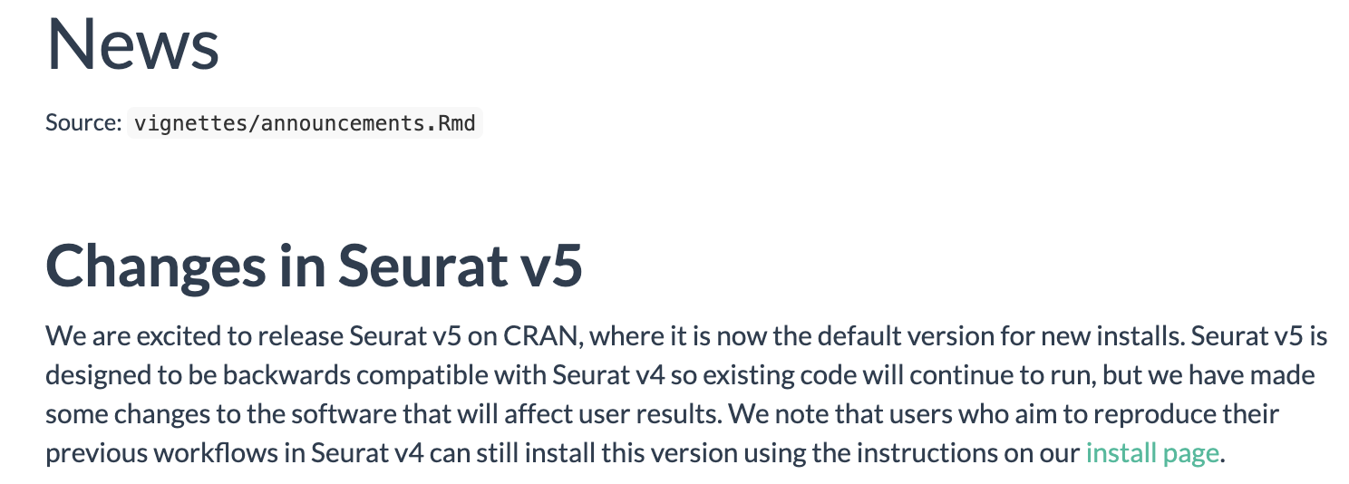
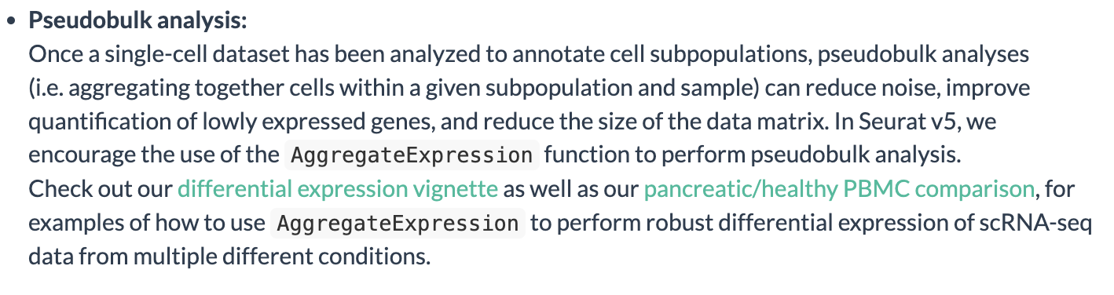
Seurat v5

Slide 4
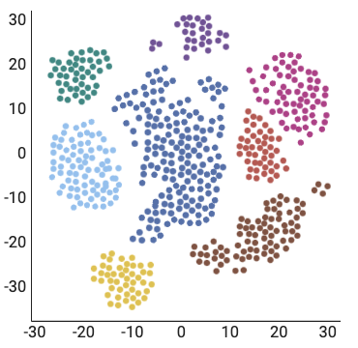
How many cells that we need to aggregate?
Which strategy performed well?

