Slide 1
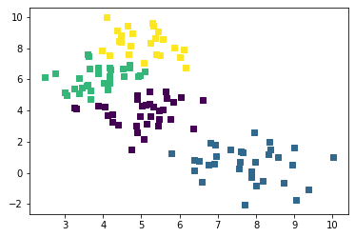
What is clustering?
Clustering is the task of grouping a set of objects in such a way that objects in the same group (called a cluster) are more similar (in some sense) to each other than to those in other groups (clusters). It is a main task of exploratory data mining, and a common technique for statistical data analysis, used in many fields.
This technique is largely used in fields like machine learning, pattern recognition, image analysis, computer graphics etc.
An example of clustering can be visualized as shown in the figure.
Visualization of a case study we are about to discuss
Number of points: 300; Number of clusters: 4

Slide 2
Types of Clustering:
Clustering can be considered as most important unsupervised learning problem.
Based on the approaches used, Clustering techniques may be classified into the two categories:
Hierarchical
Non-Hierarchical
Some most common clustering techniques include:
Centroid-based clustering(also known as K-Means algorithm)
Density-based clustering (E.g. DBSCAN)
Distribution-based clustering
K-Means Algorithm: This algorithm consists of two steps- Data assignment step & Centroid update step
In Data assignment step each data point is assigned to its nearest centroid, based on the squared Euclidean distance
Centroid update step, the centroids are recomputed. This is done by taking the mean of all data points assigned to that centroid's cluster.
Working of K-Means. Reference

Slide 3
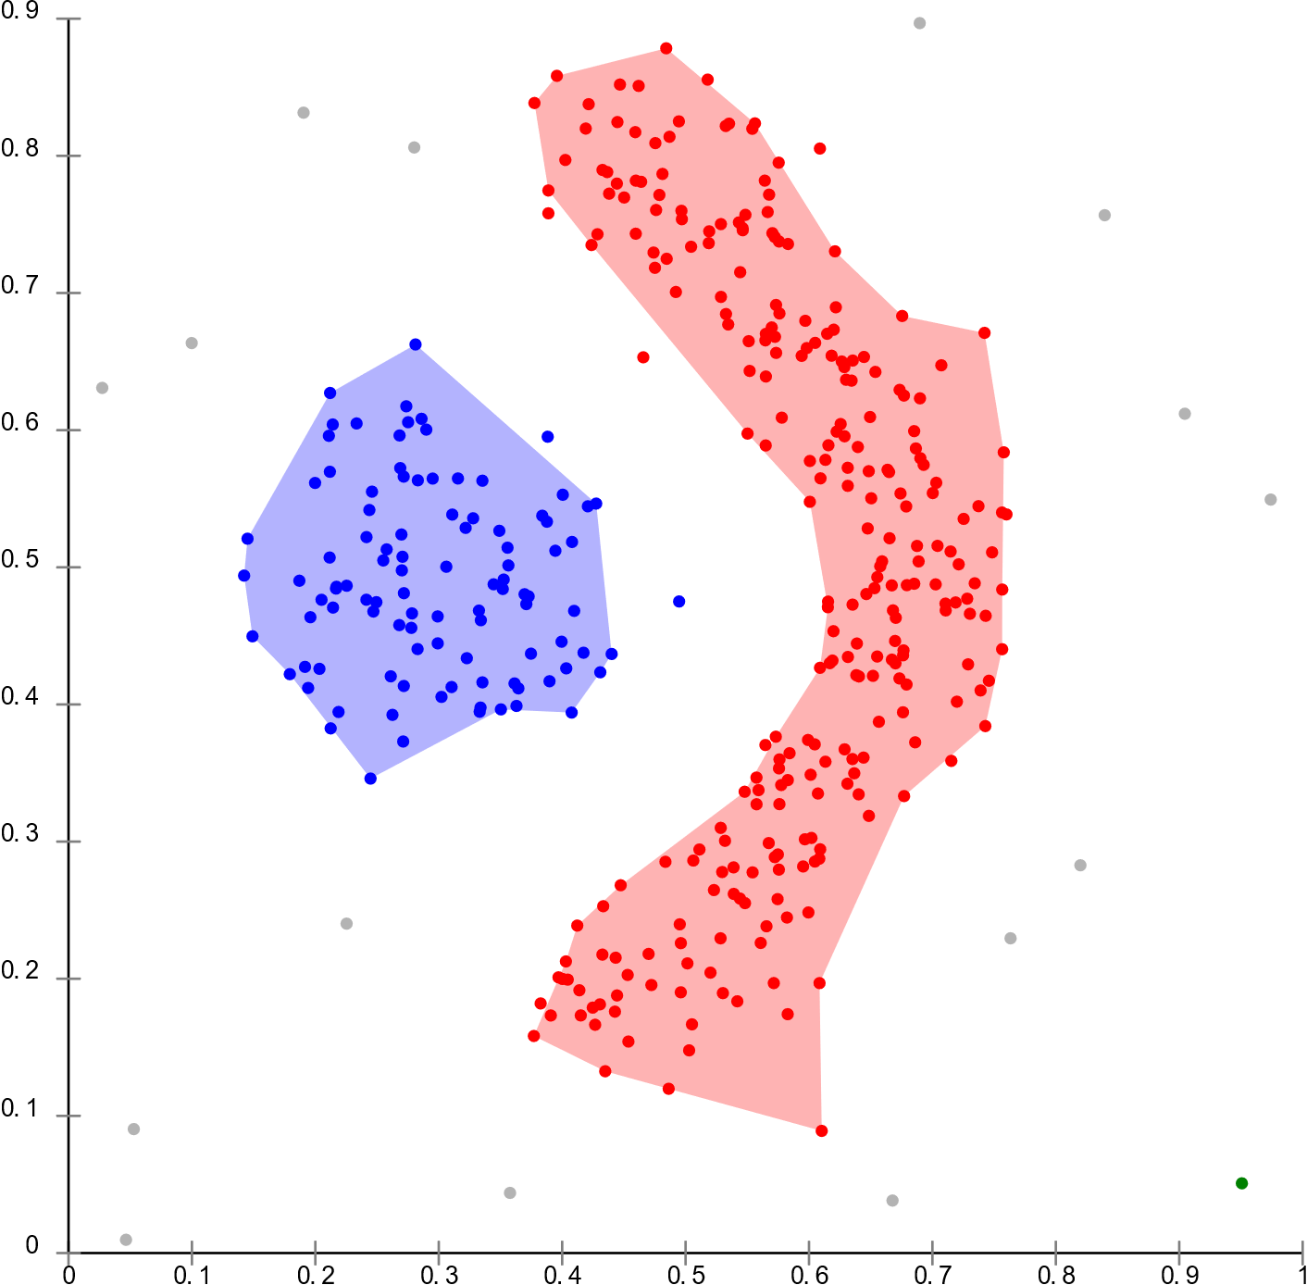
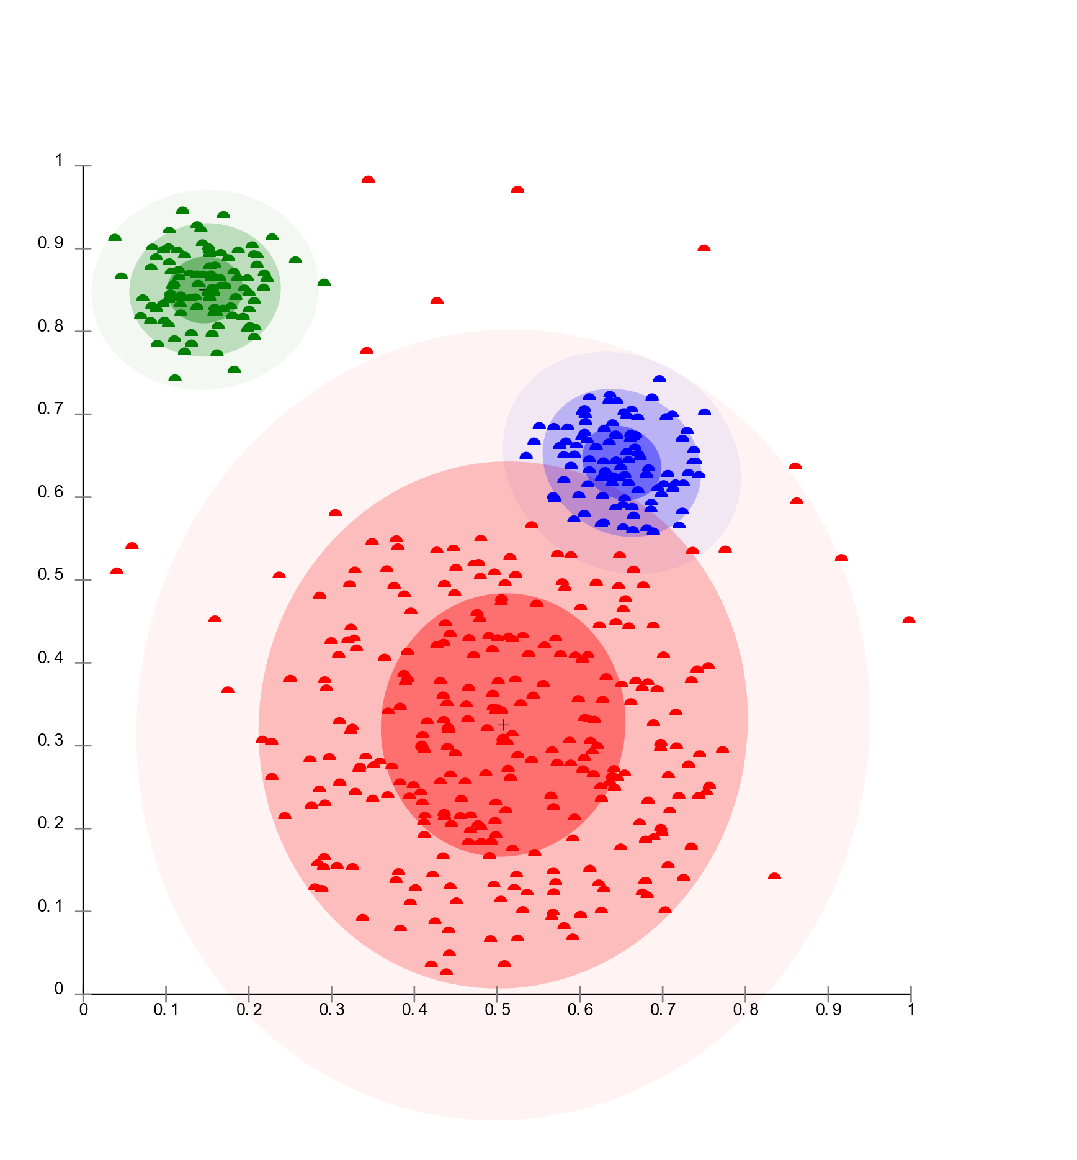
Density-based clustering:
In density-based clustering, clusters are defined as areas of higher density than the remainder of the data set. Objects in these sparse areas - that are required to separate clusters - are usually considered to be noise and border points.
The most popular density based clustering method is DBSCAN
DBSCAN model. Reference
Distribution-based clustering:
Here, the data set is usually modeled with a fixed (to avoid overfitting) number of Gaussian distributions that are initialized randomly and whose parameters are iteratively optimized to better fit the data set. This will converge to a local optimum, so multiple runs may produce different results. In order to obtain a hard clustering, objects are often then assigned to the Gaussian distribution they most likely belong to.
Distribution-based clustering.
Reference

Slide 4
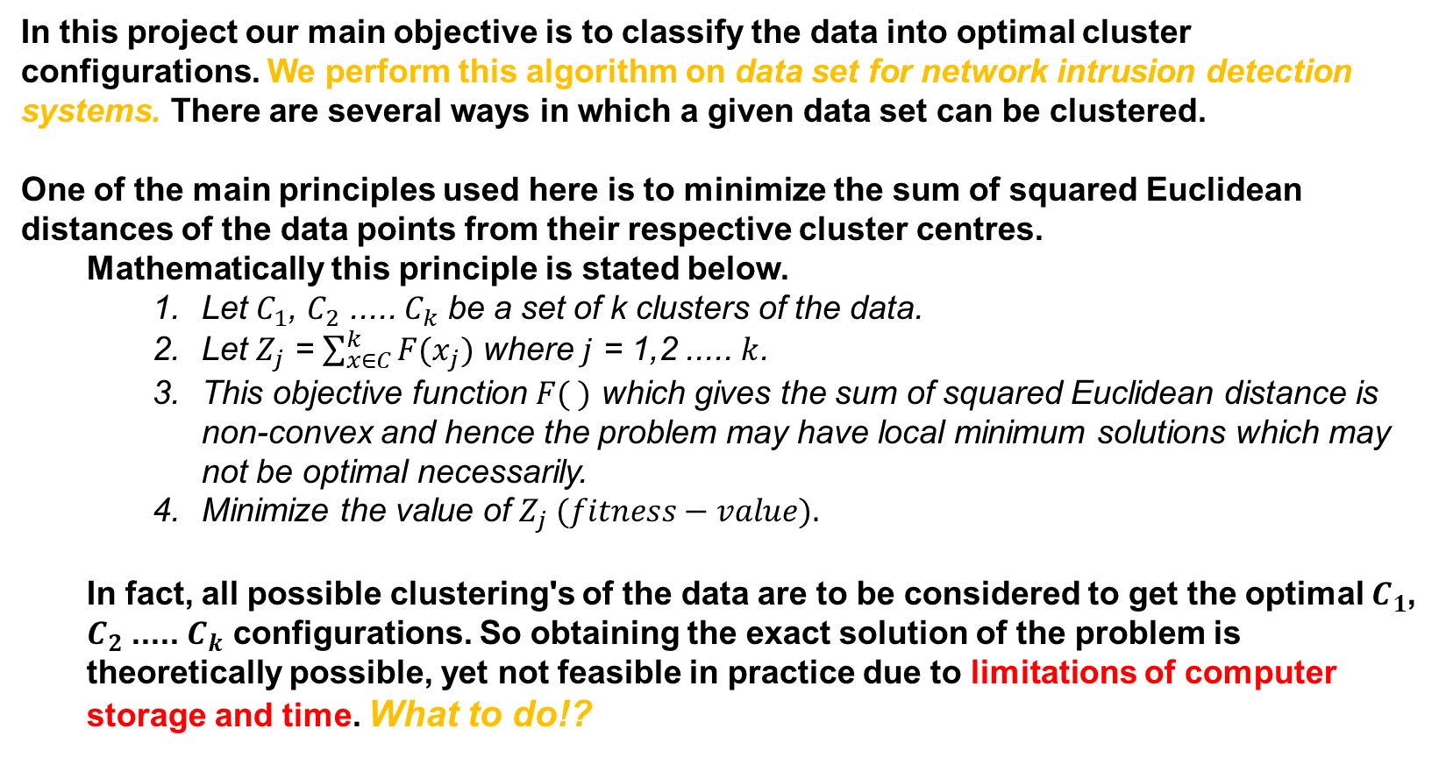
Our Motive:
In this project our main objective is to classify the data into optimal cluster configurations. We perform this algorithm on data set for network intrusion detection systems. There are several ways in which a given data set can be clustered.
One of the main principles used here is to minimize the sum of squared Euclidean distances of the data points from their respective cluster centres.
Mathematically this principle is stated below.
Let $C_{1}$, $C_{2}$ ..... $C_{k}$ be a set of k clusters of the data.
Let $Z_{j}$ = $\sum_{x∈C}^{k}{F(x_{j})}$ where $j$ = 1,2 ..... $k$.
This objective function $F( )$ which gives the sum of squared Euclidean distance is non-convex and hence the problem may have local minimum solutions which may not be optimal necessarily.
Minimize the value of $Z_{j} (fitness−value).$
In fact, all possible clustering's of the data are to be considered to get the optimal $C_{1}$, $C_{2}$ ..... $C_{k}$ configurations. So obtaining the exact solution of the problem is theoretically possible, yet not feasible in practice due to limitations of computer storage and time. What to do!?

Slide 5
Here comes the solution: Genetic Algorithm
What is Genetic Algorithm?
Genetic Algorithms (GAs) are stochastic search methods based on the principle of natural genetic systems. It is a method for solving both constrained and unconstrained optimization problems that is based on natural selection, the process that drives biological evolution.
The genetic algorithm repeatedly modifies a population of individual solutions. At each step, the genetic algorithm selects individuals at random from the current population to be parents and uses them to produce the children for the next generation.
Over successive generations, the population evolves toward an optimal solution. You can apply the genetic algorithm to solve a variety of optimization problems that are not well suited for standard optimization algorithms.

Slide 6
Why Genetic Algorithm, over other standard optimization methods?
All standard optimization techniques converge to a local minima assuming it is the best i.e. Global solution
Unlike conventional search methods, GAs deal with multiple solutions simultaneously and compute the fitness function values for these solutions. They perform a multi-dimensional search in order to provide an optimal value of an evaluation (fitness) function in an optimization problem.
GAs are theoretically and empirically found to provide global near-optimal solutions for various complex optimization problems in the field of operation research, VLSI design, Pattern Recognition, Image Processing, Machine Learning, etc.

Slide 7
Working principle and approach
In a genetic algorithm, a population of candidate solutions (called individuals) to an optimization problem is evolved toward better solutions. Each candidate solution has a set of properties (its chromosomes or genotype) which can be mutated and altered
The evolution usually starts from a population of randomly generated individuals, and is an iterative process, with the population in each iteration called a generation.
The genetic algorithm uses three main types of rules at each step to create the next generation from the current population:
Selection rules select the individuals, called parents, that contribute to the population at the next generation.
Crossover rules combine two parents to form children for the next generation.
Mutation rules apply random changes to individual parents to form children.

Slide 8
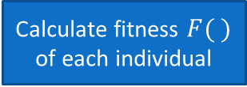
Flow Chart
Satisfy stopping criteria?
start
Generate initial random population
Calculate fitness $F( )$ of each individual
no
Selection of individuals
yes
Perform crossOver & Mutation
End
Send it to next Generation

Slide 9
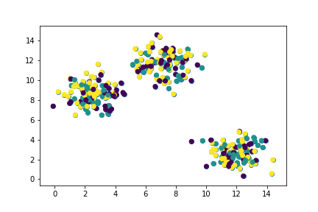
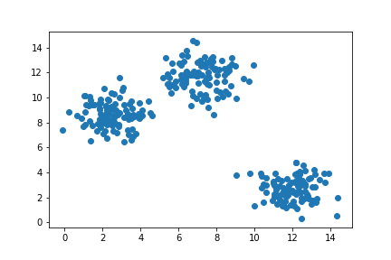
Initial Population:
This is the 1ST phase of the algorithm which occurs only Once.
An initial population of size P for a genetic algorithm is usually chosen at random. In the present implementation, several strings of length m are generated randomly where the value of each element of the string is allowed to lie between 1 and k. Only valid strings (that have at least one data point in each cluster) are considered to be included in the initial population to avoid wastage of processing time on invalid strings.
Case Study:
Let us visualize how this happens using small artificially created data.
The left picture shows how this data is spatially arranged originally.
The right picture shows the initial population which is randomly generated.

Slide 10
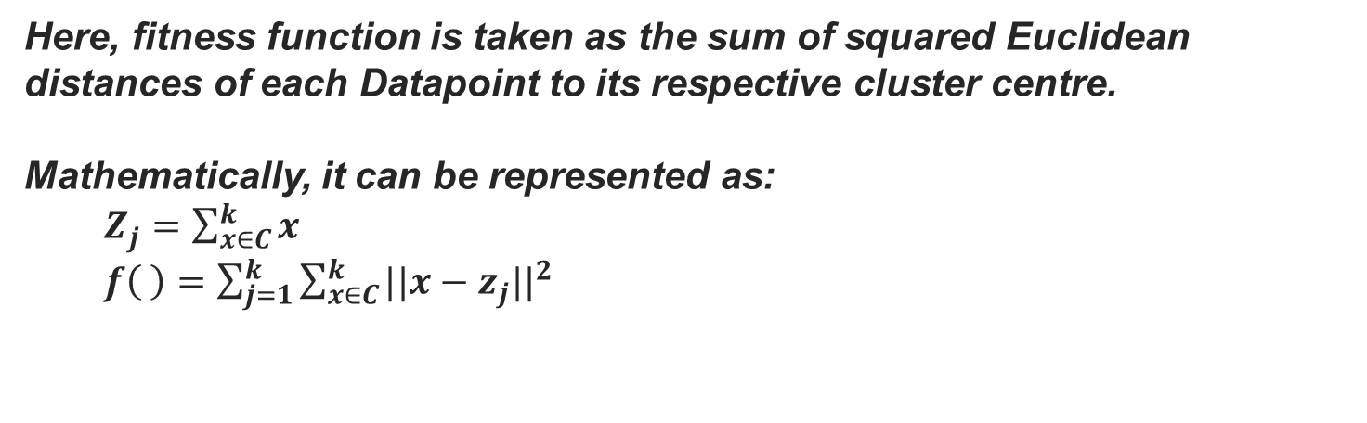
Here, fitness function is taken as the sum of squared Euclidean distances of each Datapoint to its respective cluster centre. Mathematically, it can be represented as: $Z_{j}=\sum_{x∈C}^{k}{x}$ $f\left( \right)=\sum_{j=1}^{k}{\sum_{x∈C}^{k}{{||x−z_{j}||}^{2}}}$
Fitness function:
Selection:
Here strings are selected from a population to create a mating pool. The probability of selection of a particular string is directly or inversely proportional to the fitness value depending on whether the problem is that of maximization or minimization.
Select P/2 pairs of strings randomly from the mating pool so that every string in the mating pool belongs to exactly one pair of strings.

Slide 11
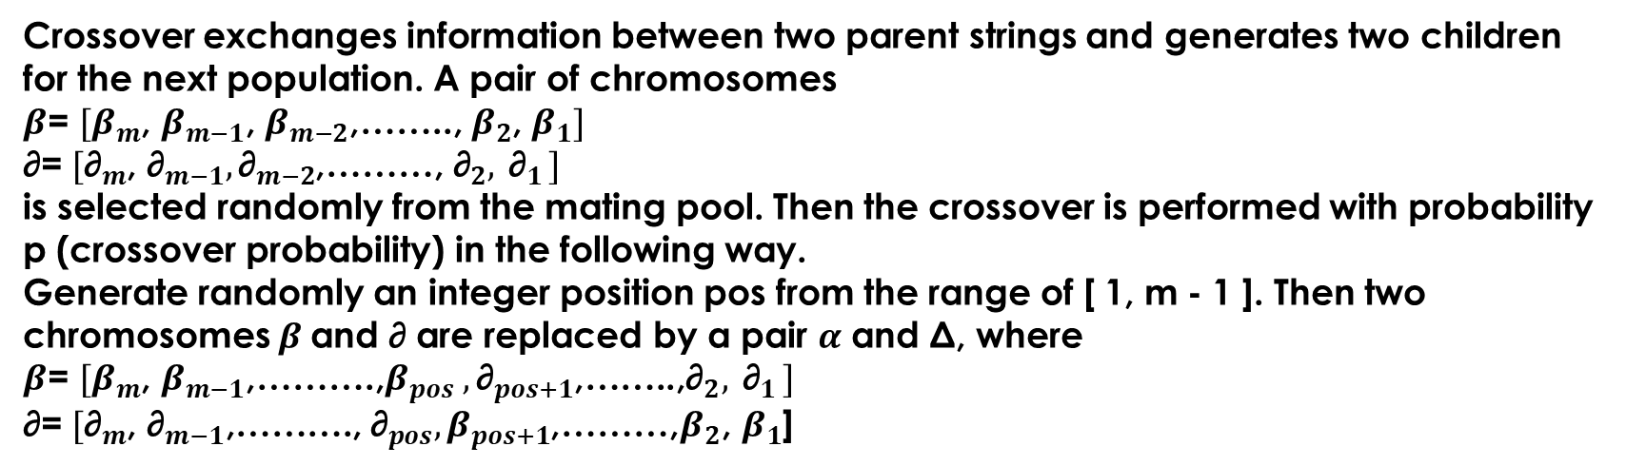
crossOver:
Suppose the population size is 6, then 6 lists are created, encoded in such a way that value at each index denoted cluster number of that data.
Initial population:
S1: [0,1,2,0,2,0,1………………0,0,1,0,2,1,0,1,0,2]
S2: [1,1,2,0,1,1,0………………0,1,2,1,0,1,0,2,1,0]
S3: [0,2,1,0,1,2,0……………....1,0,2,1,0,2,1,0,0,2]
S4: [2,1,0,2,1,0,0………………2,0,1,1,0,1,0,1,0,2]
S5: [1,0,1,0,2,1,0………………0,1,2,1,1,2,0,2,0,1]
S6: [0,2,1,0,1,2,0……………...1,0,2,1,0,2,1,0,0,2]
All these samples are sent into the mating pool in 3 pairs randomly.
Crossover exchanges information between two parent strings and generates two children for the next population. A pair of chromosomes
$β$= ${[β}_{m}$, $β_{m−1}$, $β_{m−2}$,…….., $β_{2}$, $β_{1}]$
∂= ${[\text{∂}}_{m}$, ${\text{∂}}_{m−1},{\text{∂}}_{m−2}$,………,${ \text{∂}}_{2}{, \text{∂}}_{1}]$
is selected randomly from the mating pool. Then the crossover is performed with probability p (crossover probability) in the following way.
Generate randomly an integer position pos from the range of [ 1, m - 1 ]. Then two chromosomes $β$and ∂ are replaced by a pair $α$ and Δ, where
$β$= ${[β}_{m}$, $β_{m−1}$,……….,$β_{pos} ,{\text{∂}}_{pos+1}$,……..,${\text{∂}}_{2}{, \text{∂}}_{1}]$
∂= ${[\text{∂}}_{m}$, ${\text{∂}}_{m−1}\text{,……….,}{{ \text{∂}}_{pos},β}_{pos+1}$,………,$β_{2}\text{,} β_{1}$]

Slide 12
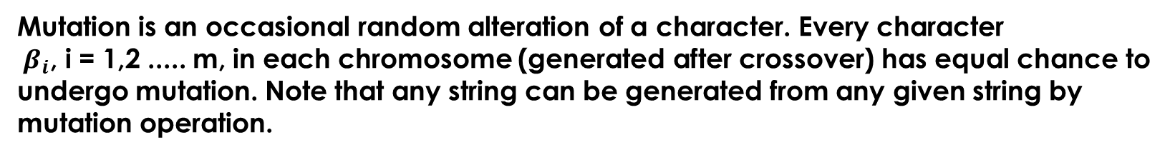
Mutation:
Mutation is an occasional random alteration of a character. Every character
${ β}_{i}$, i = 1,2 ..... m, in each chromosome (generated after crossover) has equal chance to undergo mutation. Note that any string can be generated from any given string by mutation operation.
Evolution of the Algorithm:
If everything goes well, this is how the optimization happens.
The initial population

Slide 13
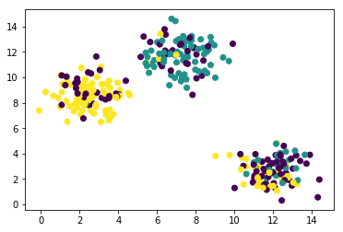
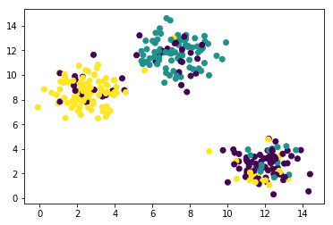
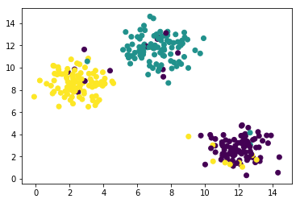
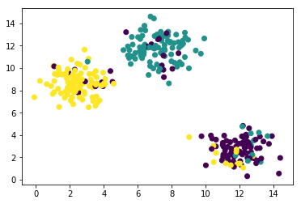
After 450 generations
After 900 generations
After 1800 generations
After 1350 generations

Slide 14
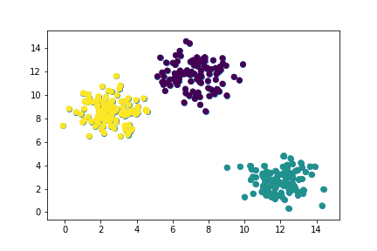
Comparison
After 1800 Generations
Actual arrangement

Slide 15
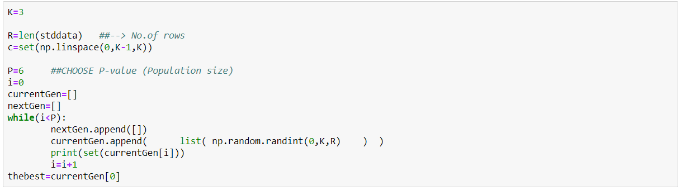
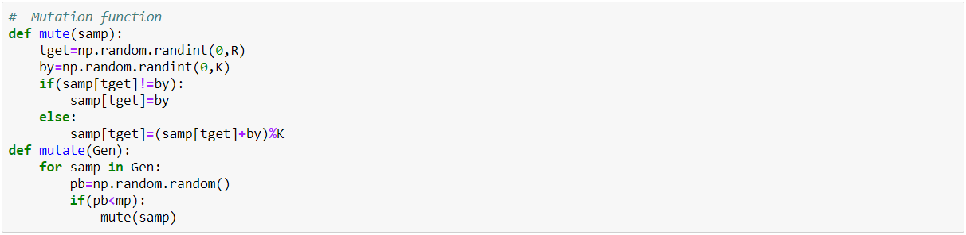
Code Samples:
initial population
Mutation

Slide 16
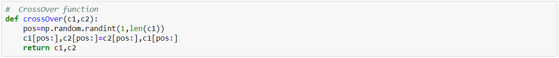
cross-over
Conclusion:
The aim of this work is to observe whether the proposed GA-based method can find the optimal clustering without searching all possible partitions.
While solving an optimization problem using GAs, one always needs to make a compromise between two conflicting facets of GAs. One facet is the maintenance of population diversity such that the process searches for optimal strings in different regions of the search space.
The other facet is that as the GA goes nearer to the optimal solution, fewer changes in the bits of the present best string are necessary to get the optimal string.
This means that as the process approaches the optimal string, the search space needs to be confined to the strings in the vicinity of the present best string.

Slide 17
References:
Murthy, C. A., & Chowdhury, N. (1996). In search of optimal clusters using genetic algorithms. Pattern Recognition Letters, 17(8), 825-832.
Blashfield, R. K. (1980). Propositions regarding the use of cluster analysis in clinical research. Journal of consulting and clinical psychology, 48(4), 456.
Moustafa, N., & Slay, J. (2015, November). UNSW-NB15: a comprehensive data set for network intrusion detection systems (UNSW-NB15 network data set). In 2015 military communications and information systems conference (MilCIS)(pp. 1-6). IEEE..

