Slide 1
Citibike Ridership Stats & Revenue Analysis
2016 and 2017 data

Slide 2
Context & Assumptions
An analysis of the trip data for NYC’s bikeshare program looking at the year’s 2016 and 2017 with the goal of finding new revenue sources after a drop in sponsorship revenue
Assumptions made about the data:
There are 136,702 Subscribers, as stated in the Dec 2017 system report. I am assuming this number is true for 2016 as well and that each Subscriber paid in full at the beginning of the year
The current pricing structure is being used for this data. Subscribers pay $185/year; Non-Subscribers pay $3.99/ride
The usertype “Customer” is users who are not subscribed. They are described as both “Customer” or “Non-Subscriber” in this deck.

Slide 3
Executive Summary
Loss of sponsorship revenue requires alternative revenue sources to make up the deficit
Bicycle rental is highly seasonal and the system is underutilized in winter and spring. Encouraging off-season riding could make up some revenue shortfall
Increasing the overtime fees by 2 cents per minute could net an additional $1.9 million over the course of two years if 2016/2017 ridership levels and habits are maintained

Slide 4
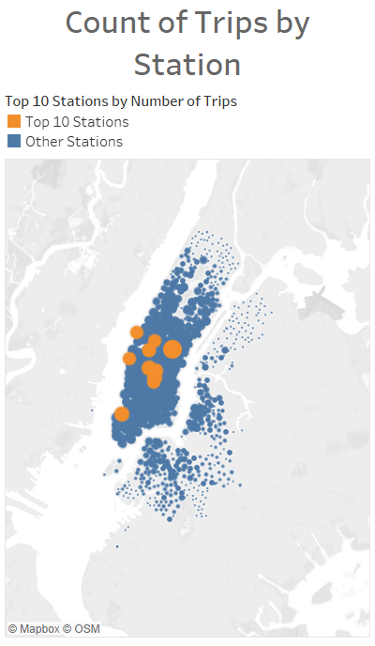
Quick Facts
In 2016 there were 13,845,655 trips averaging 16 minutes per trip
In 2017 there were 16,364,657 trips averaging 17 minutes
Subscribers are responsible for 89% of all trips in both 2016 and 2017
Excluding overtime fees Subscribers generated $50.6 million in revenue and Non-Subscribers generated $13.1 million

Slide 5
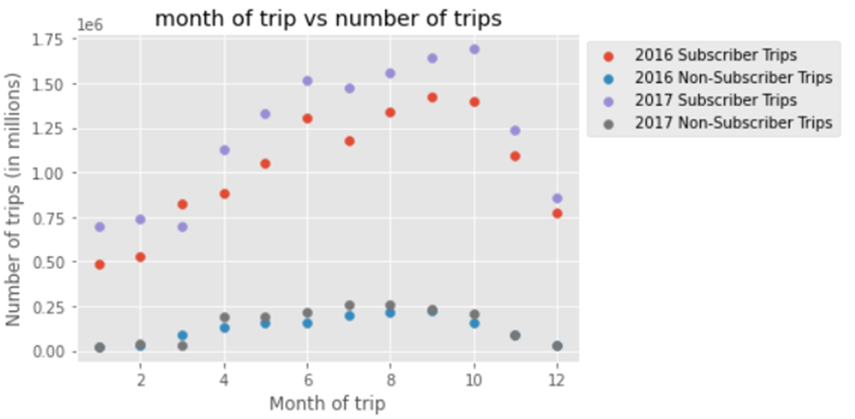
Increasing off-season riding could generate additional revenue
Variation by season is dependent on the type of user
Subscribers show a much greater variety in the times of year that they are using the bicycle network.
During winter months in 2016 there were as few as 50,000 trips while in peak months it went as high as 1.4 million trips in a month
Among Non-Subscribers there was less variation overall, but it still followed the same pattern
There is capacity in the system to handle higher traffic volumes in spring and winter if there were a way to incentivize riders

Slide 6
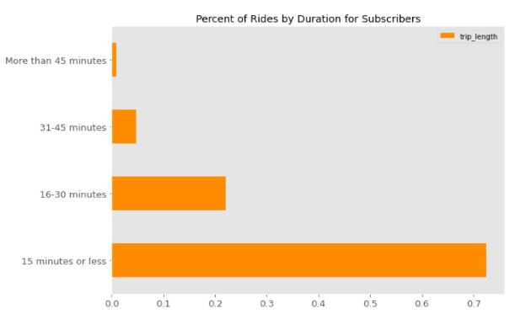
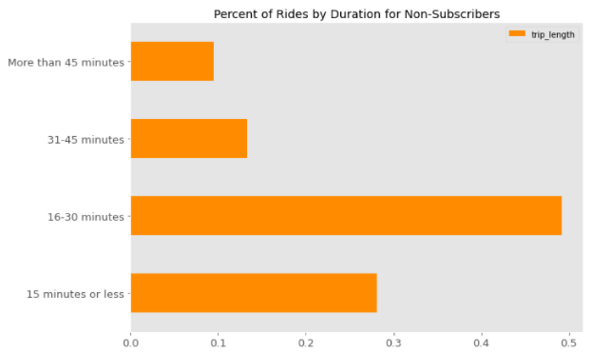
Non-Subscriber’s rides last much longer than Subscribers. 72% of Non-Subscriber trips are 16 minutes or longer, compared to 38% for Subscribers
Subscribers are using the bikes for quick trips whereas Non-Subscribers are using them for longer, dedicated trips
Since Non-Subscribers pay per-ride faster turnover of bikes by Non-Subscribers could net more revenue

Slide 7
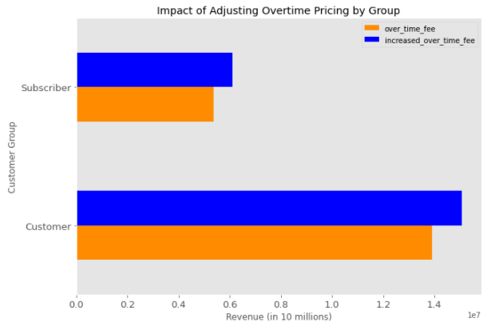
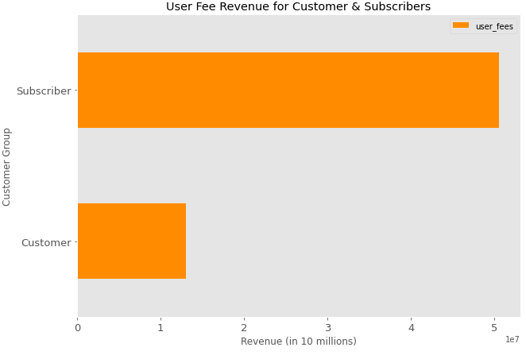
If the overtime fees for both groups are raised by $0.02 it would raise an extra $1.2 million over two years from Non-Subscribers and $717 thousand from Subscribers.
Subscribers pay a flat fee of $185 per year. Extra revenue comes from the $0.15/minute fee if they keep the bike beyond the allocated 45 minutes per trip
Customers pay $3.99 per trip. If they keep the bike for more than 30 minutes they are paying an extra $0.23/minute fee
Fewer than 1% of rides in 2016 and 2017 resulted in overage fees for Subscribers; 22% for Non-Subscribers
Since so few Subscribers encounter overtime fees this fee increase is unlikely to have a significant negative impact on subscription numbers

Slide 8
Recommendations & Next Steps
Run a test to see if changing the overtime fee could impact the durations of rides that Non-Subscribers are taking as well as if it has any impact on ridership
Segmenting the customer base beyond Subscriber/Non-Subscriber could help find other avenues to increase ridership and revenue
User retention: when were accounts created, when did they become Subscribers, what is the rate of conversion from Customer to Subscriber
Usage by different customer segments: find out if the same Non-Subscribers are using bikes frequently
Examine the usage of stations and see if there can be any adjustments made to coverage of the city without compromising user experience
If there are several infrequently used stations in close proximity see if one can be removed while keeping the distance to stations reasonable

