Slide 1


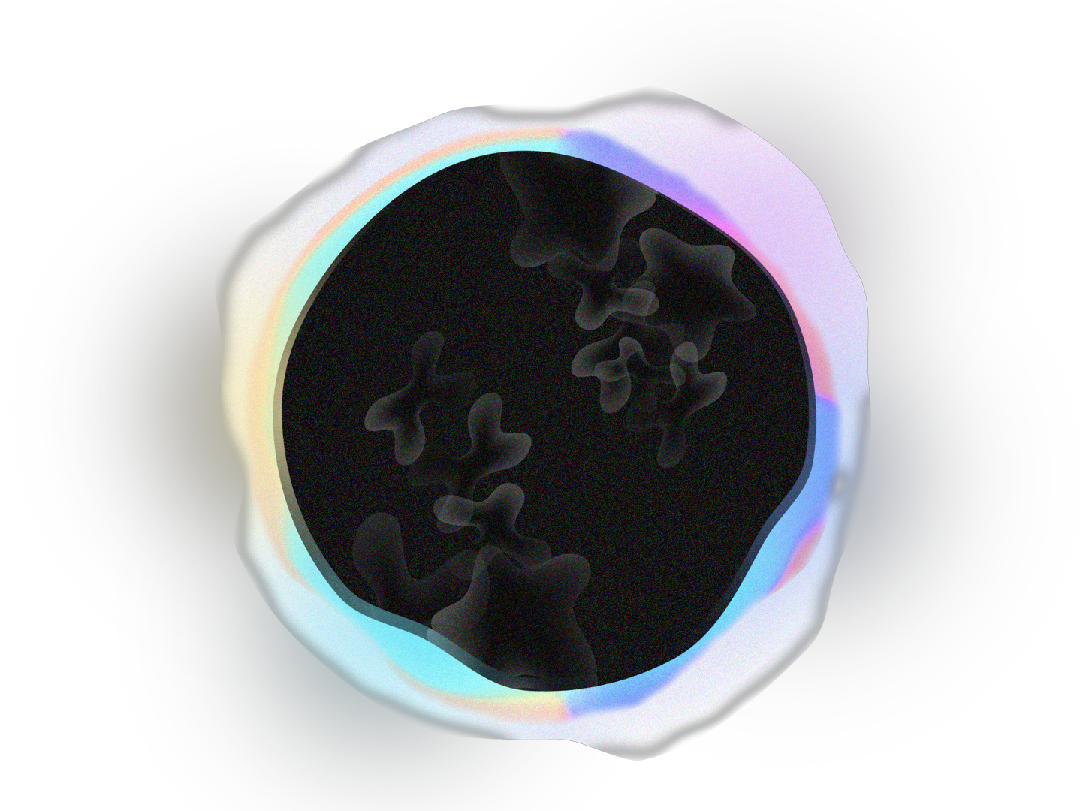
Neural-Symbolic Integration
Using OpenCog
Anatoly Belikov
abelikov@singularitynet.io
2

Slide 2
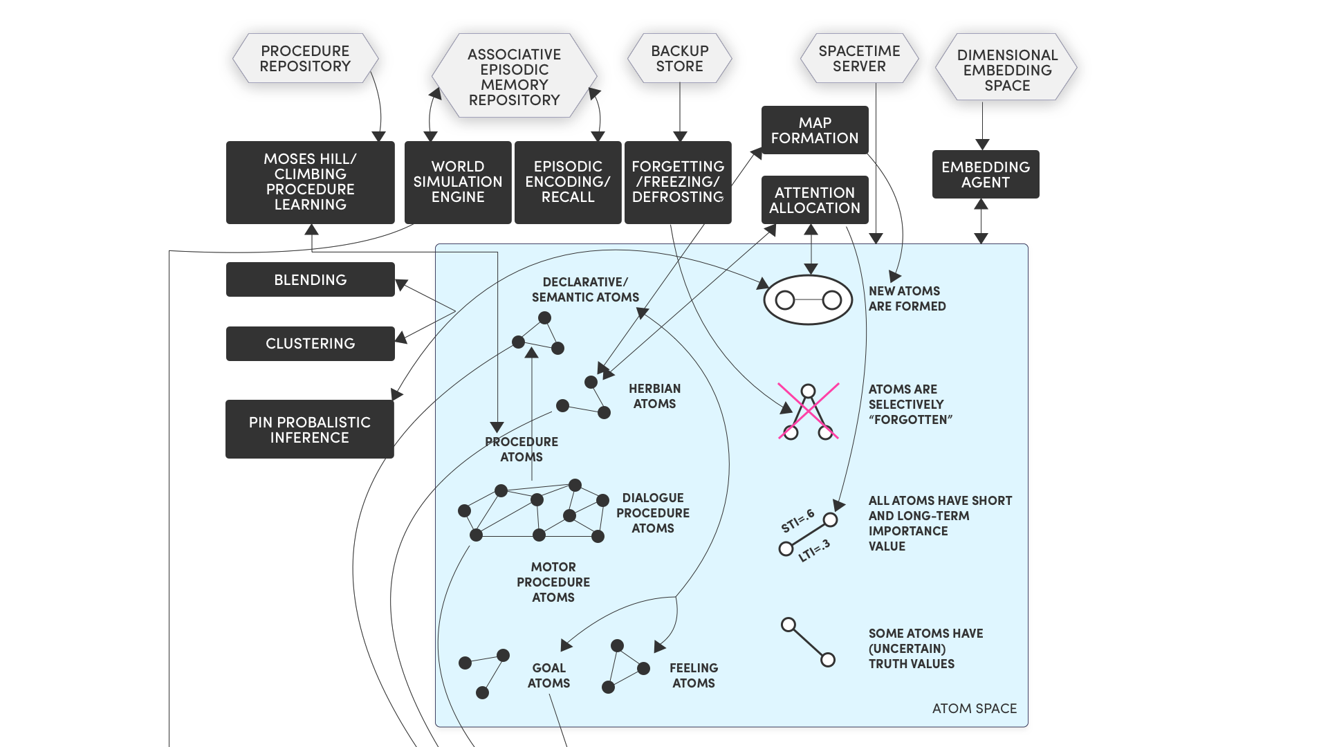

CogPrime
4

Slide 3
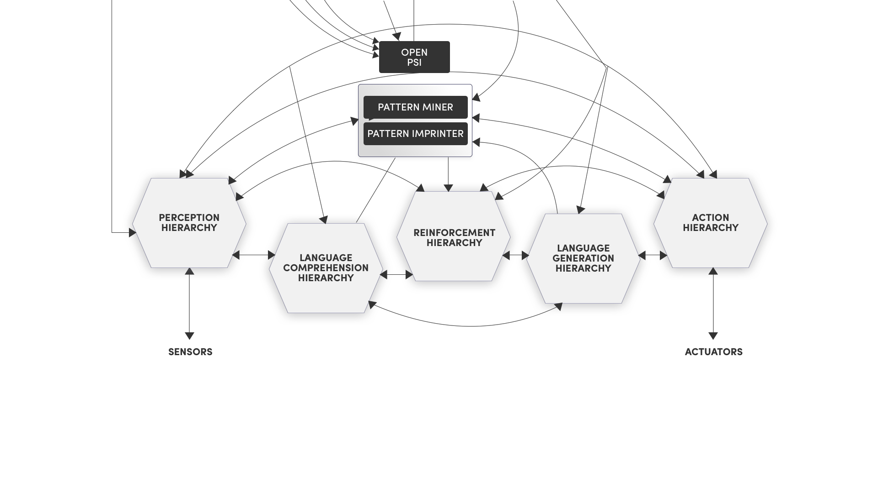
CogPrime
5

Slide 4
OpenCog
Probabilistic Logic
Network(PLN)
MOSES
Evolutionary programming
pattern miner
CogNets(pytorch)
Unified Rule Engine(URE)
pattern matcher
AtomSpace
6

Slide 5
Types of data in atomspace: Atoms
Atom
Node
Link
7

Slide 6
Types of data in atomspace: Values
Atom
FloatValue
StringValue
LinkValue
PtrValue
TruthValue
8

Slide 7
Code walkthrough and demonstration
10

Slide 8
Module networks for VQA
question
functional program
What is a large, red object made of?
query_material
filter_size[large]
filter_color[red]
scene
lstm
10

Slide 9
Module networks for VQA
functional program
execution
query_material
filter_size[large]
filter_color[red]
scene
out1 = filter_color(red, attention, features)
out2 = filter_size(large, out1, features)
result = classify(material, out2, features)
10

Slide 10
Using knowledge base
functional program
query_material
filter_size[large]
filter_color[red]
scene
out1 = filter_color(red, attention, features)
out2 = filter_size(large, out1, features)
out3 = filter_material(Variable(“X”),
out2, features)
result = argmax(out3)
10

Slide 11
Code walkthrough and demonstration
10

Slide 12
Functional vs Logical programs for VQA
Is there a large, rubber object that is red?
Nested functional program:
nonempty(
filter(red,
filter(large,
filter(rubber, Attention, Features)
, Features)
Features))
Logical program:
filter(red, X, Features),
filter(large, Y, Features),
filter(rubber, Z, Features),
intersect(X, Y, Z, Result),
nonempty(Result).
61

Slide 13
GQA-opencog – logical programs for VQA
Is the horse on the edge
of water brown and small?
[{"argument": "water (447019)",
"dependencies": [],
"operation": "select"},
{"argument": "horse,on the edge of,s (447018)",
"dependencies": [0],
"operation": "relate"},
{"argument": "brown",
"dependencies": [1],
"operation": "verify color"},
{"argument": "small ",
"dependencies": [1],
"operation": "verify size"},
{"argument": "", "dependencies": [2, 3],
"operation": "and"}]
61

Slide 14
GQA-opencog – logical programs for VQA
Is the horse on the edge
of water brown and small?
has_color(brown, $Y) and on($Y, $Z) and
edge_of($Z, $X) and object(horse, $Y) and
object(water, $X) and has_size(small , $Y)
https://github.com/noskill/GQA-opencog
61

Slide 15
TorchPLN
TTensorTruthValue – subclass of torch.Tensor
scheme
(define (precise-modus-ponens-strength-formula sA sAB snotAB)
(+ (* sAB sA) (* snotAB (negate sA))))
python
def precise_modus_ponens_strength_formula(sA, sAB, snotAB):
return sAB * sA + snotAB * (1 - sA)
https://github.com/singnet/pln
61

Slide 16
Integrating opencog with neural networks
CogNets
Passing arbitrary python objects between ExecutionOutputLinks
Allows to express computation graph as pytorch expression
Allows to integrate and update ontologies
61

Slide 17
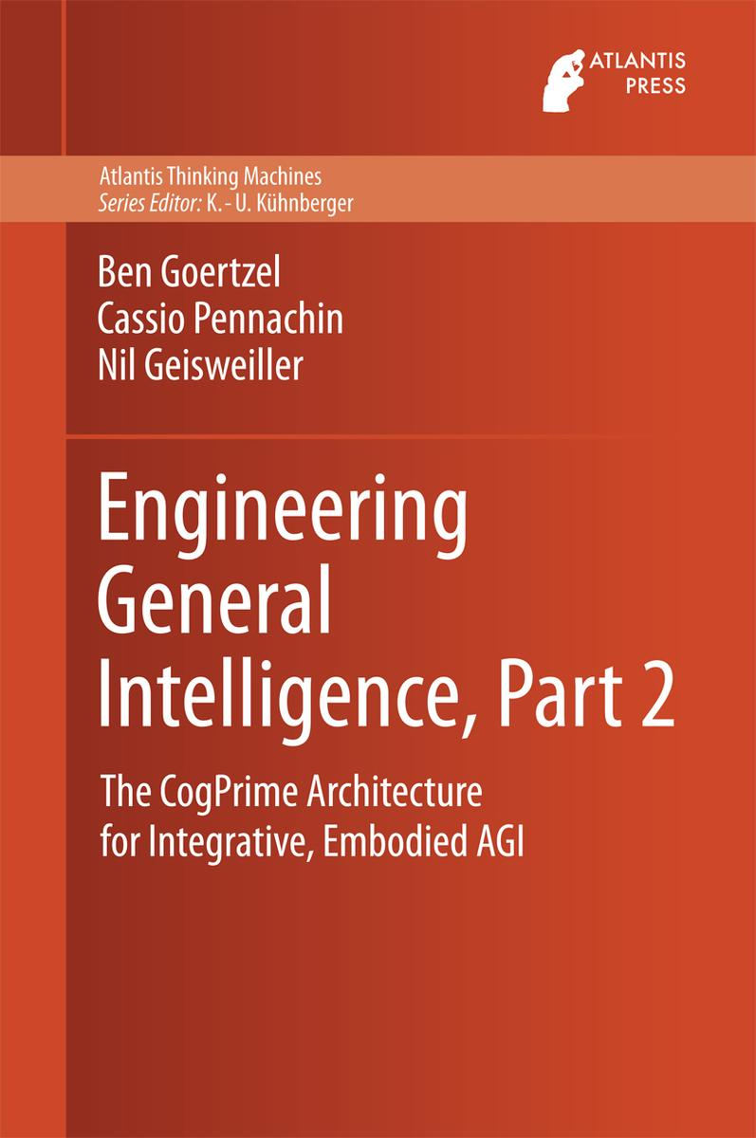
Resources
wiki.opencog.org/
github.com/singnet/atomspace
github.com/singnet/semantic-vision
blog.singularitynet.io
62

Slide 18
63

