Slide 1

Reputation System
over 23 years
Anton Kolonin
anton@singularitynet.io
akolonin@aigents.com
Telegram: akolonin
AIGENTS

Slide 2
Reputation System 1999-2001
WebMind
Personal WebMind
Agent A
Collaborative Filtering
B_{d}
A_{d}
C_{d}
B_{a}
C_{a}
D_{a}
B_{c}
A_{c}
D_{c}
Artificial Psychology
Agent B
Human D
Human C
Compassion-based “Psyche” Model
(based on social/mental hyper-graph)
A_{b}
C_{b}
D_{b}

Slide 3








Reputation System 1999-2016
WebMind
Aigents®
Personal Assistant
Computable cognitive model based on social evidence and restricted by resources: Applications for personalized search and social media in multi-agent environments
https://ieeexplore.ieee.org/document/7361869
WWW
Google
Foundation
graph
VKontakte
Messenger
Communication
graph
Facebook
Inference
engine
Imagination
graph
Twitter
Reddit
Cognitive Architecture of Collective Intelligence Based on Social Evidence
https://www.sciencedirect.com/science/article/pii/S1877050916317239
Steemit
Evidence
graph
Golos.id

Slide 4

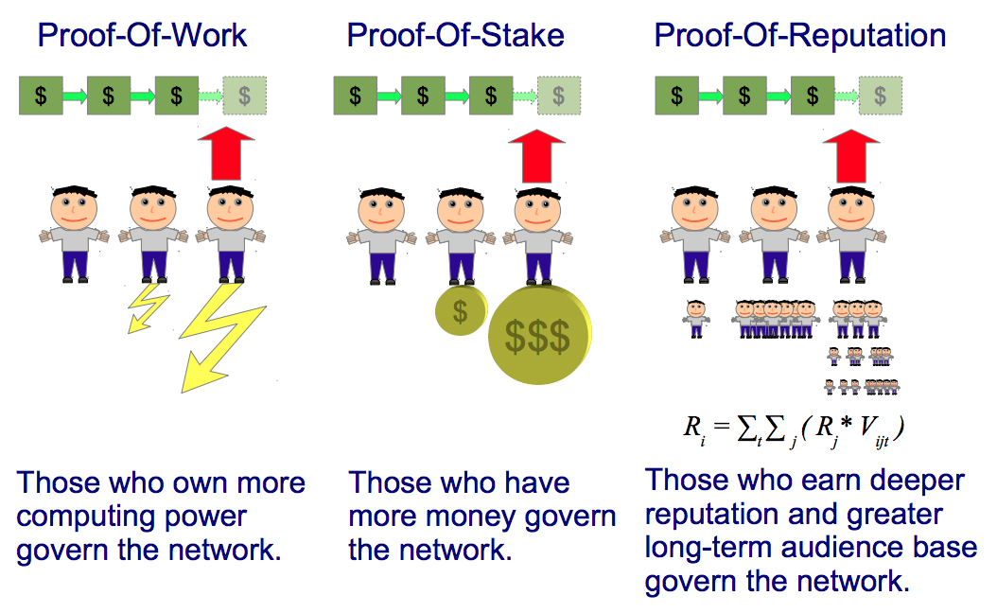





Reputation System 1999-2017
WebMind
RSS
Aigents®
Social Computing
WWW
Aigents®
PoR
Google
VKontakte
Messenger
Facebook
Twitter
PayPal
Reddit
Ethereum
Telegram
Steemit
Slack
Golos.id
Discourse
https://steemit.com/blockchain/@aigents/proof-of-reputation-as-liquid-democracy-for-blockchain

Slide 5
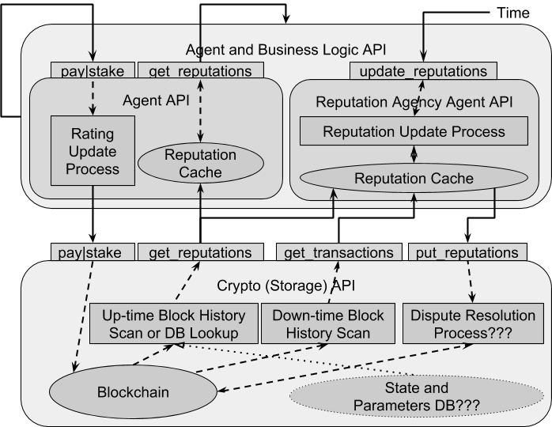
Reputation System 1999-2018
WebMind
Aigents®
Social Computing
Aigents®
PoR
SingularityNET
DRS and WLR
Decentralized Reputation System (DRS) and
Reputation Agency Design
https://blog.singularitynet.io/reputation-system-design-for-singularitynet-8b5b61e8ed0e
https://arxiv.org/abs/1806.07342
Weighted Liquid Rank (WLR) Reputation Algorithm
https://arxiv.org/abs/1806.07342

Slide 6

Reputation System 1999-2019
WebMind
Aigents®
Social Computing
Aigents®
PoR
SingularityNET
DRS and WLR
https://github.com/aigents/aigents-java
Aigents®
RS (Java)
SingularityNET
RS for Marketplaces
SingularityNET
RS (Python)
https://github.com/singnet/reputation/
Using Reputation System for protection from scam identifying dishonest suppliers on online marketplaces
https://arxiv.org/pdf/1905.08036.pdf
https://blog.singularitynet.io/minimizing-recommendation-fraud-7dabbee8fc00

Slide 7
Reputation System 1999-2020
WebMind
Aigents®
Social Computing
Aigents®
PoR
SingularityNET
DRS and WLR
Aigents®
RS (Java)
SingularityNET
RS for Marketplaces
SingularityNET
RS (Python)
VKontakte
Twitter
Reddit
Ethereum
Slack
Steemit
Unified Liquid Rank Reputation computation across diverse social media platforms
Telegram
Golos.id
Discourse
https://arxiv.org/abs/1912.00176
https://aigents.medium.com/aigents-bot-for-telegram-groups-1dba32140047

Slide 8
Reputation System 1999-2022
WebMind
Aigents®
Social Computing
Aigents®
PoR
SingularityNET
DRS and WLR
Aigents®
RS (Java)
SingularityNET
RS (Python)
Reputation Consensus
for Blockchain
SingularityNET
RS for Marketplaces
https://arxiv.org/abs/2108.03542
Mindplex
Reputation System
Reputation System
for Content Recommendation
HyperСycle
Reputation System
https://arxiv.org/abs/2209.07641
https://hypercycle.ai/

Slide 9
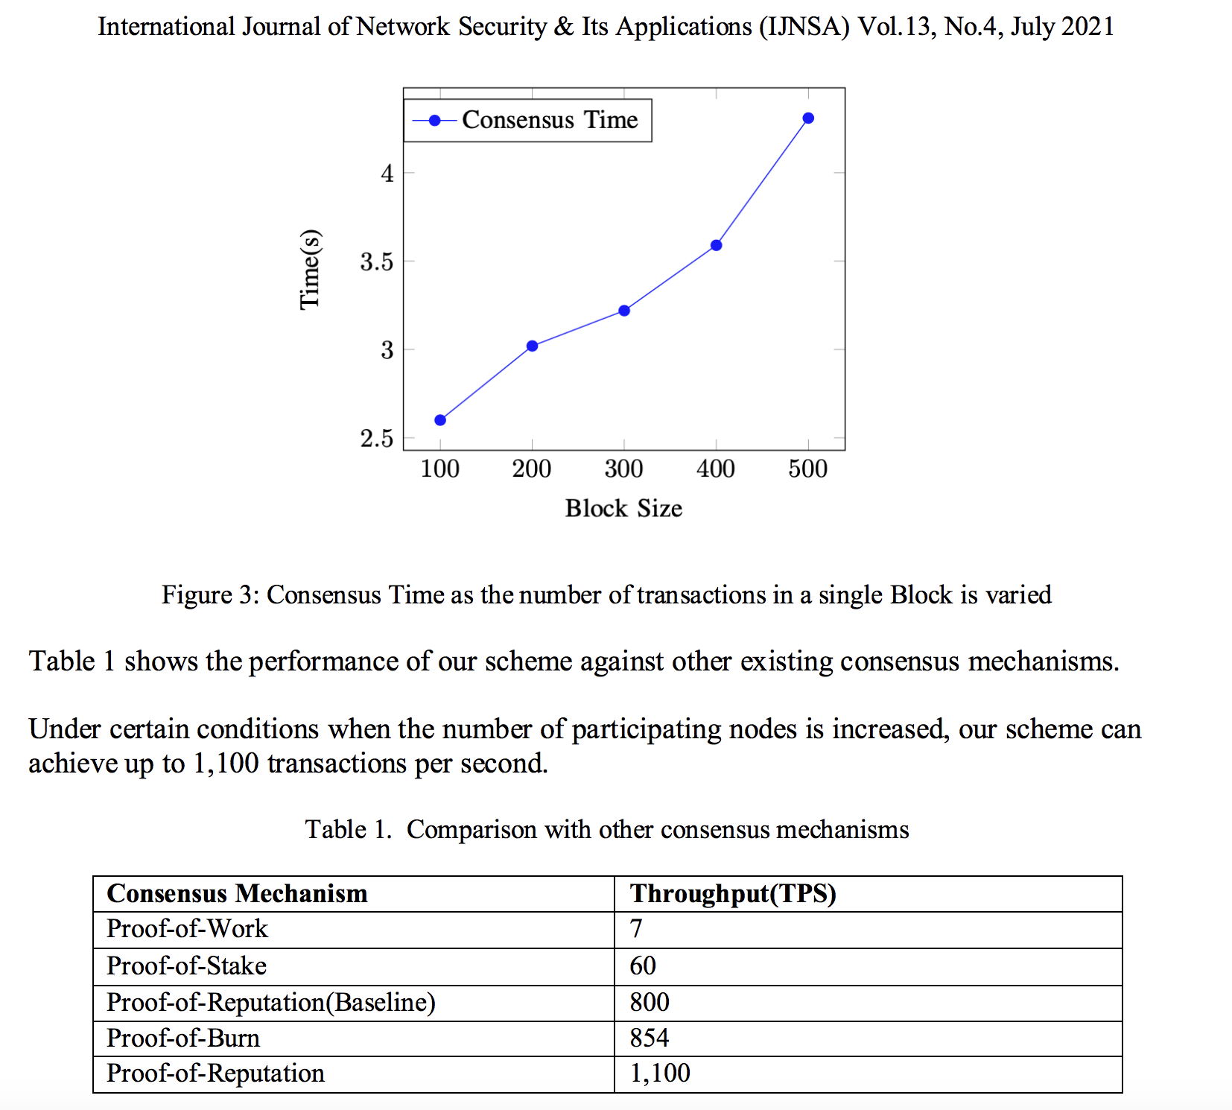
Reputation System 2021-2022
Reputation Consensus
for Blockchain
PROOF-OF-REPUTATION: AN
ALTERNATIVE CONSENSUS MECHANISM
FOR BLOCKCHAIN SYSTEMS
https://arxiv.org/abs/2108.03542

Slide 10
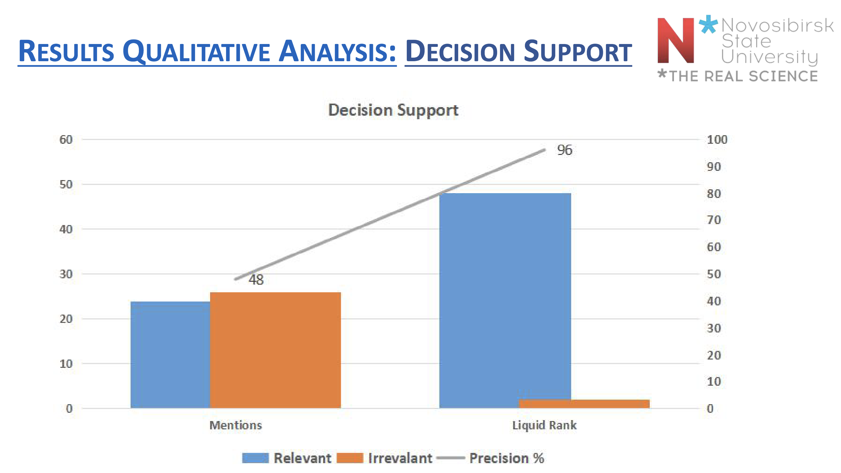
Reputation System 2017-2021
Reputation System
for Content Recommendation
Application of Liquid Rank Reputation System for Content Recommendation
https://arxiv.org/abs/2209.07641

