Slide 1


Future of Blockchain DLT
and Reputation Consensus
Anton Kolonin
akolonin@aigents.com
Facebook: akolonin
Telegram: akolonin
AIGENTS
https://aigents.com

Slide 2
Blockchain DLT Fundamental Issue
Speed + Cheapness + Security + Decentralization = CONST

Slide 3
Blockchain DLT Fundamental Issue
Optimistic rollup
Speed + Cheapness + Security + Decentralization = CONST

Slide 4
Blockchain DLT Fundamental Issue
Zero-Knowledge Succinct Non-Interactive Argument of Knowledge
(ZK-SNARK)
Speed + Cheapness + Security + Decentralization = CONST

Slide 5
Blockchain DLT Fundamental Issue
Side-chains (Level 2)
Speed + Cheapness + Security + Decentralization = CONST

Slide 6
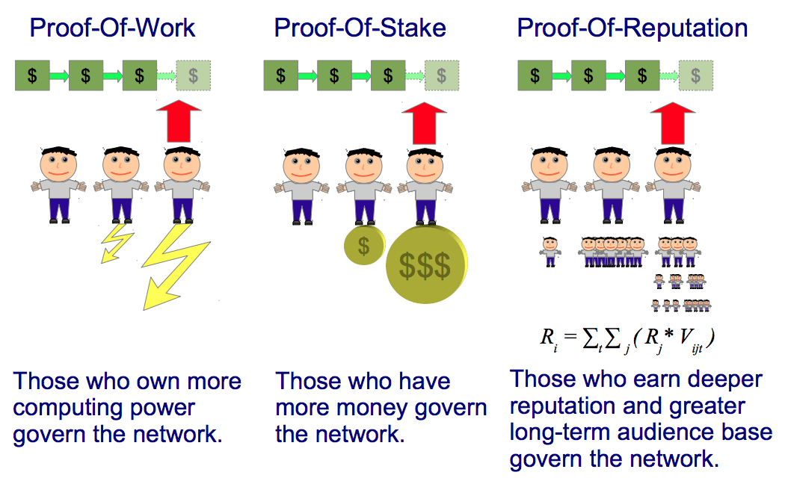
Reputation Consensus as a Liquid Democracy (2017)
https://steemit.com/blockchain/@aigents/proof-of-reputation-as-liquid-democracy-for-blockchain
https://research.nsu.ru/en/publications/reputation-systems-for-human-computer-environments
https://ieeexplore.ieee.org/document/8109887

Slide 7
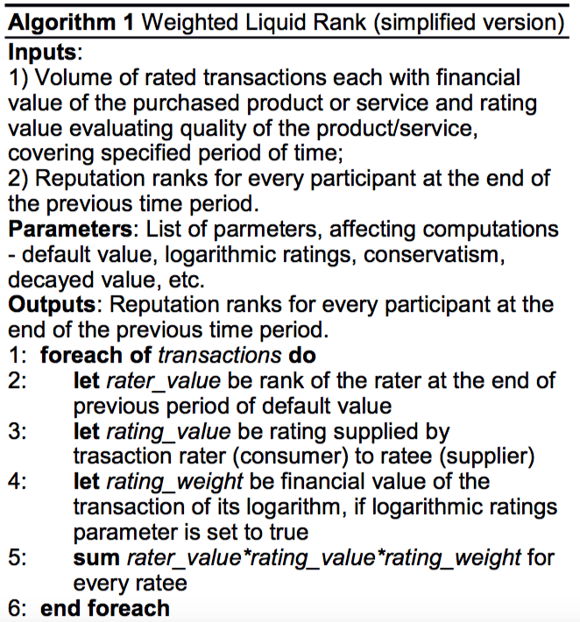
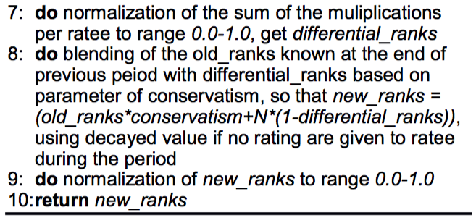
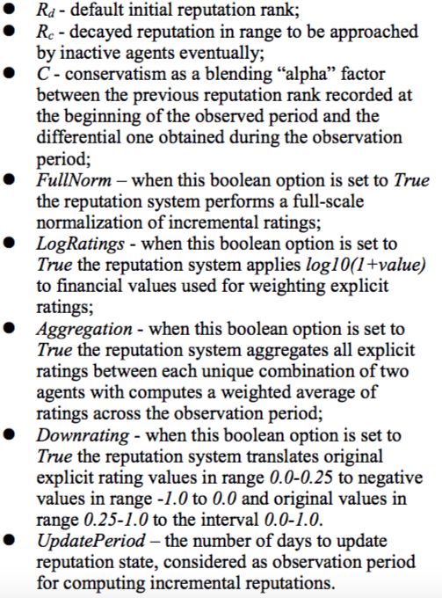
Reputation Engine
A Reputation System for Multi-Agent Marketplaces
Anton Kolonin, Ben Goertzel, Cassio Pennachin, Deborah Duong, Matt Iklé , Nejc Znidar, Marco Argentieri
https://arxiv.org/pdf/1905.08036.pdf
https://github.com/singnet/reputation
https://github.com/aigents/aigents-java/blob/master/src/main/java/net/webstructor/peer/Reputationer.java

Slide 8









Reputation System for Social Platforms (2014-2022)
Unified Liquid Rank Reputation computation across diverse social platforms
Reddit
VKontakte
Twitter
Discourse
Ethereum
Aigents®
Steemit
Telegram
Golos.id
Slack
https://arxiv.org/abs/1912.00176
https://aigents.medium.com/aigents-bot-for-telegram-groups-1dba32140047

Slide 9

“Weighted Liquid Rank” for Fraud Resistance (2019)
Using Reputation System for protection from scam identifying dishonest suppliers on online marketplaces
https://arxiv.org/pdf/1905.08036.pdf
https://blog.singularitynet.io/minimizing-recommendation-fraud-7dabbee8fc00
https://aiforgood2019.github.io/papers/IJCAI19-AI4SG_paper_28.pdf

Slide 10
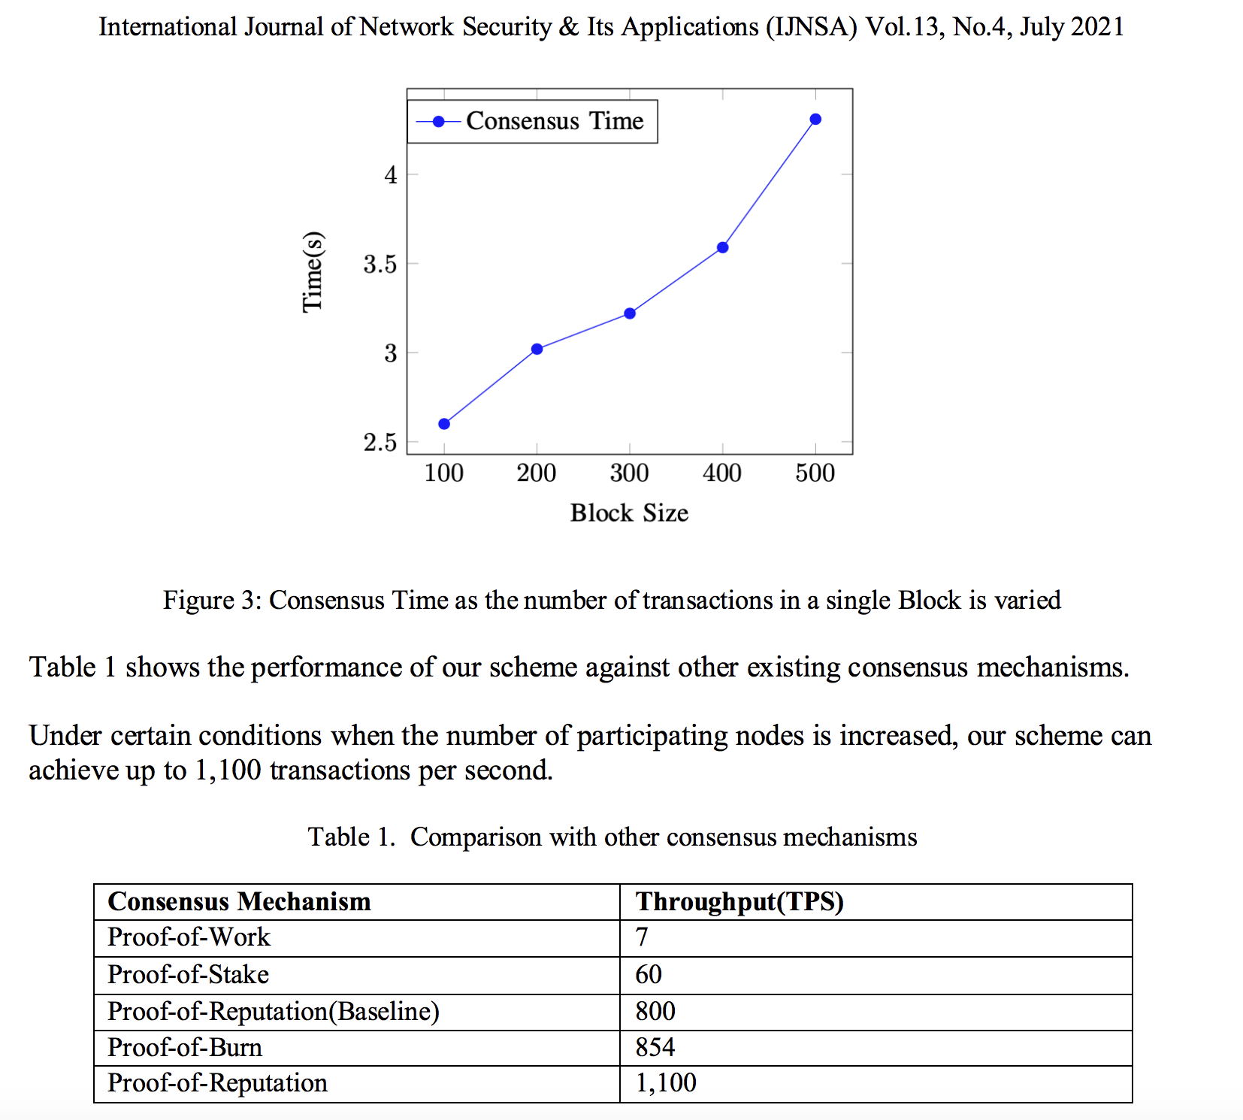
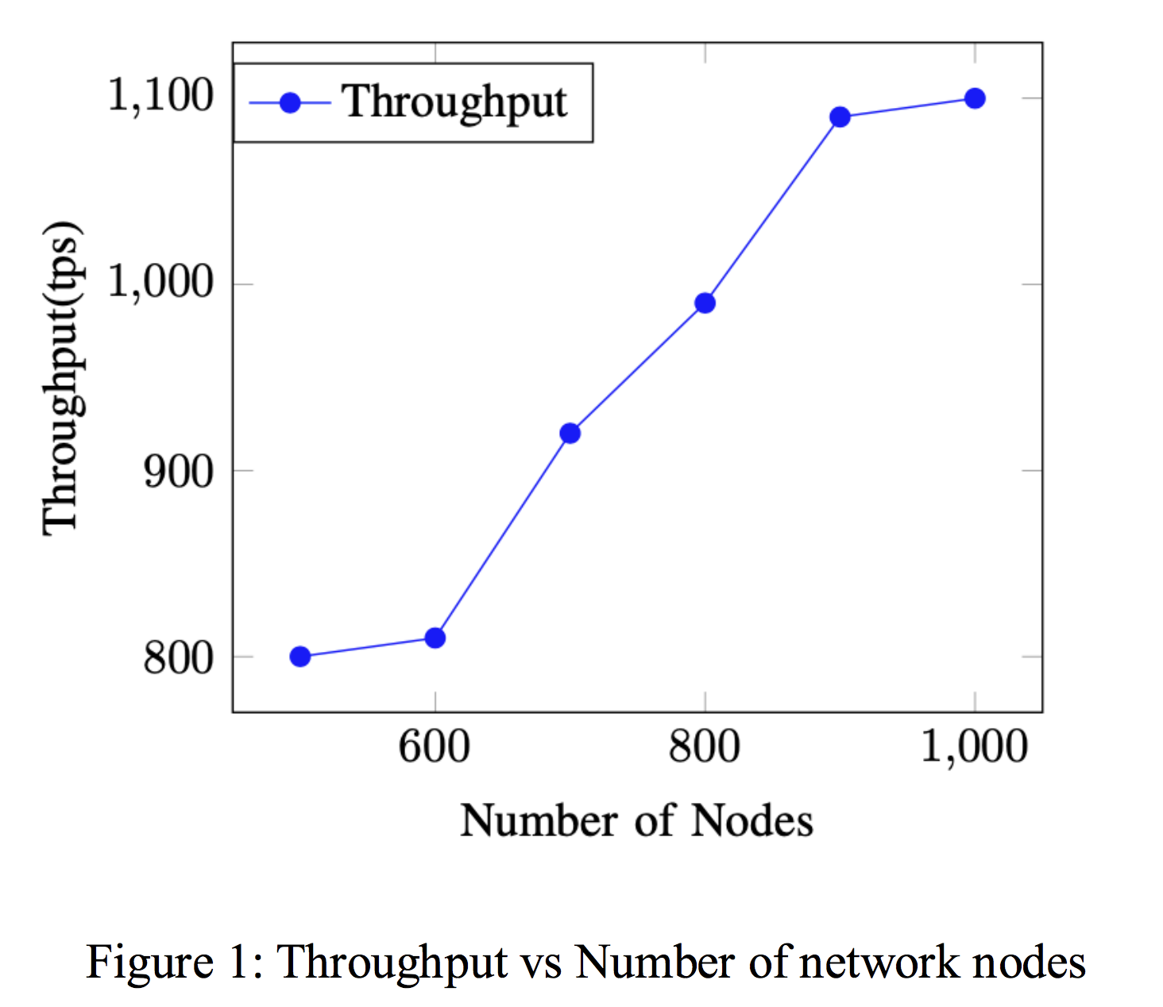
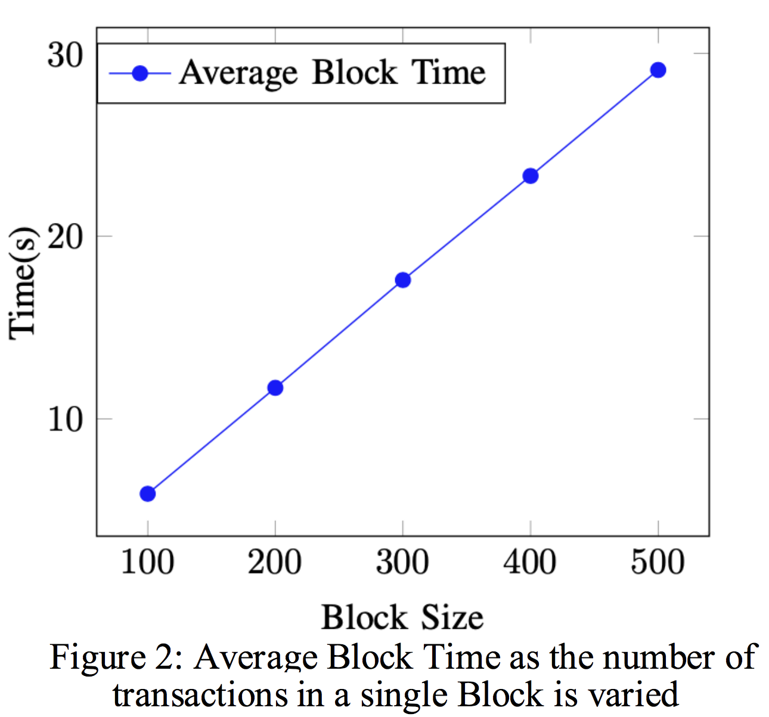
Reputation Consensus for Distributed Ledger (2021)
Proof-of-Reputation: An Alternative Consensus Mechanism for Blockchain Systems
https://arxiv.org/abs/2108.03542
https://aircconline.com/ijnsa/V13N4/13421ijnsa03.pdf

Slide 11
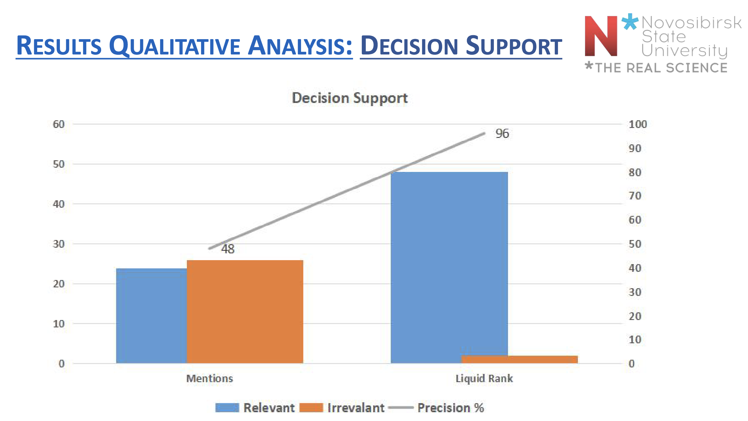
Reputation System for Recommendation (2022)
Application of Liquid Rank Reputation System for Content Recommendation
https://arxiv.org/abs/2209.07641
https://ieeexplore.ieee.org/document/9923352

Slide 12
Reputation Consensus – Synchronization Options
Blockchain
Blockchain
$
$
$
$
$
$
$
$
$
$
$
$
Reputation
Snapshot
1 day/hour
Reputation
Snapshot
Reputation
Snapshot
Reputation
Snapshot
Reputation
Snapshot
Reputation
Snapshot
Reputation
Snapshot
Blockchain
Snapshot
Blockchain
Snapshot
Block-wise
(expensive)
Periodic
(optimal)
A Reputation System for Artificial Societies
Anton Kolonin, Ben Goertzel, Deborah Duong, Matt Ikle
https://arxiv.org/pdf/1806.07342.pdf

Slide 13
Reputation Consensus – Rating Sources
Blockchain
$
$
$
$
$
$
$
$
$
$
$
$
$
Endorsing Ratings
Follows
Stakes
Stars
Transactional Ratings
Reputation Engine
Implicit Ratings
Explicit Ratings
Tips
Likes
Transactions
Mentions
Stars
Comments
Reputation
Snapshot
Reputation
Snapshot
A Reputation System for Artificial Societies
Anton Kolonin, Ben Goertzel, Deborah Duong, Matt Ikle
https://arxiv.org/pdf/1806.07342.pdf

Slide 14
Reputation Consensus – Engine Design Options
$
$
$
$
$
$
$
$
Reputation
Snapshot
Reputation
Snapshot
Reputation
Snapshot
Reputation
Snapshot
Centralized off-chain
Decentralized off-chain
$
$
$
$
$
$
$
$
Reputation
Snapshot
Reputation
Snapshot
Reputation
Snapshot
Reputation
Snapshot
Reputation
Snapshot
Reputation
Snapshot
Decentralized on-chain (reputation mining)
Decentralized side-chain (reputation consensus)
A Reputation System for Artificial Societies
Anton Kolonin, Ben Goertzel, Deborah Duong, Matt Ikle
https://arxiv.org/pdf/1806.07342.pdf

Slide 15
Next: Resisting Reputation Gaming (Churning) [1.0..-1.0]
A
A
B
A
B
1.0
Default
1
1.0
Default
A
0
A
0
B
“Organic” Ratings
C
C
1
C
C
1
C
D
D
Default
Default
0
-1
“Cleaned”
0
0.75
E
E
E
1.0
C
F
D
G
D
1
C
-1.0
F
1
E
F
“Cleaned”
1
0
G
1.0
1
G
D
1
1
1.0
D
F
0
“Cleaned”
G
Reputation Gaming
(“Voting Rings”)
0
“Cleaned”
Abused Reputation Snapshot
Rescued Reputation Snapshot

Slide 16
Next: Resisting Reputation Gaming (Churning)
A
A
B
0.5
A
B
1.0
Default
1
1.0
Default
A
A
0
B
“Organic” Ratings
C
C
1
C
C
1
0.5
C
D
D
Default
Default
0
“Cleaned”
0
0.75
E
0
E
E
1.0
D
F
D
G
1
C
F
1
E
F
“Cleaned”
1
0
G
1.0
1
G
D
1
1
1.0
D
F
0
“Cleaned”
G
Reputation Gaming
(“Voting Rings”)
0
“Cleaned”
Abused Reputation Snapshot
Rescued Reputation Snapshot

Slide 17
Thank You and Welcome!
Anton Kolonin
akolonin@aigents.com
Facebook: akolonin
Telegram: akolonin
AIGENTS
https://aigents.com

