Slide 1

INTRODUCTION
A Blockchain-Based Voting System can provide various benefits such as transparency, immutability, and security. However, there are certain challenges that need to be addressed for the successful implementation of such a system.

Slide 2
CHALLENGES:
One of the primary challenges is ensuring the privacy of users'data while using a blockchain-based system. Using Ethereum addresses as user identifiers can help address this issue. However, it is essential to ensure that these addresses cannot be traced back to the user's identity.
Another challenge is ensuring that only eligible individuals can cast their votes. This requires a robust verification process to confirm the identity of voters and their eligibility to vote. Accuracy and transparency of the vote count is another critical aspect that needs to be considered. The blockchain-based systemshould ensure that all votes are accurately recorded and counted without any possibility of tampering or manipulation.
Additionally, ensuring the security of the system is also crucial. The system should be designed to resist any attacks, and appropriate measures should be taken to safeguard against any security breaches.

Slide 3

CODE

Slide 4

CODE

Slide 5

CODE

Slide 6
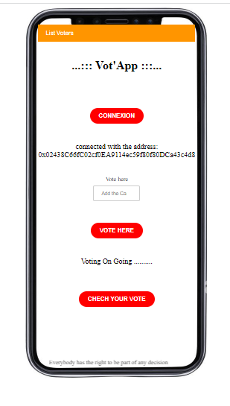
Vot’App

Slide 7
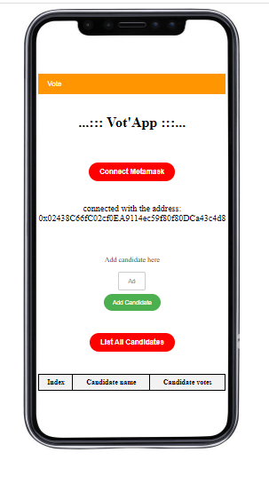
Vot’App

Slide 8
CONCLUSION
In summary, implementing a Blockchain-Based Voting System can bring various benefits, but it requires careful consideration of several challenges such as privacy, eligibility verification, vote counting, and security. Addressing these challenges can help ensure the successful implementation of such a system.

Slide 9


THANK YOU FOR YOUR ATTENTION
IT IS THE QUESTION TIME

