Slide 1
How to hack house prices
Sung Bae

Slide 2
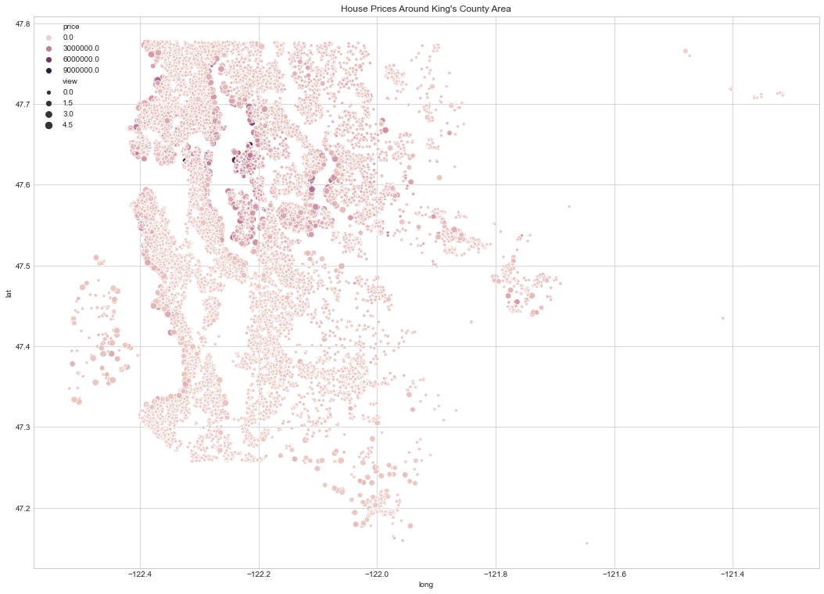
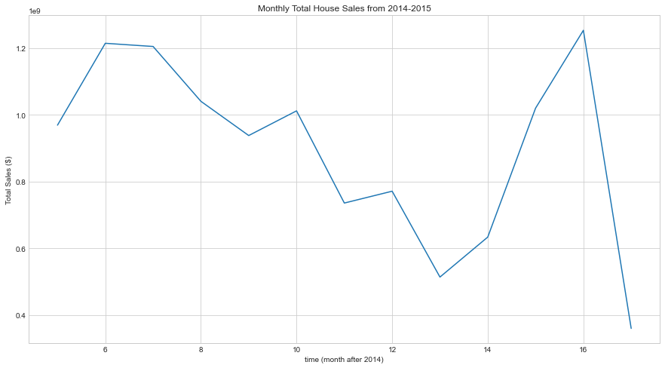
Introduction
House sale is a huge even during recessions (around $1B each month)
House prices differ depending on various factors (ex. location)

Slide 3
Question 1
What factors affect the house prices the most in most interpretable and reasonable way?

Slide 4
Model
Priority: interpretability
Reasonable predictors
May not result in highest r² value

Slide 5
Question 1: Factors that affect house prices
Positive effectors:
1. living area = more space means higher price
2. waterfront = having waterfront increases the value of the price
3. grade x bathroom = having great bathrooms count!
4. higher latitude = usually results in higher price
Negative effectors:
1. bath and bed= having too many of them decreases the price
2.longitude = higher longitude results in lower price

Slide 6
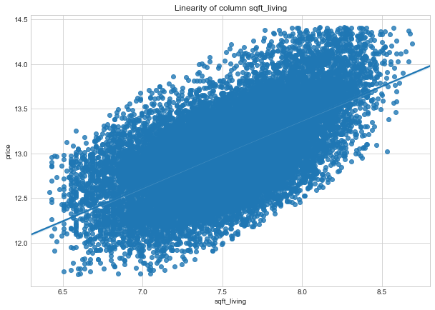
Strong positive association between living space and price

Slide 7
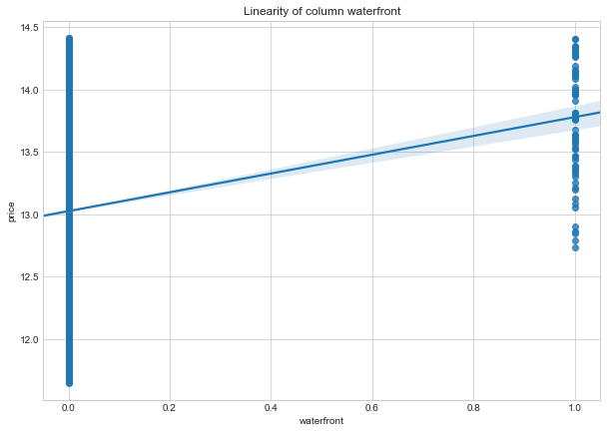
Strong positive association between presence of waterfront and price

Slide 8
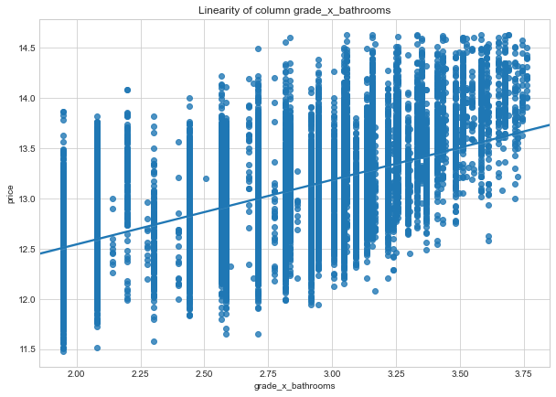
Strong positive association between presence of living area-bedroom ratio and price

Slide 9
Question 2
So what can be done to maximize house price by the homeowners?

Slide 10
Actions that can be done:
Increase Living Area
grade x bathrooms
Make some waterfront
second strongest factor
Shows that people love having bigger independent open spaces
Shows how important it is to have great quality bathrooms
Renovating bathrooms can be key to increasing your house value!
The strongest factor
Shows people love nature
construct or install some sort of water fountains or pond that can be seen from the house

Slide 11
Actions that can be done:
Some Serious Renovation!
Increase Living Area
grade x bathrooms
Make some waterfront
second strongest factor
Shows that people love having bigger independent open spaces
Shows how important it is to have great quality bathrooms
Renovating bathrooms can be key to increasing your house value!
The strongest factor
Shows people love nature
construct or install some sort of water fountains or pond that can be seen from the house

Slide 12
Conclusion
Model is limited
However it can give us a good idea of what factors we can control and change to change the house price
Actionable changes
Renovate to
Increase open space
Waterfront presence
Better quality bathrooms
What NOT to do
increase number of bathrooms and bedrooms in total

Slide 13
Future Studies

Slide 14
Thank you for listening

Slide 15
Appendix

Slide 17
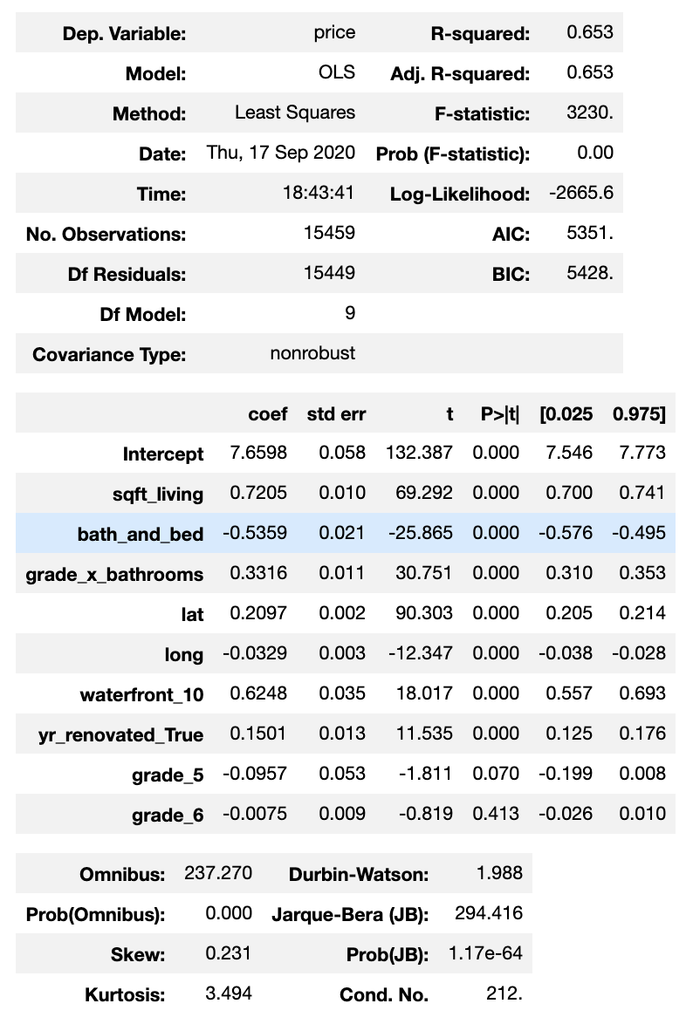
Notes:
Final Model

Slide 18
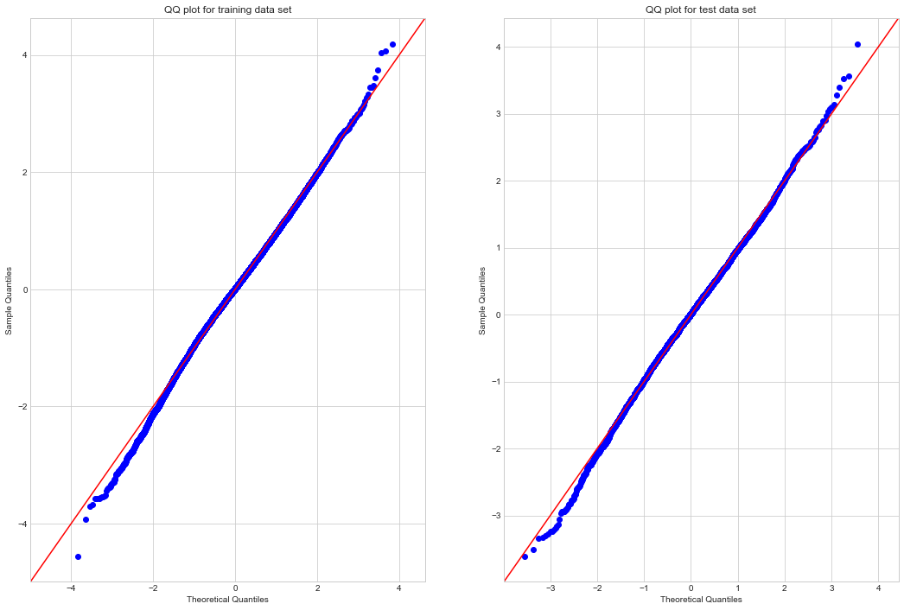
Notes:
QQ-plot of the final model

Slide 19
