Slide 1
What type of film to make?
Sung Bae

Slide 2
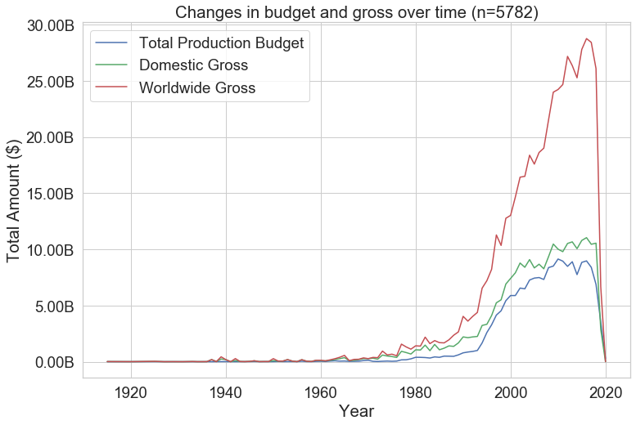
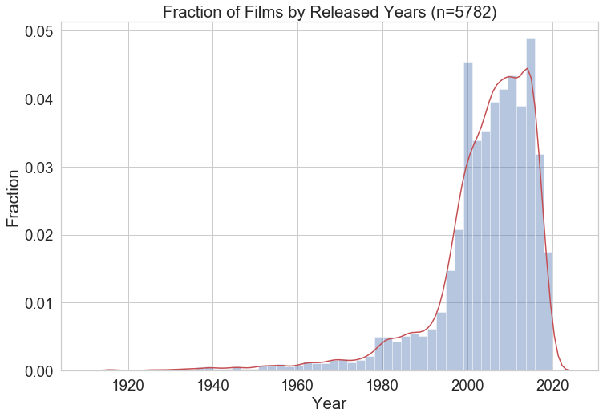
Introduction
Film industry has been growing
Especially the global market has been increasing until Covid-19
Still it is great to get into rapidly increasing film industry

Slide 3
Defining the “best” type of a film
Return on Investment (ROI)
Total Gross Profit
Average Ratings
Indicates effectiveness
Mainly focus maximizing domestic ROI
Limited since percentage does not fully describe total profit
Indicates the magnitude of its impact
Mainly focus on maximizing domestic gross profit
Sets up the image of the company
Important factor for future
Focus on what factors might result in higher average ratings

Slide 4
Goals of today’s Presentation
Choosing the time of release
Selecting genres
Setting up production budgets
Selecting crews
Return on Investment (ROI)
Total Gross Profit
Average Ratings
Indicates effectiveness
Mainly focus maximizing domestic ROI
Limited since percentage does not fully describe total profit
Indicates the magnitude of its impact
Mainly focus on maximizing domestic gross profit
Sets up the image of the company
Important factor for future
Focus on what factors might result in higher average ratings

Slide 5
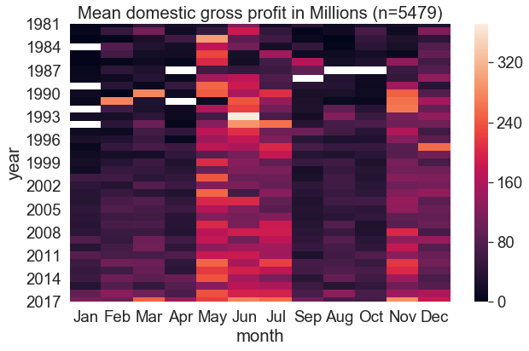
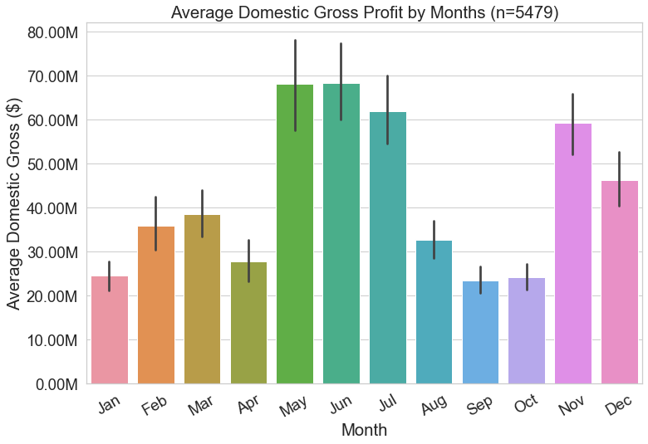
Action 1: Time Table
Possible Months
May, June, July which result in average domestic gross of $60-70M

Slide 6
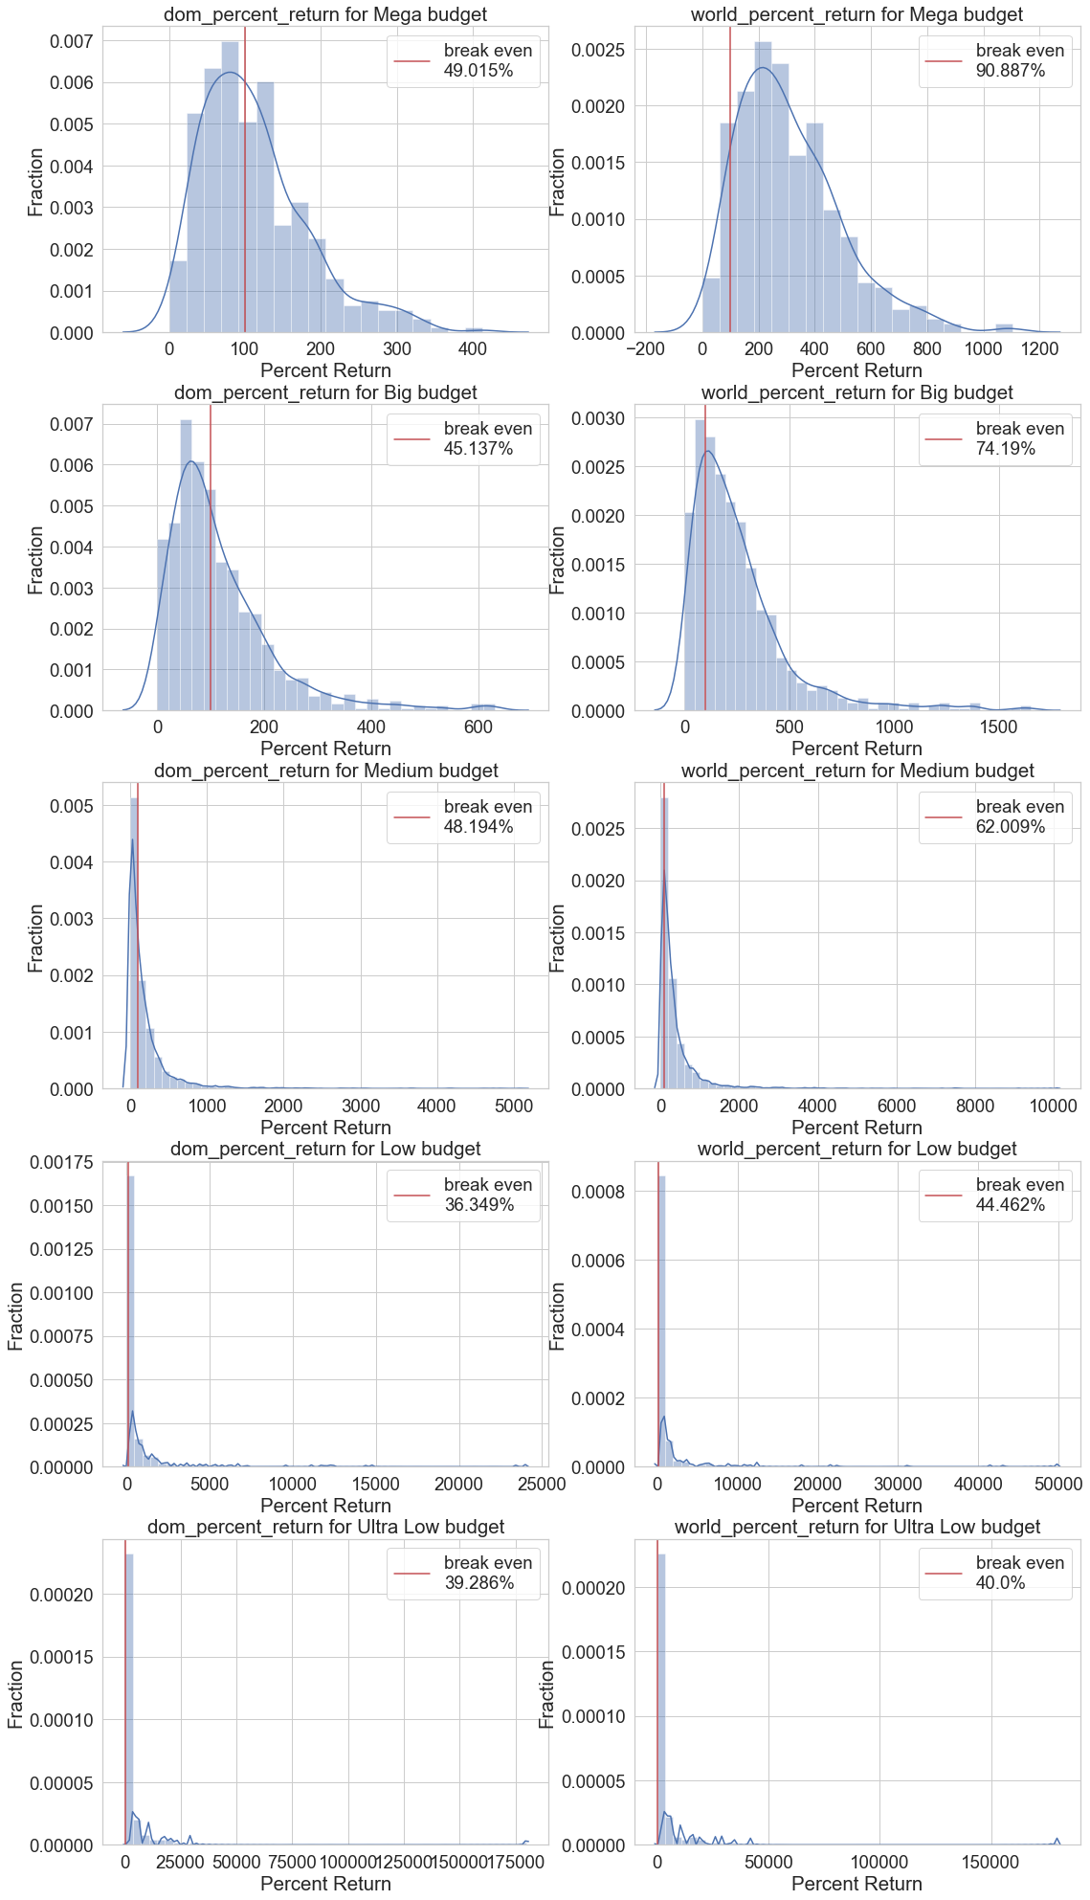
Action 2a – Setting the Budget
Categories: Mega, Big, Medium, Low, Ultra-Low
Production budget > $100 M
Notes:
Hard to read
fivethirtyeight
Adjustments = more readable titles
needed more time to exploring with the audience

Slide 7
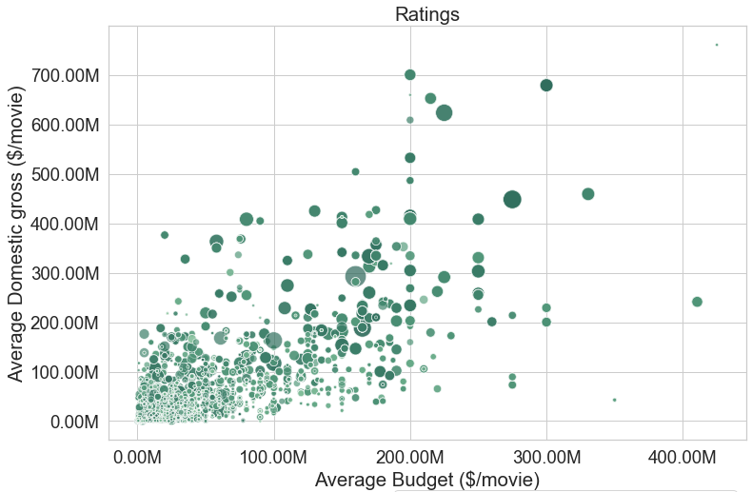
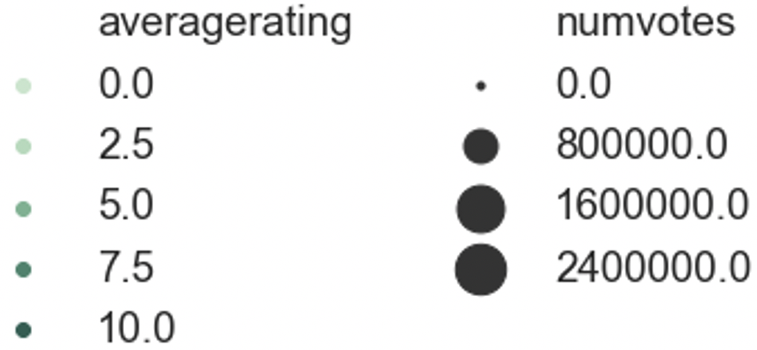
Action 2b – Setting the Budget
Production budget > $100 M
Categories: Mega, Big, Medium, Low, Ultra-Low
Production budget > $100 M

Slide 8
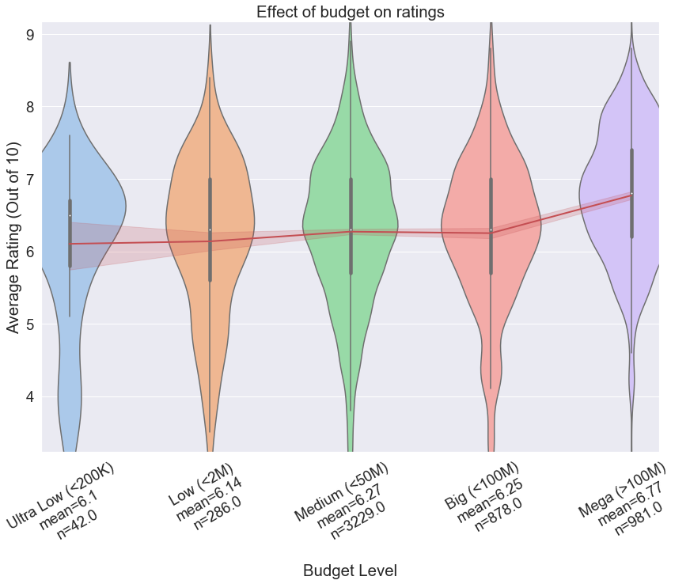
Suggestion:
Production budget greater than 100M results in higher average ratings

Slide 9
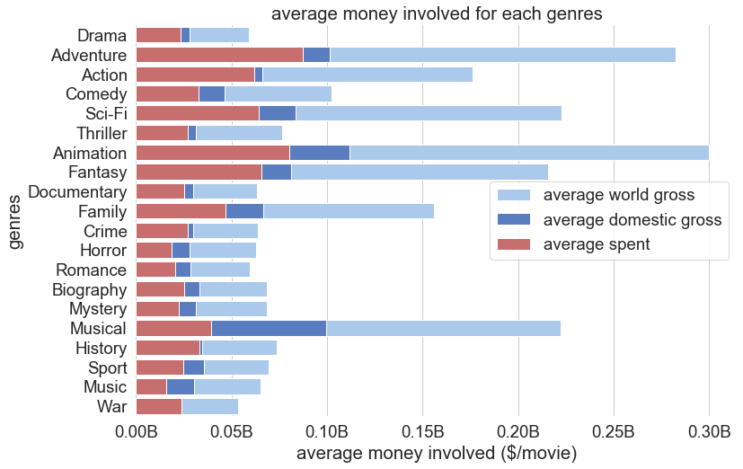
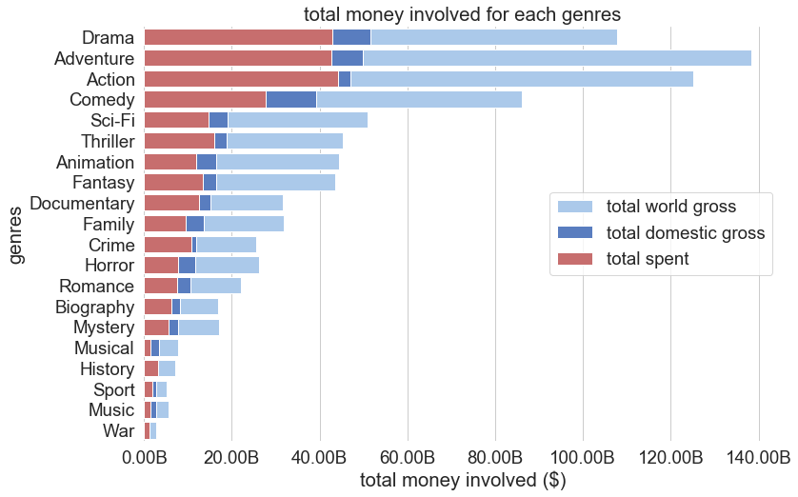
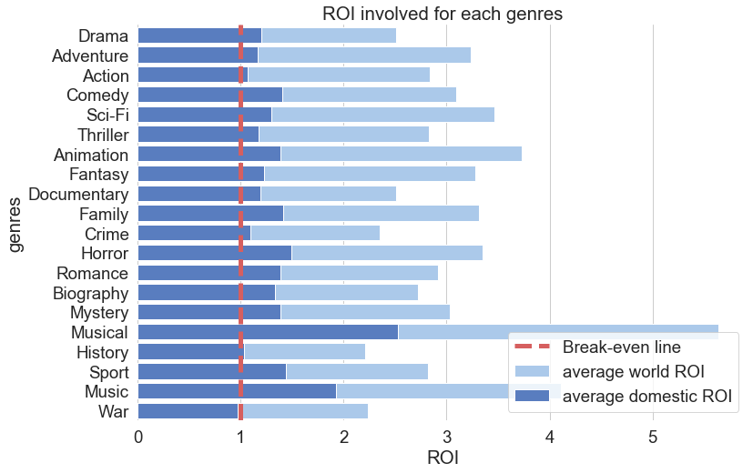
Action 3 – Choosing Possible Genres
For higher profit : drama, adventure
For higher efficiency : musical, music

Slide 10
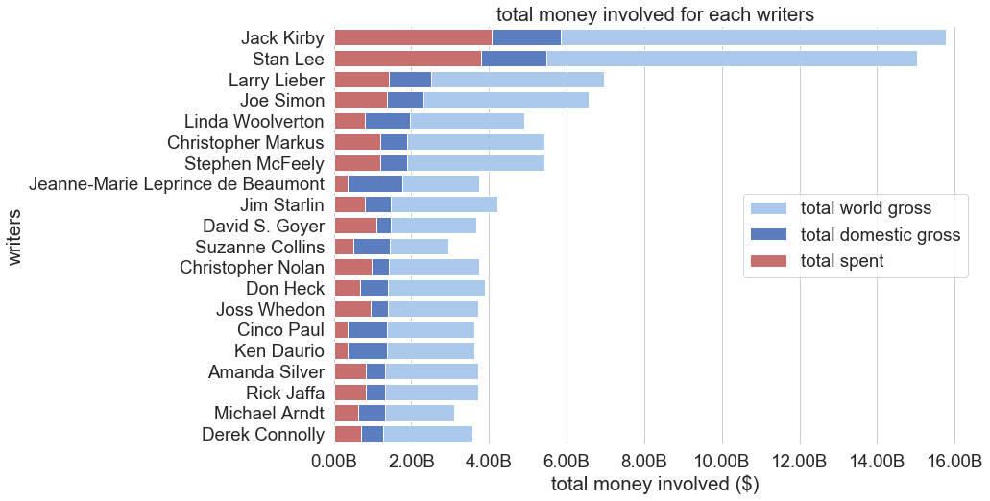
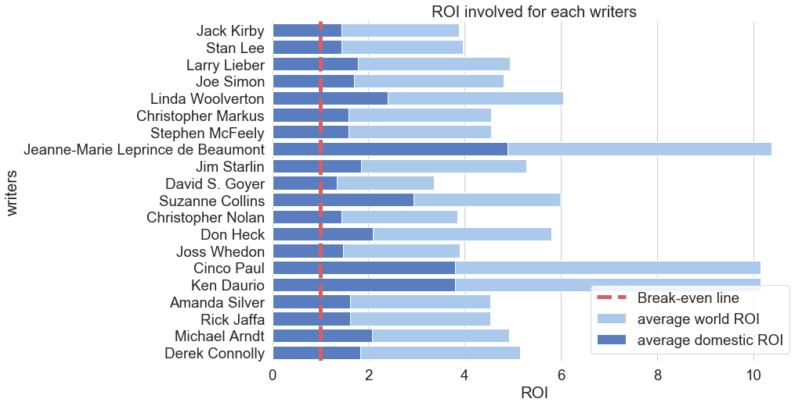
Action 4a – Assembling the Ultimate Team
Directors and Writers
F
For higher profit: Jack Kirby, Stan Lee
For higher efficiency: Beaumont, Cinco Paul and Ken Daurio

Slide 11
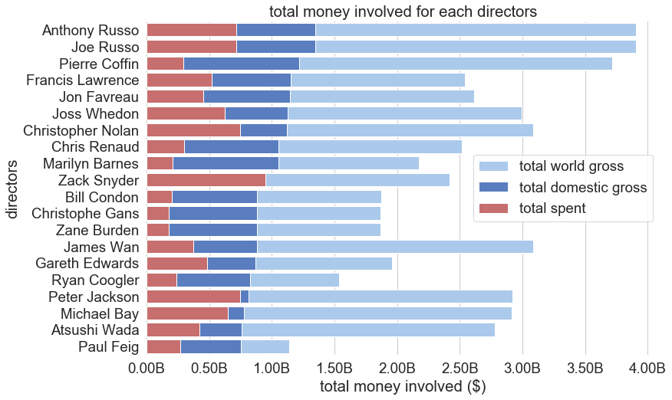
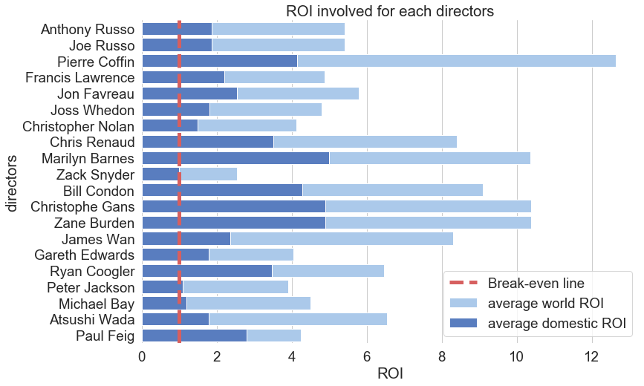
Action 4b – Assembling the Ultimate Team
For higher profit: Russo brothers or Coffin
For higher efficiency: Avoid Peter Jackon and Michael Bay

Slide 12
Conclusion
Time
May, June, July which result in average domestic gross of $60-70M
Budget
Production budget > $100 M
Genres
For higher profit : drama, adventure
For higher efficiency : musical, music
Writers
For higher profit: Jack Kirby, Stan Lee
For higher efficiency: Beaumont, Cinco Paul and Ken Daurio
Directors
For higher profit: Russo brothers or Coffin
For higher efficiency: Avoid Peter Jackon and Michael Bay

Slide 13
Thank you for listening

Slide 14
Appendix

Slide 15
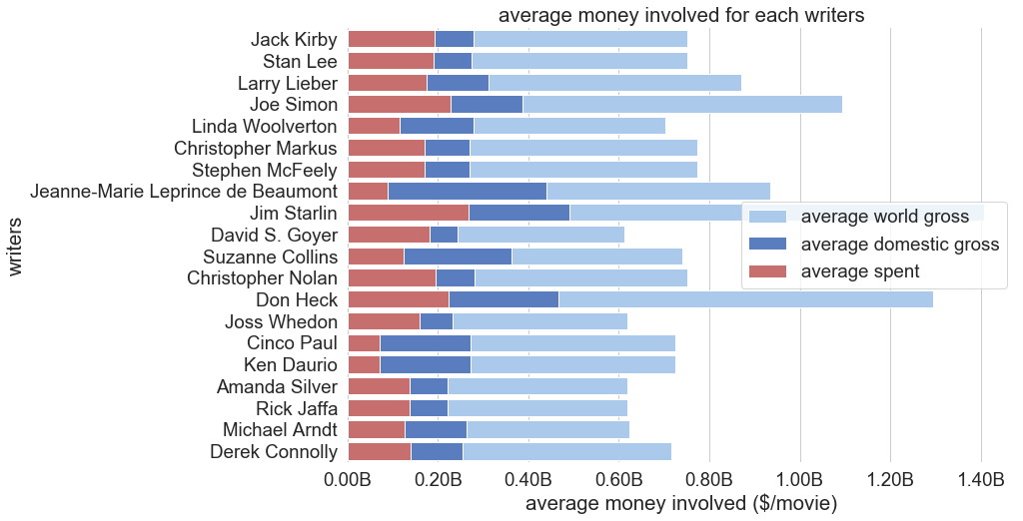
Suggestion

Slide 16
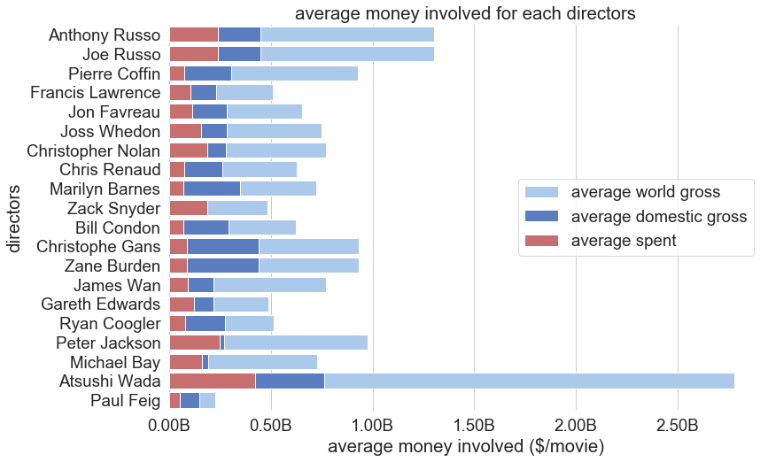

Slide 17
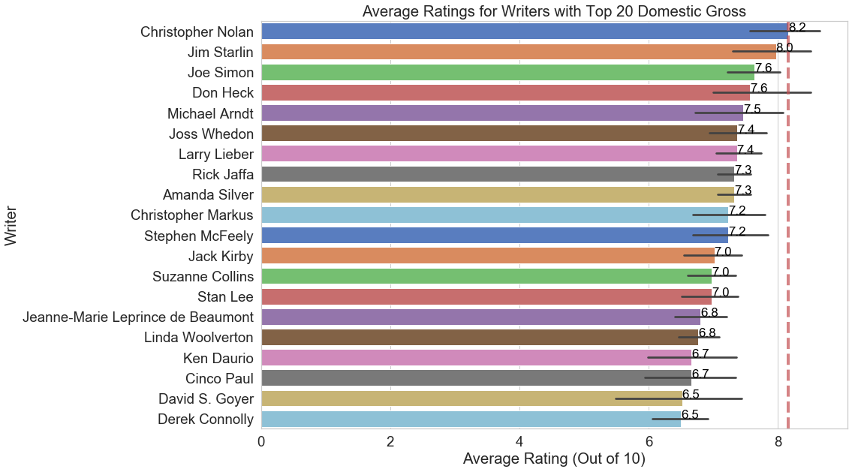

Slide 18
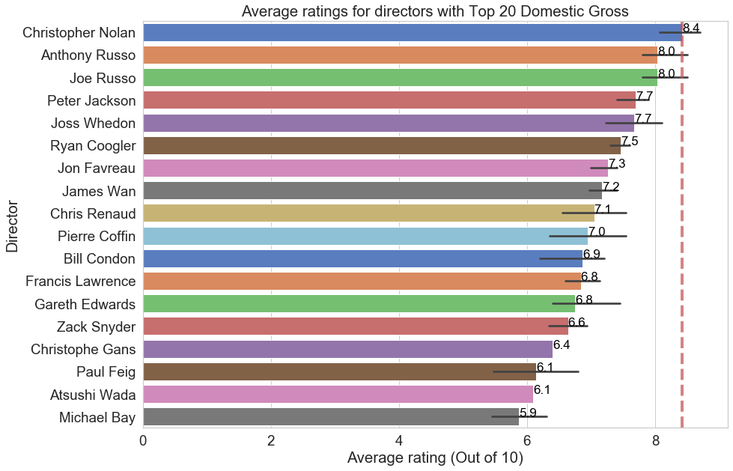

Slide 19
df_movie_gross (bom)
*title
studio
domestic_gross
foreign_gross
year
(3387 x 4)
titleAkas
*title_id
ordering
title
region
language
types
attributes
is_original_title
(331703 x 7)
titleRatings
*tconst
averagerating
numvotes
(73856 x 2)
titleBasics
*tconst
primary_title
original_title
start_year
runtime_minutes
genres
(145144 x 5)
movieBudgets(tn)
*id
release_date
movie
production_budget
domestic_gross
worldwide_gross
(5782 x 5)
titlePrincipals
*title
studio
domestic_gross
foreign_gross
year
(3387 x 4)
nameBasics
*nconst
primary_name
birth_year
primary_profession
known_for_titles
(606648 x 5)
movies (tmdb)
genre_ids
id
original_language
original_title
popularity
release_date
title
vote_average
vote_count
(26517 x 9)
titleCrew
*tconst
directors
writers
(146144 x 2)

