Slide 1
How to hack house prices
Sung Bae

Slide 2
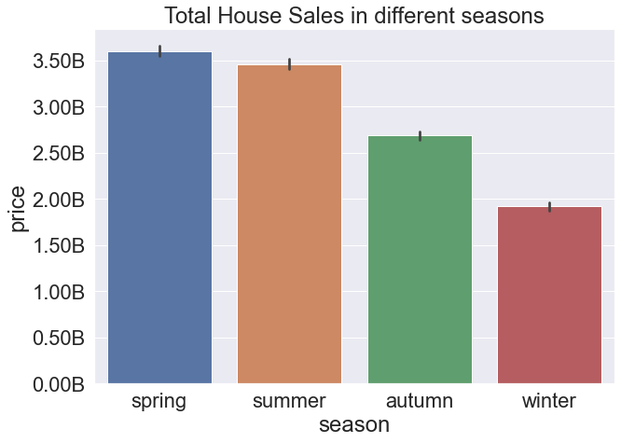
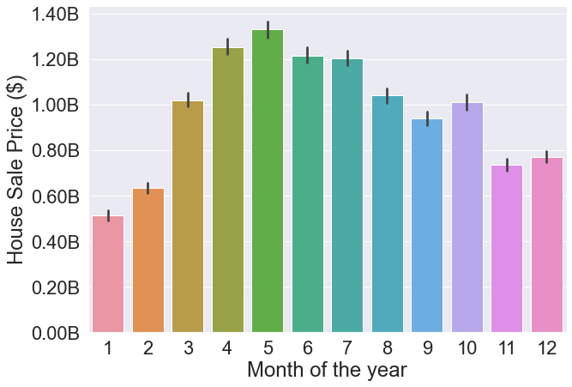
Introduction
House sales market is huge – around billions in each season
There are different factors that could affect house price
Example. Time/seasonal factor

Slide 3
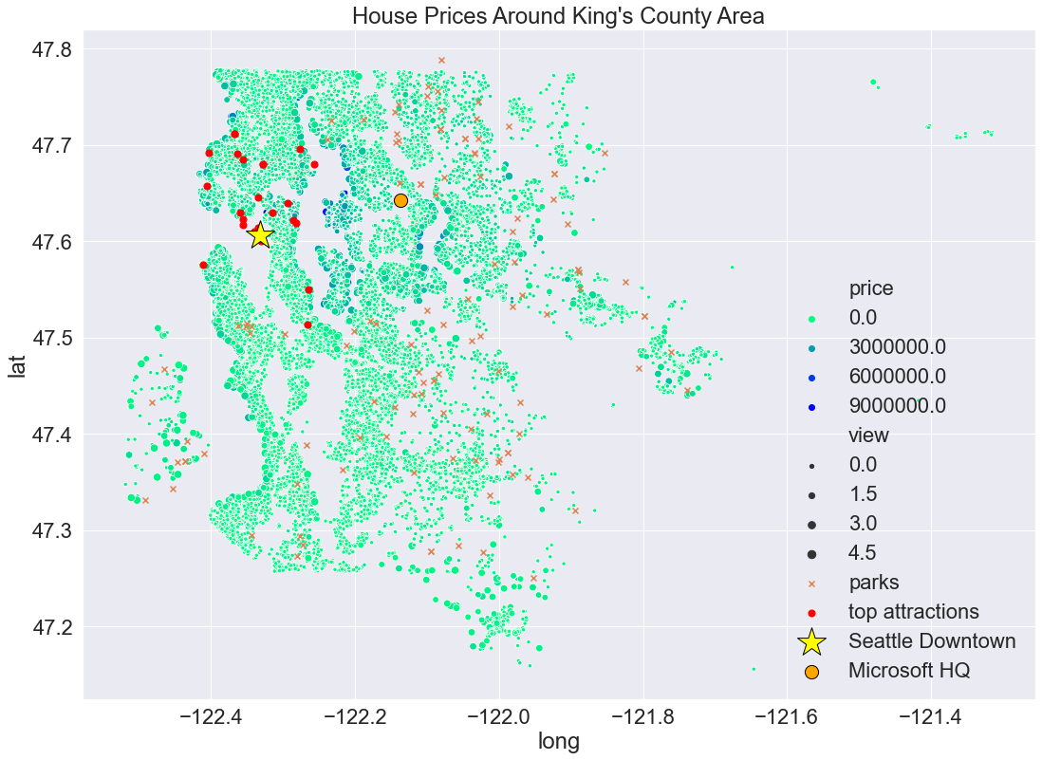
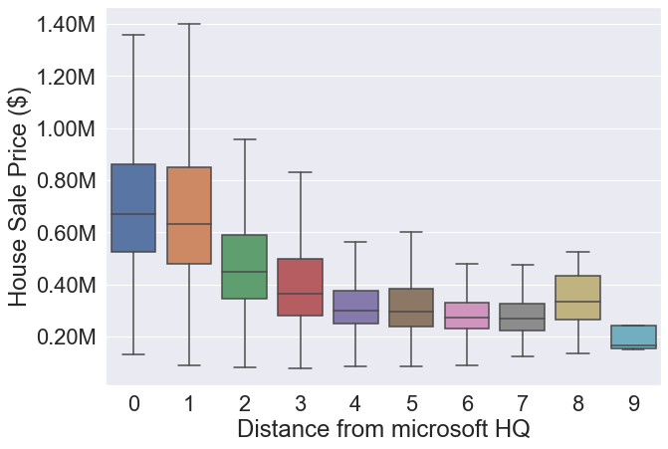
Geographical factor
Higher Prices
Usually clustered
Near water area
Lower Prices
Spread out
Away from the main city

Slide 4
Question 1
What factors affect the house prices the most in most interpretable and reasonable way?

Slide 5
Model Goals
Prioritize interpretability
Have reasonable predictors that can be altered by the owners
May not result in highest accuracy (R²)

Slide 6
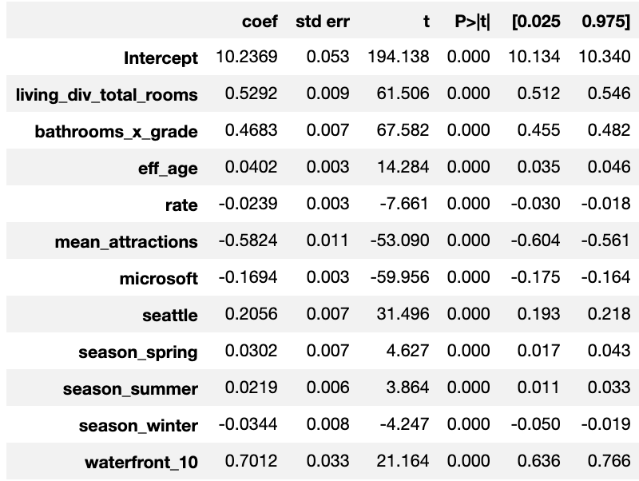
Model Result – Positive Effectors
Major Positive Effectors:
1. waterfront = water scenery matters
2. average room space = more space is better
3. grade x bathroom = having great bathrooms count!
4. Seattle = Further you live from Seattle is better
Minor Positive Effectors:
1. Effective age
2. Selling in Spring
3. Selling in Summer
Predictors

Slide 7
Model Result – Negative Effectors
Major Negative Effectors:
1. mean distance from main attractions = further you live, the value goes down generally
2. distance from Microsoft HQ = further you live, the value goes down generally
Minor Negative Effectors:
1. Mortgage rate – higher rate lowers the house value
2. Selling in winter
Predictors

Slide 8
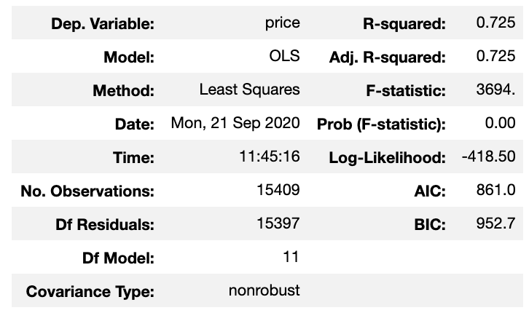
Model Result - Accuracy
R-squared: 0.725
72.5 % of the price can be described by adding in the factors
This model can be used to intuitively understand how house prices are effected by different factors

Slide 9
Question 2
So what can be done to maximize house price by the homeowners?

Slide 10
Actions that can be done:
Increase Living Area
grade x bathrooms
Make some waterfront
second strongest factor
Shows that people love having bigger independent open spaces
Shows how important it is to have great quality bathrooms
Renovating bathrooms can be key to increasing your house value!
The strongest factor
Shows people love nature
construct or install some sort of water fountains or pond that can be seen from the house

Slide 11
Actions that can be done:
Some Serious Renovation!
Increase Living Area
grade x bathrooms
Make some waterfront
second strongest factor
Shows that people love having bigger independent open spaces
Shows how important it is to have great quality bathrooms
Renovating bathrooms can be key to increasing your house value!
The strongest factor
Shows people love nature
construct or install some sort of water fountains or pond that can be seen from the house

Slide 12
Conclusion
Model is limited in accuracy (R² = 0.725)
However it can give us a good idea of what factors we can control and change to change the house price
Actionable changes
Renovate to
Increase open space
Waterfront presence
Better quality bathrooms
What NOT to do
increase number of bathrooms and bedrooms in total
sell in the winter season
sell during high mortgage rate

Slide 13
Future Studies
The following features could be added to increase the accuracy of the model:
school district for elementary, middle and high school rating
average traffic time to major attractions
noise level
flood factors

Slide 14
Thank you for listening

Slide 15
Appendix

Slide 16
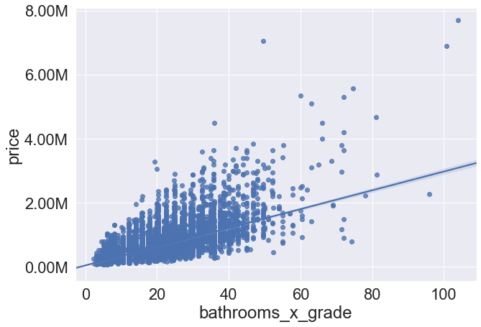
Price vs. Bathroom x grade

Slide 17
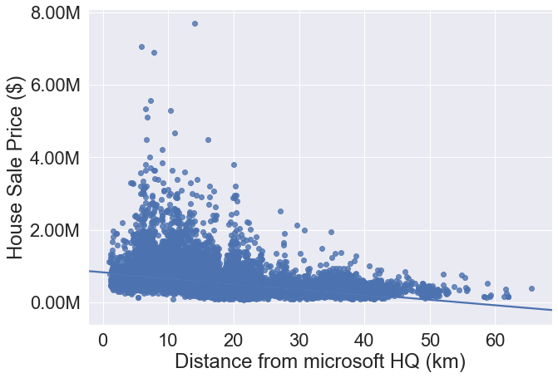
Price vs. Distance from MS HQ

Slide 18
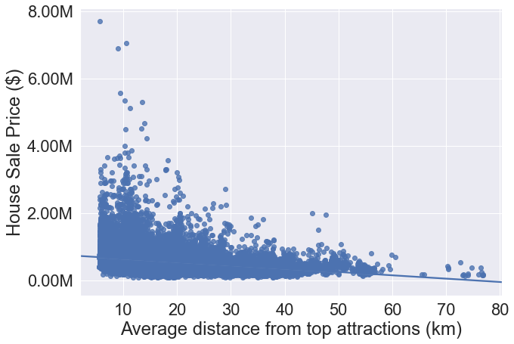
Price vs. Average distance from main attractions

Slide 19
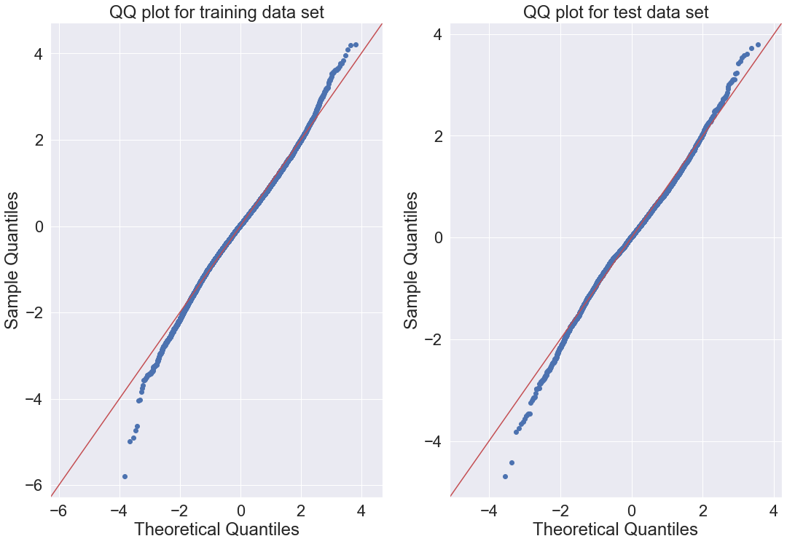

Slide 20
