Slide 1
How well are the wells?
Predicting Tanzanian Water Wells Functionality
Sung Bae

Slide 2

Tanzanian Water Crisis Facts
Importance of water
Source of life
Improve life quality
Increase school attendance
Empowers families
24 million people without basic access to safe water
Numerous organizations have been working to provide safe and accessible water
Notes:
image source: https://unsplash.com/s/photos/water-drop

Slide 3
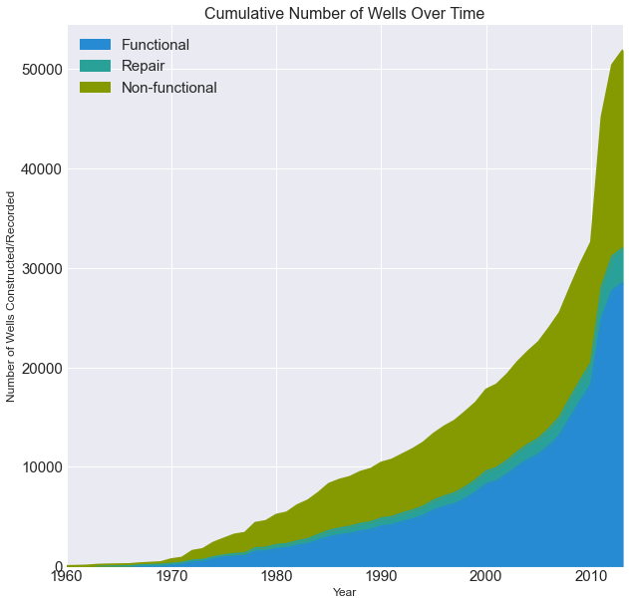
Tanzanian Water Crisis Facts
More than 50,000 water wells are installed by 2013
54.9 % Functional
38.3 % Non-functional
6.8 % Needs repair
Imperative to determine which wells are not functioning or need repairing accurately

Slide 4

Goals and Objectives
Construct a model that can classify
[1] functioning wells,
[2] functioning but need repairing wells, and
[3] non-functioning wells.
Top Priorities
Correctly identify non-functioning and need repairing wells (high recalls)
Overall accuracy
Provide features that affect functionalities of water well
Notes:
image source: https://blog.mellanox.com/2019/05/an-out-of-band-malware-detection-with-mellanox-bluefield/

Slide 5
Modeling Plan
Stacking
(meta classifier)
Higher
Predictive Force
Bagging
Boosting
Strong predictive force
in different areas
Decreases model’s variance
Examples
Random Forest
Extra Trees
Decreases model’s bias
Examples
XGBoost
Adaboost
Gradient Boost

Slide 6
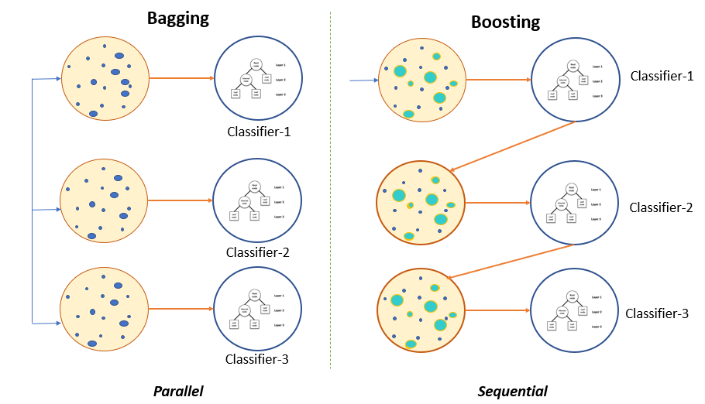
Notes:
source: https://www.pluralsight.com/guides/ensemble-methods:-bagging-versus-boosting

Slide 7
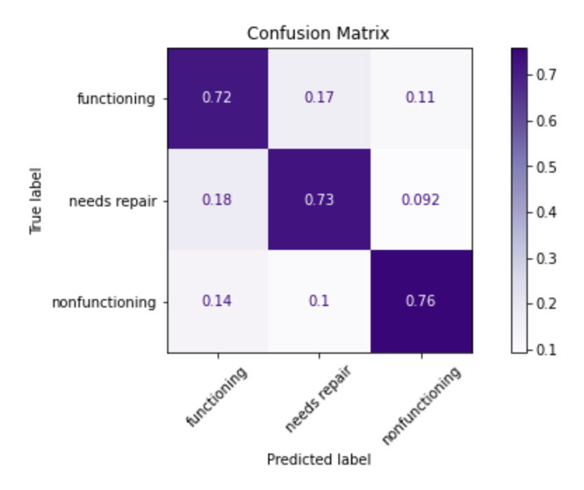
Best Model: Recalls
72% of functioning wells
were correctly identified.
73% of need-repairing wells were correctly identified.
76% of non-functioning wells were correctly identified.
[1] Recall = 73%
[2] Accuracy = 76.6%
[3] Effective Recalls = 72%, 82%, 86%
[5] 1st Layer Models: XGBoost, Random Forest, Extra Trees, KNN; 2nd Layer: Random Forest

Slide 8
Best Model: Effective Recalls
Out of all the well-functioning wells, 28% will be identified as in a need of functioning
- wasteful cost
Out of all the wells that need repairing, 82.2% them would be flagged to be in a need of repairing.
Out of all the wells that are not functioning, 86% them would be flagged to be in a need of repairing.

Slide 9
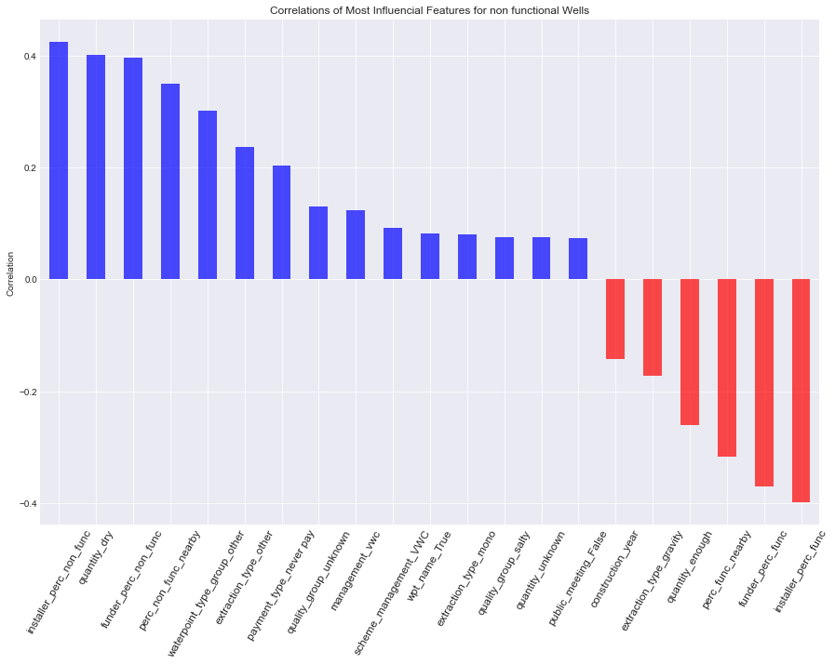
Important Features
Installer
Funder
Neighboring
Water Type
Payment
Management
Extraction type
Waterpoint name
Features to look out for:

Slide 10
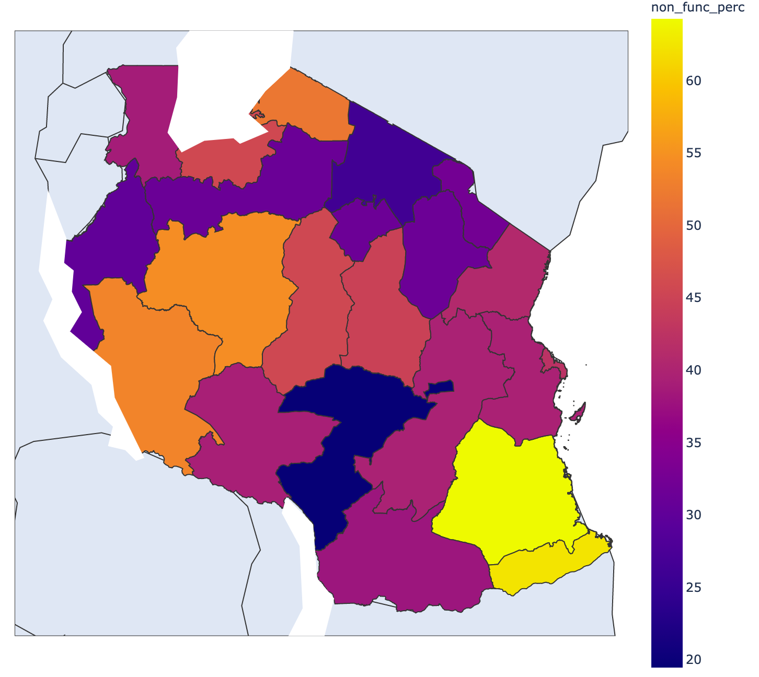
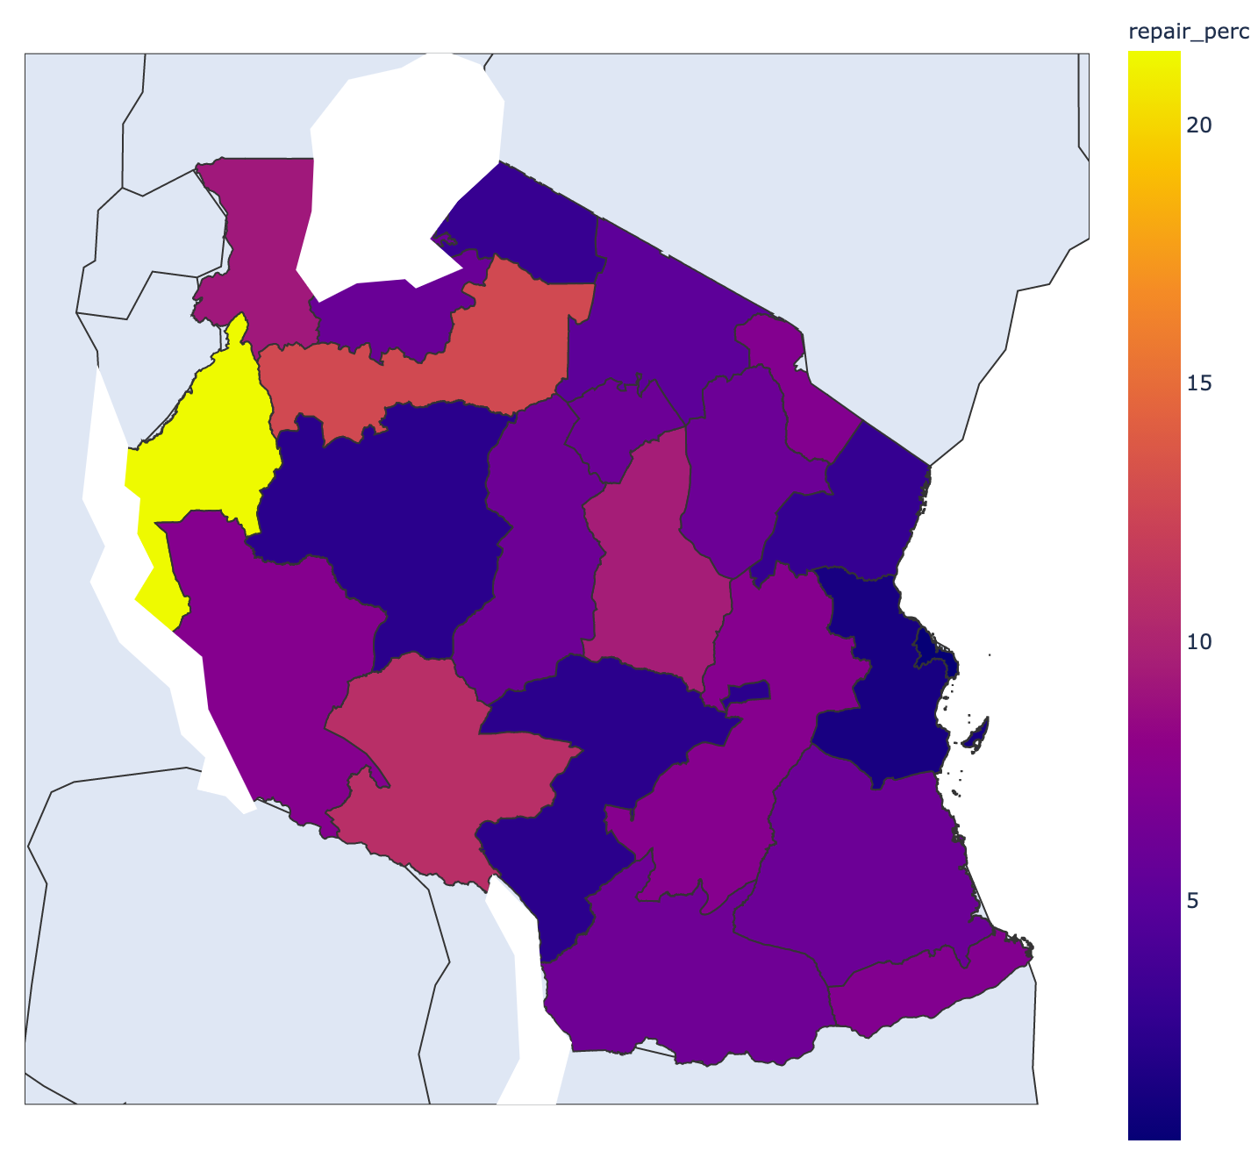
Action 1: Watch out for certain regions!
Regions with most non-functioning wells:
Lindi (64.23%)
Mtwara (62.43%)
Tabora (54.42%)
Regions with most need repairing wells:
Kigoma (21.41%)
Shinyanga (12.75%)
Percent Non-Functioning Wells
Percent Need-Repairing Wells
Region: Lindi
N = 1546
Percentage: 64.23%
Region: Kigoma
N = 2816
Percentage: 21.41 %

Slide 11
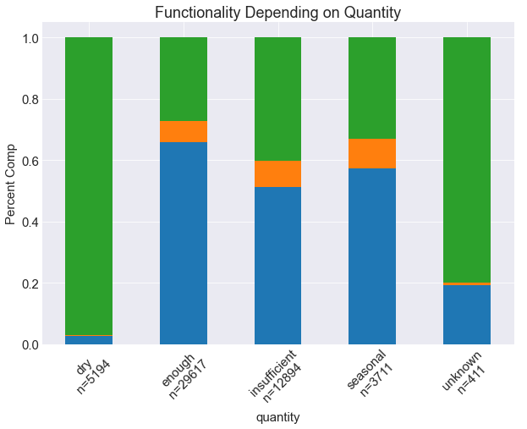
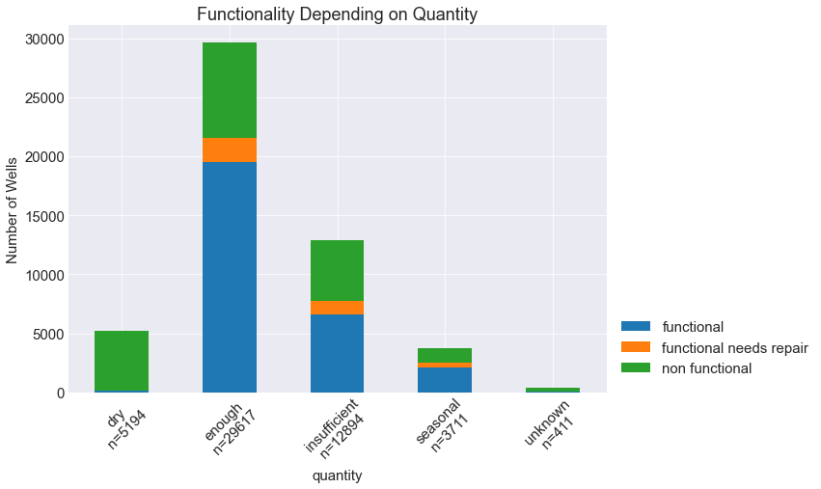
Action 2: Watch out for ”Dry” and “unknown”
More than 90% non-functional wells for ”dry quantity” wells.
More than 80% non-functional wells for ”unknown quantity” wells.

Slide 12
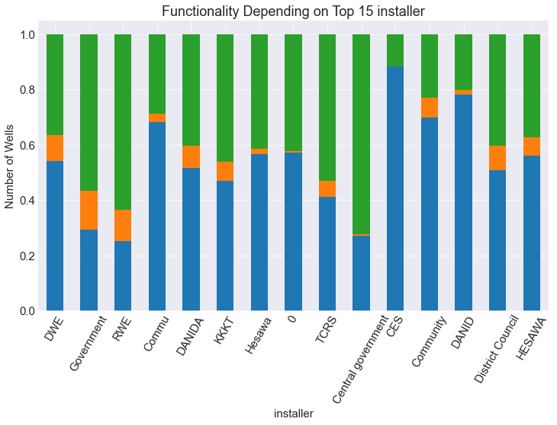
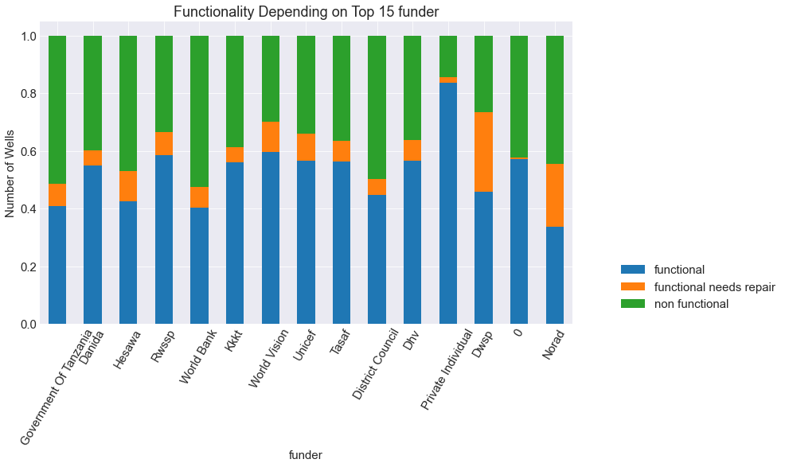
Action 3: Funders and Installers
Watch out for government and RWE installed wells
Watch out for government and Norad funded wells

Slide 13
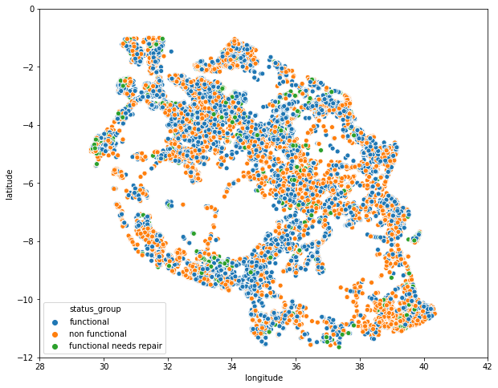
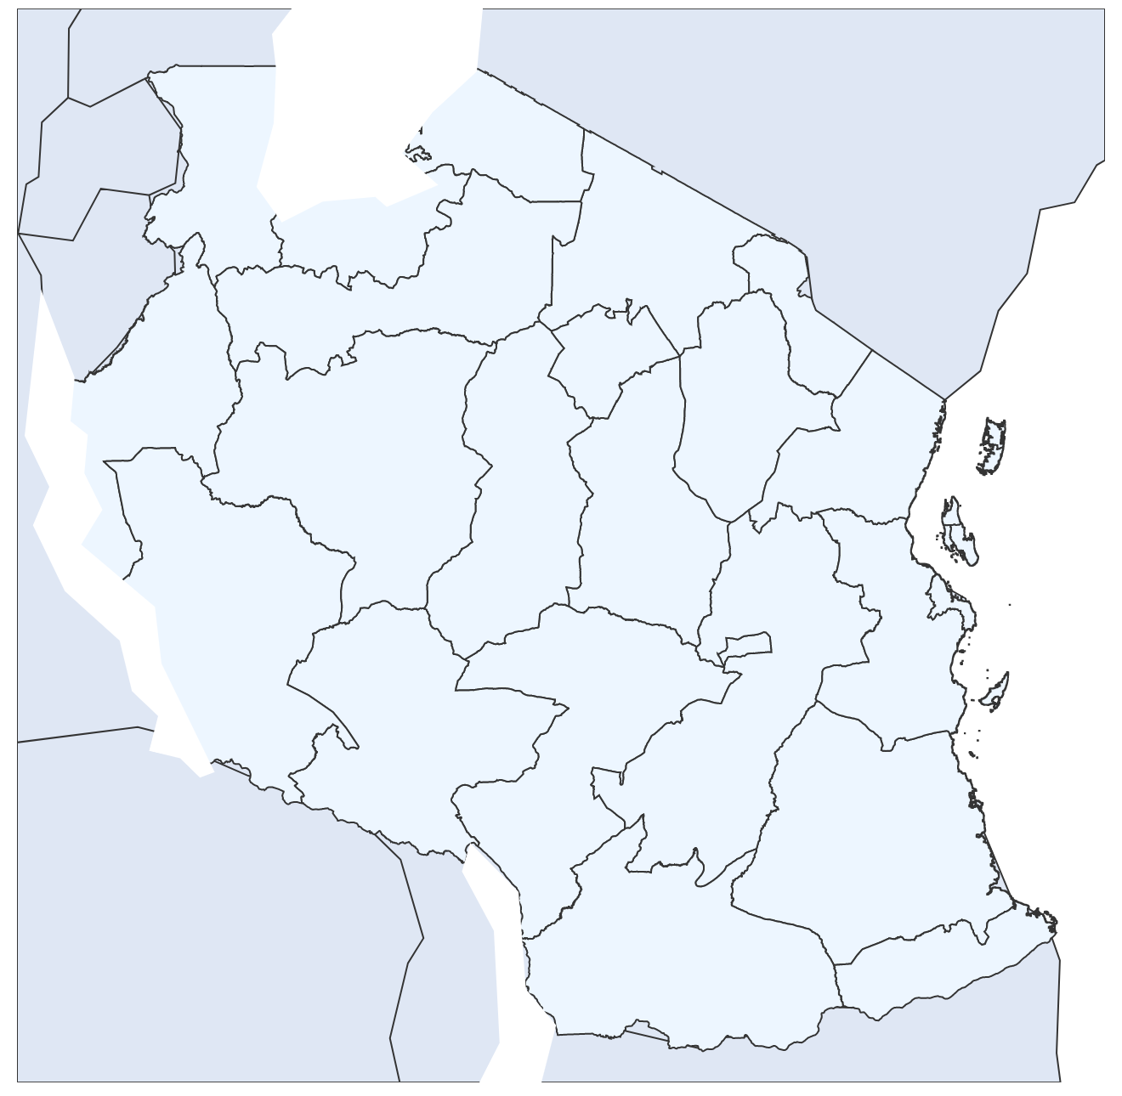
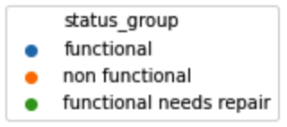
Action 4: Neighboring
Wells that are near wells that in need of maintenance should raise a flag!

Slide 14
Conclusion
Our final models can
Predict with ~80% recall (Random Forest – 4 1st layers)
Features correlated with water wells in need of maintenance
[1] Installer: Government and RWE installers
[2] Water quantity: Dry and unknown quantities
[3] Funder: Government and Norad funders
[4] Extraction type: other than gravity type
[5] Payment: no payment for usage
[6] Management: VWC management
[7] Neighboring: highly dense non-functioning wells area

Slide 15
Future Studies
Further hyperparameter tuning can be done for each model used
Different combinations of ensemble models can be tested
Different methods of dealing with class imbalance can be used
under sampling
different class weights
Cost function for
[1] wrongly identifying functioning wells as need repairing wells and
[2] not being able to identify wells in need of repairing
would improve the model to minimize both economical and sociological cost.

Slide 16
Thank you for listening

Slide 17
Appendix

Slide 18
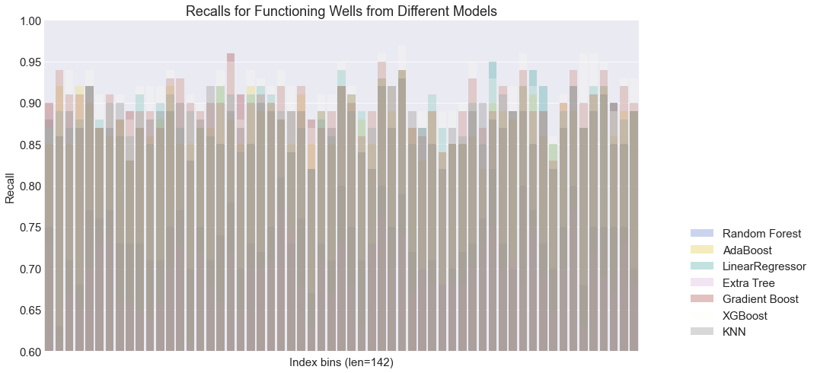

Slide 19
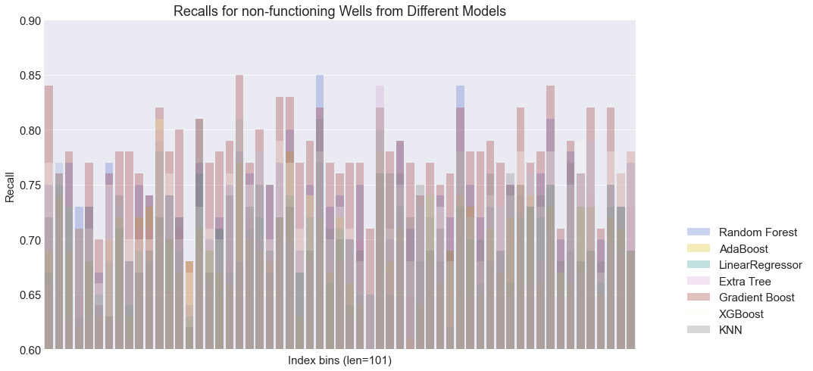

Slide 20
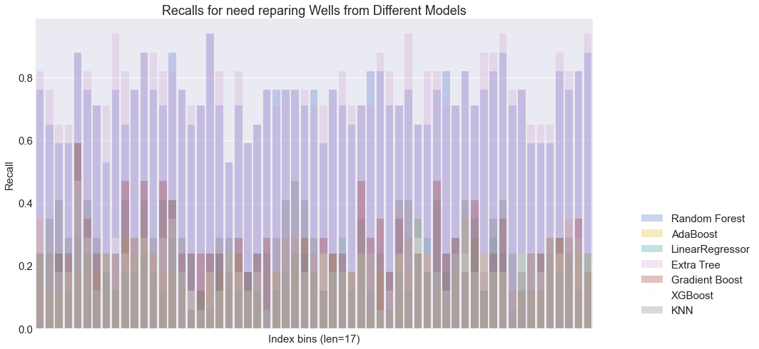

Slide 21
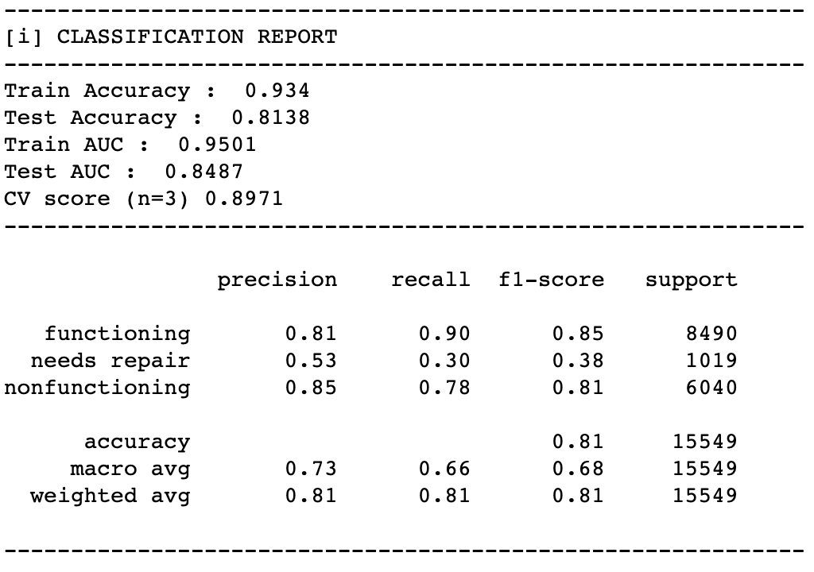
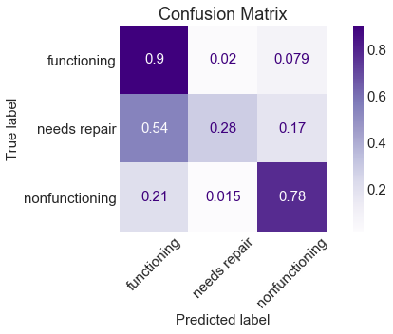
Best Accuracy Model: Adaboost
[1] Possibly overfit
[2] Accuracy = 81%
[3] Test Accuracy = 79%
[4] Low Recall for repair
[5] 1st Layer Models: All the first layer models were used

Slide 22
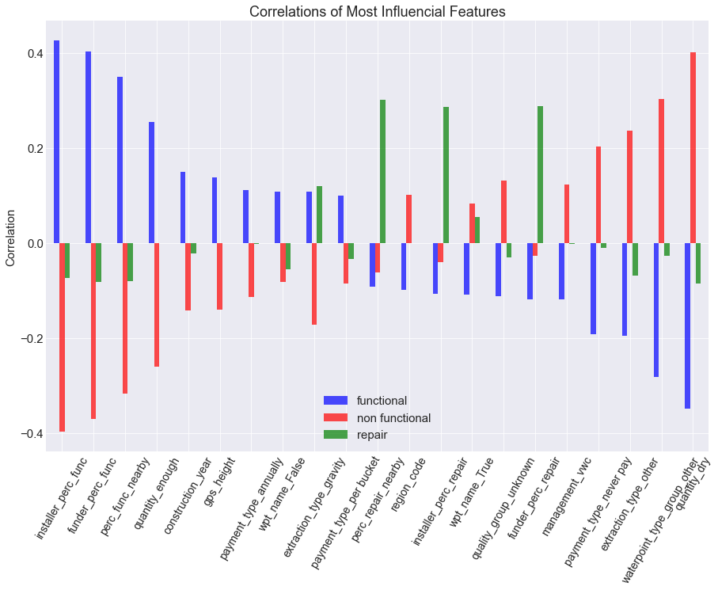
Interpreting the Model
Expected
Functioning and non-functioning have opposite correlation
New Finding
Repair is all over the places which makes the prediction extra tough

Slide 23
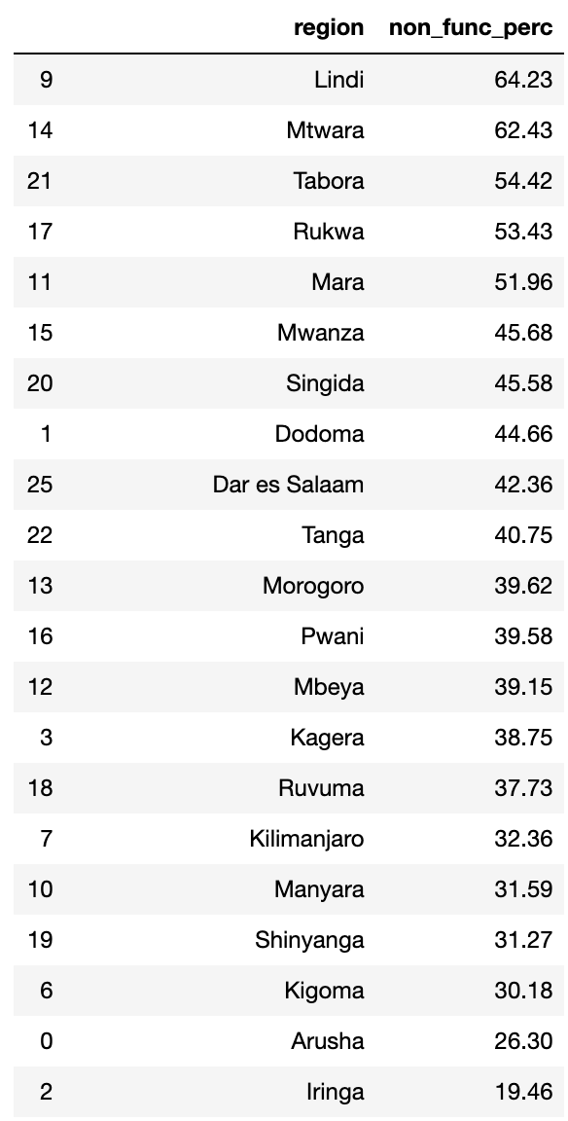
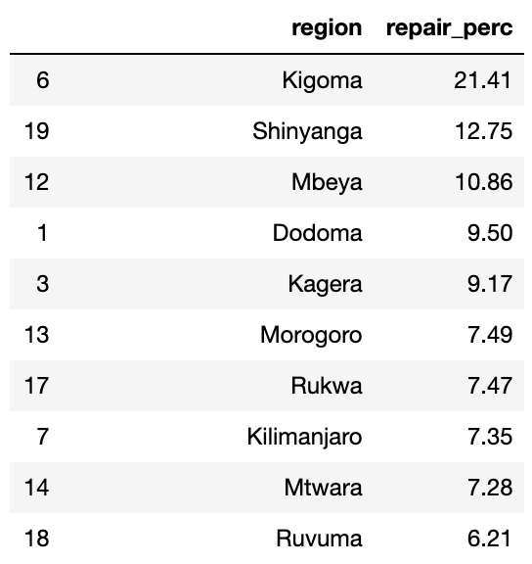
Region Lists for non-functioning and repair

