Slide 1

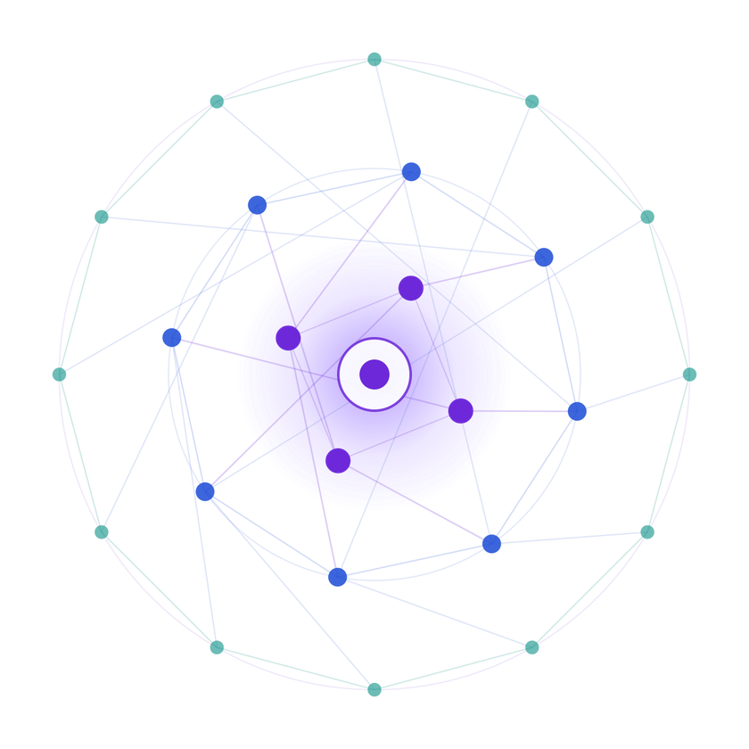
SAMSUNG PRISM
Generative AI
Hackathon
3rd Edition 2026 – 27
  Theme ID - Theme 2
  Team Name - CtrlZ
  College Name - SRM
  Aditya Narayan Pandey - an0815@srmist.edu.in
  Aayush Sinha - as6696@srmist.edu.in
  Sujoy Behera - beherasujoy@gmail.com
  Divjot Singh Uppal - ds0725@srmist.edu.in
  Submission Github link - https://github.com/sinha-aayush/prism-troubleshoot

Slide 2
Theme
Smart Guided Troubleshooting Engine
Problem Statement
Customers often describe device problems in vague, non-technical language, such as:
“Screen flickers and the battery dies fast.”
This creates two major challenges:
  Agents spend time manually interpreting customer complaints and converting them into troubleshooting steps.
  Users still have to navigate through Settings to actually perform the recommended fix.
What We Build
A GenAI-powered troubleshooting engine that:
Understands
→ Converts vague complaints into technical queries
Generates
→ Produces clean, ordered troubleshooting actions
Connects
→ Maps each action to the appropriate Settings deeplink
Accelerates
→ Uses cached, pre-validated answers for <300 ms responses

Slide 3
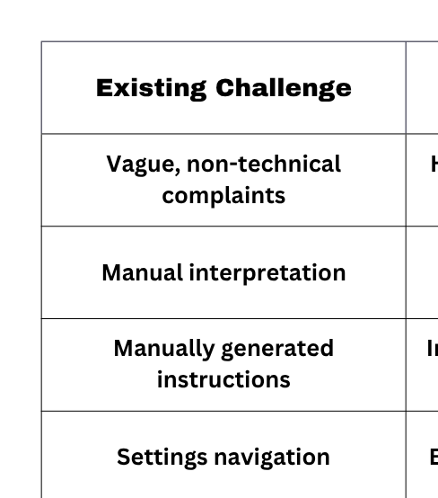
Existing Solutions & Gaps
Existing Approach
key gaps
Customer Complaint
“My phone screen keeps flickering and my battery drains quickly.”
Support Agent
Manually interprets the complaint
Troubleshooting Search
Finds relevant troubleshooting information
Manual Instructions
Converts information into steps for the customer
Customer
Manually searches through Settings to perform the fix

Slide 4
Our Solutions & Architecture Diagram
One-Line description
A 4-stage pipeline that transforms vague customer complaints into structured, actionable troubleshooting plans.
QUERY ENRICHMENT
Vague complaint
↓
Technical query
LLM STRUCTURING
Goal
Actions
Ordered Steps
DEEPLINK MAPPING
Step
↓
Settings Deeplink
FAST PATH CACHE
Pre-Validated Answer
↓
~50 ms response
Rest API
POST /v1/troubleshoot
↓
Structured JSON
↓
Actions + Steps + Deeplinks + Metadata

Slide 5
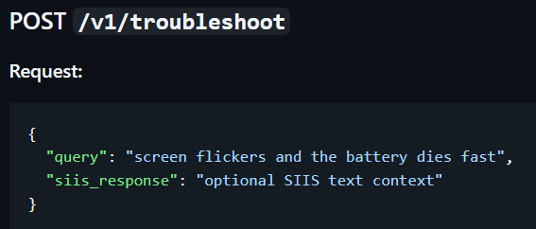
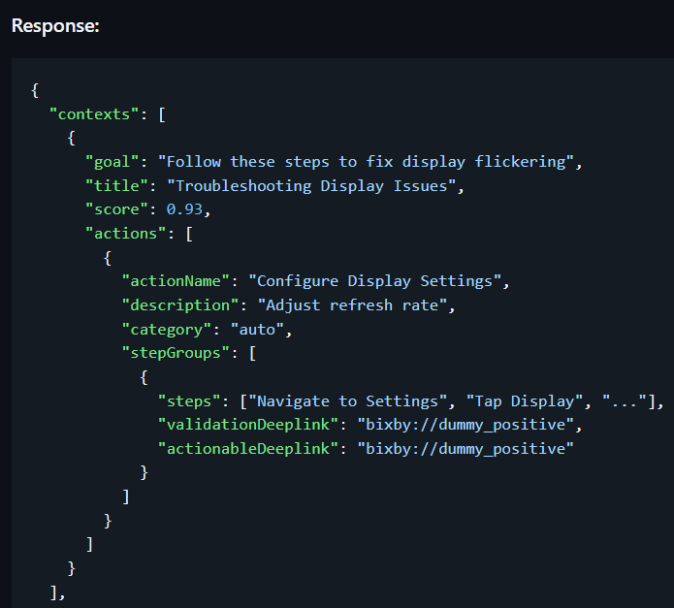
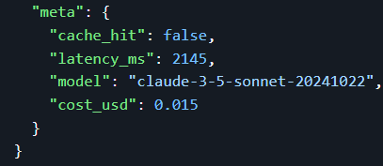
Demo & Product Walkthrough

Slide 6
Tools and tech stack used
Claude 3.5 Sonnet
Query enrichment
Step generation
Python
Core programming language
FastAPI
REST API
Request/response handling
REST + JSON
Structured API communication
In-Memory Cache
Fast-path responses
~50 ms cache hit
Settings Deeplinks
Connect steps to Settings actions
Settings Deeplinks
Connect steps to Settings actions

Slide 7
Impact & Use case
Customer Problem
Vague complaint
“Screen flickers and battery dies fast”
PRISM
Understands + structures + maps
  Technical query enrichment
  Ordered troubleshooting steps
  Settings deeplink resolution
User Outcome
One-tap troubleshooting
  Clear action path
  No Settings hunting
  Structured JSON response
15 min
Manual agent effort
10K+
Production-scale scenario target
<300 ms
Fast-path response target

Slide 8
Innovation highlights, results and limitations
Innovation
Results
Limitations
Query Enrichment
Vague complaint → technical query
Two-Stage LLM
Intent → ordered troubleshooting steps
Deeplink Mapping
Every step → exact Settings action
Fast-Path Cache
Pre-validated answers → instant response
~85%
STEP ACCURACY
50 ms
CACHE HIT
2–3 s
COLD QUERY
100%
SCHEMA COMPLIANCE
$0.015
COST / QUERY
  Exact-match cache in current prototype
  In-memory cache instead of persistent Redis
  Deeplink catalog requires expansion
  Limited validation dataset
  Single-language support

Slide 9
What’s next
STAGE 1 — PROTOTYPE
CURRENT
  FastAPI REST API
  Claude-powered reasoning
  Structured JSON
  In-memory cache
  Settings deeplinks
STAGE 2 — SMARTER CACHE
NEXT
  Semantic similarity matching
  Detect paraphrased complaints
  Redis persistent cache
  Better cache coverage
STAGE 4 — CONTINUOUS IMPROVEMENT
IMPACT
  Track troubleshooting success
  User feedback
  Step-level validation
  Latency & cost analytics
  Continuous refinement
STAGE 3 — PRODUCTION SCALE
SCALE
  Expand to 10K+ scenarios
  Larger deeplink catalog
  Multi-device support
  Multi-language support
  Persistent infrastructure

Slide 10
WHY PRISM STANDS OUT
01 — AI THAT UNDERSTANDS
  Vague complaint → Technical intent
  Instead of requiring users to know technical terminology, the engine enriches the raw complaint before generating the troubleshooting flow.
S02 — ACTIONABLE, NOT JUST CONVERSATIONAL
  Step → Settings deeplink
  The output doesn't stop at:
“Go to Display Settings.”
  It provides the associated deeplink so the user can directly reach the relevant action.
03 — SPEED BY DESIGN
  LLM for intelligence + cache for speed
  Frequently repeated/pre-validated scenarios can bypass expensive LLM processing.
  Target: <300 ms
  Prototype: ~50 ms cache hit
04 — BUILT FOR SCALE
  Reusable mapping architecture
  The same mapping approach is designed to expand toward:
  10K+ troubleshooting scenarios
  without hardcoding a completely separate workflow for every complaint.

Slide 11
Checklist- Updated on Public GitHub
✓ PUBLIC GITHUB REPOSITORY
Working prototype code - https://github.com/sinha-aayush/prism-troubleshoot
─────────────────────────────
✓ REPRODUCIBLE README
Setup • API • Docker • Testing
─────────────────────────────
DEMO VIDEO
YouTube - https://youtu.be/Nm0PtH_SBFQ
─────────────────────────────
✓ PRESENTATION FILE
PPT / PDF

Slide 12
Thank you

