Slide 1
Facial Keypoints Detection with k-NN and Convolutional Neural Nets

Slide 2
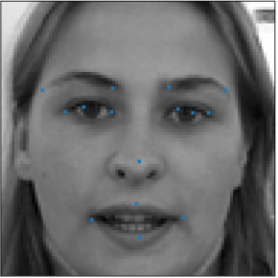
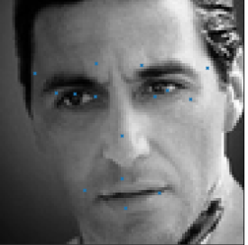
The problem
Identify specific points on an image of a face (“left_eye_center” , mouth_center_bottom_lip”) - 15 total
We tried kNN and convolutional neural nets (CNN)
Notes:
Scott
The problem is to identify specific features in an image of a face. Example features include the center of either eye, the outer end of an eyebrow, the tip of the nose, or the center of the bottom lip. There are 15 points total.
Every image in the training data contains at least some accompanying labels, but not every image has every feature labeled. Only 4 of the 15 points have ~ 7000 examples, while the remaining 11 have ~ 2000. which limits the size of the training data for some labels.
We tried to address the problem with k-nearest neighbor models as well as convolutional neural networks. Before all was done, we had worked with scikit-learn, Theano, Lasagne, and TensorFlow.

Slide 3
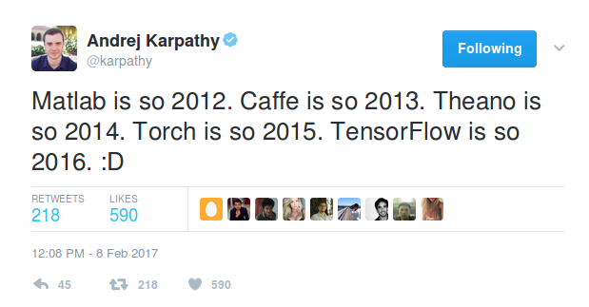
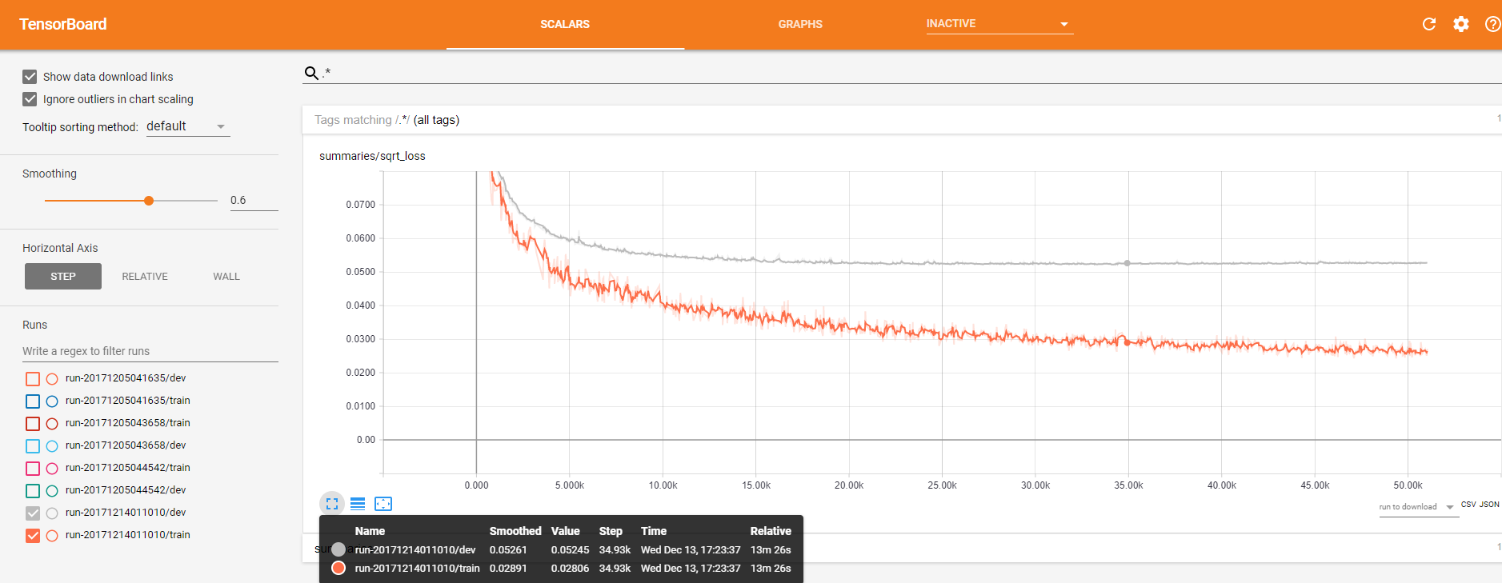
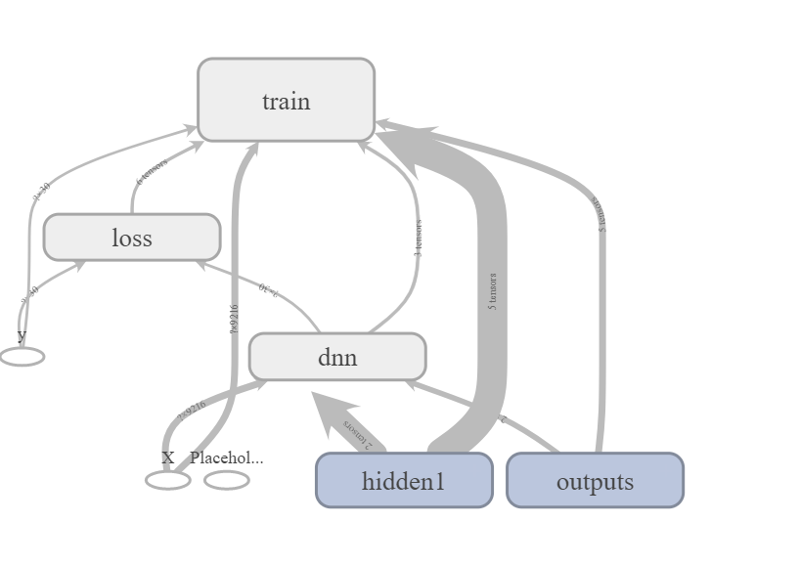
Getting up and running
ML Library Soup: Theano, Lasagne, TensorFlow, Keras, TF-slim, endless sets of tutorials
Run a simple model first (simple != neural net)
Training speed is a problem, only partly solved by GPUs
Tensorboard is very useful for visualizing training progress, not as good for presentation graphics
Notes:
Scott
One of the first challenges is that there is lots of information out there on neural nets, and there are lots of technologies. It’s hard to know which tutorial to spend time with and which library to work in.. We chose TensorFlow as our base after working through some tutorials in Theano and Lasagne, then learning that Theano wouldn’t be supported much in the future. And of course TensorFlow has its own (steep) learning curve.
As to GPU lessons:
You need an nVidia GPU
Don’t try to get an AWS EC2 GPU service level increase last minute (especially not on a weekend)
Don’t try to get an AWS EC2 GPU service level increase above 1 turned around quickly
GPU parallelization is a challenge: Running TF on multiple GPUs requires constructing model “in a multi-tower fashion where each tower is assigned to a different GPU” [4]
You have to configure TensorFlow properly to work with the GPU -- may need to pip install tensorflow-gpu in addition to or instead of tensorflow.
Tensorboard is a useful add-on that interfaces with TensorFlow logs.
Now I”ll hand to Kathleen to discuss the models we tried.

Slide 4
Models Overview
Benchmark Model: K- nearest neighbor
Net 1 - Simple neural network
Net 2 - Convolutional single neural network
Data Augmentation (flipping the images)
Implementing momentum increase and learning rate decay
Experiment with activation functions, drop out, filter sizes and etc.
Net 3 - Combination of individual convolutional models
Built 6 different networks for 6 subsets of the 30 keypoints
Initialize weights with weights from net 2
Notes:
It is a great learning experience. Here I will share two main lessons I learned through this project.
#1 lesson learned: Collaborating with fellow data scientists can be more difficult than it seems. Everyone has different opinions and different ways of approaching the problem, even the way we structure our codes are significantly different. So it took considerable effort just to standardize our codes so we can put everything into one notebook. It’s probably a good practise to plan the whole project out as a group first before launching into individual work. For example, We did not decide on things such as setting random seed until much later. As a result, we were unable to compare our dev data result meaningfully because each of us have a different dev data set.
That being said, this awesome team achieved quite a lot in the past couple of months. Here I will briefly mention the types of models we experimented and Arunima and Anamika will go into further details
Our base model is simple k nearest neighbor regression. Note we are predicting key points, not classifying. Our main focus was on neural networks. Our first model is a single simple neural net with 1-2 hidden layers. Next, we looked into convolutional neural net, but still use one single model to predict all 30 keypoints. We experimented with data augmentation, momentum, learning rate and etc. Last but not least, we experimented with building individual models for different key points, and initializing weights using trained weights from net 2.

Slide 5
Benchmark - KNN regression
For the benchmark model, k-nearest neighbor is chosen:
Produces great out-of-the-box results
Simple model
Runtime
Regression instead of classification
Individual models instead of multivariate knn
Other alternatives
Notes:
That leads to my second lesson learned.
simple algorithms are not necessarily bad. Given the time and effort to construct Convolutional NN, we might have made mistakes along the way. If the goal is to get the best accuracy at all cost, then neural nets give you more possible ways to tune the model. However, if the goal is to have a good enough prediction given the time constraint, simpler models like KNN should be seriously considered.
For the benchmark model, k-nearest neighbor is chosen because: 1) it Produces great out-of-the-box results for image related problems 2) it is a simple model with few hyper parameter to tune
3) its Runtime is long, but the run time pales in comparison to convoluted neural nets
Please note again that we used Regression instead of classification. And we used a combination of 30 simple individual models instead of multivariate knn - which we haven’t spent time figuring out how to do in sklearn. We thought about logistic regression but Couldn’t figure out how to do a regression instead of classification through sklearn

Slide 6
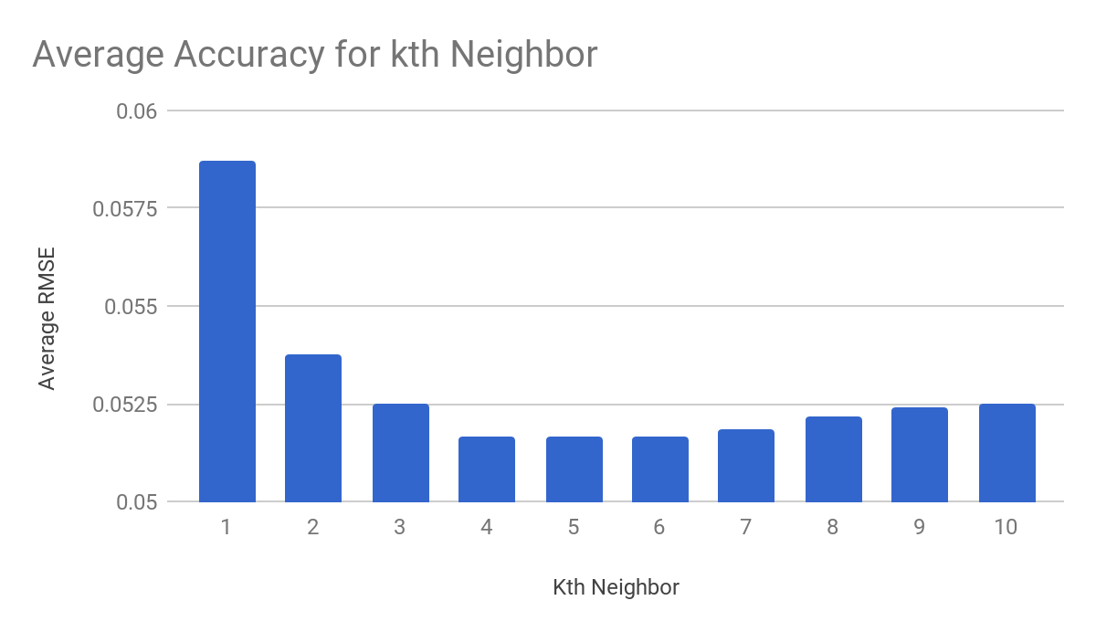
KNN regression - k
For each of the 30 keypoints, 10 KNN models were run
The average RMSE of the 30 keypoints for each k is used to select the optimum k
Average RMSE is the lowest at k = 5
Notes:
Here are the results for KNN. The only hyper parameter tuned was‘k’. Here, it seems that using 5 neighbors gives the lowest root mean square error

Slide 7
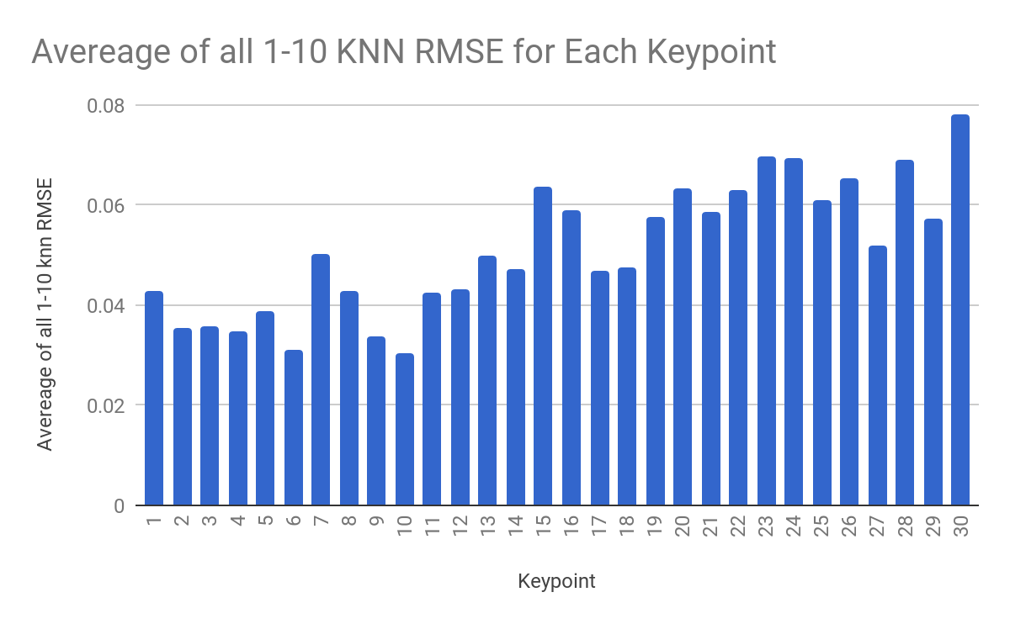
KNN regression - key point
Eye related points
Eyebrow related
Nose related
Mouth related
Certain key points have lower accuracy than others
Mouth related key points seem particularly difficult for our model to predict
Notes:
From the knn models, we can see that not all keypoints are created equal. Certain key points have lower accuracy than others. In particular, the mouth related keypoints seem very difficult to predict. If we had more time, we could experiement with some error analysis and maybe add more features to boost the accuracy for those keypoints. You will see similar issue in our net 3.
Next, I will hand off to Arunima to talk about exiciting neural net development.

Slide 8
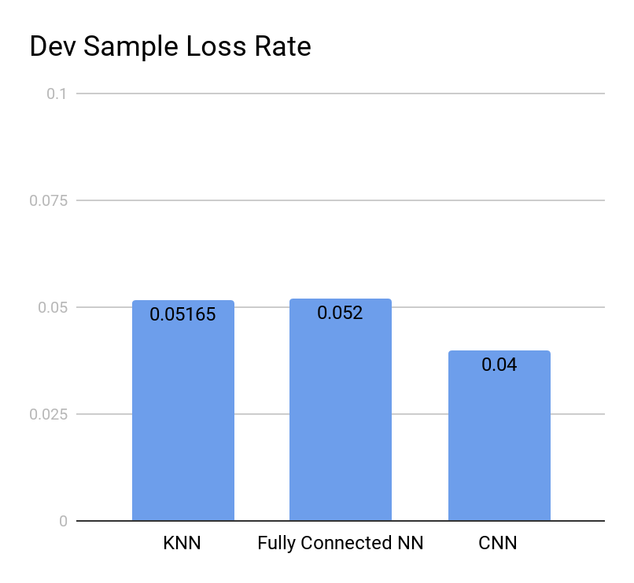
Overall, CNN did better than KNN, but fully connected NN was comparable to KNN
Notes:
Once we established the baseline with KNN, we tried to predict using a simple fully connected neural network, and a Convolutional Neural Network. The simple network performed similar to KNN, but the CNN did substantially better.

Slide 9
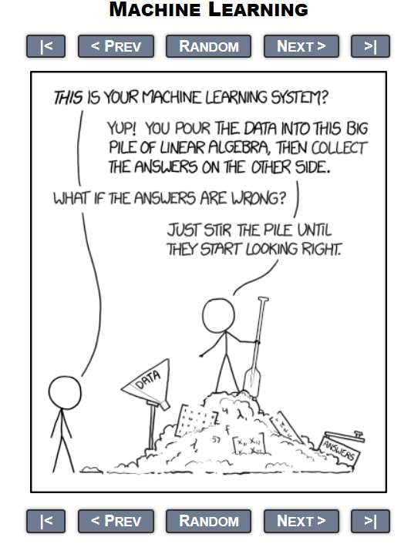
We experimented with tuning several hyperparameters in the simple and convolutional neural network
Number of layers : 1 vs 2 hidden layers in the fully connected neural network.
Data Pre-processing - maximizing range of data, gaussian blur, taking out the mean image
Data Augmentation by horizontally flipping the images
Filter sizes for the 3 convolutional layers
Learning rate - single rate, learning rate decay with momentum increase.
Activation Functions - Relu, Leaky relu
Notes:
We then tried tuning several parameters in the simple and Convolutional neural network … will mostly read from the slide from here.

Slide 10
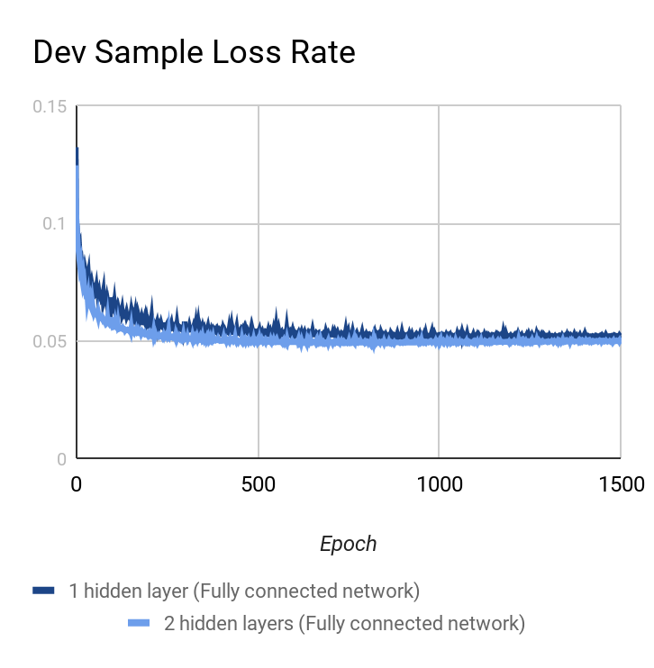
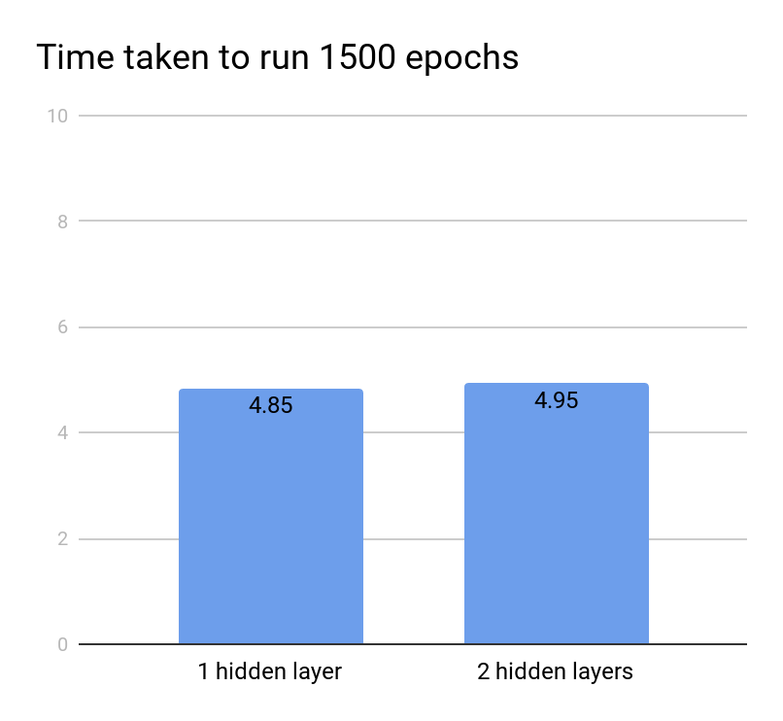
Adding a second hidden layer marginally improved accuracy for the fully connected network accuracy
Notes:
Adding a second hidden layer in the fully connected neural network improved accuracy only marginally.

Slide 11
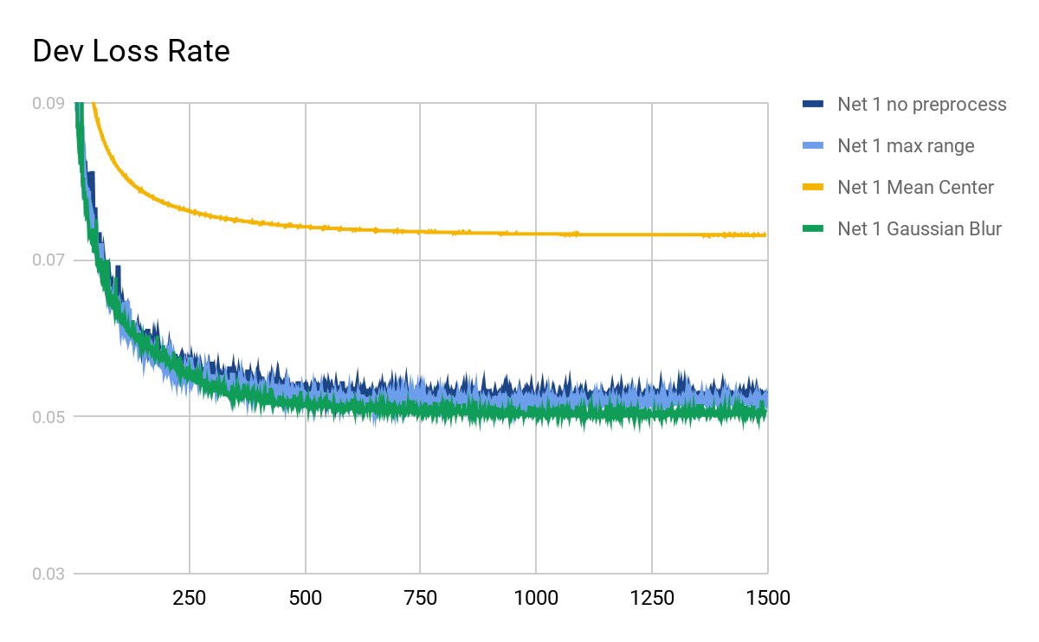
Image pre-processing : Adding a Gaussian Blur led to a marginal improvement in accuracy
Notes:
We tried a few different ways to pre-process the image. Only the Gaussian Blur led to some increased accuracy.

Slide 12
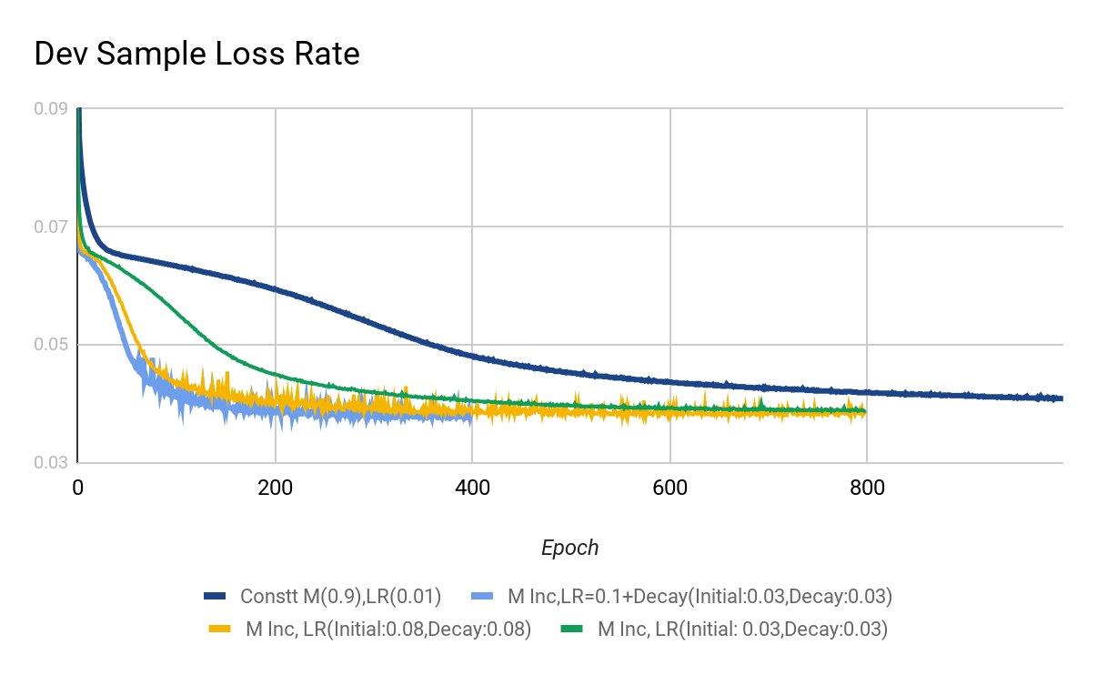
Changing learning rate and momentum can lead to faster convergence
Momentum: Linear increase between 0.9 and 0.99.
Learning Rate: Exponential decay :Decayed_learning_rate = Initial learning_rate * decay_rate ^ (current_epoch / n_epochs)
Notes:
Changing the learning rate and momentum led to out most significant results. We used momentum based optimization and initially had a flat learning rate of 0.01, and momentum of 0.9. We also tried increasing the momentum from 0.9 to 0.99, and expoentially decaying the learning rate from a higher learning rate than 0.01 to a smaller value in the range of 0.0003. We found that certain values of these parameters led to faster convergence. This can be very useful when optimizing, as faster convergence enables testing more values of the other parameters.

Slide 13
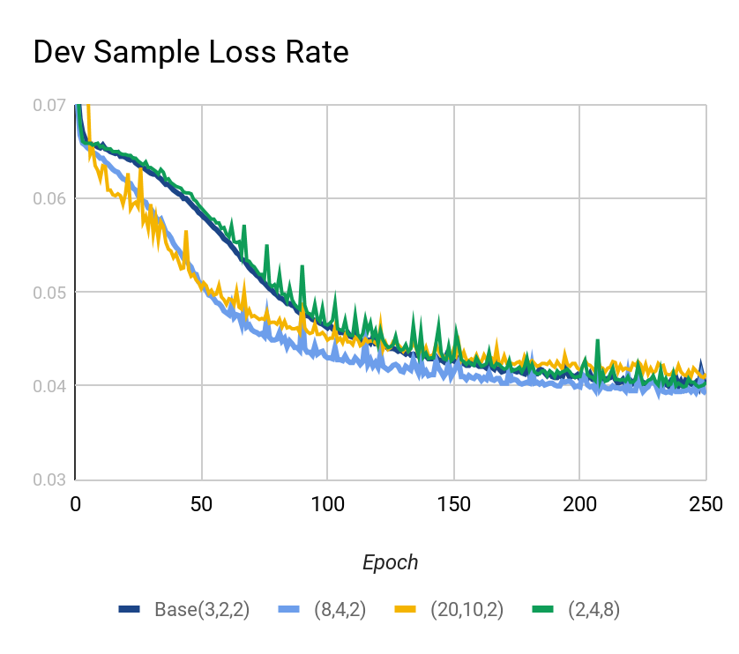
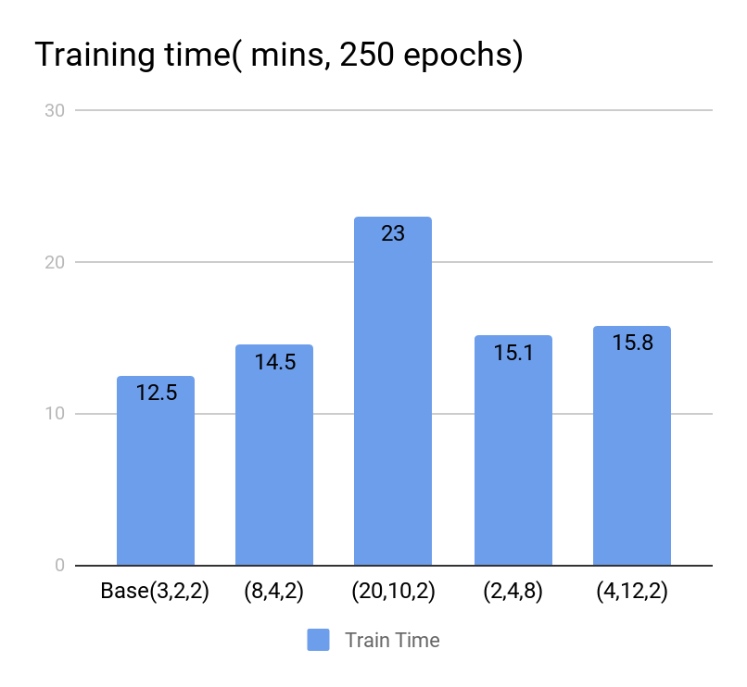
Changing CNN layer filter sizes had surprisingly little effect on accuracy
Notes:
We tried varying the filter size in the 3 Convolutional Layers. Our initial values were 3X3, 2X2, and 2X2. We did not see a material or consistent improvement in accuracy with changing filter sizes in the range we tried, but did see some higher training times.

Slide 14
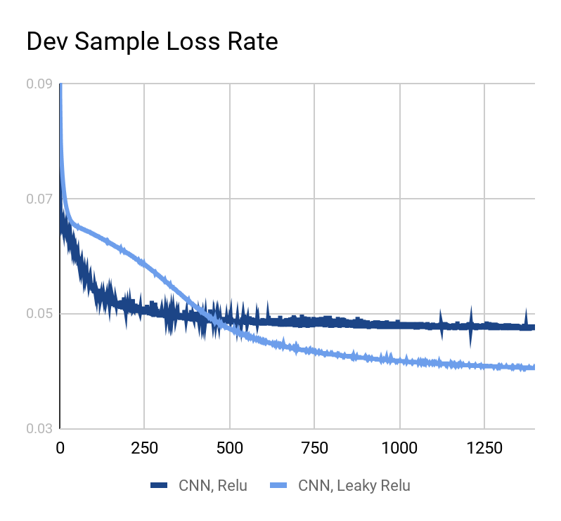
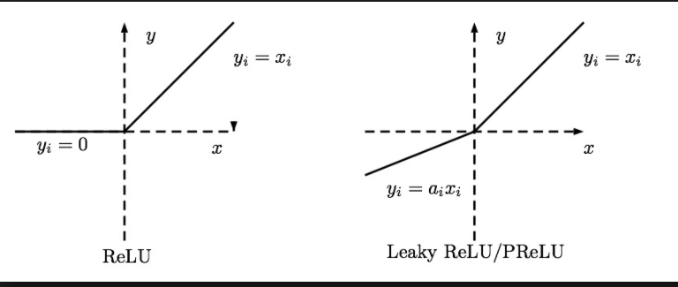
Leaky Relu had better performance than Relu
Notes:
Lastly, we tried to vary the activation function. The Relu function can lead to some dead neurons once it gets close to 0. Leaky Relu corrects for this by having a small slope in the negative region. We did see better performance with Leaky Relu

Slide 15
Key takeaways from tuning Net 1 and Net 2
The potential combinations of hyper-parameters is very large making it challenging to find the optimal.
Picking a good learning rate and momentum option early can help get to convergence faster, enabling more iterations for tuning the other parameters.
Some things that made a difference in accuracy : Leaky Relu, Gaussian Blur.
Some things that did not make a material difference to accuracy within the range tried : Adding more layers, increasing filter size of CNN layers
Several other hyperparameters can be tried : Number of neurons in fully connected layers of CNN, number of CNN layers etc.
Notes:
Overall, from tuning net 1 and 2, we learnt that .. will mostly read from the slide from here ..
And now I will hand it over to Anamika to talk about our most complicated model.

Slide 16
Net3 - Individual Facial Models
Why Six Individual models?
Keypoints | #Rows | Keypoints | #Rows
Mouth_corner_top(3) | 2270 | Eye_center(2) | 7036
Mouth_bottom(1) | 7016 | Eyebrow(4) | 2225
Nose_tip(1) | 7049 | Eye_corners(4) | 2268

Slide 17
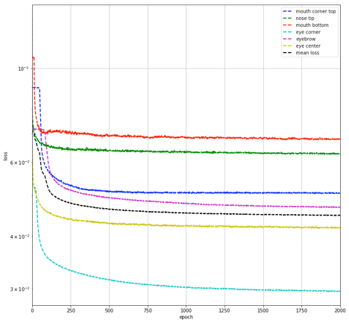
Comparing Dev loss of Individual models

Slide 18
Lessons Learned from Net 3
Weight Initialization from another model
Increasing the number of epochs does not help if we increase the learning rate
Early stopping could be helpful.
Notes:
Ensure that the number of tensorflow variables match in the two model other than keepig the CNN architecture constant.

Slide 19
Kaggle submission
Net | Kaggle Score | Rank
Basic Convolutional Network(Net2) | 3.383 | 80th
Individual models(Net3) | 2.595 | 53rd

Slide 20
Conclusion
Revisiting Key lessons learned
Figuring out the right library and setting up the environment in AWS takes time. As newbies, we learnt by experimenting.
It takes more effort to write code that teammates can reuse.
Tensorflow is easy in terms of installation but has a complex set of features and capabilities which we did not not have time to explore fully.
Pick a good learning rate early on.
Hyperparameter tuning - We tried a lot of combinations. There are still many more to experiment with….

Slide 21
References
Using convolutional neural nets to detect facial keypoints tutorial. Daniel Nouri. December 17, 2014 (retrieved on December 13, 2017). http://danielnouri.org/notes/2014/12/17/using-convolutional-neural-nets-to-detect-facial-keypoints-tutorial/
Detecting facial keypoints with TensorFlow. Alex Staravoitau. January 8, 2017 (retrieved on December 13, 2017). https://navoshta.com/facial-with-tensorflow/
Hands-On Machine Learning with Scikit-Learn and TensorFlow. Aurélien Géron. O’Reilly Media. March 2017.
https://www.tensorflow.org

Slide 22
Easter egg
Go to the TF CNN tutorial at https://www.tensorflow.org/tutorials/deep_cnn and click the link that says “Congratulations” at the bottom
Then hate me for sharing that.

Slide 23
BackUp

Slide 24
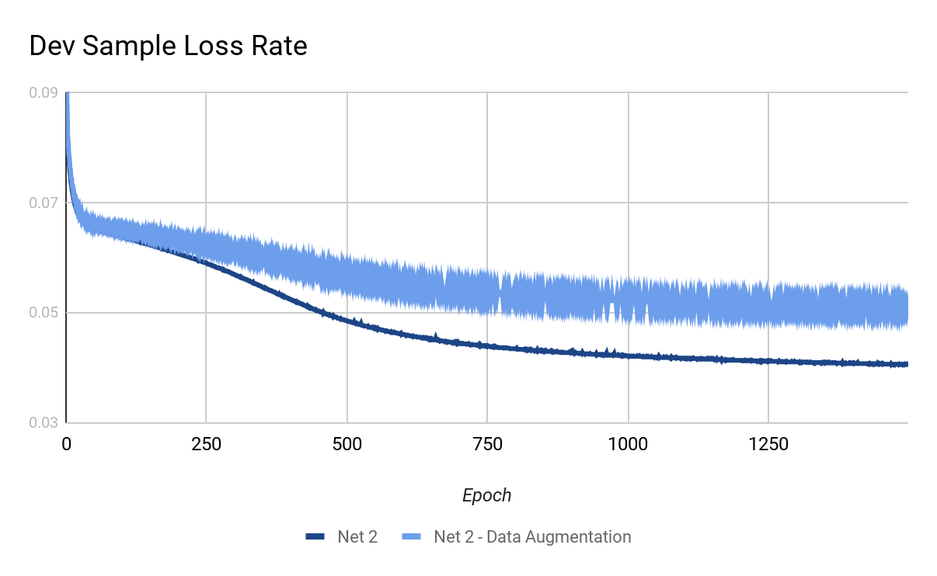
Data augmentation by horizontally flipping the images did not lead to improved accuracy. May need to tune other hyperparameters to get a better outcome.

Slide 25
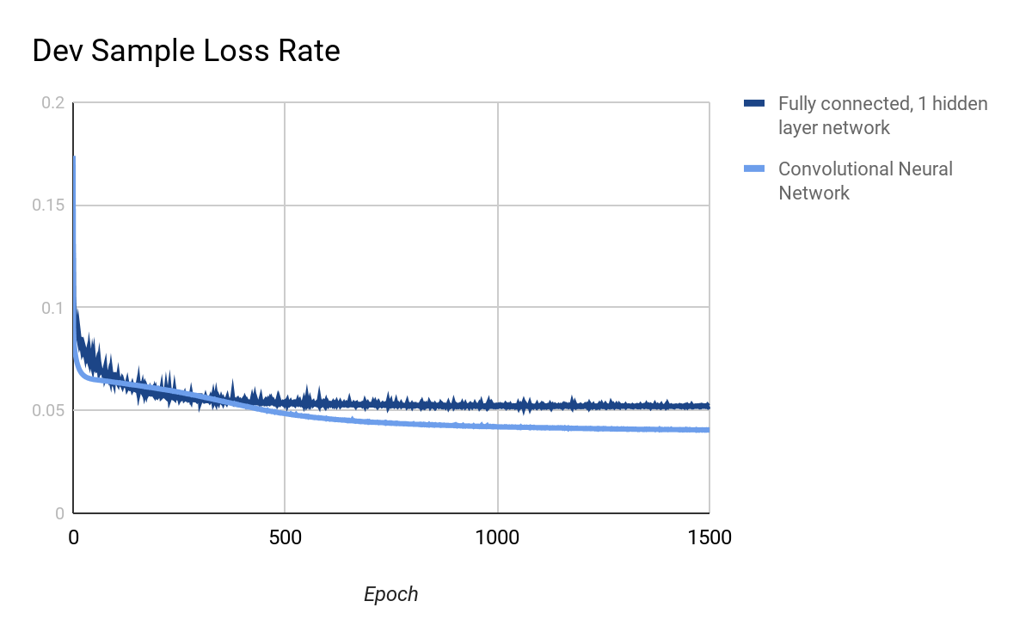
Convolutional Neural Network outperforms a simple Neural Network with 1 hidden layer

Slide 26
An Overview of Gradient Descent Optimization Algorithms used in this project
Vanilla gradient descent, aka batch gradient descent, computes the gradient of the cost function w.r.t. to the parameters θθ for the entire training dataset:
θ=θ−η⋅∇θJ(θ)θ=θ−η⋅∇θJ(θ).
Momentum [2] is a method that helps accelerate SGD in the relevant direction and dampens oscillations as can be seen in Image 3. It does this by adding a fraction γγ of the update vector of the past time step to the current update vector:
vtθ=γvt−1+η∇θJ(θ)=θ−vt
Essentially, when using momentum, we push a ball down a hill. The ball accumulates momentum as it rolls downhill, becoming faster and faster on the way (until it reaches its terminal velocity if there is air resistance, i.e. γ<1γ<1)
However, a ball that rolls down a hill, blindly following the slope, is highly unsatisfactory. We'd like to have a smarter ball, a ball that has a notion of where it is going so that it knows to slow down before the hill slopes up again.

