Slide 1
svm
Support Vector Machines

Slide 2
Svm
SVM is an exciting algorithm and the concepts are relatively simple.
The classifier separates data points using a hyperplane with the largest amount of margin.
That's why an SVM classifier is also known as a discriminative classifier.
SVM finds an optimal hyperplane which helps in classifying new data points.

Slide 3
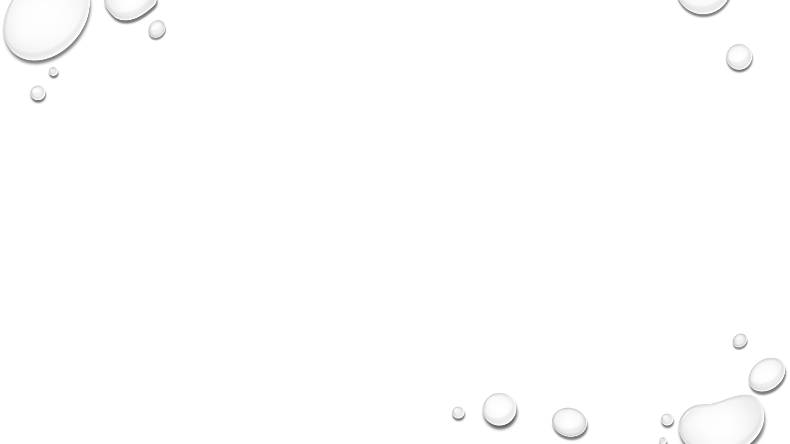
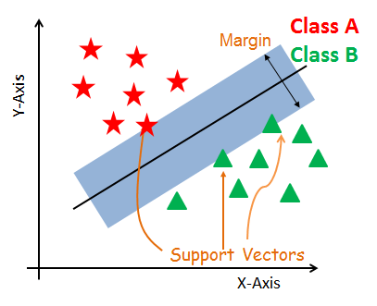
svm
SVM constructs a hyperplane in multidimensional space to separate different classes.
SVM generates optimal hyperplane in an iterative manner, which is used to minimize an error.
The core idea of SVM is to find a maximum marginal hyperplane(MMH) that best divides the dataset into classes.

Slide 4
Support Vectors
Support vectors are the data points, which are closest to the hyperplane.
These points will define the separating line better by calculating margins.
These points are more relevant to the construction of the classifier.

Slide 5
Hyperplane
A hyperplane is a decision plane which separates between a set of objects having different class memberships

Slide 6
Margin
A margin is a gap between the two lines on the closest class points.
This is calculated as the perpendicular distance from the line to support vectors or closest points.
If the margin is larger in between the classes, then it is considered a good margin, a smaller margin is a bad margin.

Slide 7
How does SVM work?
The main objective is to segregate the given dataset in the best possible way.
The distance between the either nearest points is known as the margin.
The objective is to select a hyperplane with the maximum possible margin between support vectors in the given dataset.
SVM searches for the maximum marginal hyperplane.

Slide 8
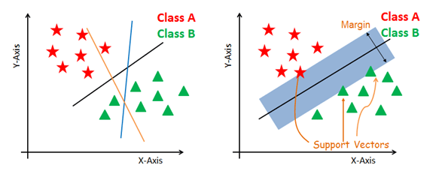
How does SVM work?
Generate hyperplanes which segregates the classes in the best way.
Left-hand side figure showing three hyperplanes black, blue and orange.
Here, the blue and orange have higher classification error, but the black is separating the two classes correctly

Slide 9
How does SVM work?
Select the right hyperplane with the maximum segregation from the either nearest data points as shown in the right-hand side figure.

Slide 10
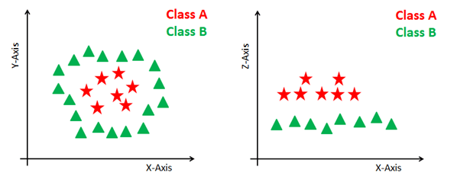
Dealing with non-linear and inseparable planes
Some problems can’t be solved using linear hyperplane, as shown in the figure below (left-hand side).
In such situation, SVM uses a kernel trick to transform the input space to a higher dimensional space as shown on the right.
The data points are plotted on the x-axis and z-axis (Z is the squared sum of both x and y: z=x^2=y^2).
Now you can easily segregate these points using linear separation.

Slide 11
SVM Kernels
SVM uses a technique called the kernel trick.
Here, the kernel takes a low-dimensional input space and transforms it into a higher dimensional space.
In other words, you can say that it converts non separable problem to separable problems by adding more dimension to it.
It is most useful in non-linear separation problem.
Kernel trick helps you to build a more accurate classifier.

Slide 12
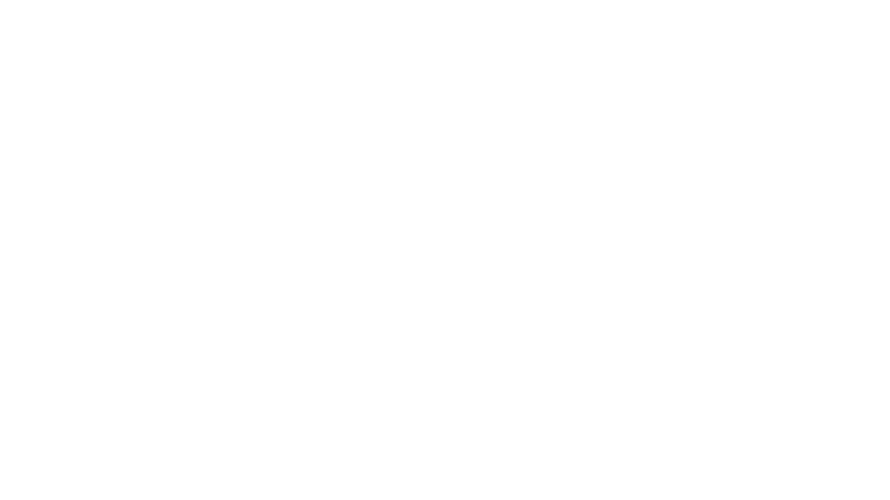
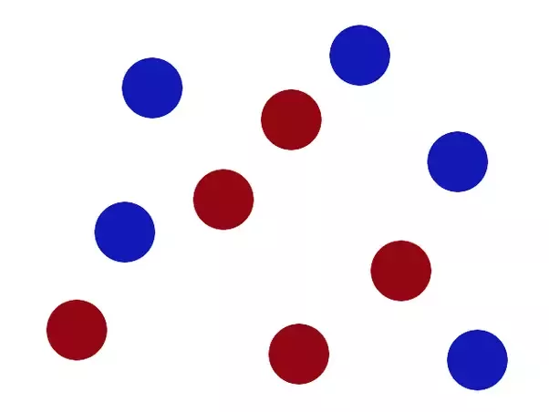
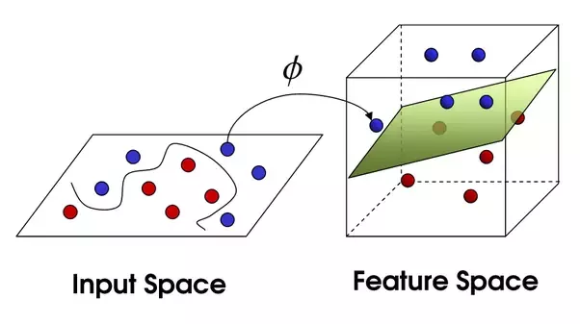
kernel
There’s no stick in the world that will let you split those balls well, so what do you do?
You flip the table of course! Throwing the balls into the air.
Then, with your pro ninja skills, you grab a sheet of paper and slip it between the balls.

Slide 13
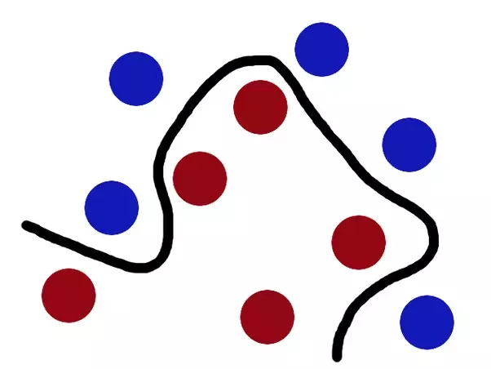
kernel
Now, looking at the balls from where the villain is standing, they balls will look split by some curvy line.
Boring adults the call balls data, the stick a classifier, the biggest gap trick optimization, call flipping the table kernelling and the piece of paper a hyperplane.

Slide 14
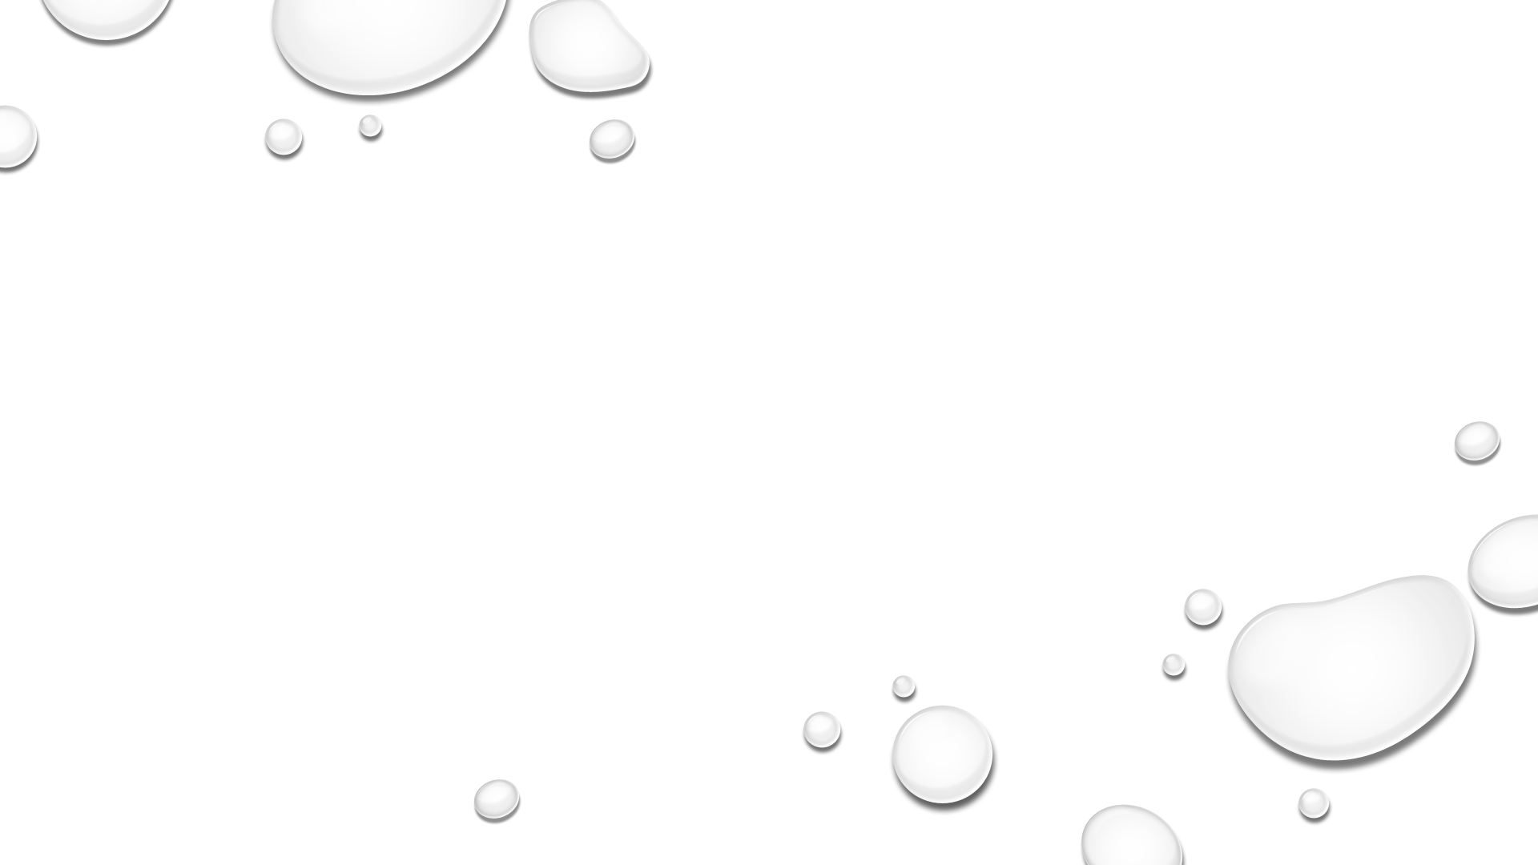
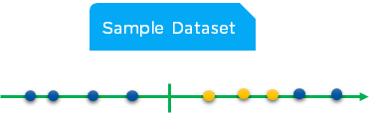
Can you try to solve the given below problem linearly? The yellow and blue balls cannot be separated by a straight line as they are randomly distributed

Slide 15
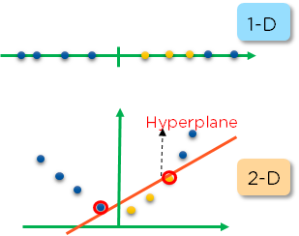
So how do we solve this problem?
Here, it’s necessary to move away from a 1-D view of the data to a 2-D view, for which kernel function plays a major role.
A kernel function will take the 1-Dimensional input data and transfer it to 2-Dimensional Output.

Slide 16
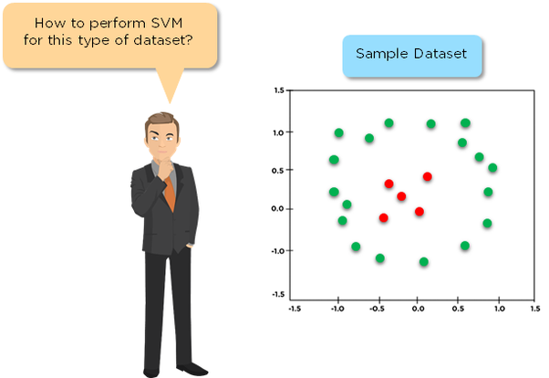
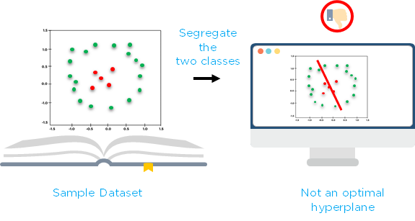
kernel
Briefly speaking, a kernel is a shortcut that helps us do certain calculation faster which otherwise would involve computations in higher dimensional space.
Mathematical definition: K(x, y) = <f(x), f(y)>. Here K is the kernel function, x, y are n dimensional inputs. f is a map from n-dimension to m-dimension space. usually m is much larger than n.
Notes:
< x,y> denotes the dot product.
Intuition: normally calculating <f(x), f(y)> requires us to calculate f(x), f(y) first, and then do the dot product. These two computation steps can be quite expensive as they involve manipulations in m dimensional space, where m can be a large number. But after all the trouble of going to the high dimensional space, the result of the dot product is really a scalar: we come back to one-dimensional space again! Now, the question we have is: do we really need to go through all the trouble to get this one number? do we really have to go to the m-dimensional space? The answer is no, if you find a clever kernel.
Simple Example: x = (x1, x2, x3); y = (y1, y2, y3). Then for the function f(x) = (x1x1, x1x2, x1x3, x2x1, x2x2, x2x3, x3x1, x3x2, x3x3), the kernel is K(x, y ) = (<x, y>)^2.
Let's plug in some numbers to make this more intuitive: suppose x = (1, 2, 3); y = (4, 5, 6). Then: f(x) = (1, 2, 3, 2, 4, 6, 3, 6, 9) f(y) = (16, 20, 24, 20, 25, 30, 24, 30, 36)
<f(x), f(y)> = 16 + 40 + 72 + 40 + 100+ 180 + 72 + 180 + 324 = 1024
A lot of algebra. Mainly because f is a mapping from 3-dimensional to 9 dimensional space.
Now let us use the kernel instead: K(x, y) = (4 + 10 + 18 ) ^2 = 32^2 = 1024 Same result, but this calculation is so much easier.

Slide 17
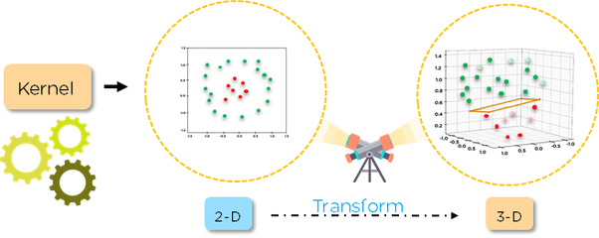
For a good result, we need to introduce a kernel function here which will take the 2-D input data and transfer it to 3-D output data

Slide 18
Advantages & Disadvantages
They also use less memory because they use a subset of training points in the decision phase.
SVM works well with a clear margin of separation and with high dimensional space.
SVM is not suitable for large datasets because of its high training time and it also takes more time in training compared to Naïve Bayes. It works poorly with overlapping classes and is also sensitive to the type of kernel used.

