Slide 1
KNN
K-NEAREST NEIGHBOR ALGORITHM

Slide 2
INTRODUCTION
Most of the machine learning algorithms are parametric.
if we are trying to model an linear regression model with one dependent variable and one independent variable. The best fit we are looking is the line equations with optimized parameters. The parameters could be the intercept and coefficient.
For any classification algorithm, we will try to get a boundary. Which successfully separates different target classes.
But today we are going to learn a different kind of algorithm which is non-parametric classification algorithm.
The algorithm uses the neighbor points information to predict the target class.
The simple version of the K-nearest neighbor classifier algorithms is to predict the target label by finding the nearest neighbor class. The closest class will be identified using the distance measures like Euclidean distance.

Slide 3
Application
Let’s assume a money lending company “XYZ”. Money lending XYZ company is interested in making the money lending system comfortable & safe for lenders as well as for borrowers. The company holds a database of customer’s details.
Using customer’s detailed information from the database, it will calculate a credit score(discrete value) for each customer. The calculated credit score helps the company and lenders to understand the credibility of a customer clearly. So they can simply take a decision whether they should lend money to a particular customer or not

Slide 4
APPLICATION
The customer’s details could be:
Educational background details.
Highest graduated degree.
Cumulative grade points average (CGPA) or marks percentage.
The reputation of the college.
Consistency in his lower degrees.
Whether to take the education loan or not.
Cleared education loan dues.
Employment details.
Salary.
Year of experience.
Got any onsite opportunities.
Average job change duration.

Slide 5
APPLICATION
The company(XYZ) use’s these kinds of details to calculate credit score of a customer. The process of calculating the credit score from the customer’s details is expensive. To reduce the cost of predicting credit score, they realized that the customers with similar background details are getting a similar credit score.
So, they decided to use already available data of customers and predict the credit score using it by comparing it with similar data. These kinds of problems are handled by the k-nearest neighbor classifier for finding the similar kind of customers.

Slide 6
SIMILARITY MEASURES
This similarity is the very basic building block for activities such as Recommendation engines, clustering, classification and anomaly detection.
The similarity measure is the measure of how much alike two data objects are.
Similarity measure in a data mining context is a distance with dimensions representing features of the objects.
If this distance is small, it will be the high degree of similarity where large distance will be the low degree of similarity.
The relative values of each element must be normalized, or one feature could end up dominating the distance calculation. Similarity are measured in the range 0 to 1 [0,1].

Slide 7
Two main consideration about similarity
Similarity = 1 if X = Y
Similarity = 0 if X ≠ Y
Where X, Y are two objects

Slide 8

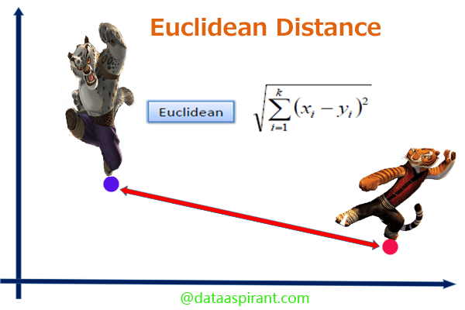
Euclidean distance
When data is dense or continuous, this is the best proximity measure.
The Euclidean distance between two points is the length of the path connecting them.
The Pythagorean theorem gives this distance between two points.

Slide 9
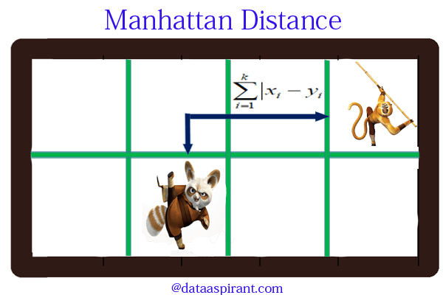
Manhattan distance
Manhattan distance is a metric in which the distance between two points is the sum of the absolute differences of their Cartesian coordinates.
In a simple way of saying it is the total sum of the difference between the x-coordinates and y-coordinates.
Manhattan may be appropriate if different dimensions are not comparable.
Manhattan distance between two points measured along axes at right angles.

Slide 10
Manhattan distance
In a plane with p1 at (x1, y1) and p2 at (x2, y2).
Manhattan distance = |x1 – x2| + |y1 – y2|
This Manhattan distance metric is also known as Manhattan length, rectilinear distance, L1 distance or L1 norm, city block distance, Minkowski’s L1 distance, taxi-cab metric, or city block distance.

Slide 11
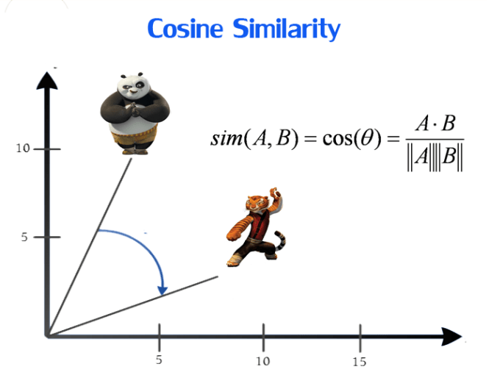
Cosine similarity
Cosine similarity metric finds the normalized dot product of the two attributes. By determining the cosine similarity, we would effectively try to find the cosine of the angle between the two objects
The cosine of 0° is 1, and it is less than 1 for any other angle.
It is thus a judgement of orientation and not magnitude: two vectors with the same orientation have a cosine similarity of 1, two vectors at 90° have a similarity of 0, and two vectors diametrically opposed have a similarity of -1, independent of their magnitude
Cosine similarity is particularly used in positive space, where the outcome is neatly bounded in [0,1]. One of the reasons for the popularity of cosine similarity is that it is very efficient to evaluate, especially for sparse vectors.

Slide 12

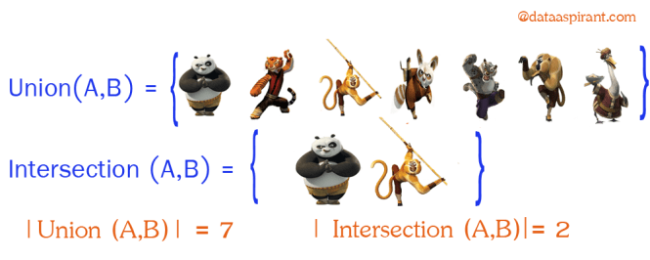
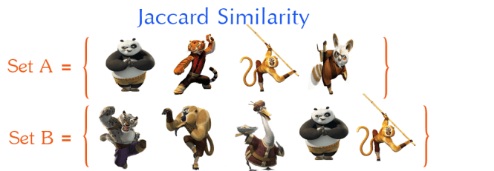
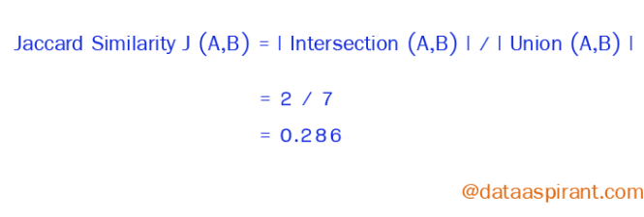
Jaccard similarity
When we consider about Jaccard similarity this objects will be sets.
The Jaccard similarity measures the similarity between finite sample sets and is defined as the cardinality of the intersection of sets divided by the cardinality of the union of the sample sets.

Slide 13
K-nearest neighbor algorithm pseudocode
Let (X_{i}, C_{i}) where i = 1, 2……., n be data points. X_{i} denotes feature values & C_{i} denotes labels for X_{i} for each i.
Assuming the number of classes as ‘c’ _{Ci} ∈ {1, 2, 3, ……, c} for all values of I
Let x be a point for which label is not known, and we would like to find the label class using k-nearest neighbor algorithms.

Slide 14
Knn Algorithm Pseudocode
Calculate “d(x, x_{i})” i =1, 2, ….., n; where d denotes the Euclidean distance between the points.
Arrange the calculated n Euclidean distances in non-decreasing order.
Let k be a +ve integer, take the first k distances from this sorted list.
Find those k-points corresponding to these k-distances.
Let k_{i} denotes the number of points belonging to the i^{th} class among k points i.e. k ≥ 0
If k_{i} >k_{j} ∀ i ≠ j then put x in class i.

Slide 15
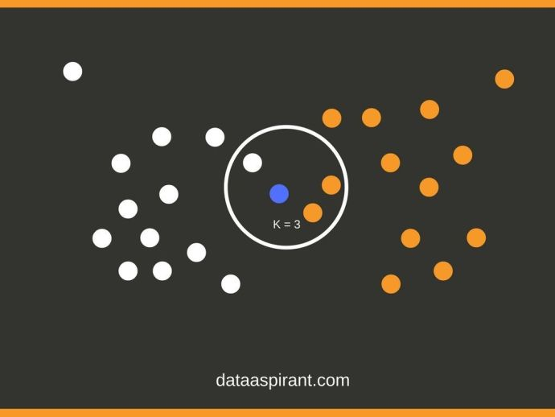
K- Nearest neighbor algorithm example
Let’s consider the image where we have two different target classes white and orange circles. We have total 26 training samples. Now we would like to predict the target class for the blue circle. Considering k value as three, we need to calculate the similarity distance using similarity measures like Euclidean distance.

Slide 16
K- Nearest neighbor algorithm example
If the similarity score is less which means the classes are close. In the image, we have calculated distance and placed the less distance circles to blue circle inside the Big circle.

Slide 17
KNN
Let’s consider a setup with “n” training samples, where x_{i} is the training data point. The training data points are categorized into “c” classes.
Using KNN, we want to predict class for the new data point.
So, the first step is to calculate the distance(Euclidean) between the new data point and all the training data points.
Next step is to arrange all the distances in non-decreasing order. Assuming a positive value of “K” and filtering “K” least values from the sorted list.
Now, we have K top distances. Let k_{i}denotes no. of points belonging to the i^{th} class among k points.
If k_{i} >k_{j} ∀i ≠ j then put x in class i.

Slide 18
Nearest Neighbor Algorithm
Nearest neighbor is a special case of k-nearest neighbor class. Where k value is 1 (k = 1). In this case, new data point target class will be assigned to the 1st closest neighbor.

Slide 19
How to choose the value of K?
A small value of K means that noise will have a higher influence on the result i.e., the probability of overfitting is very high.
A large value of K makes it computationally expensive and defeats the basic idea behind KNN (that points that are near might have similar classes ).
A simple approach to select k is k = n^(1/2).
Using the cross-validation technique, we can test KNN algorithm with different values of K. The model which gives good accuracy can be considered to be an optimal choice.

Slide 20
Condensed Nearest Neighbor Data Reduction Rule
Using the condensed nearest neighbor rule, we can clean our data and can sort the important observations out of it.
But there is a chance of accuracy reduction.
The steps to condense is to divide data points into these:
Outliers: Observations that lie at an abnormal distance from all the data points. Most of these are extreme values. Removing these observations will increase the accuracy of the model.
Prototypes: Minimum points in training set required to recognize non-outlier points.
Absorbed points: These are points that are correctly identified to be non-outlier points.

