Slide 1
ANN & CNN
Deep learning

Slide 2


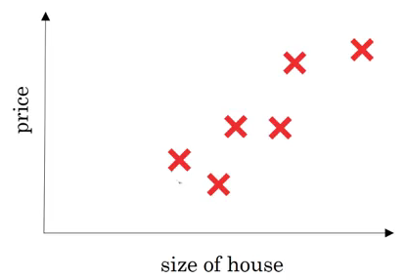
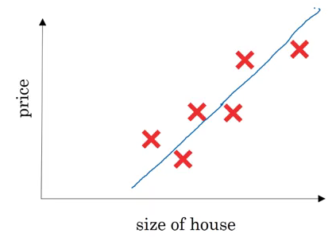
What is a neural network?
Consider an example where we have to predict the price of a house. The variables we are given are the size of the house in square feet (or square meters) and the price of the house. Now assume we have 6 houses.

Slide 3
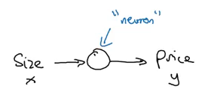
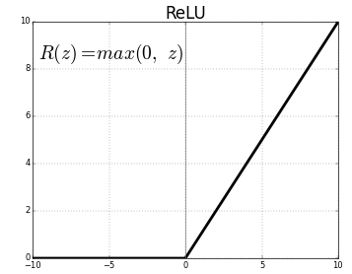
Using NN
a neuron will take an input, apply some activation function to it, and generate an output.
One of the most commonly used activation function is ReLU (Rectified Linear Unit):

Slide 4
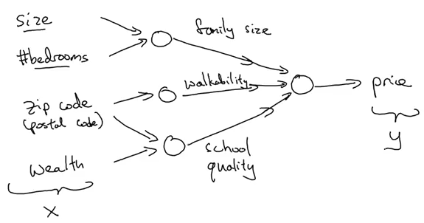

Slide 5
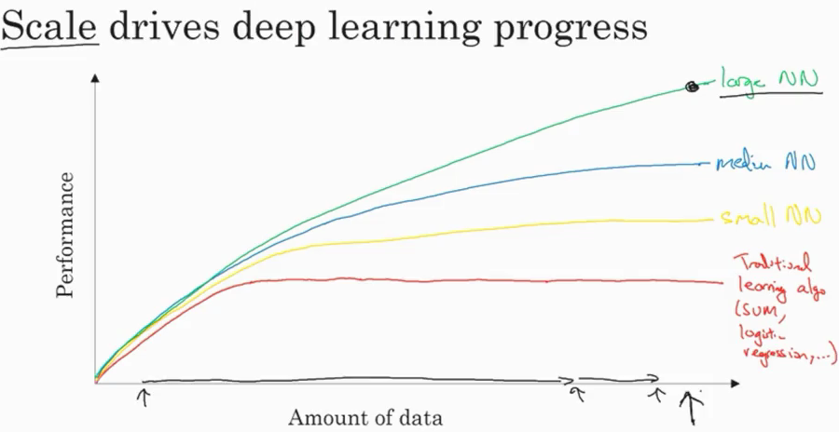

Slide 6
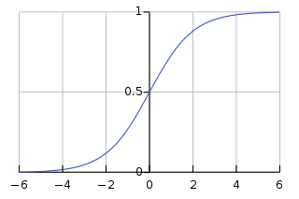
activation function
The slope, or the gradient of 1st function, at the extreme ends is close to zero. Therefore, the parameters are updated very slowly, resulting in very slow learning.
Hence, switching from a sigmoid activation function to ReLU (Rectified Linear Unit) is one of the biggest breakthroughs we have seen in neural networks.
ReLU updates the parameters much faster as the slope is 1 when x>0.

Slide 7


Logistic Regression Cost Function

Slide 8
Gradient Descent
We want our cost function to be as small as possible. For that, we want our parameters w and b to be optimized.
This is a technique that helps to learn the parameters w and b in such a way that the cost function is minimized.
The cost function for logistic regression is convex in nature (i.e. only one global minima) and that is the reason for choosing this function instead of the squared error (can have multiple local minima).

Slide 9
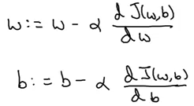
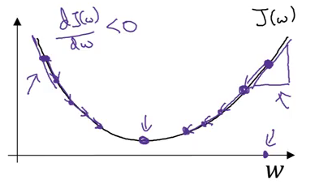
Steps of gradient descent
Initialize w and b (usually initialized to 0 for logistic regression)
Take a step in the steepest downhill direction
Repeat step 2 until global optimum is achieved

Slide 10

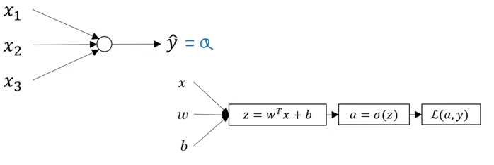
logistic regression

Slide 11
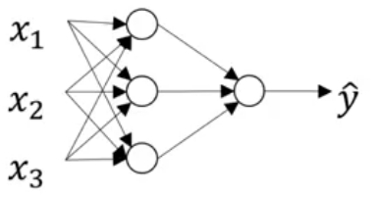
neural network with a single hidden layer

Slide 12
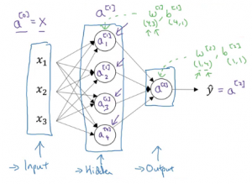
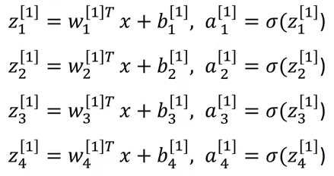
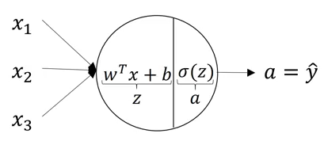
Computing a Neural Network’s Output

Slide 13
Why do we need non-linear activation functions?
The composition of two linear functions is itself a linear function, and unless we use some non-linear activations, we are not computing more interesting functions.

Slide 14

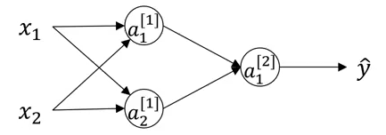

Initializing weights
No matter how many units we use in a layer, we are always getting the same output which is similar to that of using a single unit.
So, instead of initializing the weights to 0, we generally initialize small weights randomly.

Slide 15

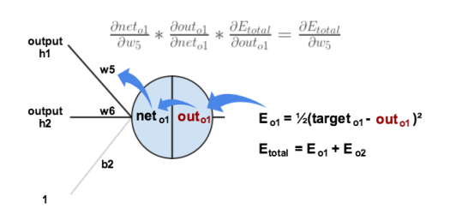
backpropagation
Gradient descent

Slide 16
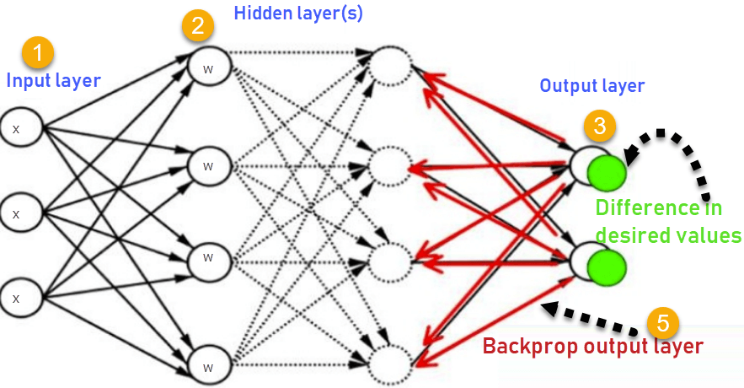
Backpropagation
Inputs X, arrive through the preconnected path
Input is modeled using real weights W. The weights are usually randomly selected.
Calculate the output for every neuron from the input layer, to the hidden layers, to the output layer.
Calculate the error in the outputs
Travel back from the output layer to the hidden layer to adjust the weights such that the error is decreased.

Slide 17
NN
https://www.youtube.com/watch?v=aircAruvnKk&list=PLZHQObOWTQDNU6R1_67000Dx_ZCJB-3pi&index=1
https://www.youtube.com/watch?v=IHZwWFHWa-w&list=PLZHQObOWTQDNU6R1_67000Dx_ZCJB-3pi&index=2
https://www.youtube.com/watch?v=Ilg3gGewQ5U&list=PLZHQObOWTQDNU6R1_67000Dx_ZCJB-3pi&index=3
https://www.youtube.com/watch?v=tIeHLnjs5U8

Slide 18
simulator
https://www.mladdict.com/neural-network-simulator
https://www.youtube.com/watch?v=P2HPcj8lRJE&list=PLjJh1vlSEYgvGod9wWiydumYl8hOXixNu&index=3&t=0s

Slide 19
BONUS
https://www.analyticsvidhya.com/blog/2018/11/neural-networks-hyperparameter-tuning-regularization-deeplearning/

Slide 20
CNN
https://www.youtube.com/watch?v=jajksuQW4mc
https://www.youtube.com/watch?v=IeLrFNc5HqY
https://www.youtube.com/watch?v=YRhxdVk_sIs
https://www.youtube.com/watch?v=JiN9p5vWHDY&list=PLjJh1vlSEYgvGod9wWiydumYl8hOXixNu&index=9&t=0s

