Slide 1
Natural Language Processing

Slide 2
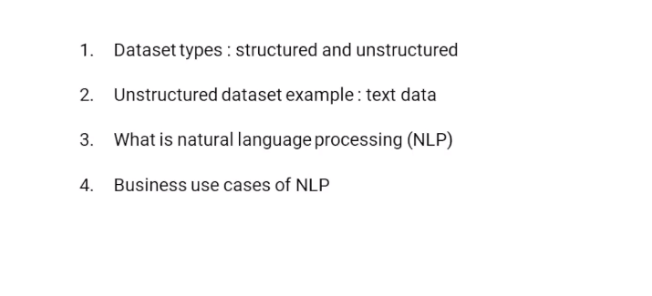
What’s there:

Slide 3
Natural language processing:
Field concerned with the ability of a computer to understand,analyze, manipulate, and potentially generate human language.
by human language, we're simply referring to any language used for everyday communication (This can be English, Spanish, French, anything like that)

Slide 4
Dataset types:
Any form of data can be categorised into two types:
Structured data
Fixed dimension,
well-organized,
tabular data,
key-value pair.

Slide 5
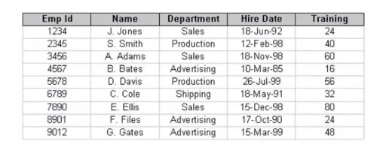

Slide 6
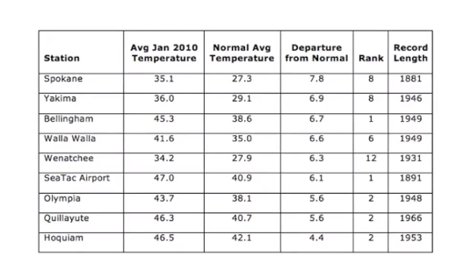

Slide 7
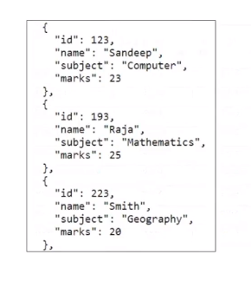

Slide 8
2. Unstructured data
No Fixed dimension,
No structure

Slide 9
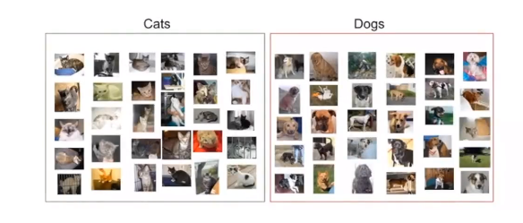
Image data

Slide 10

Video data

Slide 11
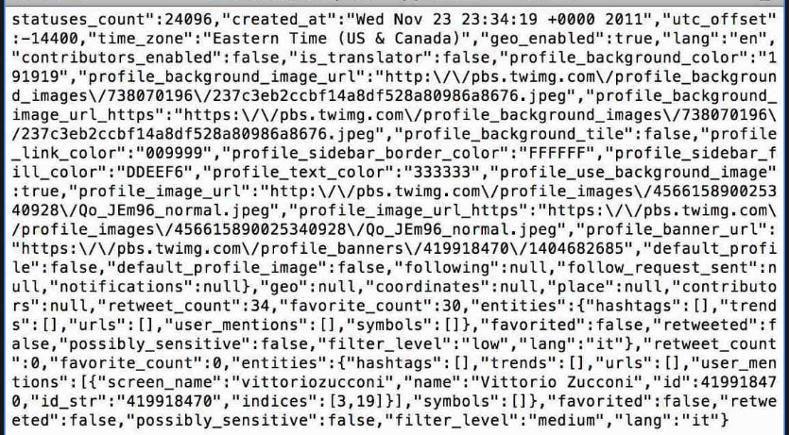
Text data

Slide 12
Example of TEXT data:
Social media: tweets, posts, comments.
Conversations: messages, emails, chats.
Articles: news, blogs, transcripts.

Slide 13
Thus,
Unstructured data cannot be represented in a well defined tabular format.

Slide 14
Natural Language Processing in Real Life
spam filter:
where your email server is determining whether an incoming email is spam or not, based on the content of the body, the subject, and maybe the email domain.

Slide 15
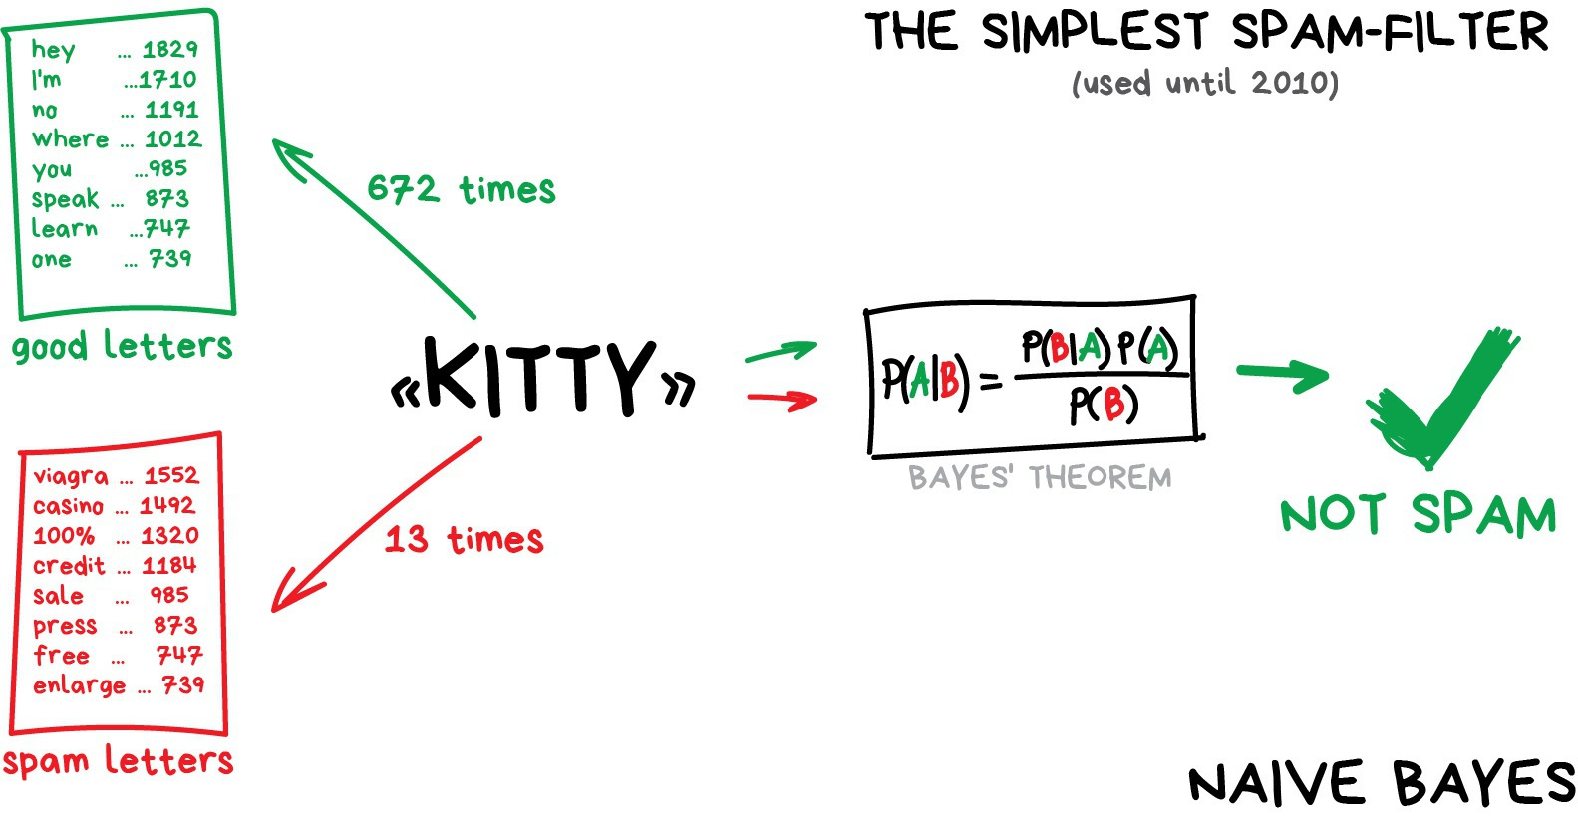

Slide 16
2. Auto-complete
where Google is basically predicting what you're interested in searching for based on what you've already entered and what others commonly search for with those same phrases.
So if I search for natural language processing, it knows that many other people are interested in learning NLP with Python, or learning it through a course, or looking for jobs related to natural language processing. So it can auto-complete your search for you

Slide 17


Slide 18
3. Auto-correct
The last is auto-correct, where say iPhone is trying to help you correct a misspelling.

Slide 19
NLP is a very broad umbrella that encompasses many topics.:
Sentiment analysis
Topic modelling
Text classification
Part-of-speech tagging or sentence segmentation
Text summarizer
The core component of natural language processing is extracting all the information from a block of text that is relevant to a computer understanding the language.This is task specific, as well. Different information is relevant for a sentiment analysis task than is relevant for a topic modeling task.

Slide 20
Most popular NLP library: NLTK
1. The natural language toolkit is the most utilized package for handling natural language processing tasks in Python. Usually called NLTK for short,
2. It is a suite of open-source tools originally created in 2001 at the University of Pennsylvania for the purpose of making building NLP processes in Python easier.
3. This package has been expanded through the extensive contributions of open-source users in the years since its original development.
4. NLTK is great because it basically provides a jumpstart to building any NLP process by giving you the basic tools that you can then chain together to accomplish your goal rather than having to build all those tools from scratch.
5. A lot of tools are packaged into NLTK,

