Slide 1

2025
Digital Twins:
The Virtual Replicas of the Real World
By Subhadip Sinha
Department: Information Technology
Year: UG 4 Sec: A3
Roll: 102111001154
Page
01

Slide 2
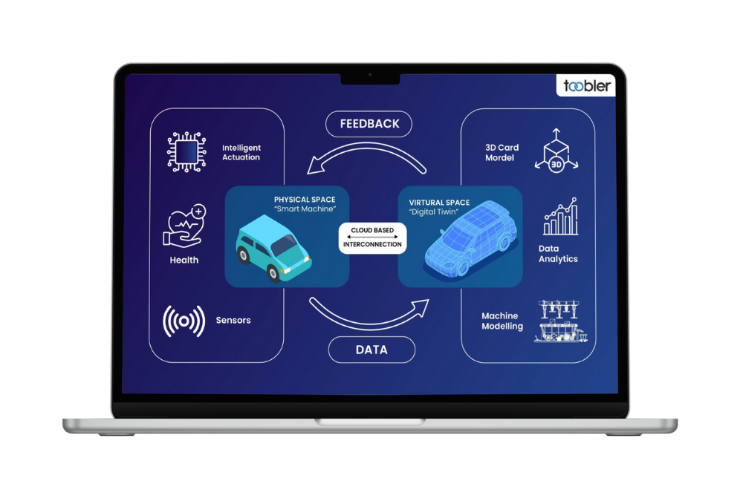

2025
INTRODUCTION:
What is a Digital Twin?
A Digital Twin is a virtual replica (a digital copy) of a physical object, system, or process.
First concept (idea of "Pairing") introduced by Dr. Michael Grieves in 2002.
Characteristics:
  Real-Time Connection: It is continuously updated with real-time data from its physical counterpart (using sensors and IoT).
  Bi-Directional Flow: Information flows to the digital model and insights/commands flow back to the physical object.
  Purpose: To monitor, analyze, simulate, and optimize the real-world performance, primarily for predictive maintenance, testing "what-if" scenarios, and making better operational decisions.
Page
02

Slide 3
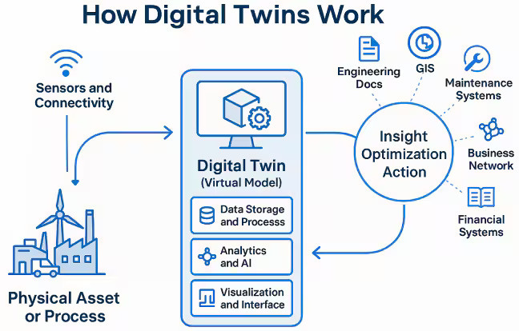
2025
Core Components:
  Physical asset(s) — the machine, building, vehicle, or process you want to mirror.
  Sensors & data sources — IoT sensors, PLCs, gateways, logs, CAD/PLM/BIM data, operator inputs, historical databases.
  Connectivity & ingestion — HTTP/APIs, edge gateways — mechanisms to move data from the real world to the digital world.
  Data platform / storage — time-series DBs, object stores, metadata repositories (cloud or on-prem).
  Digital model / representation — the mathematical, physics, or rule-based model that represents structure and behaviour (can be CAD geometry, physics model, statistical model, or hybrid).
  Simulation & analytics — simulation engines, physics solvers, ML models, rule engines for prediction, anomaly detection, what-if scenarios.
  Visualization / UI — dashboards, 3D viewers (e.g., digital factory floor plans), AR/VR overlays for operators.
  Control / feedback loop — where outputs from the twin drive alerts, control signals, or operator decisions that affect the physical asset.
  Governance & integration layer — mapping models, APIs, security, data quality, and lifecycle management.
Page
03

Slide 4




2025
Working Principle:
Creating digital Model by the data
Receiving data through sensors and connectivity
Feedback
User Interaction
  Step 1: Installing IoT sensors, connecting PLCs (controllers), or using existing data systems that already measure things.
  Step 2: Sensors and controllers generate data, need to collect it and send it to the digital twin system.
  Step 3: Clean, normalize, label and store the data in database.
  Step 4: Map the data into the model.
  Step 5: Analyze and simulate things virtually. Test digital experiments safely, send alerts, predict failures.
  Step 6: A dashboard shows current motor speed, power, and health score to user to see any anomaly.
Page
04

Slide 5
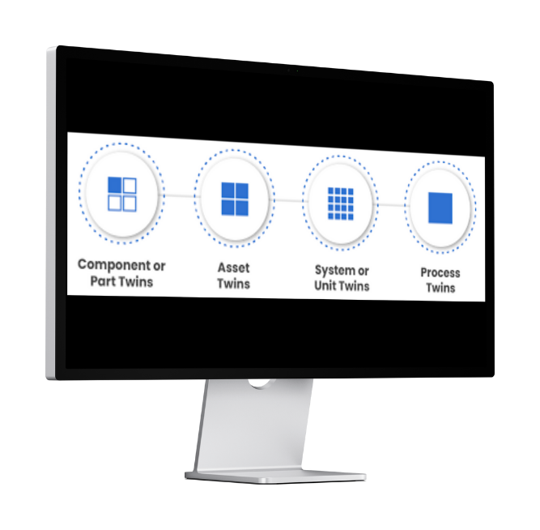
2025
Types of Digital Twins:
  Component or Part Twins: For single part of a unit (e.g., an engine sensor module).
  Asset Twins: For whole machine (e.g., a turbine).
  System or Unit Twins: Connects multiple assets together to model how they interact as part of a larger system.
  Process Twins: A business or manufacturing process (workflow optimization).
Page
05

Slide 6


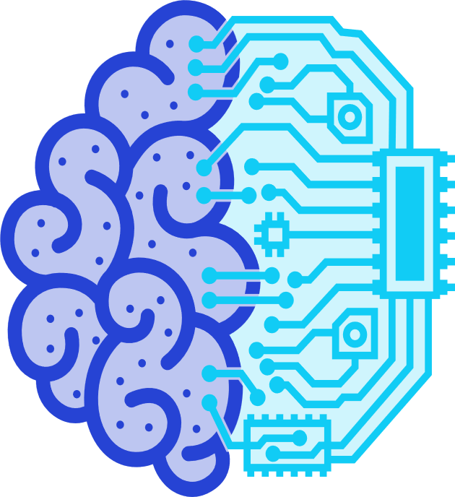
2025
Technologies used in Digital Twin:
IoT sensors are attached to the physical object (like a jet engine in the image) and constantly collect operational data (temperature, pressure, vibration, speed, etc.).
CAD(Computer-Aided Design),PLM(Product Lifecycle Management),BIM(Building Information Modeling) for 3D model.
IoT
3D structure
Cloud
AI & ML
The massive amount of data continuously gathered by the IoT sensors is stored and processed in the virtual cloud.
AI, often coupled with Machine Learning (ML), acts as the advanced analytical tool.
Page
06

Slide 7

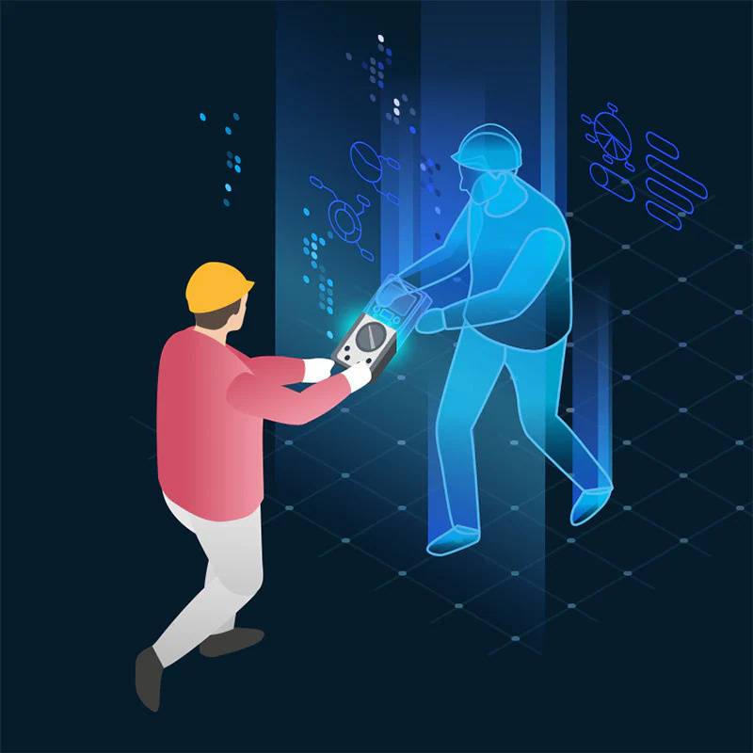
2025
Benefits of Digital Twin:
  Accelerated Testing: Enables faster debugging and testing in a virtual environment, reducing the need for costly physical prototypes.
  Cost Savings: Allows for Predictive Maintenance, lowering unscheduled downtime and overall O&M (Operations & Maintenance) costs.
  Optimized Design: Facilitates better design decisions by running extensive "digital experiments" and simulations.
  Centralized Monitoring: Provides real-time visibility and performance insights across geographically distributed assets or locations.
  Risk Mitigation: Allows for the safer testing of extreme scenarios (e.g., system failures, disaster planning) without physical danger.
Page
07

Slide 8
2025
Challenges
& Limitaions
Data Quality & Integration
Model Fidelity vs. Cost
Security & Privacy
Difficult to integrate data consistently due to the variety of sensor types, legacy equipment, and messy data formats.
Creating high-fidelity, highly accurate physics-based models is extremely expensive and complex.
It contains sensitive operational data. This requires robust cybersecurity and strict access controls to prevent unauthorized access.
Standards & Interoperability
Organizational Change
There is a current lack of universal standards and protocols, making it challenging and costly to ensure different vendors' digital twin components can work together (interoperate)
Successful implementation requires significant adaptation in business culture. Employees and processes must be trained to trust and act upon the data-driven decisions recommended by the twin.
Page
08

Slide 9
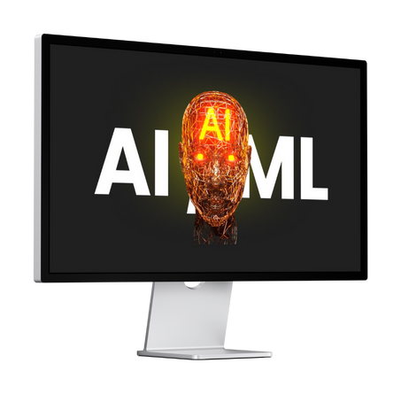


2025
Conclusion:
  Digital Twins bridge the physical and digital worlds, enabling real-time monitoring, simulation, and optimization.
  By combining IoT, AI/ML, Big Data, and 3D Simulation, they provide deep insights into asset and process performance.
  They help industries achieve predictive maintenance, reduced downtime, and improved efficiency.
  From components to full business processes, Digital Twins are transforming how we design, operate, and innovate.
Page
09

Slide 10
2025
Questions?
Page
10

Slide 11
2025
Thank
You.
Page
10

