Slide 1
SEMANTIC TECHNOLOGY
PROTÉGÉ FEATURE – MAPPING VALIDATOR
AMAN SINHA, EMCL

Slide 2

OBJECTIVE
To build a mapping validator in Protege (a plugin for Ontop) in order to verify if the target query (mapping) is written correctly.

Slide 3

MOTIVATION
Currently, the mapping dialog panel in Protege only validates the SQL query and gives the functionality of testing SQL query.
Idea: Extend this functionality and support mapping validation.

Slide 4
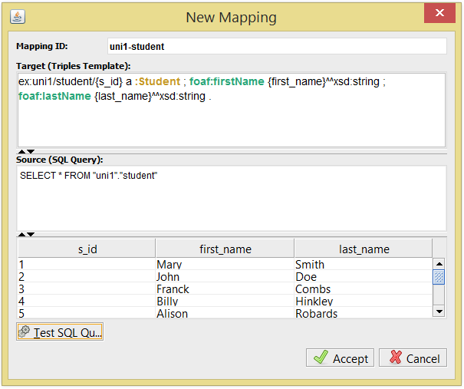

CURRENT SCENARIO

Slide 5
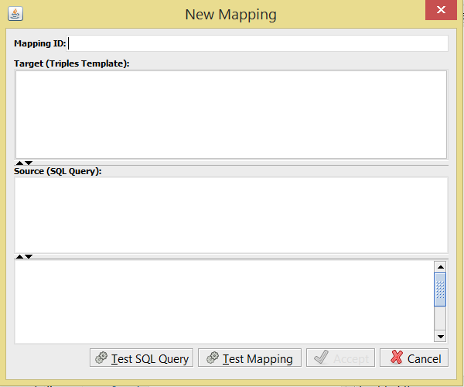

EXPECTED SCENARIO

Slide 6
INTRODUCTION
Ontop is a platform to query relational databases as Virtual RDF Graphs using SPARQL.
Protege is a free, open-source platform that provides a growing user community with a suite of tools to construct domain models and knowledge-based applications with ontologies.

Slide 7
ARCHITECTURE
Extensions (Protégé)
OWL API
Quest Core API

Slide 8
ARCHITECHTURE
Extensions (Protégé)
Menus
Tabs
Reasoner
…
Extensions (Protégé)
Panels
OWL API
Quest Core API

Slide 9
APPROACH
Parser – checks if the source and target query are syntactically correct
Reasoner – uses ontology and OBDAModel.
Display the result in the form of triples.

Slide 10
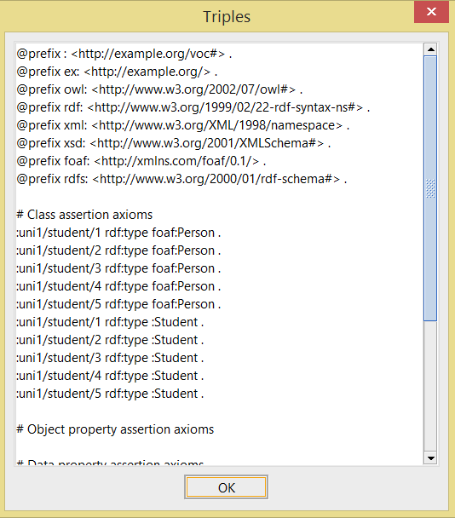

Slide 11
THANK YOU!

