Slide 1


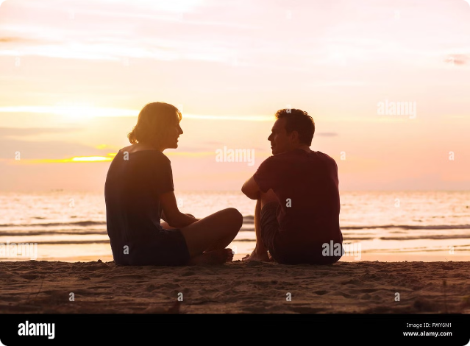

Welcome to the Anonymous World Group Chat
Join our vibrant community where people can connect, collaborate, and explore the decentralized future.
by Keshav Prem Gupta
Abhishree Sinha
Manisha

Slide 2

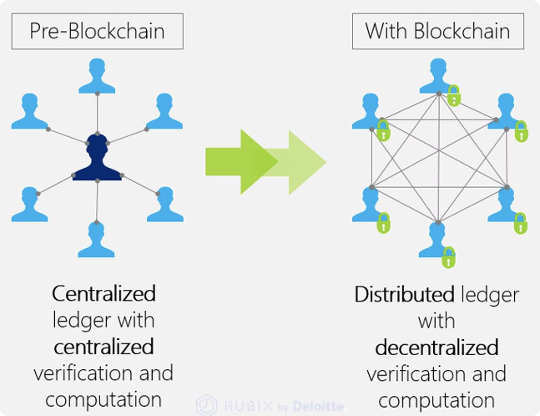
Powered by GUN: Decentralized Storage
Data Sovereignty
Own your data and control who accesses it. GUN empowers you with full ownership and control over your information.
Resilience
Your data is distributed across a network of nodes, making it resistant to censorship and single points of failure.
Privacy
GUN encrypts your messages, ensuring that only authorized parties can access your conversations.

Slide 3

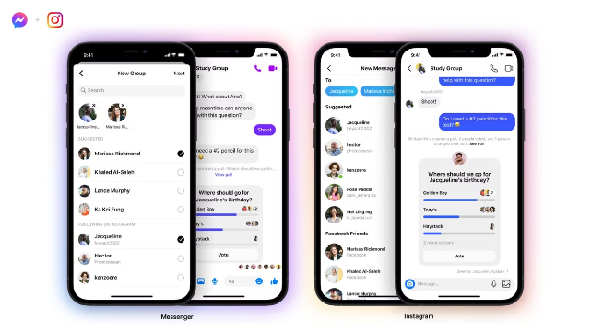
Secure and Private Messaging
1
End-to-End Encryption
All messages are encrypted, ensuring that only the intended recipient can read them.
2
Private Key Management
You control your own private keys, giving you full control over your data and identity.
3
No Central Server
Messages are stored and transmitted directly between users, eliminating the risk of data breaches.

Slide 4

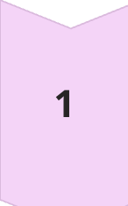
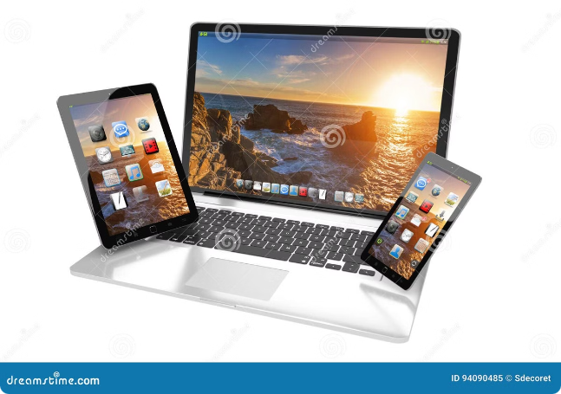
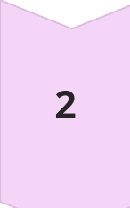
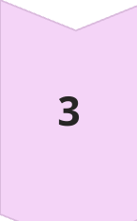
Seamless Cross-Device Synchronization
Start a Conversation
Begin a conversation on any device and seamlessly continue it on another.
Sync Across Devices
Your chat history and messages are synchronized across all your devices, ensuring you never miss a beat.
Access From Anywhere
Join the chat from your computer, smartphone, or tablet, enjoying consistent access to your conversations.

Slide 5
Collaborative Discussions and Sharing
Real-Time Collaboration
Shared Files
Interactive Conversations
Work together on ideas, projects, and documents in real time, with everyone seeing the same updates.
Upload and share files securely within the group, allowing for efficient collaboration on projects.
Engage in rich discussions, share links, and react to messages, fostering a dynamic community.

Slide 6


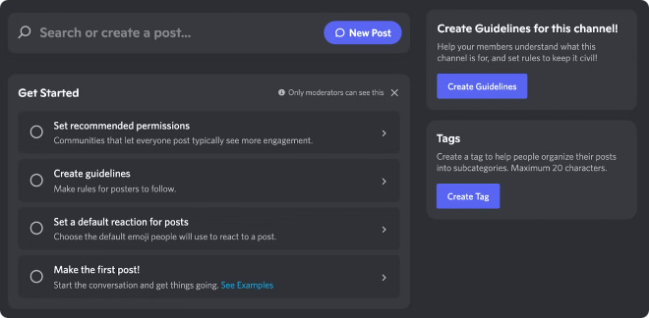


Community-Driven Moderation
Anti-Spam Measures
Automated filters and community moderation help to ensure a spam-free and safe environment.
Report Abuse
Users can report inappropriate content, allowing for prompt action and a respectful community.
Transparent Governance
Community members actively participate in shaping the platform's rules and guidelines.

Slide 7

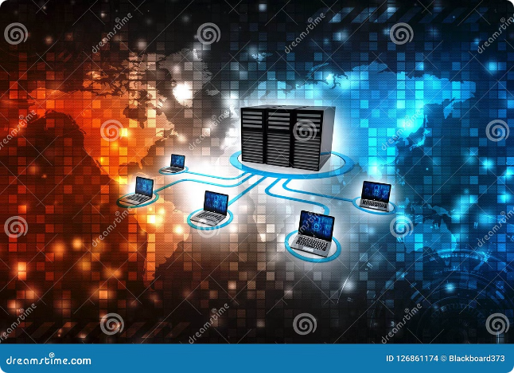
Decentralized Governance and Transparency
1
Open-Source Code
GUN's code is publicly available, fostering transparency and community contributions.
2
Decentralized Governance
Decisions are made collectively by the community, ensuring fair and equitable representation.
3
Auditable History
All actions and decisions are recorded on the blockchain, providing a transparent and immutable history.

Slide 8


Join the Web3 Revolution with Us
Connect with like-minded individuals, explore the latest Web3 trends, and contribute to the decentralized future.

