Slide 1
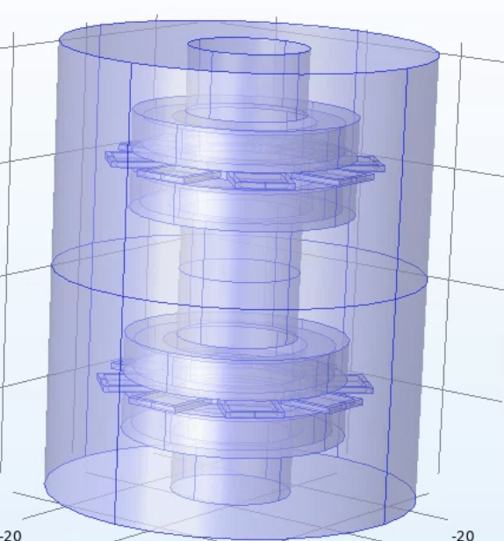
Dual rotor physics model verification and 3D magnetic foam modelling
TBD Project Picture
Jahnavi Sinha
Date: 5/9/22

Slide 2
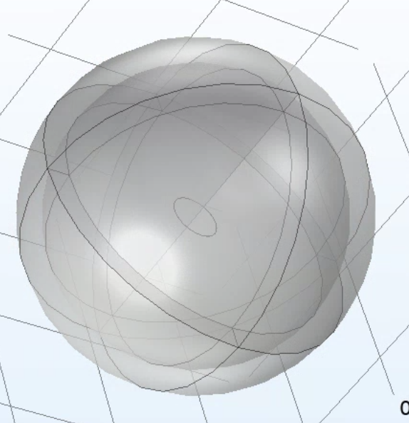
Research Q: Using COMSOL to define dual PM rotor coil physics and verify 3D foam modelling
Aims:
Run 4 coil dual rotor model for ¼ period and 4 periods to verify current behavior in upper and lower rotors
Using 4 cell and 9 cell layer conductive foam models to characterize eddy currents and induced forces
Figure 1: Dual rotor model (left)
Figure 2: 3D coil model (right)

Slide 3
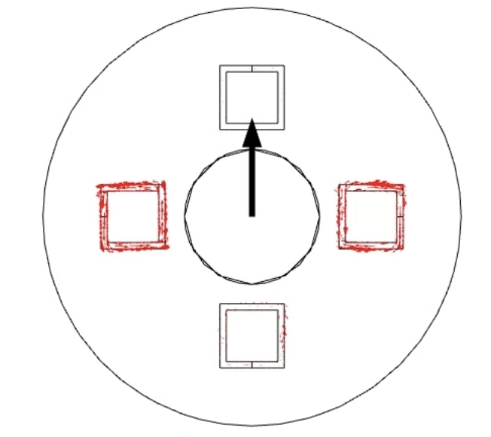
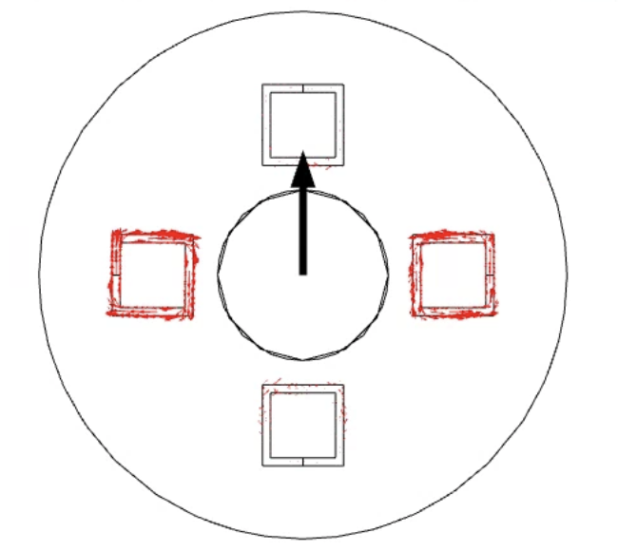
Milestone 1a: Plotting 4 coil current results for upper and lower rotors at t = 0.025s
Upper rotor Lower rotor

Slide 4
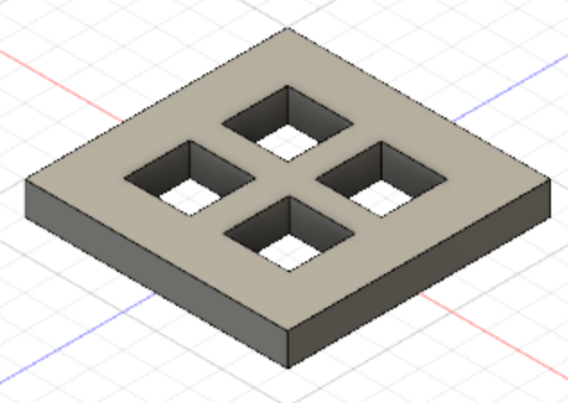
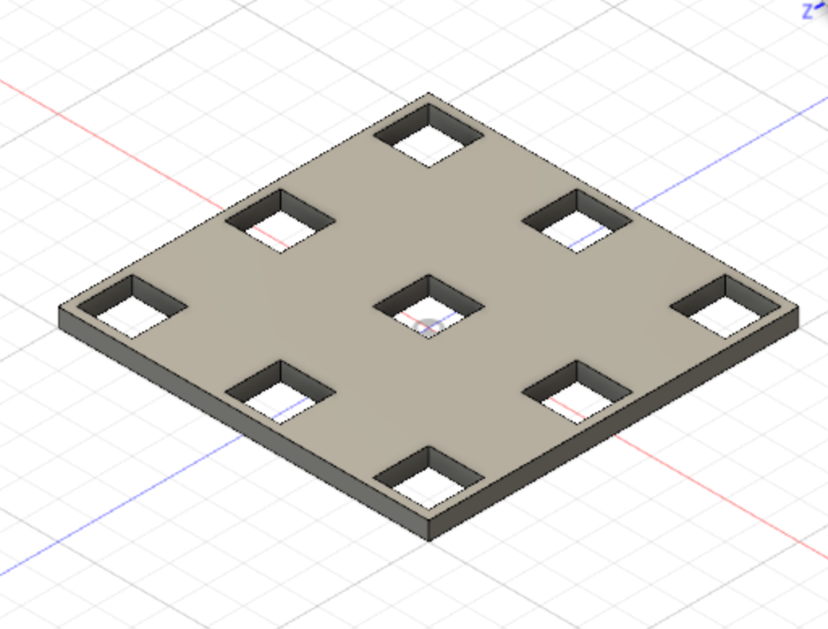
Milestone 2: Building 4-cell and 9-cell aluminium foam CAD models
4-cell model 9-cell model

Slide 5
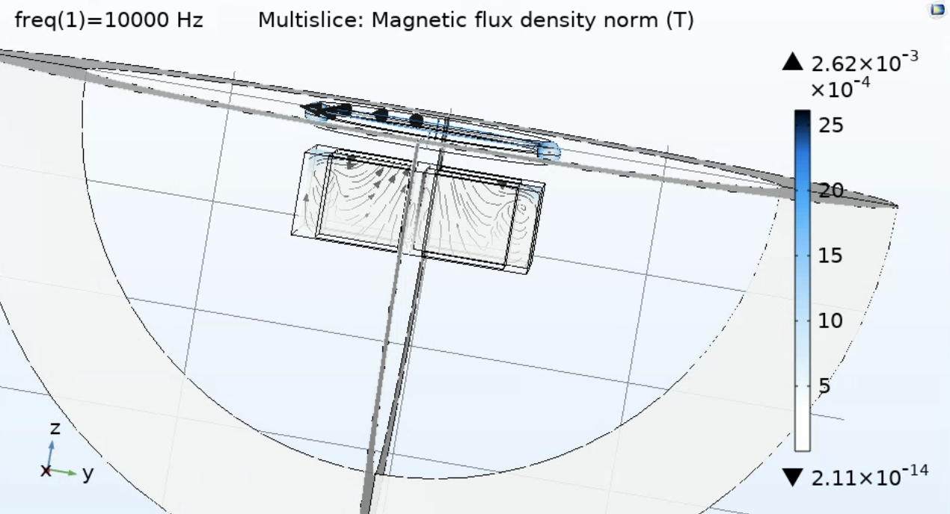
Milestone 2a: Magnetic flux density (4 cell model)
Plotting a cut plane at foam surface

Slide 6
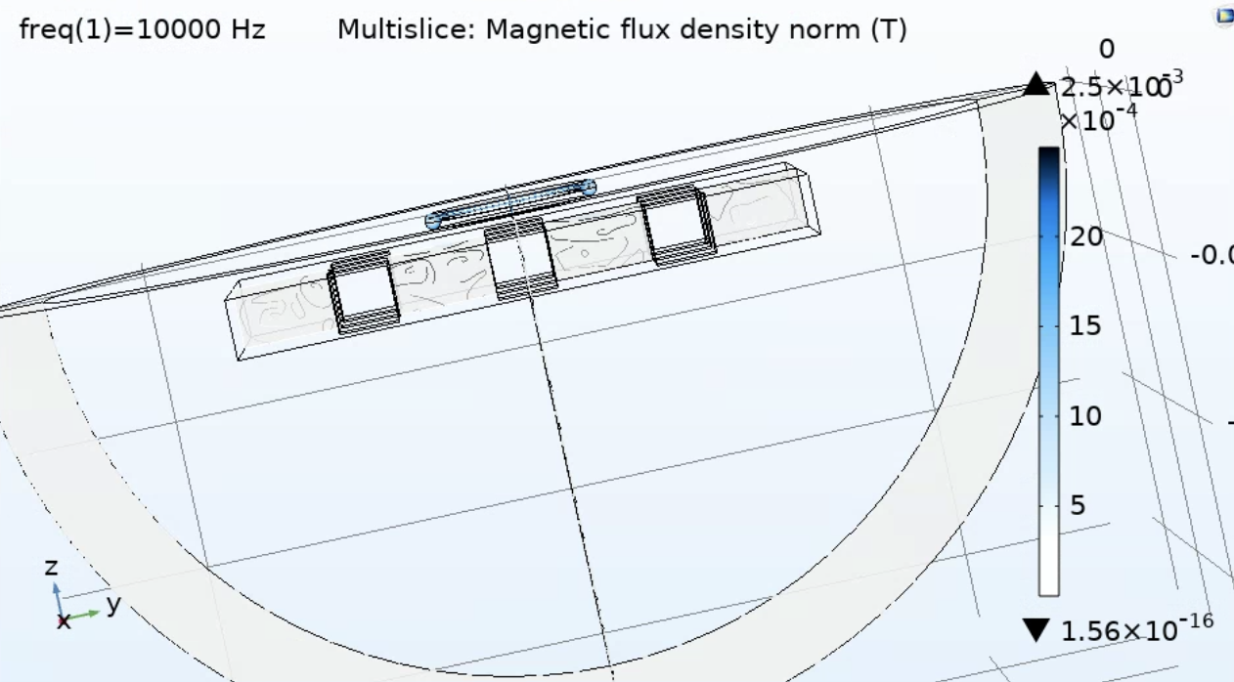
Milestone 2a: Magnetic flux density (9 cell model)
Plotting a cut plane at foam surface

Slide 7
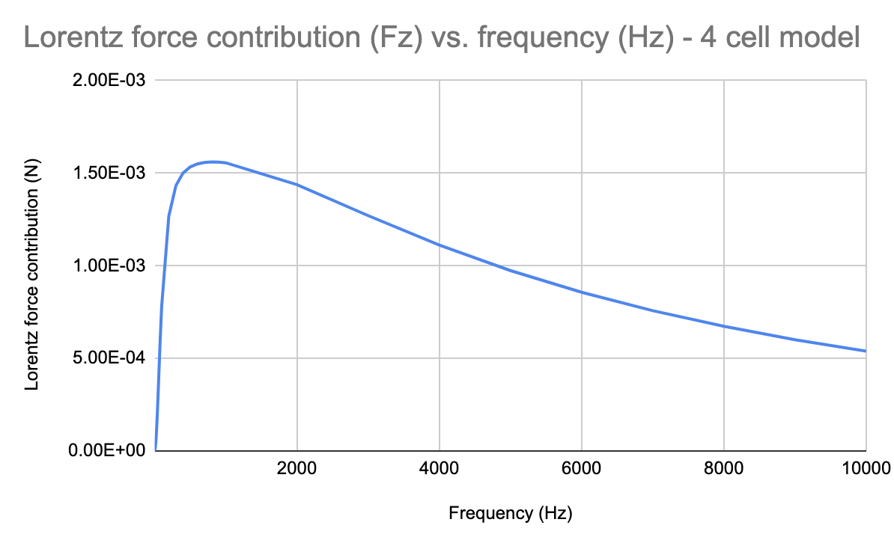
Milestone 2b: Lorentz force vs frequency plots for 4 and 9 cell foam models
Force peaks at ~1000 Hz then gradual plateau (same results for 9 cell model)

Slide 8
Milestone 3: Observations and conclusions
Dual rotor model run for 4 coils, shows symmetric current behavior as PMs rotate (current in opposite directions for upper and lower rotors)
PMs rotate together in the same direction
Frequency domain study for 4 and 9 cell foam models
Results make sense for 4 cell model
Might need to verify results for 9 cell model

Slide 9
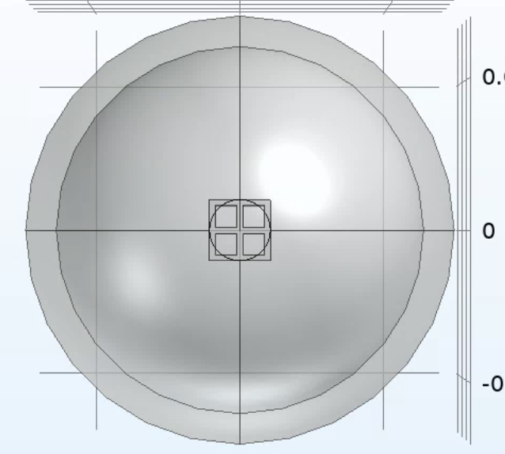
Milestone 3a: Adjusting 4 cell layer foam model and running a frequency domain study
In progress
Yet to analyse frequency domain results
May need to rebuild mesh

Slide 10
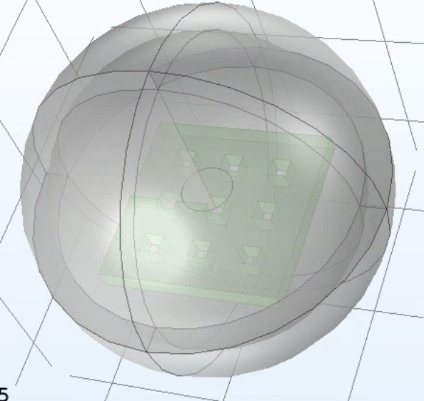
Milestone 3b: Adjusting 9 cell layer foam model and running a frequency domain study
No errors thrown on frequency domain even though domains are not selected
Nonsensical results for derived value tables

