Slide 1
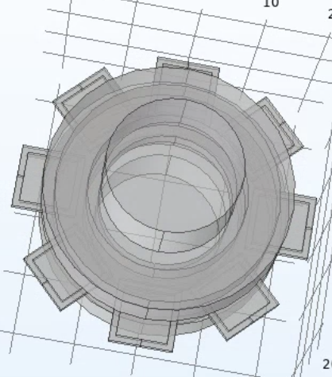
Analysing force, current and position for multi-coil rotating PM model
TBD Project Picture
Date: 3/30/22
Authors:
Cornell University Space Systems Design Studio

Slide 2
Research Q: Using COMSOL to analyze models for 2, 4, 8 coil arrangements for a rotating PM model
Aim: Generate plots of force, position and current over time for different coil arrangements and geometries (2, 3, 4, 6, 8 coils)
Figure 1: Rotating PM model showing 8 coils
Coil geometry adjusted by assigning some coils as an air domain

Slide 3
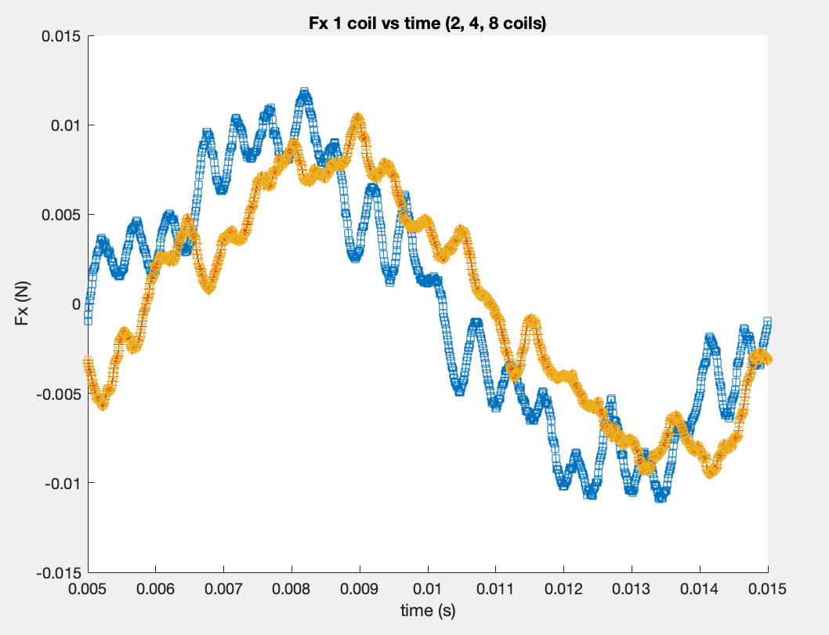
Milestone 1: Generating plots for force on one coil (Fx)
Parameter | # coils | max | min
Fx coil 1 | 2 | 0.335740479 | -0.010907803
Fx coil 1 | 4 | 0.2845773 | -0.009505068
Fx coil 1 | 8 | 0.2845773 | -0.009505068

Slide 4
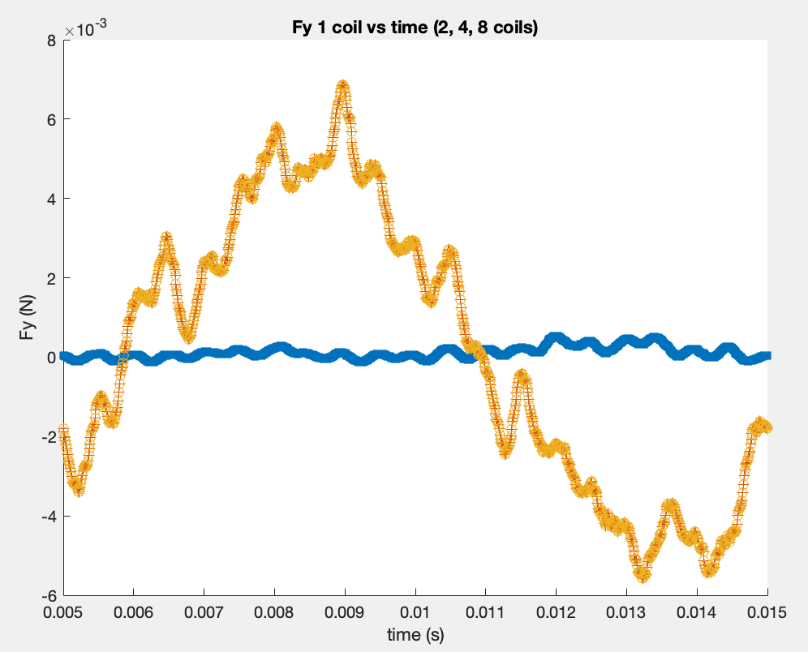
Milestone 1: Generating plots for force on one coil (Fy)
Parameter | # coils | max | min
Fy coil 1 | 2 | 0.000536 | -0.011312459
Fy coil 1 | 4 | 0.175086781 | -0.005577099
Fy coil 1 | 8 | 0.175086781 | -0.005577099

Slide 5
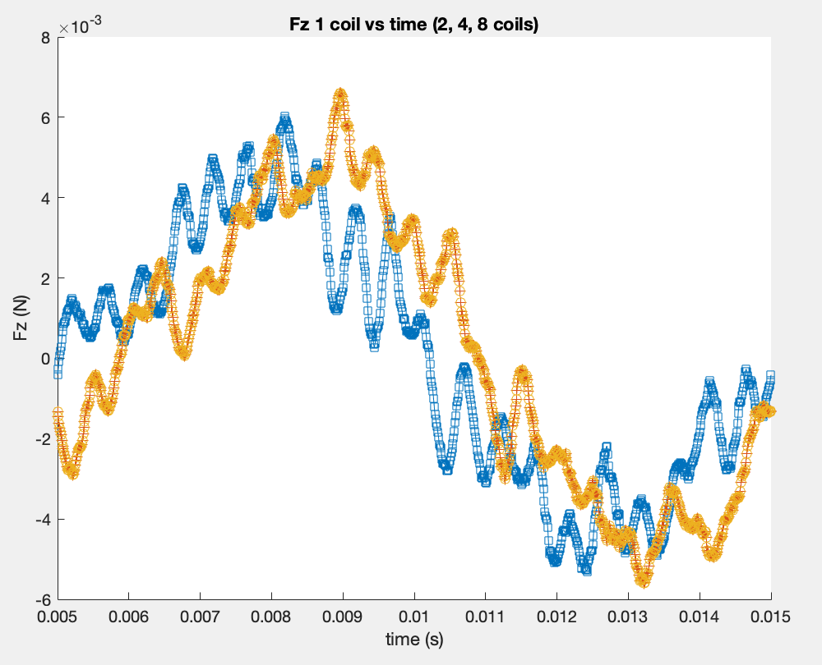
Milestone 1: Generating plots for force on one coil (Fz)
Parameter | # coils | max | min
Fz coil 1 | 2 | 0.307138069 | -0.005305249
Fz coil 1 | 4 | 0.312830164 | -0.005594067
Fz coil 1 | 8 | 0.312830164 | -0.005594067

Slide 6
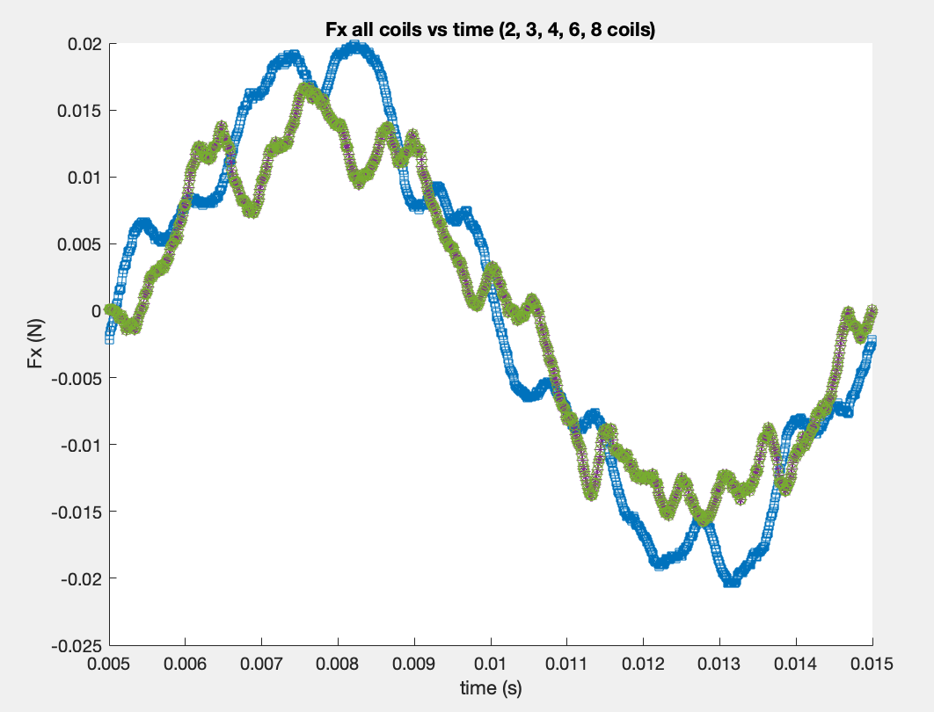
Milestone 2: Generating plots for force on all coils (Fx)
Parameter | # coils | max | min
Fx all coils | 2 | 0.100521914 | -0.020414983
Fx all coils | 3 | 0.071625747 | -0.015754648
Fx all coils | 4 | 0.071625747 | -0.015754648
Fx all coils | 6 | 0.071625747 | -0.015754648
Fx all coils | 8 | 0.071625747 | -0.015754648

Slide 7
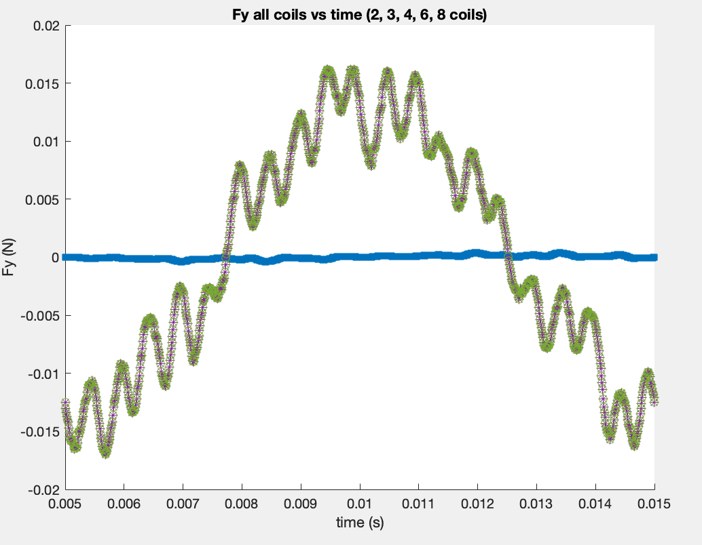
Milestone 2: Generating plots for force on all coils (Fy)
Parameter | # coils | max | min
Fy all coils | 2 | 0.000386 | -0.007700458
Fy all coils | 3 | 0.031897066 | -0.017013188
Fy all coils | 4 | 0.031897066 | -0.017013188
Fy all coils | 6 | 0.031897066 | -0.017013188
Fy all coils | 8 | 0.031897066 | -0.017013188

Slide 8
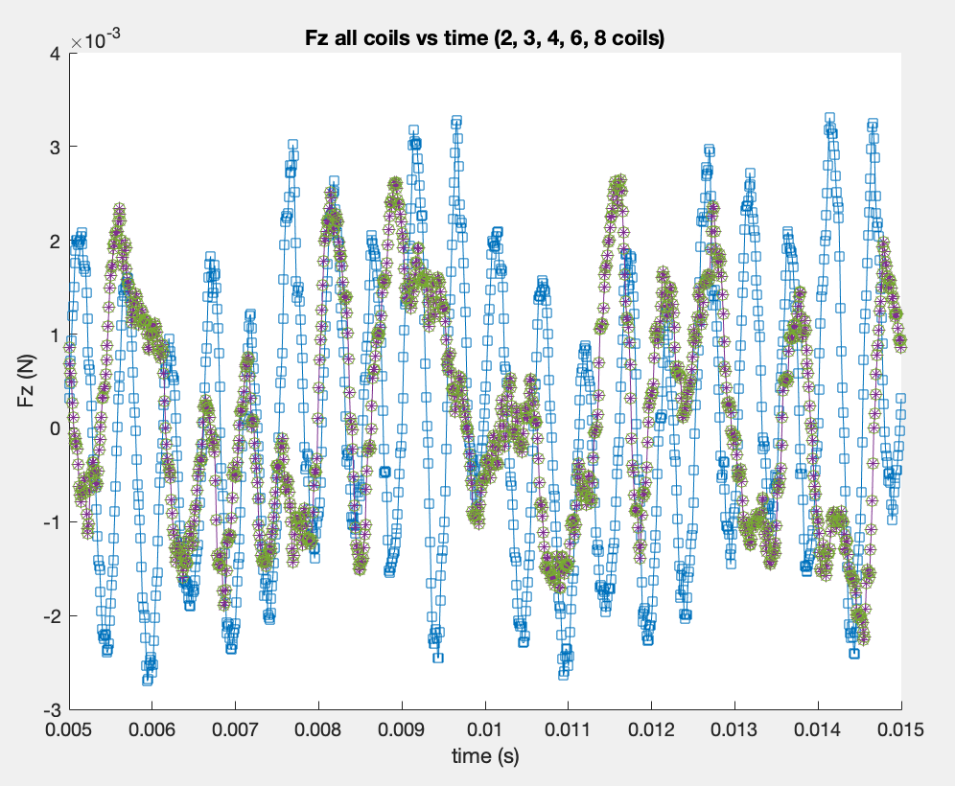
Milestone 2: Generating plots for force on all coils (Fz)
Parameter | # coils | max | min
Fz all coils | 2 | 0.487594399 | -0.002699401
Fz all coils | 3 | 0.726549011 | -0.002263613
Fz all coils | 4 | 0.726549011 | -0.002263613
Fz all coils | 6 | 0.726549011 | -0.002263613
Fz all coils | 8 | 0.726549011 | -0.002263613

Slide 9
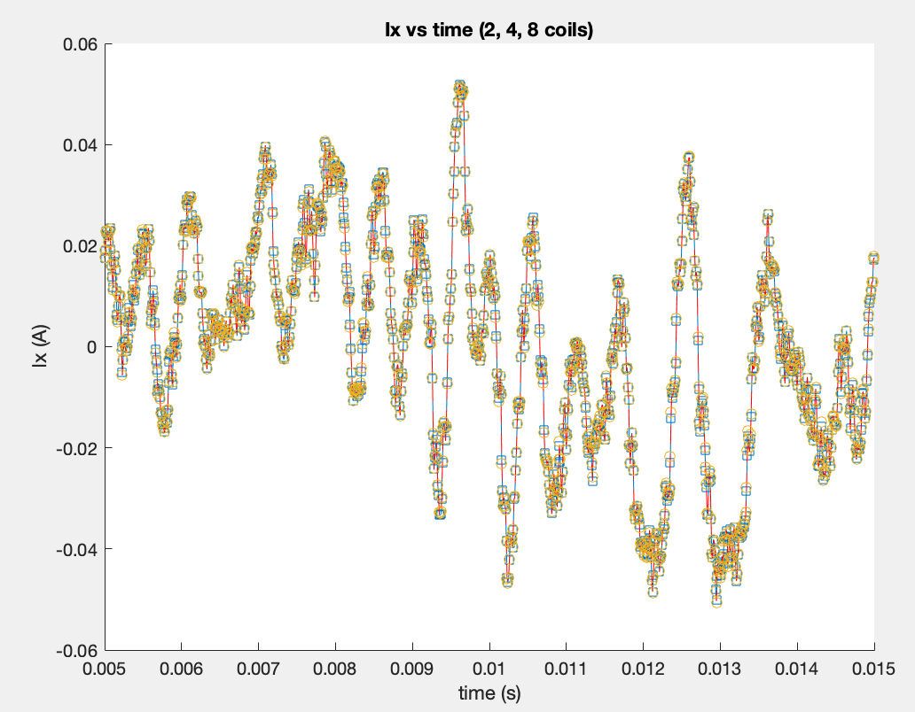
Milestone 3: Generating plots for current (x-component)

Slide 10
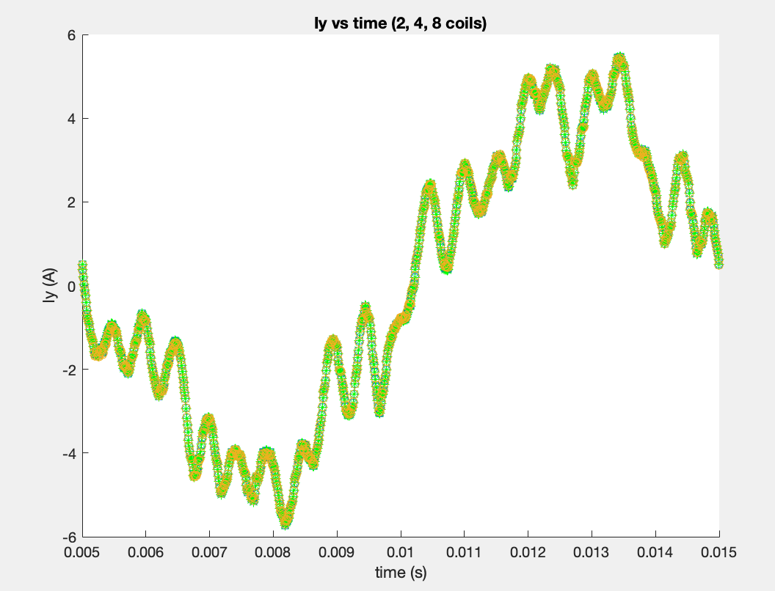
Milestone 3: Generating plots for current (y-component)

Slide 11
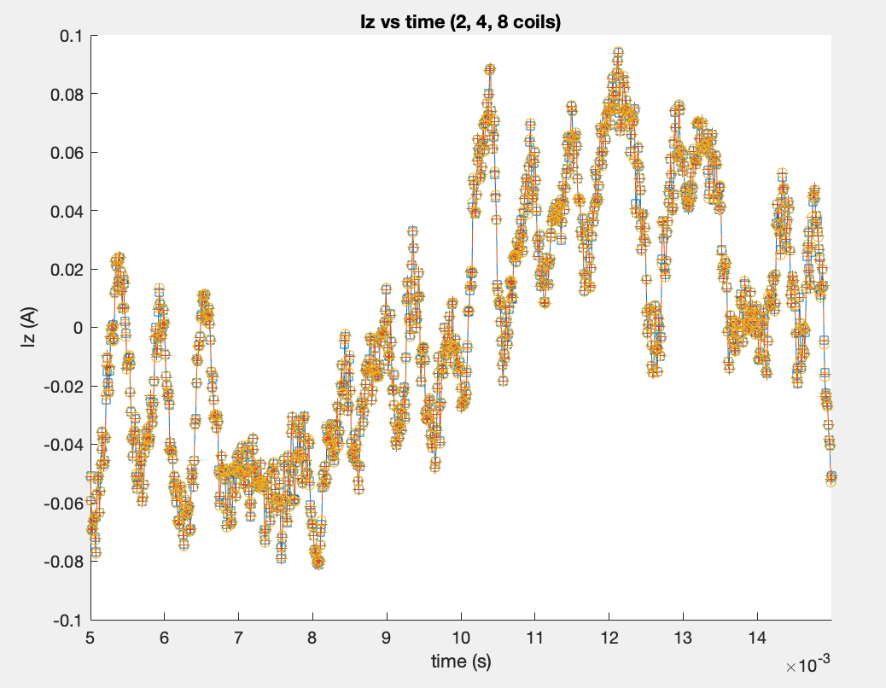
Milestone 3: Generating plots for current (z-component)

