Slide 1
FINAL REVIEW CYBER BULLYING RECOGNITION SYSTEM FOR TWITTER, FACEBOOK USING ML ALGORITHMS FOR SENTIMENT ANALYSIS
ALOK SINHA (17BCE2380)
SUNNY AGRAWAL (17BCE2389)
BIBEK SINGH (17BCE2393)
Submitted
To
Dr. Anuradha G
Assistant Professor

Slide 2
Input
User Tweets and Facebook comments.
Preview
The main aim of the detecting the cyberbullying tweets will help to improve manual monitoring for cyberbullying on Twitter.
In this project we fetch the tweets from twitter accounts and preprocess the tweets and applying generated model will detect the cyberbullying or not.
Cyberbullying
The use of electronic communication to bully a person, typically by sending messages of an intimidating or threatening nature.
Application
recommending products and service
measuring public opinion
it helps to create social harmony in the society

Slide 3
Algorithm
I. Naive Bayes Classifier
It is a classification technique based on Bayes’ Theorem with an assumption of independence among predictors.
II. Logistic regression
Logistic regression is the appropriate regression analysis to conduct when the dependent variable is dichotomous (binary).
III. Random forest
Random forests or random decision forests are an ensemble learning method for classification, regression and other tasks that operate by constructing a multitude of decision trees at training time and outputting the class that is the mode of the classes or mean prediction of the individual trees.
IV. Decision tree
A decision tree is a decision support tool that uses a tree-like model of decisions and their possible consequences, including chance event outcomes, resource costs, and utility.
V. Support Vector Machine (SVM)
In machine learning, support-vector machines are supervised learning models with associated learning algorithms that analyze data used for classification and regression analysis.

Slide 4
Feedback
Based on the user tweets and the associated sentiment in the user feedback, it categorize user feedback as positive, negative, or neutral. positive feedback gets a higher sentiment score while negative feedback gathers a lower score.
Why
I. Decision Tree
It doesn’t require to normalize the data.
It is fast to train as well as run.
It can handle multidimensional data.
II. Logistic Regression
Easier to implement, interpret, and very efficient to train.
It is very easy to realize and achieves very good performance with linearly separable classes.
III. Naive Bayes Classifier
Handle noisy data.
Allowing multiple classes of classification
Its doesn’t require a large amount of data to work.
simple and efficient to work.

Slide 5
IV. Support Vector Machine
It is not suitable for large data set.
It is relatively memory efficient.
V. Random Forest
It is suitable for extremely large data set.
it has maximum accuracy with optimum solution.
System Requirement
Hardware Requirements
Windows 10
I5 8th gen
Software Requirements
Visual Studio
Twitter API

Slide 6
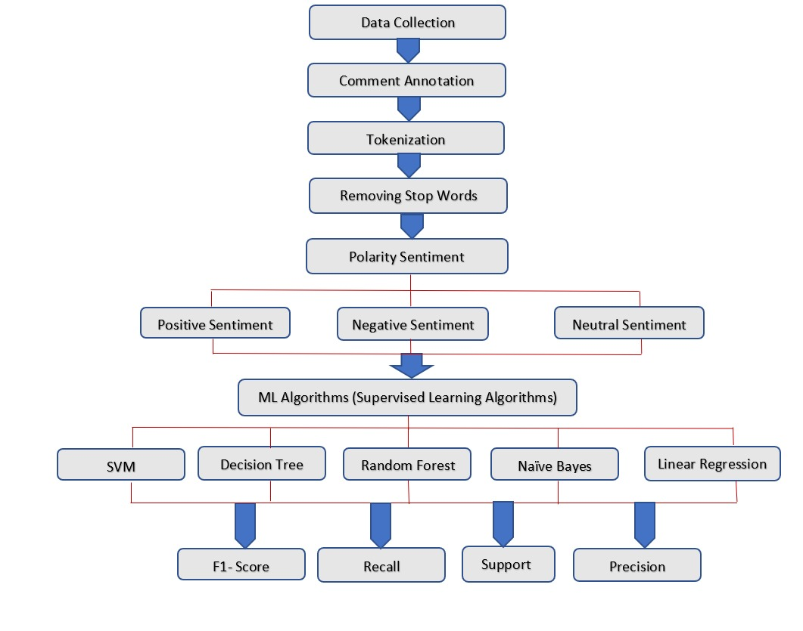
Architecture Diagram

Slide 7
Conclusion
We have generalized five different Machine Learning Algorithms for sentiment analysis of the Twitter and Facebook. The generalization of different approach and methods, studied all the different approach to make Sentiment Analysis in a better way. Different parameters are taken in consideration for different analysis that are positive, negative, and neutral. The presentation of these algorithm will make a good understanding for making the performance better. Any individual can predict which algorithm will work far better for making sentiment analysis. The post and status are posted in large number where the best technique will prove to be the best out of it and we are in approach to make a comparative analysis of different algorithms. We tentatively conclude which part of algorithm have effective on sentiment analysis because the algorithm should be good enough for the parsing, semantic analysis and able to handle errors with the help of tools.

Slide 8
Future Modification
The validity and accuracy of the predictive techniques to detect cyberbullying on twitter for this situation essentially dependent on the right psychometric order of the text. In future it is expected to improve the system created by utilize more accurate dataset and to detect the cyberbullying or not. It likewise applies other machine learning algorithm and check the accuracy of models. Higher accuracy model will assist with detecting more accurate harassing. Another fascinating bearing for future work would be the detection of fine-grained cyberbullying classes like threats, curses and expressions of racism. At the point when applied in a cascaded model, the system could discover serious instances of cyberbullying with high precision. This would be especially fascinating for checking purposes. Moreover, our dataset takes into consideration detection of member jobs regularly associated with cyberbullying.

