Slide 1

PROF. H. N. MISRA COLLEGE OF EDUCATION
Subject: Curriculum Development and Assessment
Topic : SOCIOLOGICAL DETERMINANTS OF CURRICULUM
SUBMITTED TO: SUBMITTED BY:
MR. NIRAJ K. CHAUDHARY DIVYA KRIPLANI B.Ed - II
Roll No. – 30(A)

Slide 2


Slide 3
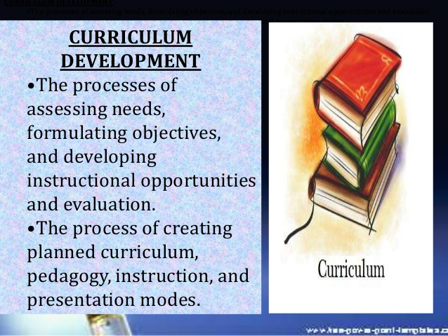

Slide 4
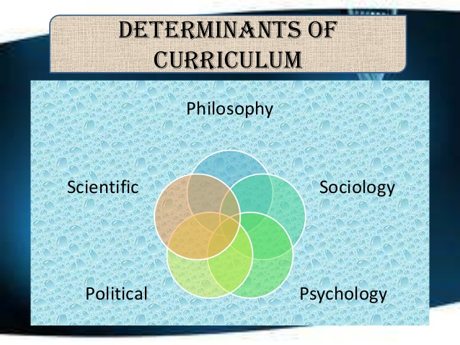

Slide 5


Slide 6
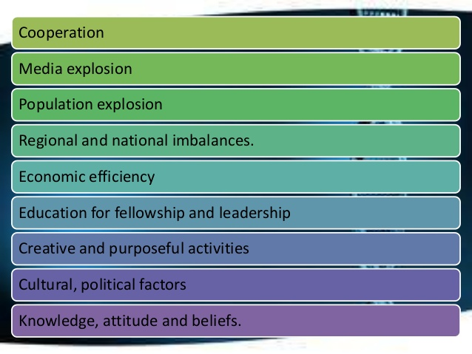

Slide 7

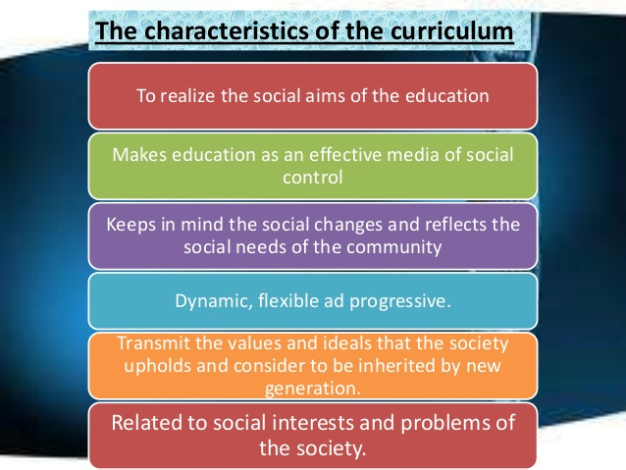

Slide 8
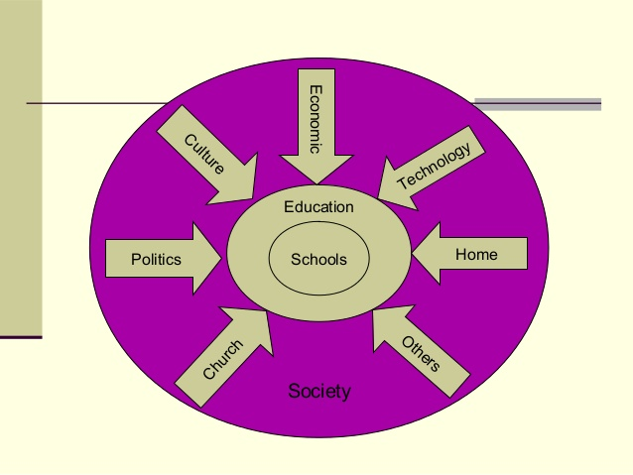

Slide 9
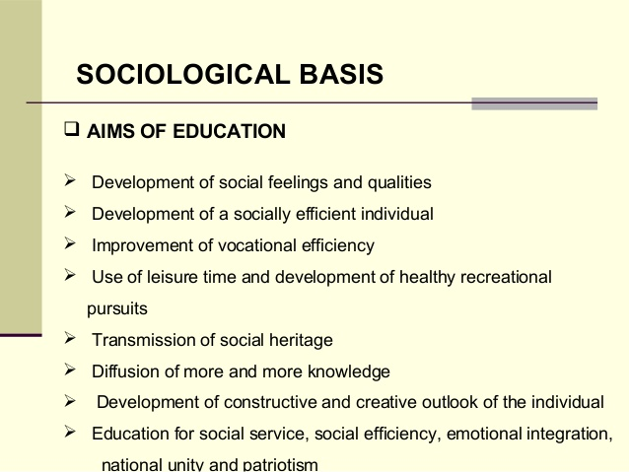

Slide 10
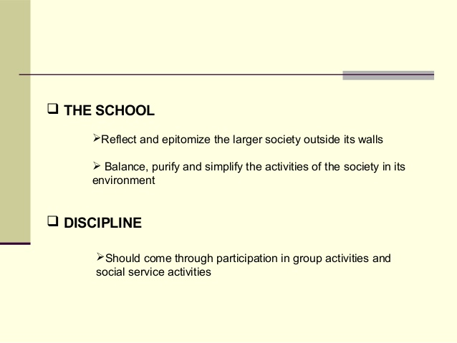

Slide 11
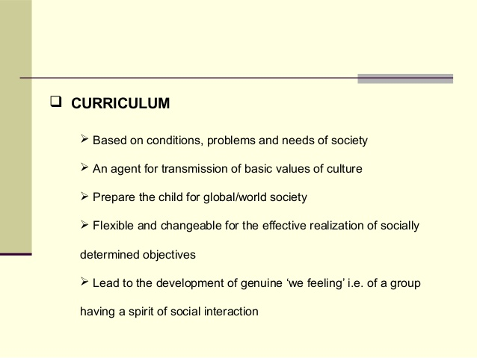

Slide 12
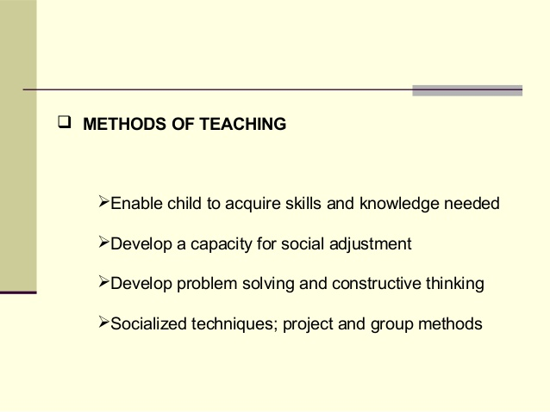

Slide 13


Slide 15
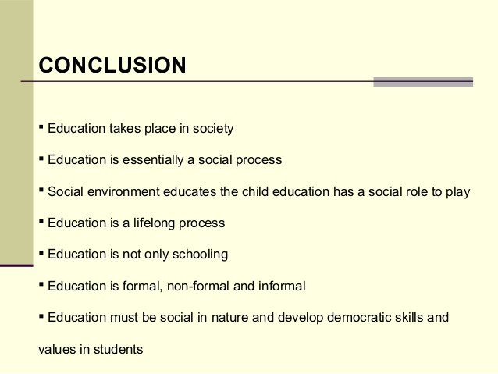

Slide 16


