Slide 1

Capstone Project - The Battle Of The Neighborhoods
Applied Data Science Capstone by IBM/Coursera
Harsh V Singh

Slide 2
Introduction - Business Problem
In this project, we will undertake the task of identifying the best location to open a new Pizza Place in Bangalore, India.
The rapid growth of the city provides a great number of lucrative business opportunities. While the city already has a vast number of restaurants spread across different localities and neighbourhoods, there are many new neighbourhoods coming up as a result of the expanding city limits. At the same time, there are new residential and commercial development projects across various locations. Both these factors combined give rise to unique business opportunities for entrepreneurs in the hospitality and food services industry.
In order to identify the most suitable location for opening a new restaurant, specifically a Pizzeria, we will follow these steps -
Collect data and analyze the various neighbourhoods across Bangalore
Identify similar neighbourhoods by categorizing them into clusters
Identify the clusters which typically have a high number of Pizza Places
Among those clusters, identify the neighbourhoods which have a scarcity of Pizza Places as compared to their respective clusters

Slide 3
Data Collection And Exploration
In the first stage of this project, we will collect the necessary data from various sources.
We can get data on pincode-wise neighbourhoods in Bangalore from this website - https://finkode.com/ka/bangalore.html. We can use the BeautifulSoup library to extract data from the webpage and store it in a pandas dataframe.
Next, we can do some preliminary clean up of the data - filtering the relevant pincodes, cleaning neighbourhood names, removing/ combining duplicate pincodes into a single row, etc.
Once we have a clean set of neighbourhoods, we will use the Google Maps API to fetch coordinates for each of the neighbourhoods.
We can then use the Folium library to plot the map of Bangalore and visualize the neighbourhoods.
We will use Foursquare API to get the list of venues for each of these neighbourhoods

Slide 4
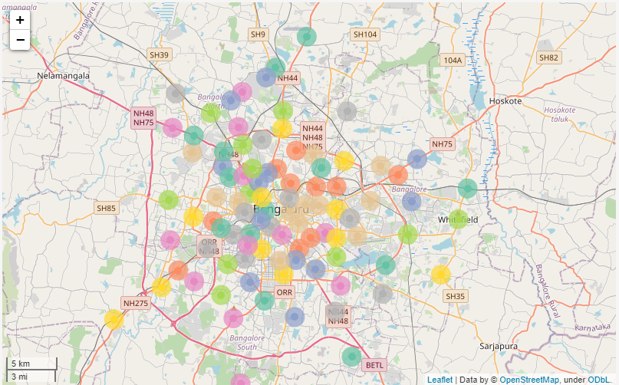
Visualizing Neighbourhoods In Bangalore

Slide 5
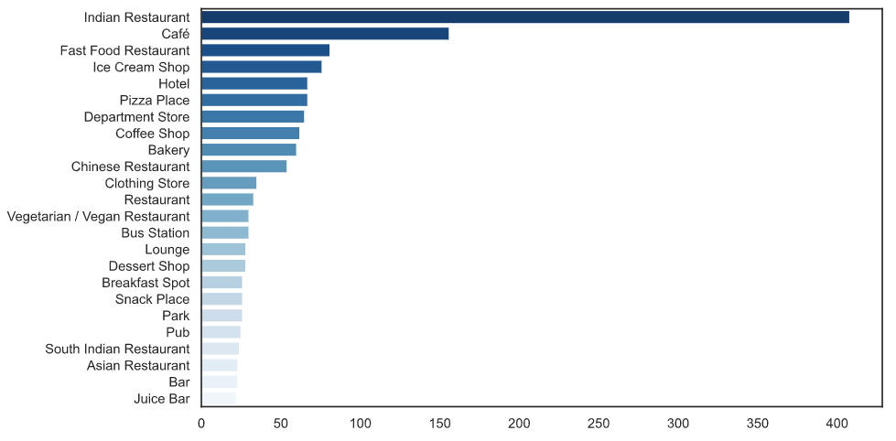
Top 25 Categories Of Venues In Bangalore Neighbourhoods
*Source: Foursquare API

Slide 6
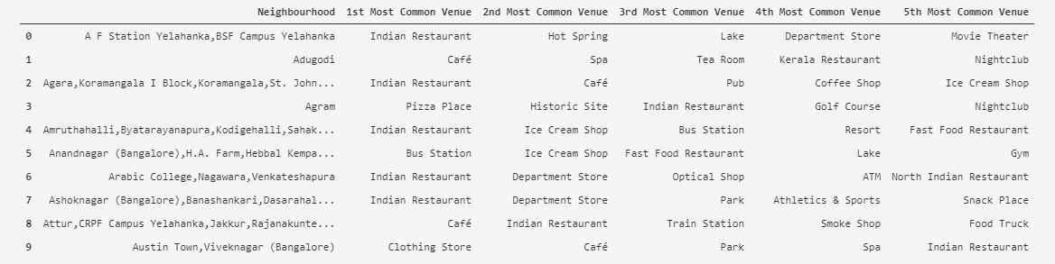
Sample Data - Most Common Categories Across Neighbourhoods

Slide 7
Modelling And Analysis
Given that we have data containing the features of each neighbourhood in Bangalore, we can now use this data to build our K-means clustering model.
We will run the algorithm for multiple values of k, and select the one with the highest Silhouette Coefficient. We will also plot the sum of squared errors and silhouette coefficients for each value of k.
For our final analysis, we will add the Cluster Labels to the venue data. We will then analyze which clusters of neighbourhoods typically have a high ratio of Pizza Places located in their vicinities.
Finally, we will try to shortlist neighbourhoods within those clusters which don't have a sufficient number of pizza places.

Slide 8
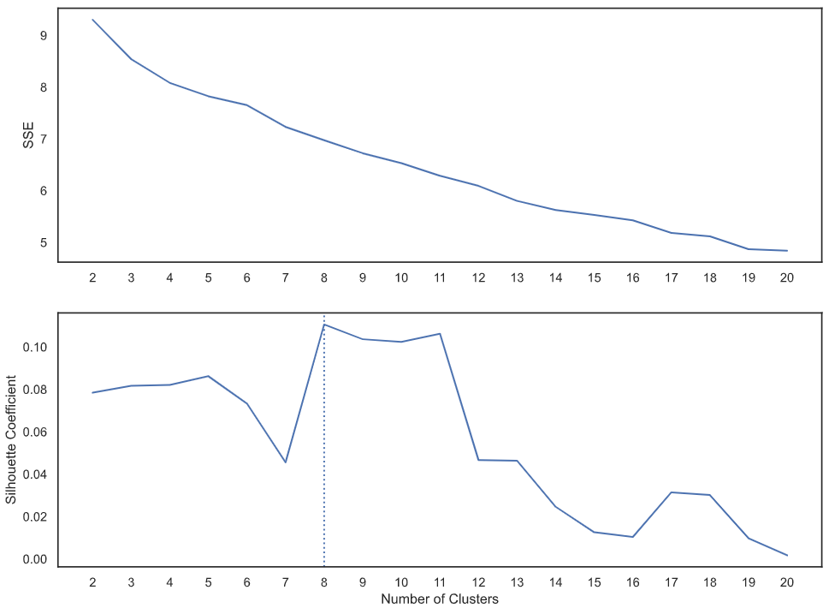
Hyperparameter Tuning For K-means Clustering Model

Slide 9
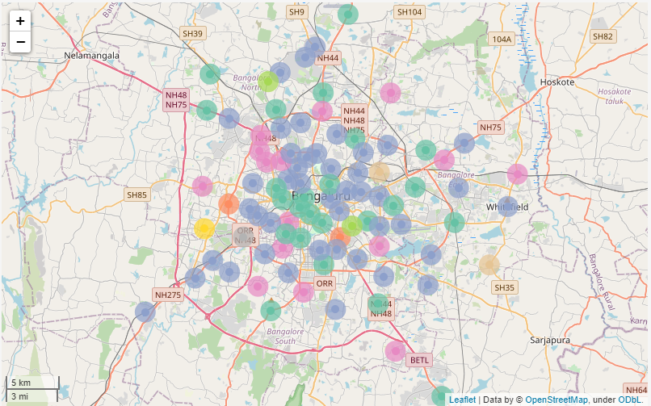
Neighbourhood Clusters In Bangalore

Slide 10
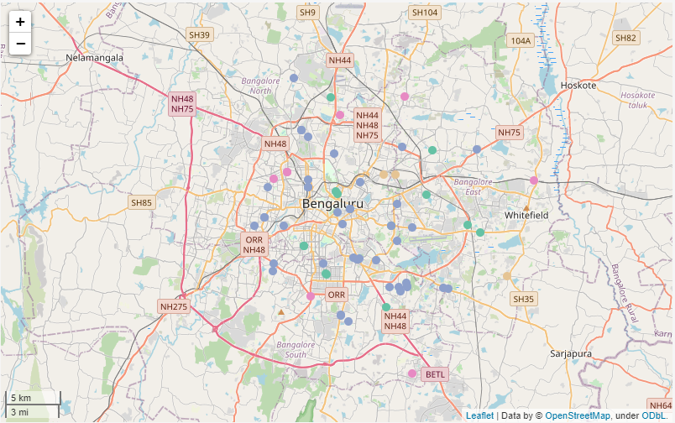
Locations Of Existing Pizza Places – By Cluster

Slide 11
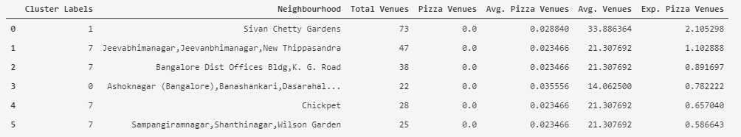
Suitable Neighbourhoods For Opening New Pizzeria
Our final result includes a list of 6 neighbourhoods which are most suitable for opening a new pizzeria. We have presented this list in the order of most suitable to least based on the expected number of pizzerias that should ideally be present in these neighbourhoods. But given that there are many other factors that may go into deciding the suitability of a location, we believe that it is best to review each of these 6 neighbourhoods in further detail. This may require on-the-ground surveys and collecting other relevant data such as property prices, total population, average age and income demographics, residential vs. commercial developments in the area, etc.

