Slide 1

Hospital Management System
A Data Analytics Report: transforming raw transactional data into actionable insights for revenue optimization, patient care, and operational efficiency.
SQL · PYTHON · POWER BI

Slide 2
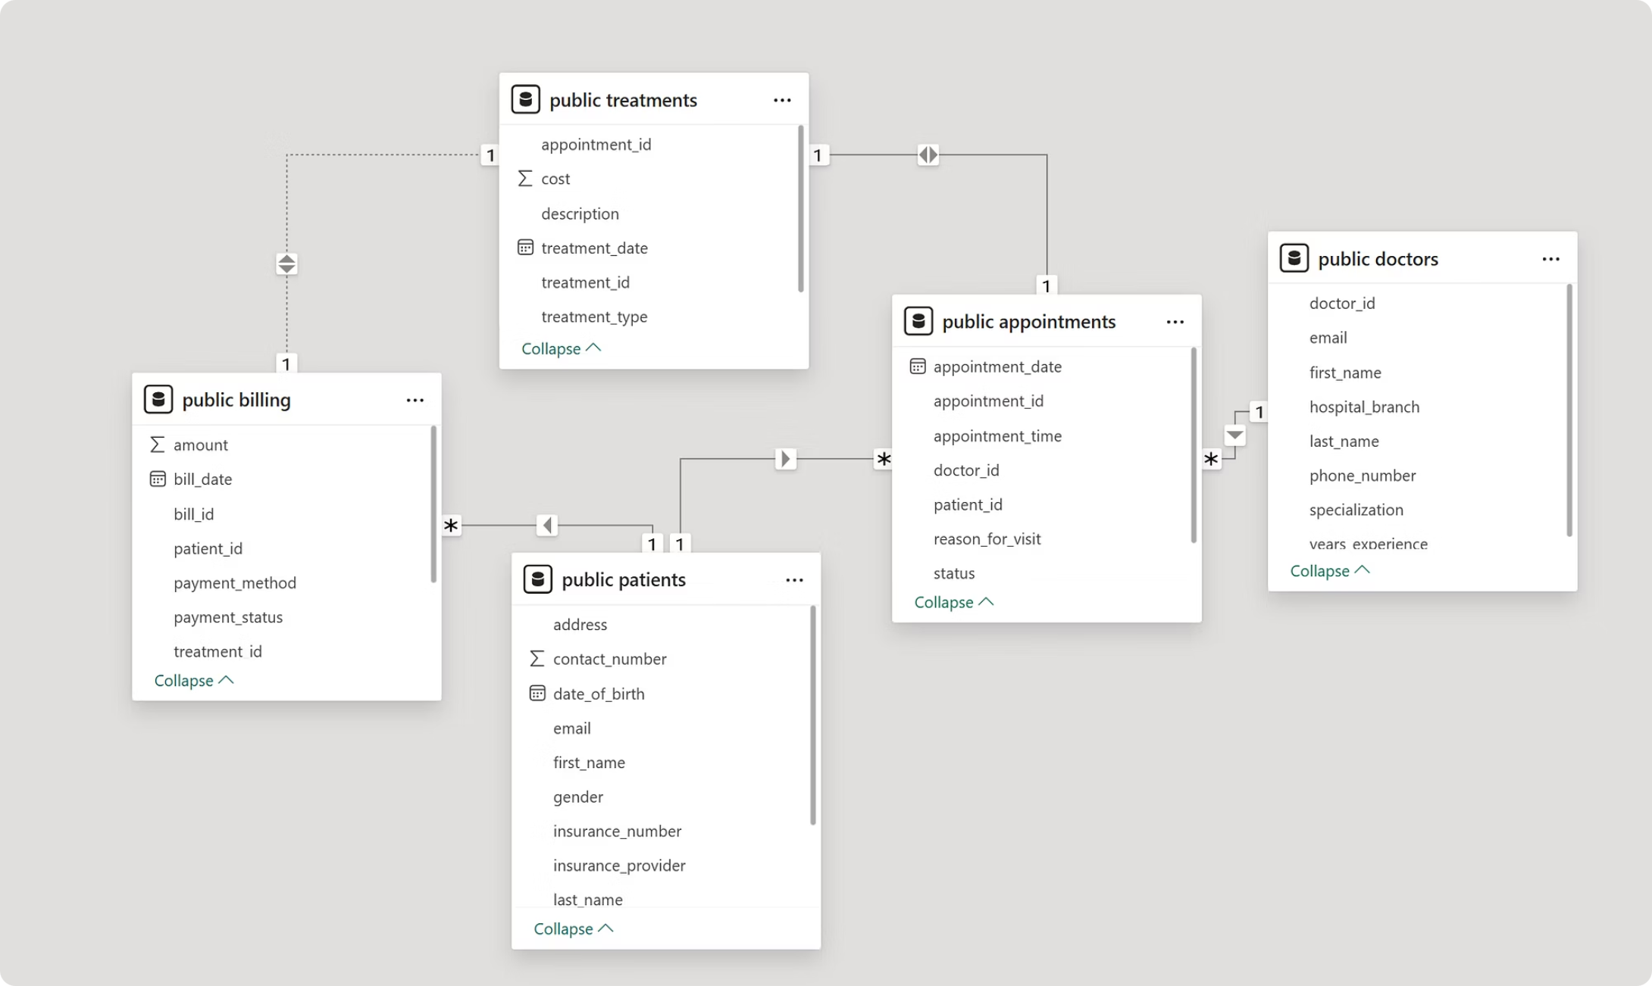

Database Schema & Data Model
Core Tables
Patients : demographics & insurance
Doctors : specialization & experience
Appointments : patient-doctor link
Treatments : procedures & costs
Billing : transactions & payment status
Star-like schema centered on Appointments — ideal for BI analytics.

Slide 3
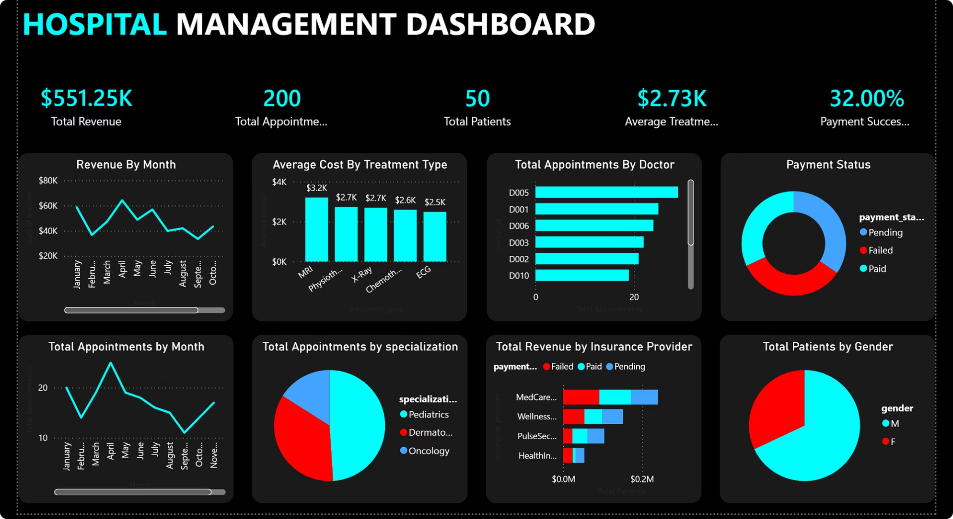
Dashboard Overview
$551.25K
200
50
Total Revenue
Appointments
Patients
$2.73K
32%
Avg. Treatment Cost
Payment Success

Slide 4

Revenue & Payment Insights
🚨 Critical Finding
Only 32% payment success rate major revenue leakage.
Cash flow problems
Inefficient billing system
Insurance processing delays
Revenue Trends
Monthly revenue fluctuates significantly peak mid-year, drops later suggest seasonal or operational inefficiencies.

Slide 5

Doctor Performance & Treatment Costs
Doctor Workload
Doctor D005 handles significantly more appointments uneven distribution creates burnout risk.
Treatment Cost Range
MRI: ~$3.2K (highest)
ECG: ~$2.5K (lowest)
High-cost treatments contribute disproportionately to revenue.

Slide 6
Appointments, Specializations & Demographics
📅 Appointment Trends
🏥 Specialization Mix
Peak in April, decline later — demand variability signals scheduling inefficiencies.
Pediatrics dominates; Oncology has least share. Staffing should match demand.
💳 Insurance Revenue
👤 Patient Demographics
Majority revenue from few providers — some insurers delay or fail payments more frequently.
Male patients significantly higher — may indicate demographic bias or dataset imbalance.

Slide 7

Key Problems Identified
🚨 Low Payment Success (32%)
Major revenue leakage
🚨 Uneven Doctor Workload
Inefficient resource allocation
🚨 Revenue Instability
Seasonal or operational issues
🚨 Insurance Dependency
Risk concentration on few providers

Slide 8


Recommendations
Financial
Stricter billing validation, automate payment follow-ups, improve insurance claim processing
Operational
Balance doctor workload, forecast demand with time series models
Strategic
Expand Pediatrics, improve outreach in low-demand areas
Data
Track payment delays, add patient satisfaction metrics

Slide 9
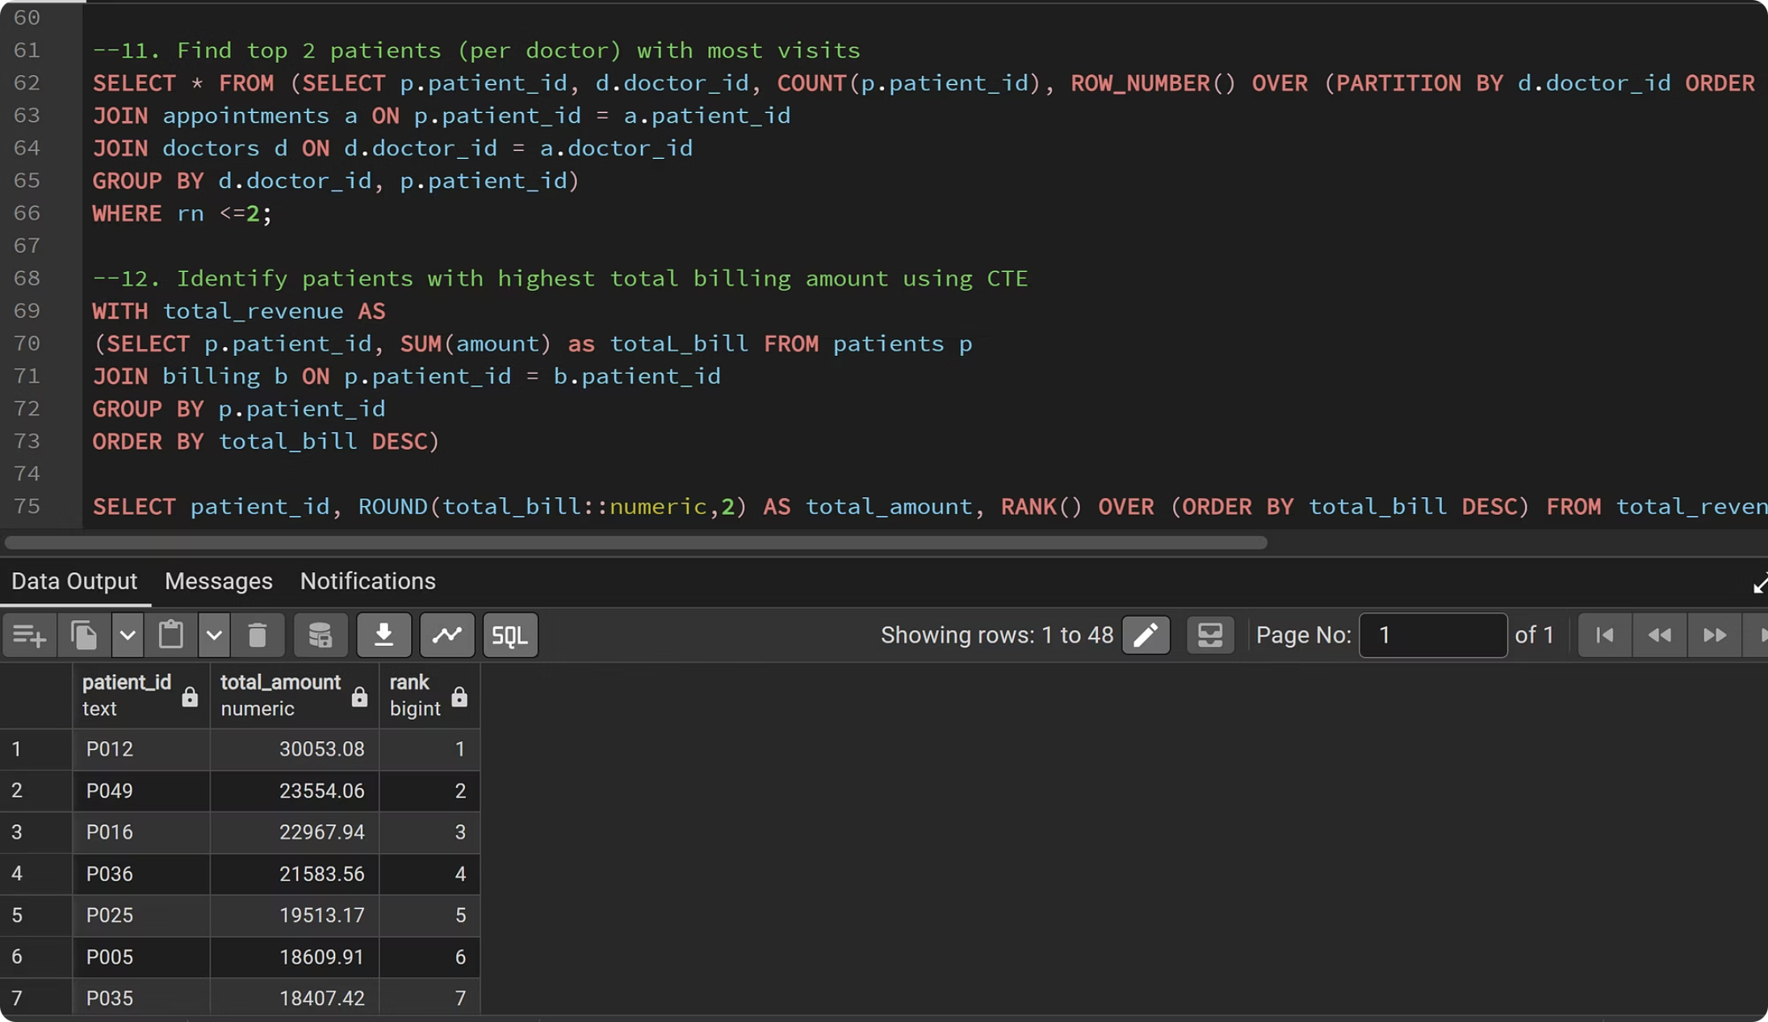
Tools & Conclusion
Technology Stack
SQL : Database design & querying
Python (Pandas, NumPy) : Data cleaning & transformation
Power BI : Visualization & dashboarding
Key Takeaway
This analysis uncovers critical issues low payment success, revenue inconsistency, and resource imbalance , that targeted solutions can resolve to improve financial performance and patient care.

