Slide 1

Amazon Customer Analysis Dashboard
Transforming 1 million transaction records into actionable business insights using Python, SQL, PostgreSQL, and Power BI.

Slide 2
Project Objective
Revenue
Returns
Devices
Top categories & cities
Rate by category
Customer ordering behavior
Sellers
Trends
Best performers by rating & revenue
Monthly sales performance

Slide 3

Tools & Technologies
Python & Pandas
Data cleaning & preprocessing
PostgreSQL & SQL
Database storage & analysis queries
Power BI
Interactive dashboard creation
Jupyter Notebook
Development environment

Slide 4
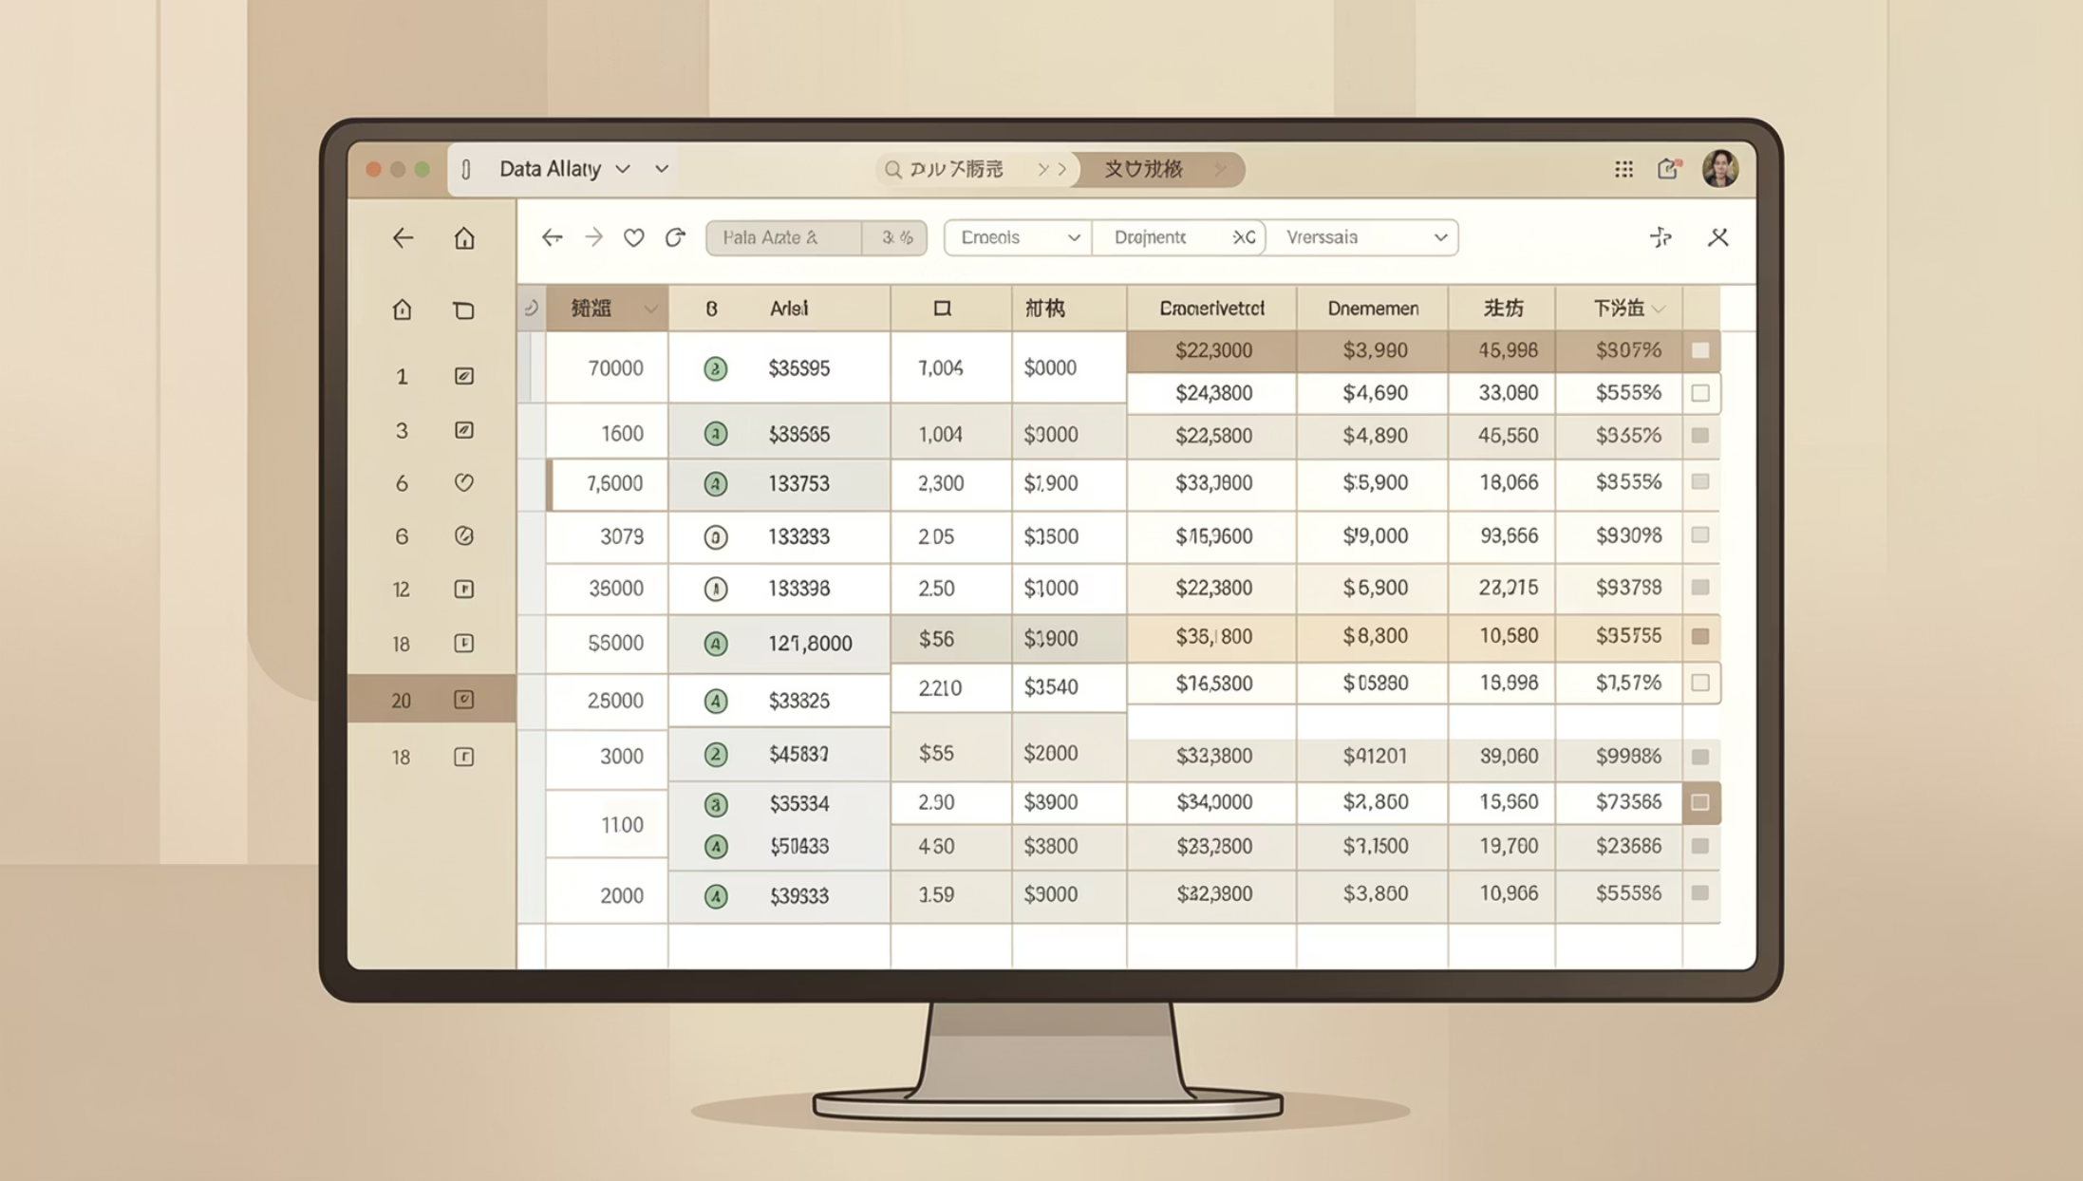
Dataset Overview
Synthetic Amazon e-commerce dataset — ~1,000,000 rows of real-world transaction data.
Customer Data
User ID, City, Device Type, Payment Method
Product Data
Category, Brand, Price, Discount, Rating
Transaction Data
Purchase Date, Return Status, Delivery Status

Slide 5
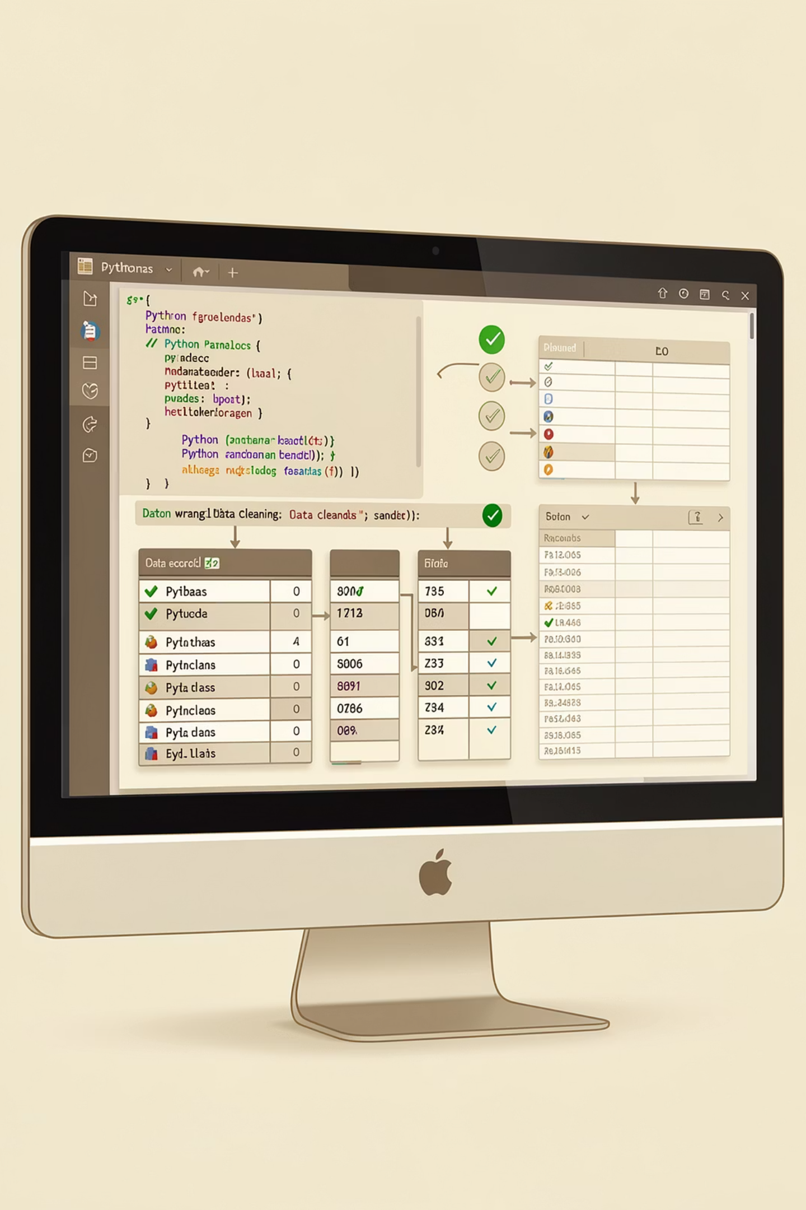
Data Cleaning & Preparation
01
Load CSV
Import with Pandas
02
Handle Missing Values
Median fill for seller ratings
03
Standardize
Rename columns, convert dates
04
Validate & Export
Check duplicates, export clean data

Slide 6
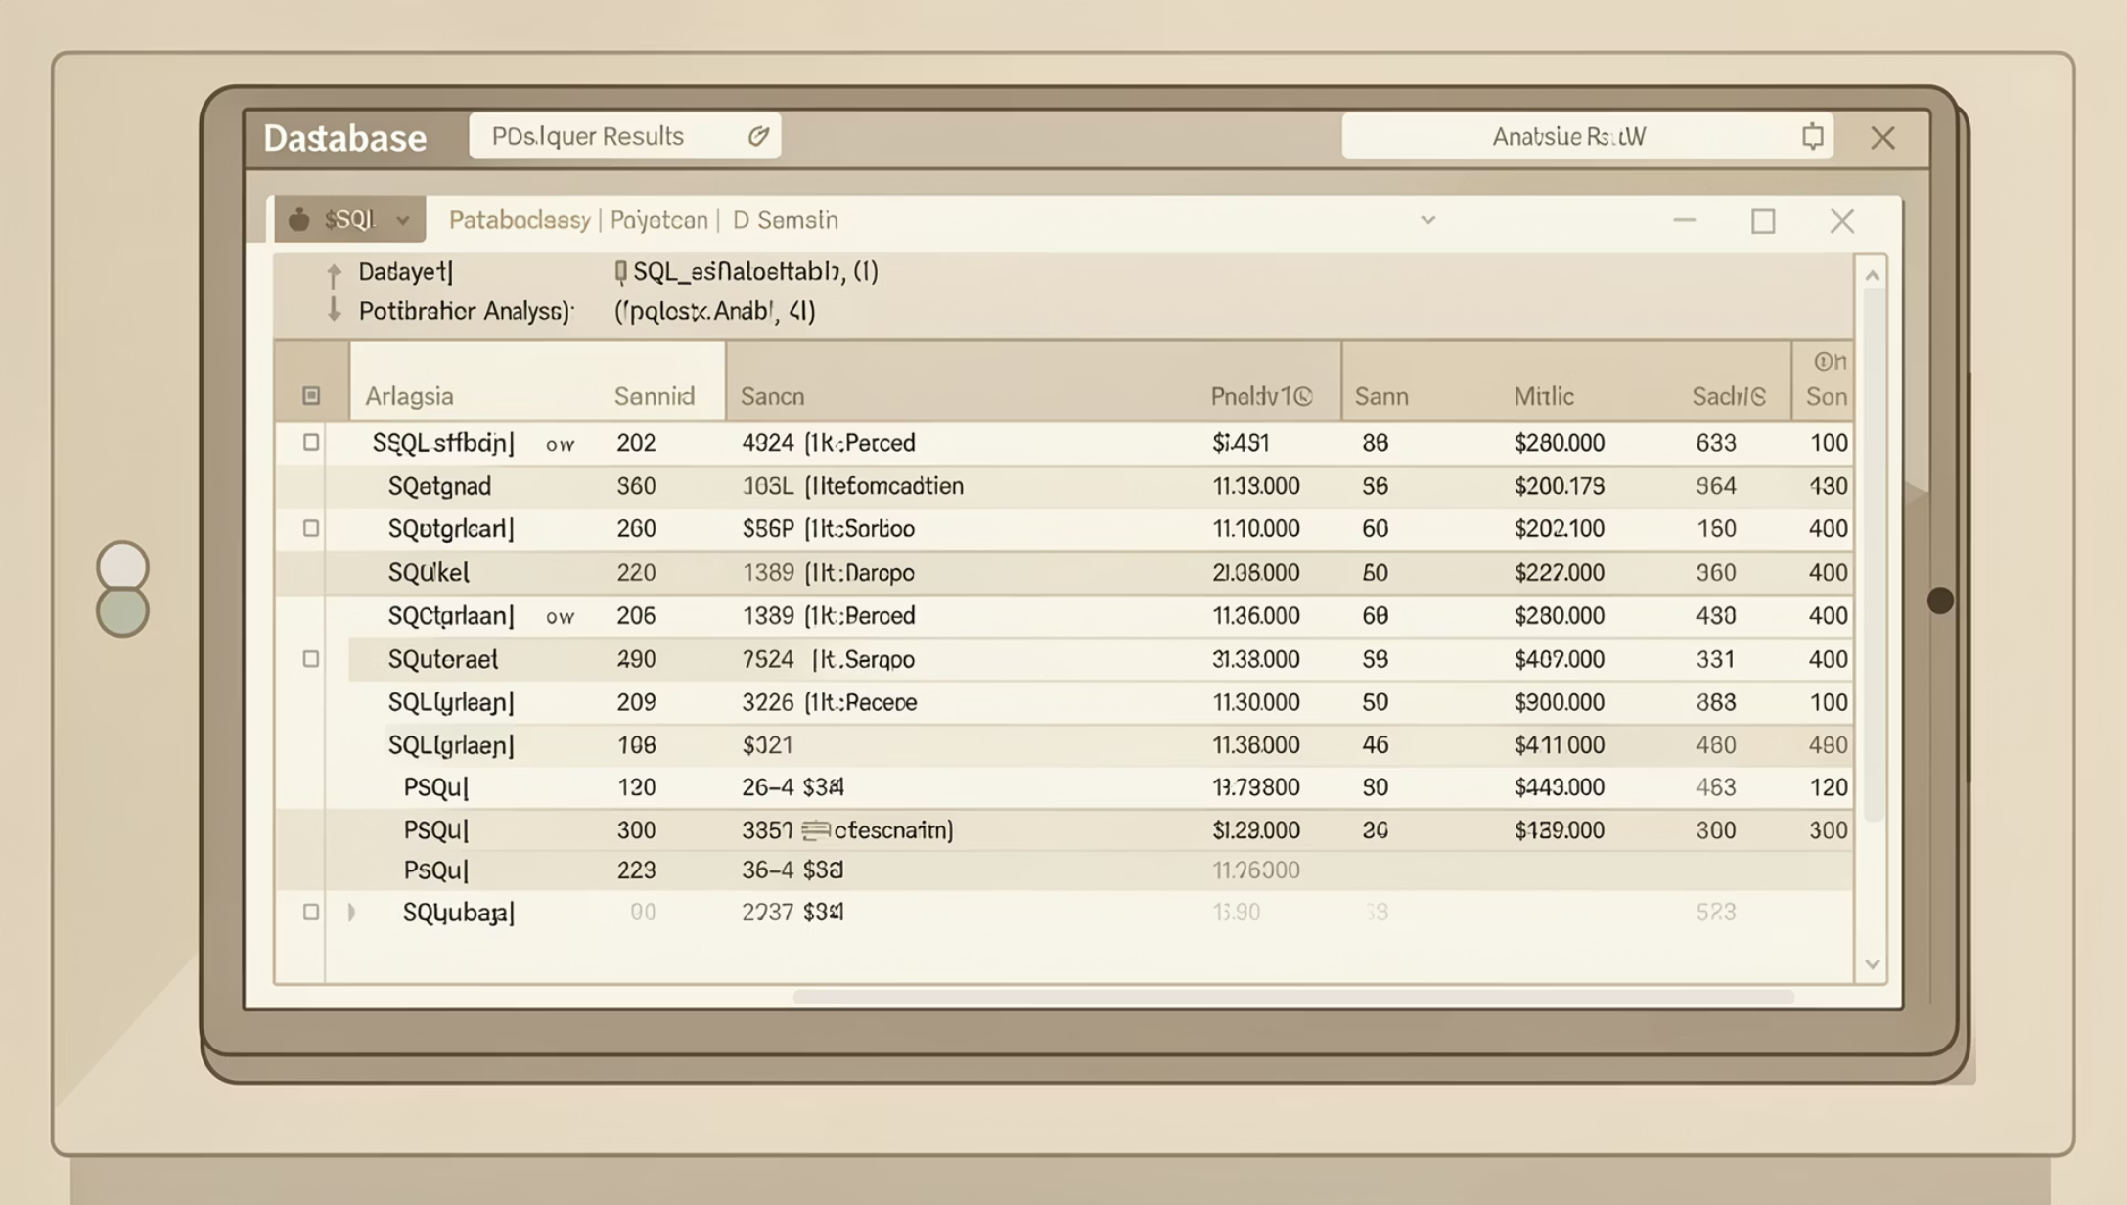
SQL Analysis in PostgreSQL
Key Analyses
Top cities by revenue
Monthly revenue trends
Return rate by category
Top-performing sellers
Category ranking with window functions
SQL Concepts Used
GROUP BY
CTES
WINDOW FUNCTIONS
RANK()
CASE WHEN

Slide 7
Power BI Dashboard — KPIs
1M
₹8.82B
11.6%
Total Orders
Net Revenue
Return Rate
₹9.94K
3.75
Avg Order Value
Avg Seller Rating

Slide 8
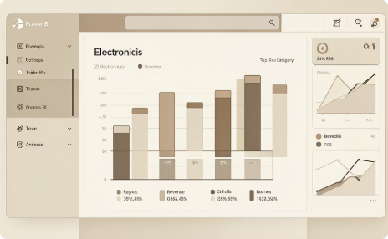
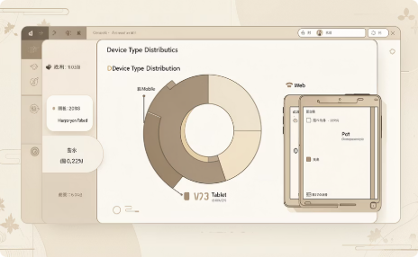
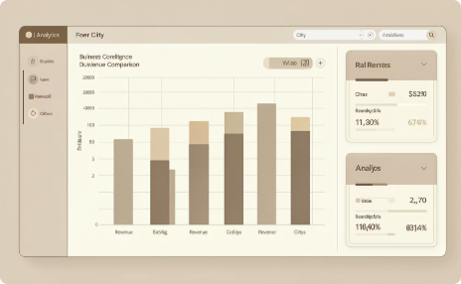

Dashboard Visualizations
Revenue by Category
Orders by Device
Revenue by City
Monthly Revenue Trend
Electronics leads revenue
Mobile, Web & Tablet split
Metro cities drive sales
Seasonality & growth patterns

Slide 9
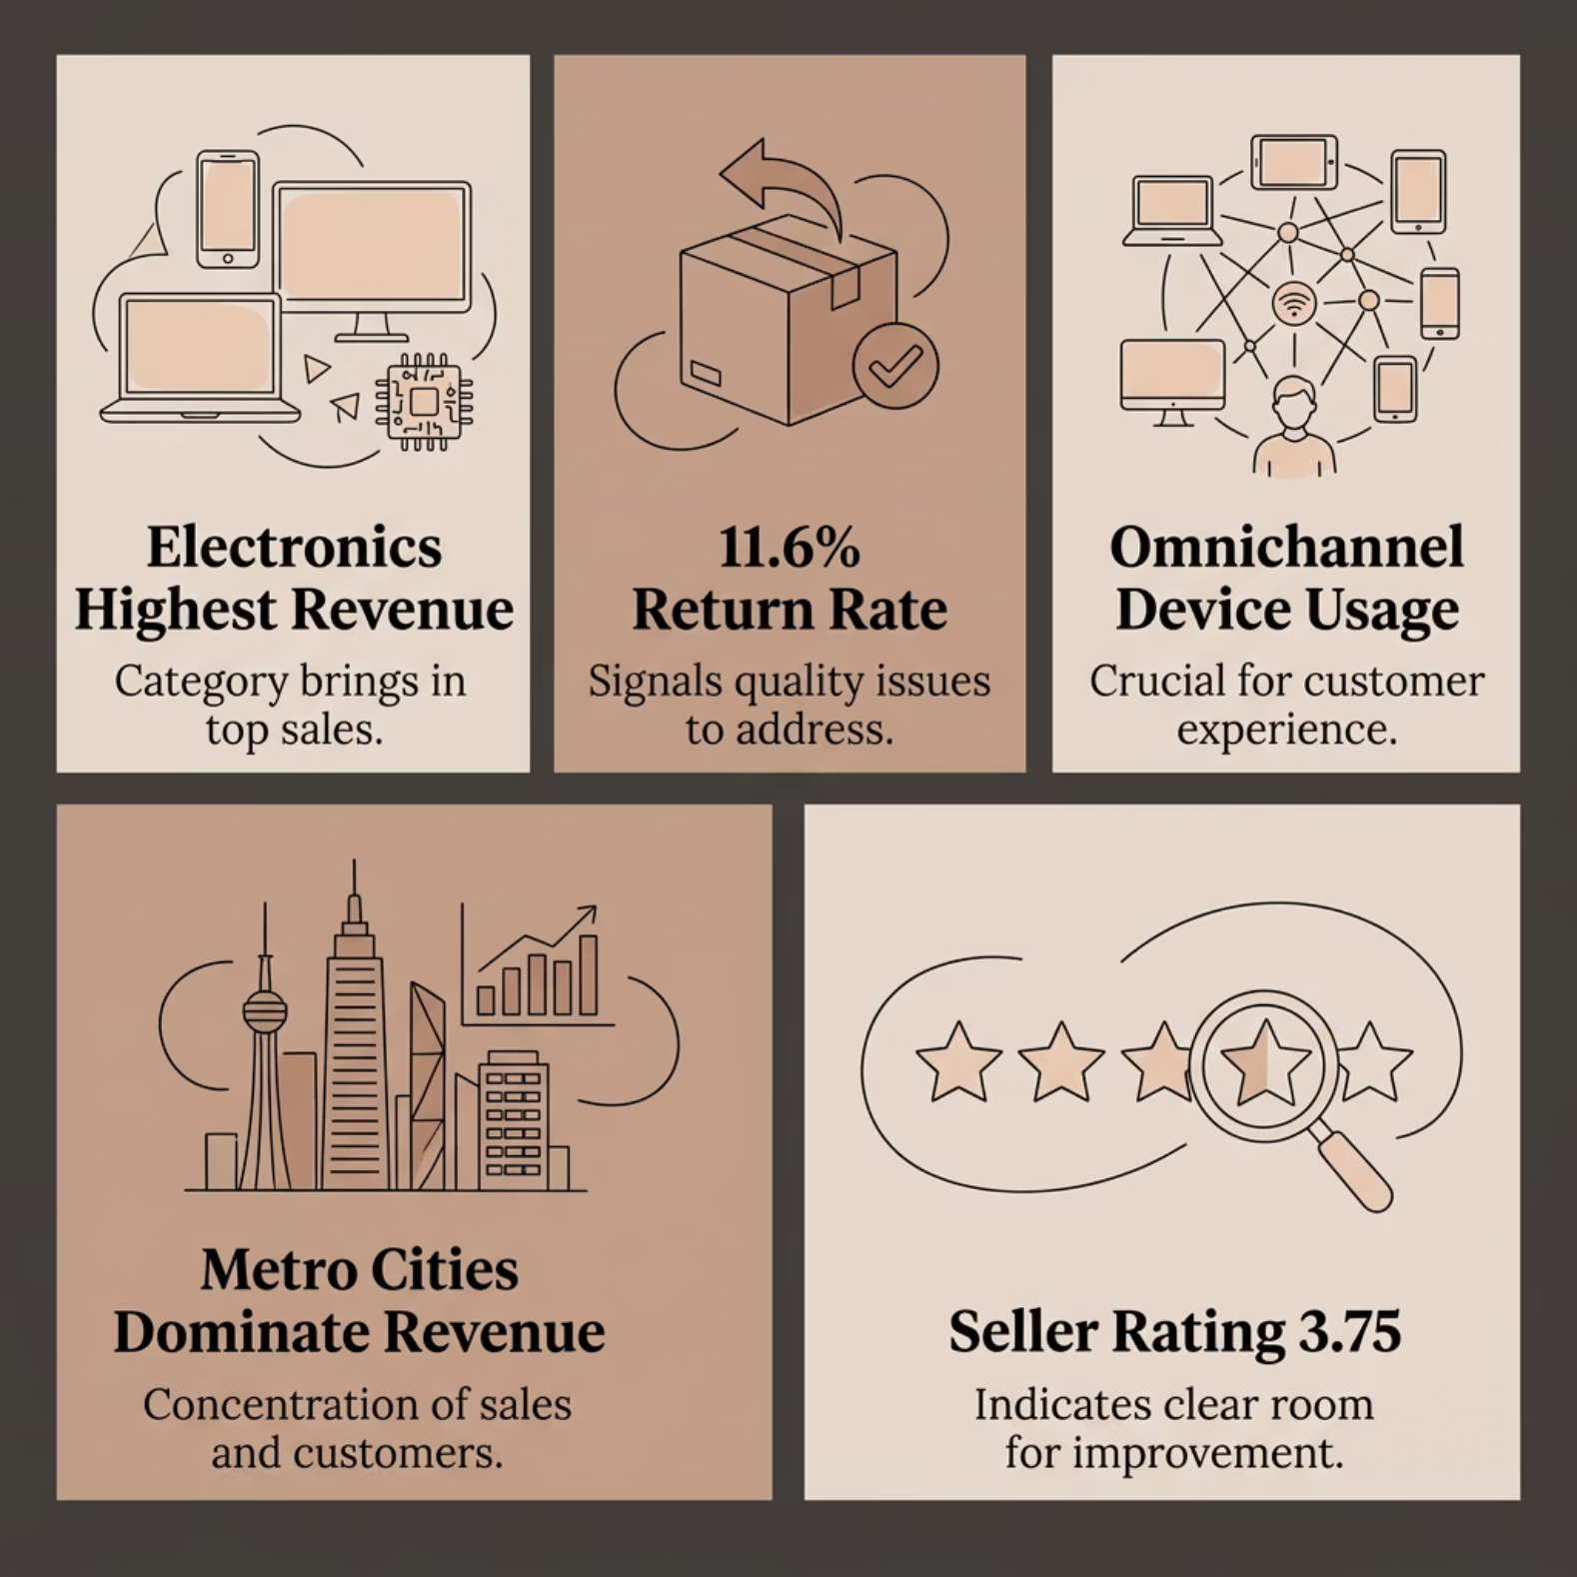

Key Business Insights
What the Data Reveals
Electronics — top revenue category
11.6% returns — quality & delivery gaps
Multi-device — omnichannel essential
Metro cities — primary revenue drivers
3.75 seller rating — room to improve

Slide 10


Recommendations & Conclusion
Improve Returns
Target high-return categories
Raise Seller Standards
Stricter quality benchmarks
Focus on Top Cities
Targeted metro campaigns
Mobile Optimization
Enhance mobile experience
Seasonal Marketing
Use trends for promotions & inventory
End-to-end analytics — from raw data to actionable insights.

