Slide 1
Dynamic, on-the-go, runtime environment initialization implementation details discussion. (Python3, Anaconda)
- Search DevOps

Slide 2
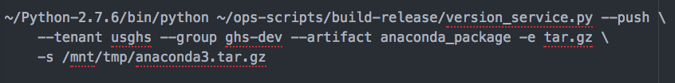
Packaging
Download source code
Compile
Update #! In bin directory
Archive
Copy to Apollo

Slide 3
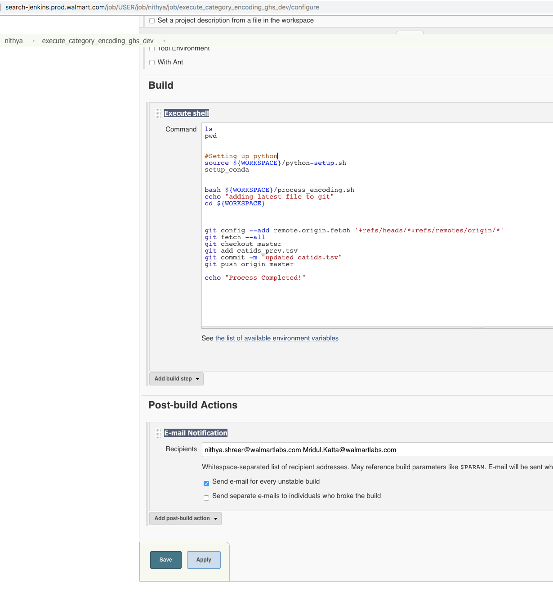
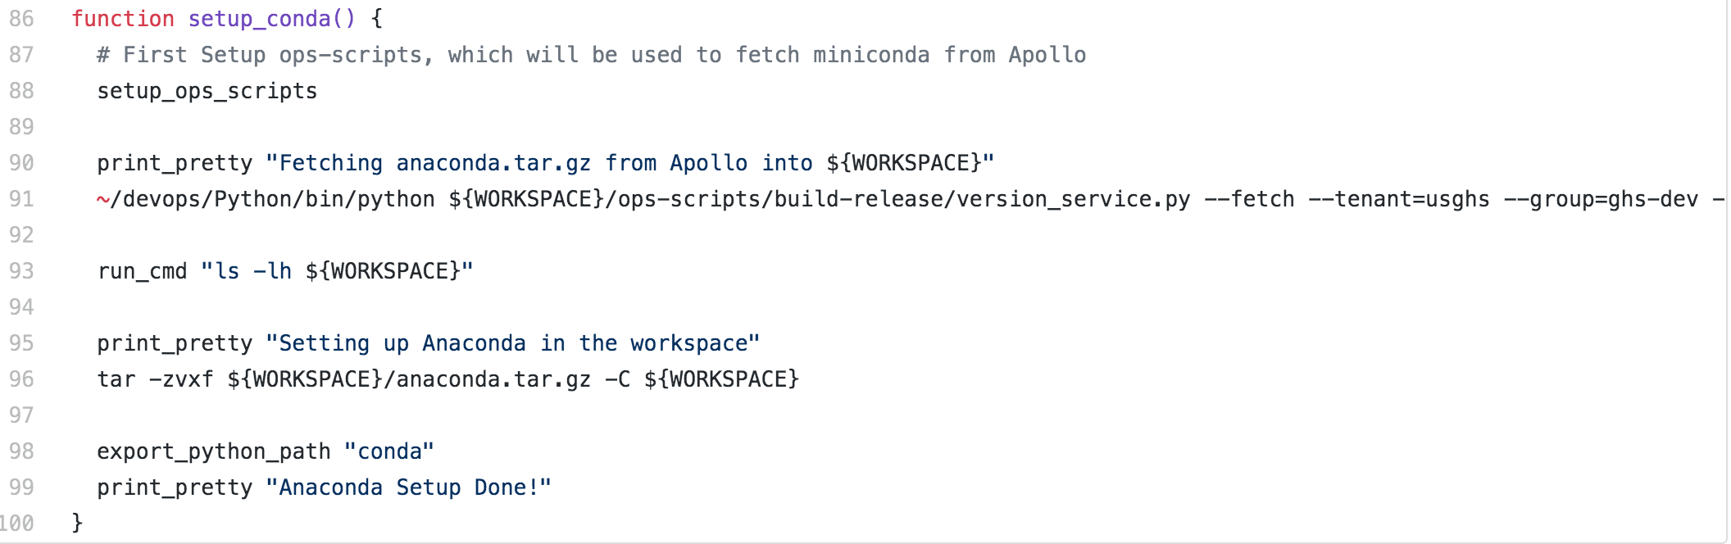
Usage (Jenkins Job)
Setup script in SCM
Invoke function to
Fetch artifact from Apollo
Extract
Update PATH & PYTHONPATH

