Slide 1
Supervised Learning – Part 1
Notes:
Today, I will talk about the supervised learning. As I mentioned previously, The supervised learning has the known target concept that is a class attribute, in another word, answer. So when we have a data set that has a class attribute, we can do supervised learning on the data set.

Slide 2
Introduction
Key idea
  Known target concept (predict certain attribute)
  Find out how other attributes can be used
Algorithms
  Rudimentary Rules (e.g., 1R)
  Statistical Modeling (e.g., Naïve Bayes)
  Divide and Conquer: Decision Trees
  Instance-Based Learning
  Neural Networks
  Support Vector Machines
Notes:
Now you know that you must have a target concept (or class attribute) that will be predicted in the supervised learning model.
For the prediction, the other attributes in the dataset can be used in the learning model. With details to be learned later, the popular supervised learning algorithms will be explained.

Slide 3
1-Rule
Generate a one-level decision tree
One attribute
Performs quite well!
Basic idea:
  Rules testing a single attribute
  Classify according to frequency in training data
  Evaluate error rate for each attribute
  Choose the best attribute
That’s all folks!
Notes:
1- Rule is a simple decision tree method and uses only one attribute. Nevertheless, the performance is quite good. Test for each property of the dataset. Classify according to the frequency of occurrence according to the value of class attribute in the training data. As a result, the error rate of each attribute is evaluated. At this time, select the attribute with the best performance.

Slide 4
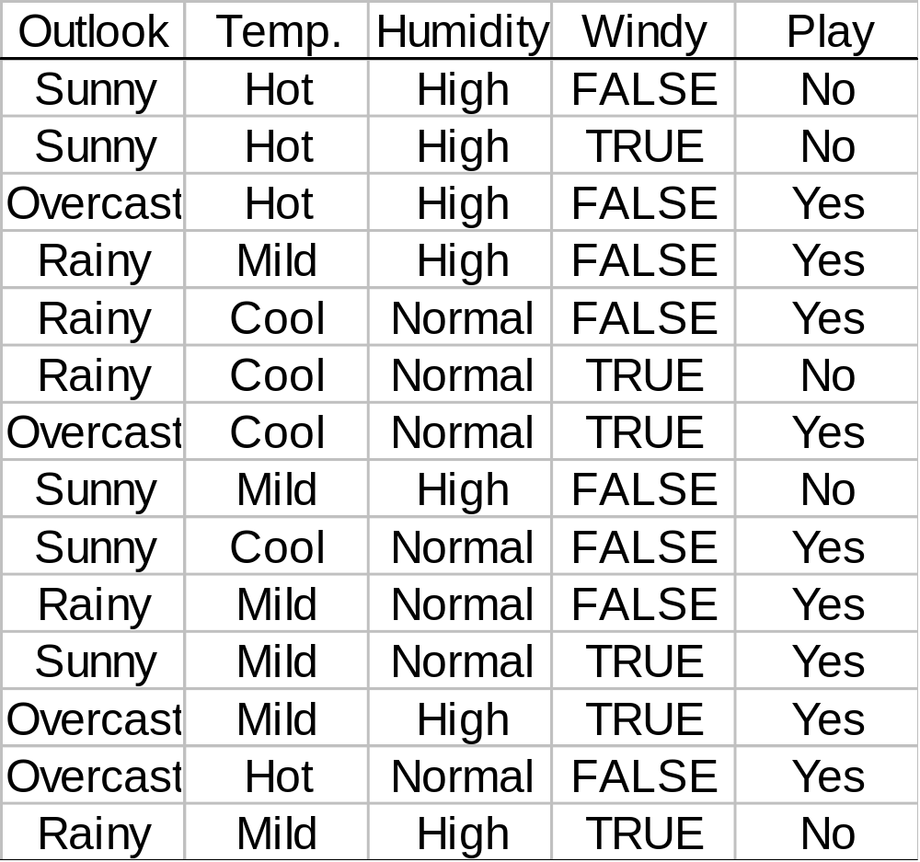
The Weather Data (again)
Notes:
Just take a look at this dataset. We will continue to use this dataset over the lecture.

Slide 5
Apply 1R
Attribute Rules Errors Total
1 outlook sunny⇒no 2/5 4/14
overcast ⇒yes 0/4
rainy ⇒yes 2/5
2 temperature hot ⇒ no 2/4 5/14
mild ⇒ yes 2/6
cool ⇒ no 3/7
3 humidity high ⇒ no 3/7 4/14
normal ⇒ yes 2/8
4 windy false ⇒ yes 2/8 5/14
true ⇒ no 3/6
Notes:
First, let's look at the first property, Outlook. This Outlook property has three values: Sunny, Overcast, and Rainy. At this time, the value that occupies the largest proportion of the class attribute values ​​corresponding to each value is allocated. For example, Sunny's highest percentage value for that class is No. At this time, not all applicable class attribute values ​​are No, and some applicable values ​​are Yes. At this time, Yes is an error. So the error rate is 2/5. In the same way, overcast is classified as Yes, where the error rate is 0%, and Rainey is also classified as Yes, where the error rate is 2/5. In the same way, the remaining properties are classified for temperature, humidity, and windy and the error rate is calculated.
Finally, if you look at the attributes that show the best performance (the smallest error rate), Outlook and Humidity perform the same, but any attribute of both can be the only one of the 1-Rule model.

Slide 6
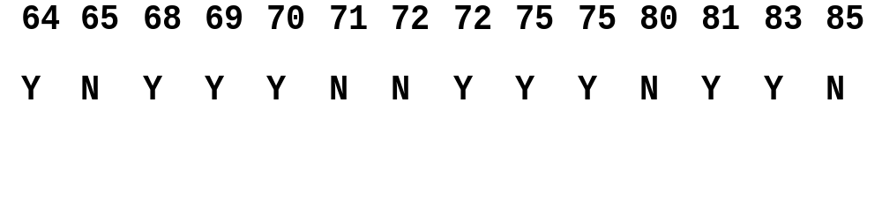
Other Features
Numeric Values
  Discretization :
    Sort training data
    Split range into categories
Missing Values
  “Dummy” attribute
Notes:
The previous method is applicable when the attribute is nominal data. If the attribute is numeric data, it is difficult to process as in the previous case. Therefore, it is necessary to discretize this numeric data. For example, in the case of temperature attribute, the values ​​are sorted in ascending order and the range where the value of the corresponding class attribute changes is divided by range. Since the corresponding class value of 65 is No, and 68, 69, and 79 are Yes, it becomes a dividing point between 65 and 68. In this way, the previous method can be applied by segmenting the numeric data and converting it into a nominal data format.

Slide 7

Naïve Bayes Classifier
Allow all attributes to contribute equally
Assumes
  All attributes equally important
  All attributes independent
Realistic?
Selection of attributes
Notes:
The next classification method uses the Bayes' theorem of statistics as naive Bayes. The assumption to use this method is that all attributes are equally important, and all attributes are independent. Do you think this assumption is practical for a dataset? Not like that. Nevertheless, this method is known to be quite effective. Since there is an assumption that all attributes are independent, the method to minimize this disadvantage as much as possible is to select and use important attributes.

Slide 8
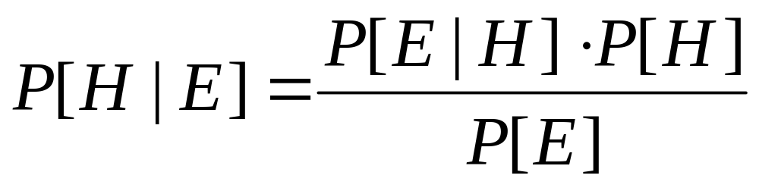
Bayes Theorem
Hypothesis
Posterior
Probability
Prior
Evidence
Conditional probability
of H given E
Notes:
Bayes' theorem is simple. If you know the probability of Evidence for each hypothesis and the prior probability, you can make predictions through the posterior probability. Here, the hypothesis of prior probability indicates a class attribute value, for example, corresponds to Yes, No of Play, which is a class of weather data. P (E / H) is the probability that the value of Outlook is sunny when yes.

Slide 9
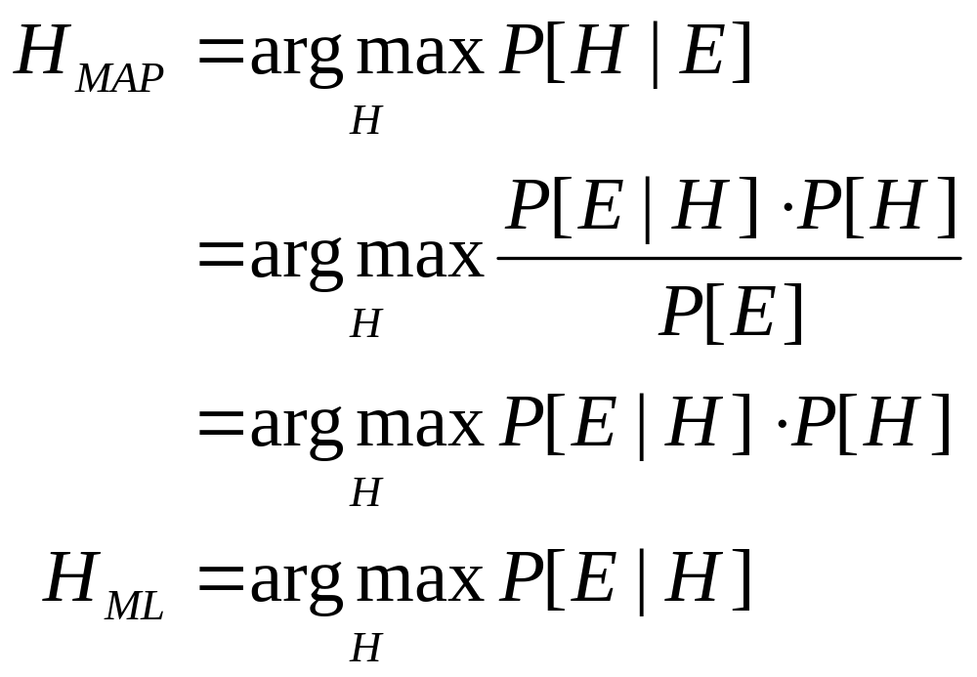
Maximum a Posteriori (MAP)
Maximum Likelihood (ML)
Notes:
What we want to know is the value of the hypothesis that maximizes the hypothesis probability based on a given Evidence. Taking the Weather dataset as an example, which value of Hypothesis (Yes or No) maximizes the conditional probability. The posterior probability is calculated for all class values, that is, the hypothesis, and the posterior probability value for which class value has the maximum value. The class value having the maximum value, that is, the hypothesis, is the final predicted classification value.

Slide 10
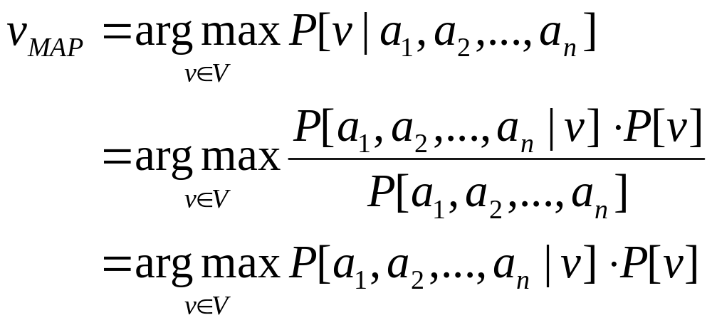
Classification
Want to classify a new instance (a₁, a₂,…, a_{n}) into finite number of categories from the set V.
Bayesian approach: Assign the most probable category v_{MAP} given (a₁, a₂,…, a_{n}).
Can we estimate the probabilities from the training data?
Notes:
This formula is a generalized expression that the class value with the maximum likelihood value using the Bayes' theorem is the predicted classification value. At this time, ai represents an attribute. P (a1, a2, ,,,, an / v] is the probability that all the attributes for each class value have a arbitrary value. Applying all attributes independent that is assumption of Naïve Bayes is a simple solution.

Slide 11
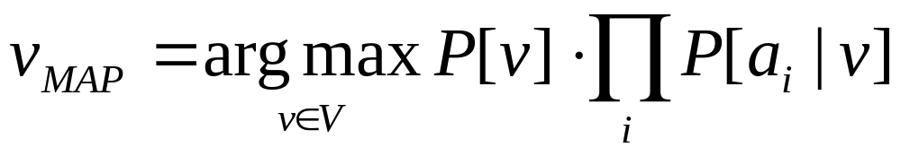
Naïve Bayes Classifier
Second probability easy to estimate
How?
The first probability difficult to estimate
Why?
Assume independence (this is the naïve bit):
Notes:
The solution can be found by looking at the bottom formula. If all attributes are independent, instead of calculating the multi-variable probability, you can calculate the probability for each attribute and multiply it.

Slide 12
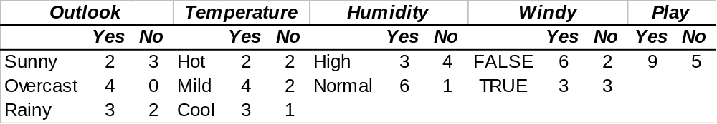
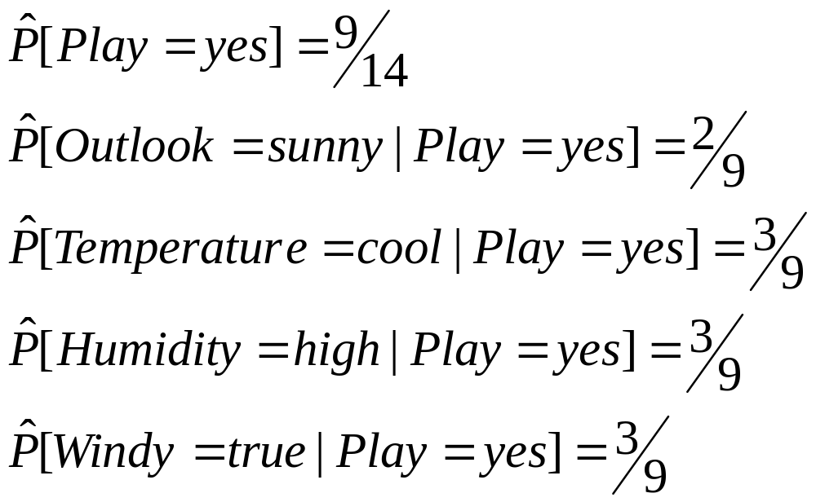
The Weather Data (yet again)
Notes:
Suppose we have a problem that we want to predict whether or not to exercise when the Outlook is sunny, the temperature is cool, the Humidity is high, and the windy is true. The probability that play is Yes in the weather dataset, that is, the prior probability is 9/14. And under the assumption that Play is Yes, the value of each attribute can be calculated as follows.

Slide 13
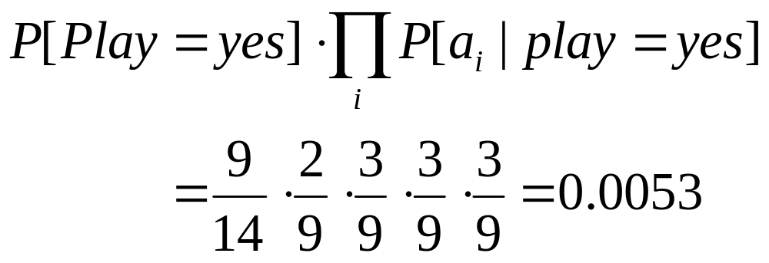
Estimation
Given a new instance with
  outlook=sunny,
  temperature=high,
  humidity=high,
  windy=true
Notes:
For a given problem, the posterior probability for Yes is 0.0053.

Slide 14
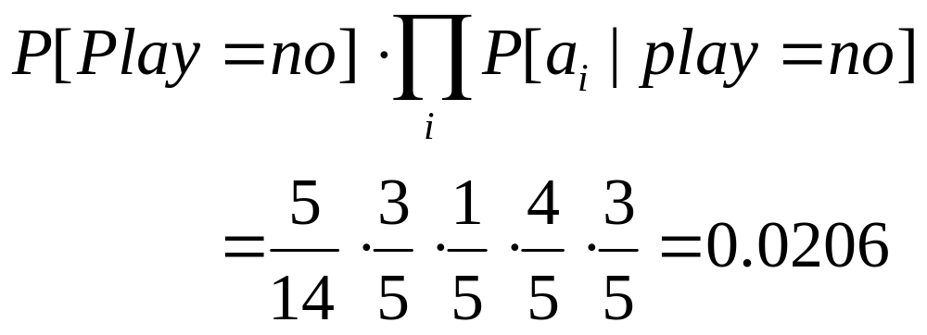
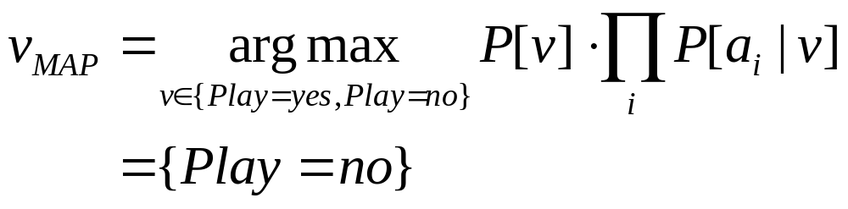
Calculations continued …
Similarly
Thus
Notes:
In the same way, the posterior probability for No is 0.0206. The predicted classification value is No because the posterior probability value in case of No is higher by the previous maximum likelihood method. In other words, the conclusion about a given problem is that it does not Play.

Slide 15
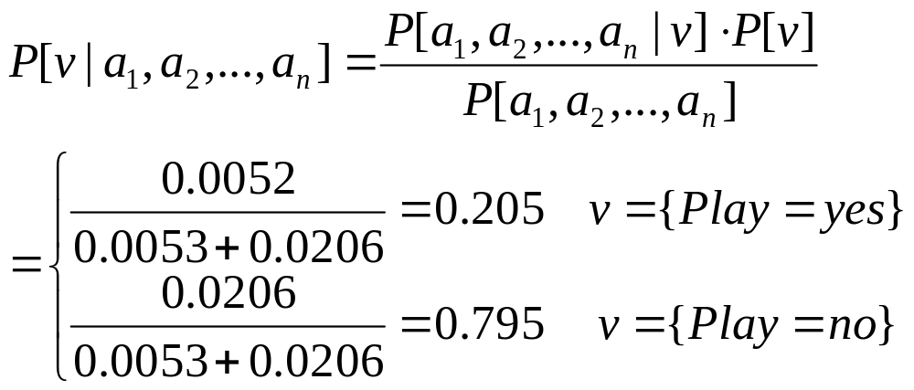
Normalization
Note that we can normalize to get the probabilities:
Notes:
If we express this through rectification, it can be clearly seen that the probability of the case of No is relatively higher as follows.

Slide 16
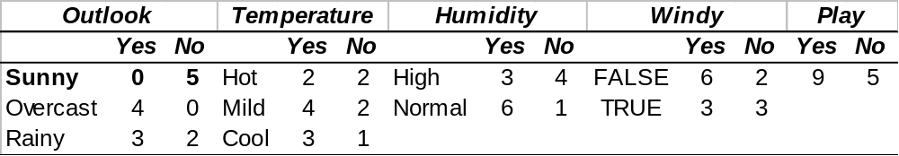
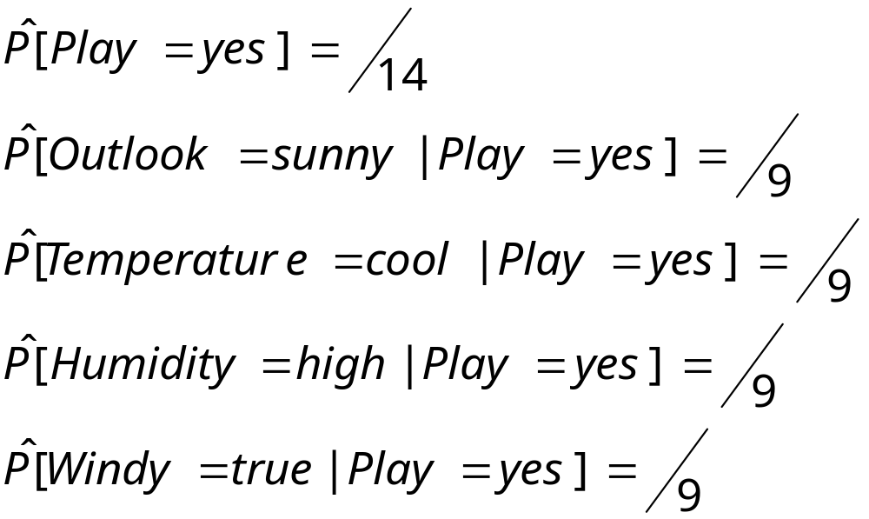
Problems ….
Suppose we had the following training data:
Now what?

Slide 17
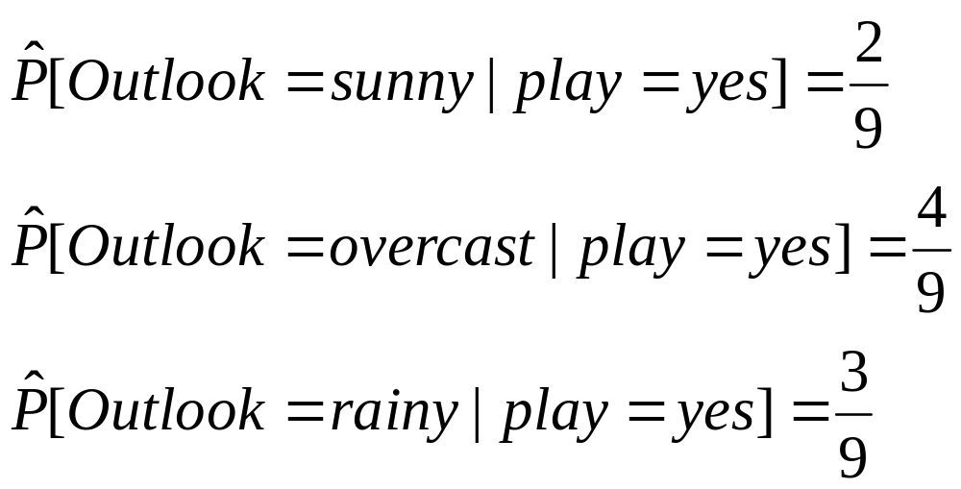
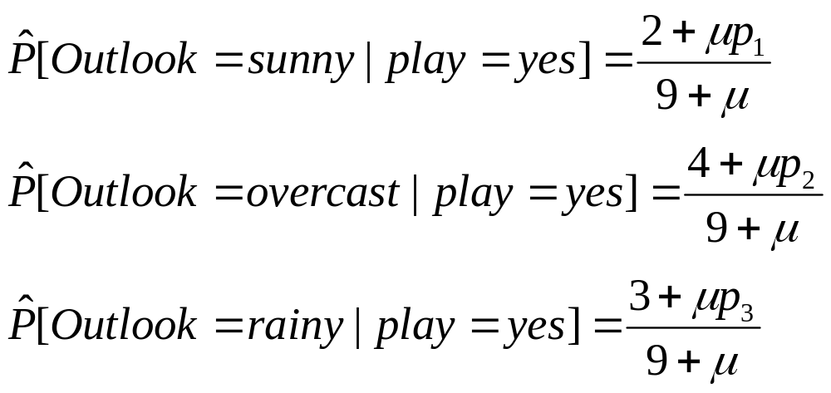
Laplace Estimator
Replace estimates
with
p₁ + p₂ + p₃ = 1

Slide 18
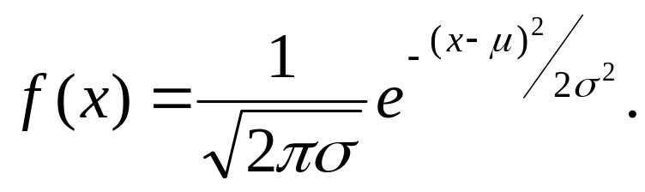
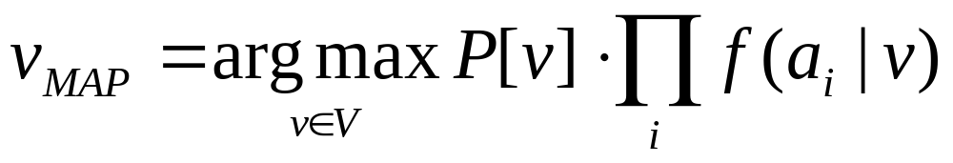
Numeric Values
Assume a probability distribution for the numeric attributes ⇒ density f(x)
  normal
  fit a distribution (better)
Similarly as before
Notes:
If the weather dataset contains numeric data, how can the probability be calculated? In this case, since it is impossible to calculate as in the previous case, the discretization method is applied in the case of 1-R or the pdf value of the normal distribution is used for the numeric attribute.

Slide 19
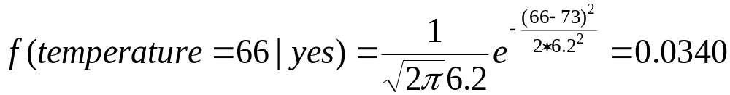
Statistics for weather data
Outlook |  |  | Temperature |  |  | Humidity |  |  | Windy |  |  | Play
 | Yes | No |  | Yes | No |  | Yes | No |  | Yes | No | Yes | No
Sunny | 2 | 3 |  | 64, 68, | 65, 71, |  | 65, 70, | 70, 85, | False | 6 | 2 | 9 | 5
Overcast | 4 | 0 |  | 69, 70, | 72, 80, |  | 70, 75, | 90, 91, | True | 3 | 3
Rainy | 3 | 2 |  | 72, … | 85, … |  | 80, … | 95, …
Sunny | 2/9 | 3/5 |  | μ =73 | μ =75 |  | μ =79 | μ =86 | False | 6/9 | 2/5 | 9/14 | 5/14
Overcast | 4/9 | 0/5 |  | σ =6.2 | σ =7.9 |  | σ =10.2 | σ =9.7 | True | 3/9 | 3/5
Rainy | 3/9 | 2/5
Example density value:
Data Mining
Notes:
For example, in the case of Yes, the probability that the value of the temperature attribute is 66 is calculated by calculating the average and standard deviation of the temperature value and substituting it into the normal distribution pdf.

Slide 20
Discussion
Simple methodology
Powerful - good results in practice
Missing values no problem
Not so good if independence assumption is severely violated
  Extreme case: multiple attributes with same values
Solutions:
  Preselect which attributes to use
  Non-naïve Bayesian methods: networks
Notes:
In summary, the Naive Bayes method is simple, but it is widely used and quite powerful. However, if the independent assumptions are severely damaged, performance may deteriorate significantly. In this case, the solution is to select only the important attributes and use them in the model or use the Bayesian network as mentioned earlier.

Slide 21
Decision Tree Learning
Basic Algorithm:
  Select an attribute to be tested
  If classification achieved return classification
  Otherwise, branch by setting attribute to each of the possible values
  Repeat with branch as your new tree
Main issue: how to select attributes
Notes:
Decision tree type algorithm is one of the most used methods in that it can show the structure of data.
The basic algorithm first tests each attribute. If the classification is finished according to the attribute, the final conclusion remains the same. Otherwise, it branches for each of all possible values ​​of the attribute. Repeat the previous process at that branch.
The most important thing here is about attribute selection. Which attribute to choose?

Slide 22
Deciding on Branching
What do we want to accomplish?
Make good predictions
Obtain simple to interpret rules
No diversity (impurity) is best
  all same class
  all classes equally likely
Goal: select attributes to reduce impurity
Notes:
The first thing we do is know what attributes will be at the top of the decision tree. The size of the decision tree depends on which attribute is on top. Which decision tree model would we like? Be good at predicting and interpreting rules. For this, the model should not be diversity. In other words, do not do impurity. Impurity means that the class values ​​are the same or the ratio of all class values ​​is the same. Think about it. The equality of class values ​​is the same as tossing a coin so it doesn't give us any information. Just give information of 1 / n.
Therefore, our goal is to select properties that can reduce impurity. Accordingly, the size of the decision tree can be reduced and impurity can be reduced.

Slide 23
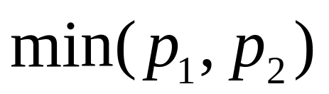
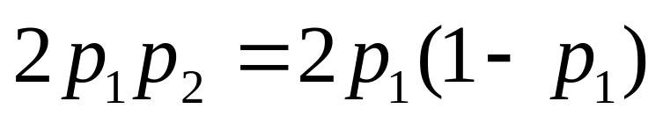
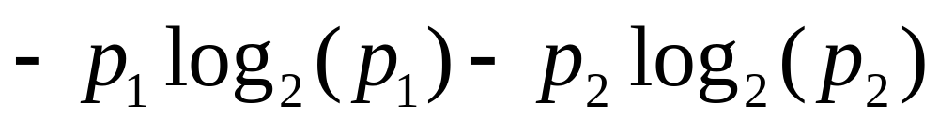
Measuring Impurity/Diversity
Lets say we only have two classes:
Minimum
Gini index/Simpson diversity index
Entropy
Notes:
There are many ways to measure impurity. Suppose you only have two classes. If the ratio of each class is p1, p2, there are methods of taking the minimum value of these two, calculating the gini index value, or calculating entropy.

Slide 24
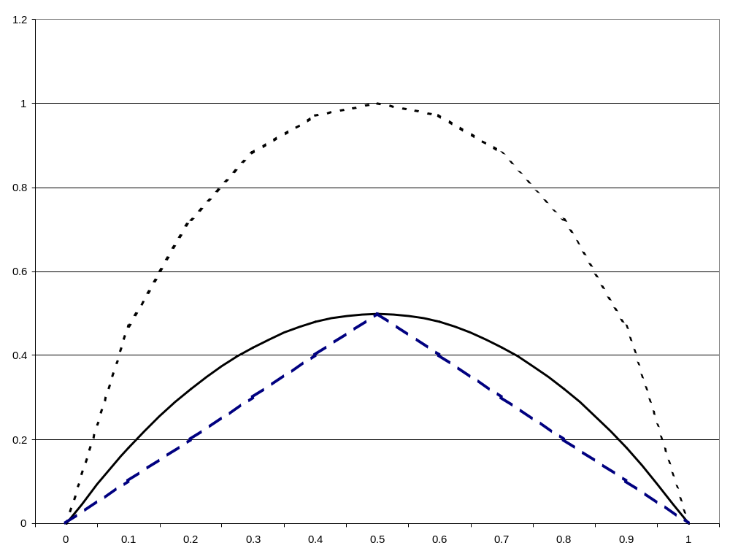
Impurity Functions
Entropy
Gini index
Minimum
Notes:
The following graph shows the distribution with the minimum and maximum values ​​of each measure. When one of p1 or p2 has a value that is biased to one side, you can see that the impurity is the minimum and the maximum when it has the same ratio. have. That is, when predicting one of the two, if each has a value of 1/2, it does not give us any information. It is like tossing a coin. The front-to-back ratio is 1/2 each. This means that anyone can talk, and in other words, nothing special.

Slide 25
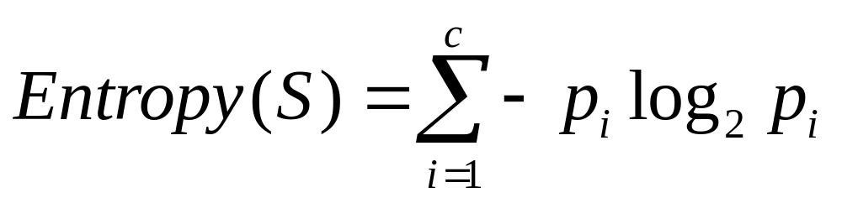
Entropy
Number of classes
Training data
(instances)
Proportion of
S classified as i
Entropy is a measure of impurity in the training data S
Measured in bits of information needed to encode a member of S
Extreme cases
  All member same classification (Note: 0·log 0 = 0)
  All classifications equally frequent
Notes:
The following is an expression of entropy. It is calculated according to the number of instances classified by each class among all data, and the sum is the entropy of all data. If all the data is classified to one side, since one of pi is 0, the entropy value becomes 0 and has the minimum value, and if pi has the same value, it has the maximum value.

Slide 26
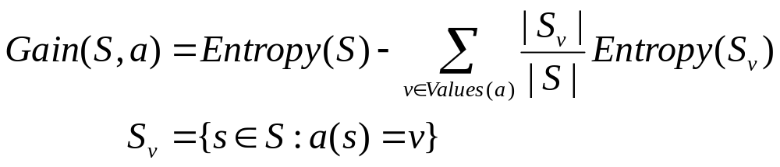
Expected Information Gain
All possible values
for attribute a
Gain(S,a) is the expected information provided about the
classification from knowing the value of attribute a
(Reduction in number of bits needed)
Notes:
Next, there is the concept of information gain, and as it is classified according to the value of one attribute in the total entropy, the entropy value decreases. At this time, the difference between these values ​​is the information gain. In other words, the high information gain property means that we can give us a lot of information.

Slide 27
The Weather Data (yet again)
Notes:
Let's look at the weather dataset again.

Slide 28
Decision Tree: Root Node
Outlook
Sunny
Rainy
Overcast
Yes
Yes
No
No
No
Yes
Yes
Yes
Yes
Yes
Yes
Yes
No
No
Notes:
Let's look at the process of creating a decision tree model based on the weather dataset. First, let's look at class distribution with possible values ​​with the first attribute, Outlook. The possible values ​​for Outlook are Sunny, Overcast, and Rainy, and the corresponding class distribution in the dataset is shown in the figure.

Slide 29
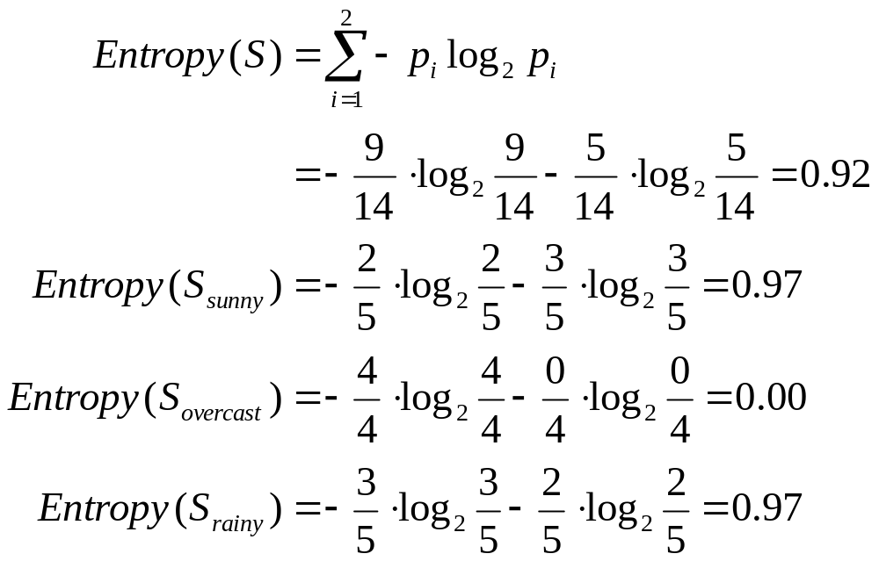
Calculating the Entropy
Notes:
As mentioned earlier, the attribute with high information gain gives us a lot of information, so if you place it at the top of the decision tree, you can reduce the size of the decision tree. Therefore, the information gain of this Outlook is first calculated.
First, the entropy of the entire dataset is calculated. In the weather dataset, the class attribute is play. The value of this play is Yes or no. Since the ratio of Yes is 9/14 and the ratio of No is 5/14, the entropy of the whole data is 0.92 by the formula. Next, calculate the entropy when branching by each value in Outlook. The picture in the previous chapter shows it. For example, the branch by Sunny accounts for 2/5 of Yes and 3/5 of No. As described above, entropy is calculated by applying to other values.

Slide 30
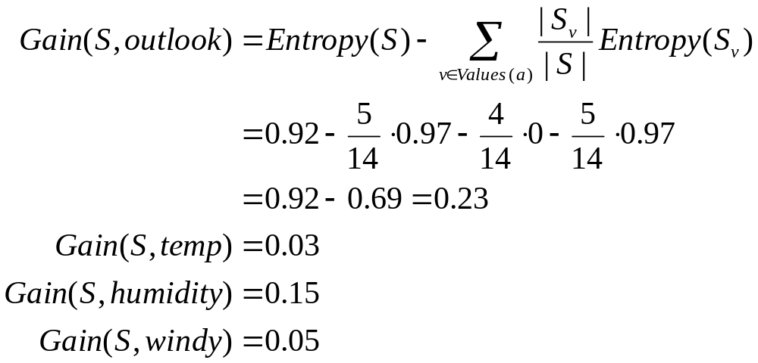
Calculating the Gain
Select!
Notes:
According to the information gain formula, the information gain value of Outlook is 0.23. When calculating the rest of the properties in the same way, the information gain value of Outlook is the highest. Therefore, we will place Outlook on the top node of the decision tree.

Slide 31
Next Level
Outlook
Sunny
Rainy
Overcast
Temperature
No
No
Yes
No
Yes
Notes:
The next thing to do is to place the rest of the properties under each branch in Outlook. The method is the same as the first. However, the data area has been reduced. Except for Outlook, you will choose one of the remaining properties: temperature, humidity, and windy. First, let's place the temperature under the sunny branch.

Slide 32
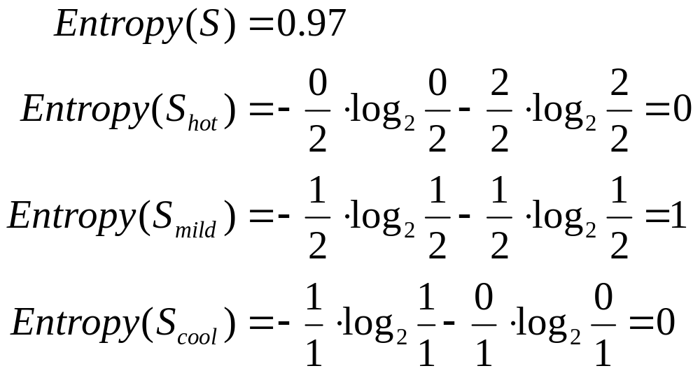
Calculating the Entropy
Notes:
The entropy values ​​can be calculated as in the previous method.

Slide 33
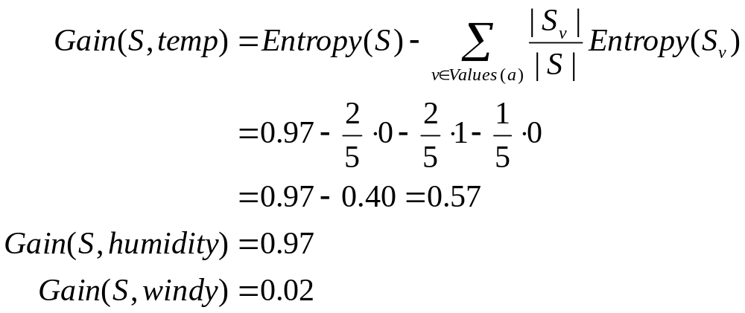
Calculating the Gain
Select
Notes:
Thus, the information gain value can be calculated, and the information gain value can be calculated on the assumption that other attributes than the temperature are located. At this time, since the humidity has the highest information gain value, the humidity attribute is placed under the sunny branch.

Slide 34
Final Tree
Outlook
Sunny
Rainy
Overcast
Humidity
Yes
Windy
High
Normal
True
False
No
Yes
No
Yes
Notes:
There is no need to branch any more because the class values ​​corresponding to the overcast, the next branch of Outlook, are all Yes. Windy is selected by testing the remaining Rainey branches for temperature and windy properties in the same manner as above. This is the final decision tree model. All leaf nodes in this model show that all classes are correctly distinguished.

Slide 35
What’s in a Tree?
Our final decision tree correctly classifies every instance
Is this good?
Two important concepts:
  Overfitting
  Pruning
Notes:
You should think about whether it would be better to distinguish all data instances correctly. What do you think? Is it a good model to distinguish all of them accurately? Here, you need to know two important concepts. The first is overfitting and the second is pruning.

Slide 36
Overfitting
Two sources of abnormalities
  Noise (randomness)
  Outliers (measurement errors)
Chasing every abnormality causes overfitting
  Tree to large and complex
  Does not generalize to new data
Solution: prune the tree
Notes:
Let's assume that there is anomalous data. Speaking of abnormal data, there may be noise and outliers. Previously, some data was used to build the model using the Naïve Bayes or Decision Tree algorithm. This data is called the learning dataset. However, if there is such anomalous data in this dataset, the model will become complex and large in order to explain the anomaly during the modeling process. This is called overfitting. Of course, this training data may be an optimal model, but if you test this model with some new generic data, it will be very vulnerable to this test.
So what are some possible solutions to avoid overfitting the decision tree model? The method is pruning trees.

Slide 37
Pruning
Prepruning
  Halt construction of decision tree early
  Use same measure as in determining attributes, e.g., halt if InfoGain < K
  Most frequent class becomes the leaf node
Postpruning
  Construct complete decision tree
  Prune it back
  Prune to minimize expected error rates
  Prune to minimize bits of encoding (Minimum Description Length principle)
Notes:
The pruning method is largely divided into preprunning and postprunning. Preprunning is to stop branching when the information gain value is less than a certain value K when selecting a certain attribute in the decision tree algorithm. It stops branching and leaves the leaf node with the highest class value. Postprunning is to first build all the entire decision tree model and then pruning it upside down to minimize the expected error rate.

Slide 38
Scalability
Need to design for large amounts of data
Two things to worry about
  Large number of attributes
    Leads to a large tree (prepruning?)
    Takes a long time
  Large amounts of data
    Can the data be kept in memory?
    Some new algorithms do not require all the data to be memory resident
Notes:
Data mining and machine learning basically deal with large amounts of data, so it takes a lot of time to process them. This is due to two reasons. First, if the number of attributes is large, this will make the decision tree large and the modeling time will be long. Another aspect is when the number of instances is large. This requires a lot of memory. Therefore, it can be said that it is important to design the algorithm so that the computation of the algorithm and the complexity of the model do not increase too much depending on the size of the data (number of attributes or number of instances). This is an important topic to be covered later.

Slide 39
Discussion: Decision Trees
The most popular methods
Quite effective
Relatively simple
Have discussed in detail the ID3 algorithm:
  Information gain to select attributes
  No pruning
  Only handles nominal attributes
Notes:
The decision tree algorithm you've seen so far has the name ID3. This algorithm is the most used and method. It is quite effective and simple. This algorithm uses information gain when selecting attributes, does not have a pruning method in it, and has a feature that can only process nominal attributes.

Slide 40
Selecting Split Attributes
Other Univariate splits
  Gain Ratio: C4.5 Algorithm (J48 in Weka)
  CART (not in Weka)
Multivariate splits
  May be possible to obtain better splits by considering two or more attributes simultaneously
Notes:
There are other types of decision tree algorithms. There are also algorithms that take the C4.5 method, CART method (branching to only one attribute at a time) used for attribute selection of the gain ratio, and divergence considering multiple attributes at the same time.

Slide 41
Instance-Based Learning
Classification
To not construct a explicit description of how to classify
Store all training data (learning)
New example: find most similar instance
  computing done at time of classification
  k-nearest neighbor
Notes:
Today we will start with instance-based learning. This method is a classification-based algorithm, and there is no special structure of the classification method. However, it is for all instances of learning data. If there is a new instance you want to predict by classification, finding the closest of all instances in the training dataset is the key to this method. The algorithm is called k-nearest neighbor, where k represents the number of the most similar instances. If the number of instances of training data similar to the new instance is 1, it is 1-nearest neighbor, and if it is 3, it is 3-nearest neighbor.

Slide 42
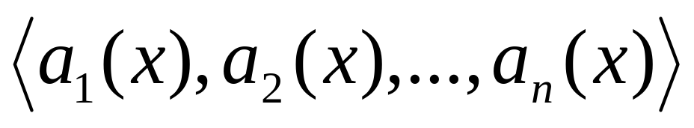
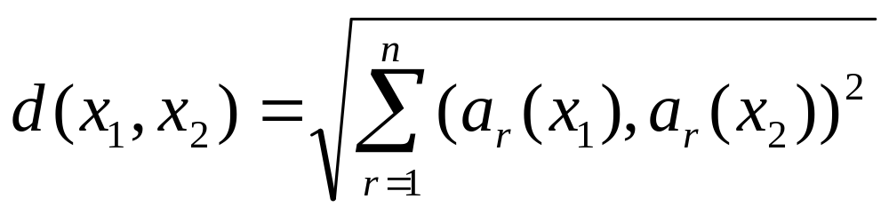
K-Nearest Neighbor
Each instance lives in n-dimensional space
Distance between instances
Notes:
If so, how to find similar instances is key, but the similarity of the instances in the dataset is measured by distance, as shown in the expression at the bottom of this slide. What are the distance measurements of the data you know? The most well-known is Euclidean Distance? You already know? Right?

Slide 43
Example: nearest neighbor
-
+
-
1-Nearest neighbor?
6-Nearest neighbor?
-
-
x_{q}*
+
-
+
-
-
+
+
Notes:
This figure shows an example of a k-nearest neighbor. For example, suppose you are using the 1-nearest neighbor algorithm. And you want to predict Xq as a classification. What is the closest instance to Xq? '+' Or '-'? The answer is +. So what is the answer to the 6-nearest neighbor? All instances in the circle are the closest 6 instances. What is the answer? There are two + and four -. So the answer is - When using the 1-nearest neighbor algorithm, Xq is classified as +, and when using the 6-nearest neighbor algorithm, Xq is classified as -.

Slide 44
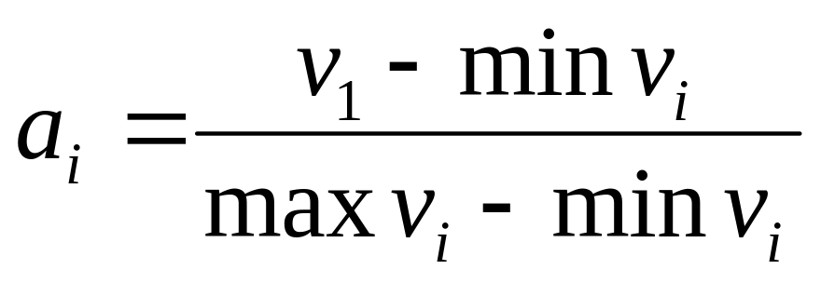
Normalizing
Some attributes may take large values and other small
Normalize
All attributes on equal footing
Notes:
When calculating the distance of instances using Euclidean distance, if the values ​​of some attributes are very large and the values ​​of other attributes are small, the difference between these large values ​​ignores the difference between the small values. Therefore, it is necessary to normalize attributes’ values ​​with numeric values ​​to have the same range values. In the normalization, a method of expressing the degree of the present value v1 compared to the maximum and minimum values ​​of the attribute is often used.

Slide 45
Other Methods for Supervised Learning
Neural networks
Support vector machines
Optimization
Rough set approach
Fuzzy set approach
Notes:
This is simple, but we have looked at some popular supervised learning algorithms. In addition, there are many algorithms such as neural networks, support vector machines, and optimization. Neural networks and support vector machines algorithms will be introduced later in the semester.

