Slide 1
Supervised Learning-Part 2

Slide 2
Evaluating the Learning
Measure of performance
Classification: error rate
Resubstitution error
Performance on training set
Poor predictor of future performance
Overfitting
Useless for evaluation
Notes:
We looked at the classification algorithm. So how can we judge whether the classification learning was good? In general, the error rate is used as a measure to measure it. There is a very important concept when calculating this error rate. Consider the error rate of a classification learning model. There may have been a training dataset that the classification learning model learned. This model is optimized for this training dataset. Therefore, the error rate of this model will be less than that of other general datasets in the training dataset. This can be a serious problem for the generalization of this learning model. In addition, this model is overfitting the training dataset, which can significantly increase the error rate in other datasets. Therefore, when calculating the error rate of a learning model, avoid using only the training dataset. This kind error rate is called Resubstitution error.

Slide 3
Test Set
Need a set of test instances
Independent of training set instances
Representative of underlying structure
Sometimes: validation data
Fine-tune parameters
Independent of training and test data
Plentiful data - no problem!
Notes:
Instead of the resubstitution error rate, for a generalized calculation of the error rate, we can do it using a test set. This test set should be independent of the training data set. However, the basic structure of the data should be similar. In the classification problem, the fact that the basic structures are the same means that the value distribution of class attributes is similar. For example, the ratio of Yes to No in the play, which is a class attribute of the weather data set, was around 9: 5, but this ratio should be maintained even when constructing the training data set and the test set.
Sometimes validation data is used to tune the parameters of the algorithm. This should also be independent of the training data set and test set. If we have a large amount of data, there is no problem organizing these datasets. However, there are cases where it is not.

Slide 4
Holdout Procedures
Common case: data set large but limited
Usual procedure:
Reserve some data for testing
Use remaining data for training
Problems:
Want both sets as large as possible
Want both sets to be representitive
Notes:
The size of the data is large, but it is often limited. A common procedure is to set aside data for testing and train with the rest of the data. In this case, the two datasets should be as large as possible and maintain the representativeness in terms of class distribution.

Slide 5
"Smart" Holdout
Simple check: Are the proportions of classes about the same in each data set?
Stratified holdout
Guarantee that classes are (approximately) proportionally represented
Repeated holdout
Randomly select holdout set several times and average the error rate estimates
Notes:
Smart holdout means that the ratio of the class values ​​of the training data set and the test set is similar to each other (stratified holdout). It is good to configure this holdout set by random sampling several times and take the average value by calculating the error rate of the learning model with this test set.

Slide 6
Holdout w/ Cross-Validation
Cross-validation
Fixed number of partitions of the data (folds)
In turn: each partition used for testing and remaining instances for training
May use stratification and randomization
Standard practice:
Stratified tenfold cross-validation
Instances divided randomly into the ten partitions
Notes:
One method of holdout is cross-validation. This is to divide the data into folds. One part of the data is used for testing and the other for training. This is repeated by folds. Generally, 10-fold cloth validation is used.

Slide 7
Cross Validation
Fold 1
Train on 90% of the data
Model
Test on 10%
of the data
Error rate e₁
Fold 2
Train on 90% of the data
Model
Test on 10%
of the data
Error rate e₂
Notes:
This figure shows an example of a 10-fold cross validation. Divide the data into 10 equal parts and use the remaining 90% for training with 10% of the data initially. In the second, the next 10% is used for testing and the remaining 90% for training. This is repeated 10 times. For each step, the calculated error rate is averaged and evaluated as the error rate of this learning model.

Slide 8
Cross-Validation
Final estimate of error
Quality of estimate
Notes:
This means that the average value of the error rate is an estimate of the final error rate and the quality of this estimate can be expressed as a confidence interval.

Slide 9
Leave-One-Out Holdout
n-Fold Cross-Validation (n instance set)
Use all but one instance for testing
Maximum use of the data
Deterministic
High computational cost
Non-stratified sample
Notes:
Leave-one-out holdout is a method of extracting one instance from the dataset for testing as the name, learning the rest, and testing it with the missing instance to determine the error. Therefore, if the dataset has n instances, it can be called n-Fold Cross-Validation. This takes a long calculation time and can be said to be a non-stratified sample of training data and test data. This method is rarely used in general.

Slide 10
Bootstrap
Sample with replacement n times
Use as training data
Use instances not in training data for testing
How many test instances are there?
Notes:
The bootstrap method uses sampled instances as training data by repeatedly sampling n times with replacement, and instances that have not been sampled for n times as a test set. At this time, the probability of not being sampled once during n times samplings as shown in the equation below this page is 0.368.

Slide 11
0.632 Bootstrap
On the average e⁻¹ n = 0.369 n instances will be in the test set
Thus, on average we have 63.2% of instance in training set
Estimate error rate
e = 0.632 e_{test} + 0.368 e_{train}
Notes:
Therefore, on average, 0.368 times n instances will be included in the test set. Therefore, on average, 63.2% of data will be included in the training dataset. The overall error rate estimate is calculated as shown in the equation below.

Slide 12
Accuracy of our Estimate?
Suppose we observe s successes in a testing set of n_{test} instances ...
We then estimate the success rate
R_{success}=s/ n_{test}.
Each instance is either a success or failure (Bernoulli trial w/success probability p)
Mean p
Variance p(1-p)
Notes:
If we test with a test set of n instances, if we correctly classify s, the success rate is s / n. At this time, each instance will be one of success and failure. The probability of success follows the Bernoulli probability distribution in p. At this time, the average is p and the variance is p (1-p).

Slide 13
Properties of Estimate
We have
E[R_{success}]=p
Var[R_{success}]=p(1-p)/n_{test}
If n_{training} is large enough the Central Limit Theorem (CLT) states that, approximately,
R_{success}~Normal(p,p(1-p)/n_{test})
Notes:
At this time, the expected value of the success rate, R = s / n, is p and the variance is p (1-p) / n. That is, the average and variance of the sample. At this time, if the sample size, n, is sufficiently large, the Bernoulli distribution follows the normal distribution by the central limit theorem.

Slide 14
Confidence Interval
Look up in table
CI for normal
CI for p
Level
Notes:
The confidence interval for the success rate can be calculated on the assumption that it follows a normal distribution.

Slide 15
Comparing Algorithms
Know how to evaluate the results of our data mining algorithms (classification)
How should we compare different algorithms?
Evaluate each algorithm
Rank
Select best one
Don't know if this ranking is reliable
Notes:
Now we can evaluate the results of the learning model produced by the data mining algorithm (classification problem). So, what other algorithms can be compared? First, each algorithm is evaluated and ranked. Choose the best of them. However, whether this ranking is reliable is another issue.

Slide 16
Assessing Other Learning
Developed procedures for classification
Association rules
Evaluated based on accuracy
Same methods as for classification
Numerical prediction
Error rate no longer applies
Same principles
use independent test set and hold-out procedures
cross-validation or bootstrap
Notes:
We have seen how to measure performance on classification problems. Other association analysis basically uses the same method. However, the error rate cannot be applied to numerical prediction problems. This is because it is not a problem of predicted success or failure. At first, the composition of training data and test data is the same as before, but the performance measurement method is slightly different.

Slide 17
Measures of Effectiveness
Need to compare:
Predicted values p₁, p₂,..., p_{n}.
Actual values a₁, a₂,..., a_{n}.
Most common measure
Mean-squared error
Notes:
When the value predicted by the algorithm is p and the actual value is a, the most frequently used measurement is the mean squared error.

Slide 18
Other Measures
Mean absolute error
Relative squared error
Relative absolute error
Correlation
Notes:
There are several other measures.

Slide 19
What to Do?
“Large” amounts of data
Hold-out 1/3 of data for testing
Train a model on 2/3 of data
Estimate error (or success) rate and calculate CI
“Moderate” amounts of data
Estimate error rate:
Use 10-fold cross-validation with stratification,
or use bootstrap.
Train model on the entire data set
Notes:
If there is enough data, the error rate is usually calculated by holding out 1/3 for testing and using the remaining 2/3 for training. If there is not much data, the 10-cross validation method or the bootstrap method is mainly used.

Slide 20
What's Going On?
Many (most) data mining applications can be thought about as detecting exceptions
Ignoring the exceptions does not significantly increase the error rate!
Ignoring the exceptions often leads to a simple model!
Thus, we can find a model that we evaluate as good but completely misses the point
Need to account for the cost of error types
Notes:
Many data mining models are considered for exception handling. Considering these exceptions can make the model large and complex. Thus, the error rate can be reduced, but overfitting, which inevitably arises from complex models, is inevitable. This is not a good way. In fact, ignoring exceptions does not significantly increase the error rate, but you can create a simple model to increase analysis and application capability.
At this point we need to consider the cost of the error types.

Slide 21
Accounting for Cost of Errors
Explicit modeling of the cost of each error
costs may not be known
often not practical
Look at trade-offs
visual inspection
semi-automated learning
Cost-sensitive learning
assign costs to classes a priori
Notes:
Modeling methods that explicitly consider the cost of each error are not practical in that it is difficult to estimate the cost. So let's look at the tradeoff between errors and costs. Common methods used in this way are visual inspection and semi-automatic learning. There is also a cost-sensitive learning method that uses a method of allocating costs to classes in advance.

Slide 22
Explicit Modeling of Cost
Confusion Matrix
(Displayed in Weka)
Notes:
A modeling method that explicitly considers the cost of each error is the Confusion Matrix, which can also be seen as a result of modeling in Weka, a data mining shareware software. The horizontal axis is the actual class, and the vertical axis is the prediction class. When the predicted value is Yes, if the actual value is Yes, it is classified as True Positive, and when the predicted value is No, if the actual value is Yes, False Negative is classified, and so on. It can be said to be a simple count and it is very difficult to estimate the cost for each.

Slide 23
Lift charts
In practice, costs are rarely known
Decisions are usually made by comparing possible scenarios
Example: promotional mailout to 1,000,000 households
Mail to all; 0.1% respond (1000)
Data mining tool identifies subset of 100,000 most promising, 0.4% of these respond (400) 40% of responses for 10% of cost may pay off
Identify subset of 400,000 most promising, 0.2% respond (800)
A lift chart allows a visual comparison
Notes:
Lift charts and ROC curves are among the most popular methods for relative comparison of errors. Suppose, for example, that an advertisement is sent to a million households. When sending advertisements to all, 0.1% responded. Let's say you selected 100,000 households that seemed to answer well with a data mining tool. The response at this time was 0.4%. In addition, when 400,000 households were selected to respond well, there was a 0.2% response. You can compare this with the lift chart.

Slide 24
Generating a lift chart
Sort instances according to predicted probability of being positive:
x axis is sample size y axis is number of true positives
 | Predicted probability | Actual class
1 | 0.95 | Yes
2 | 0.93 | Yes
3 | 0.93 | No
4 | 0.88 | Yes
… | … | …
Notes:
First, it sorts the instances in the order of the highest predicted probability (yes, responding in the previous example). The x-axis is the sample size, and the y-axis is the number of true positives.

Slide 25
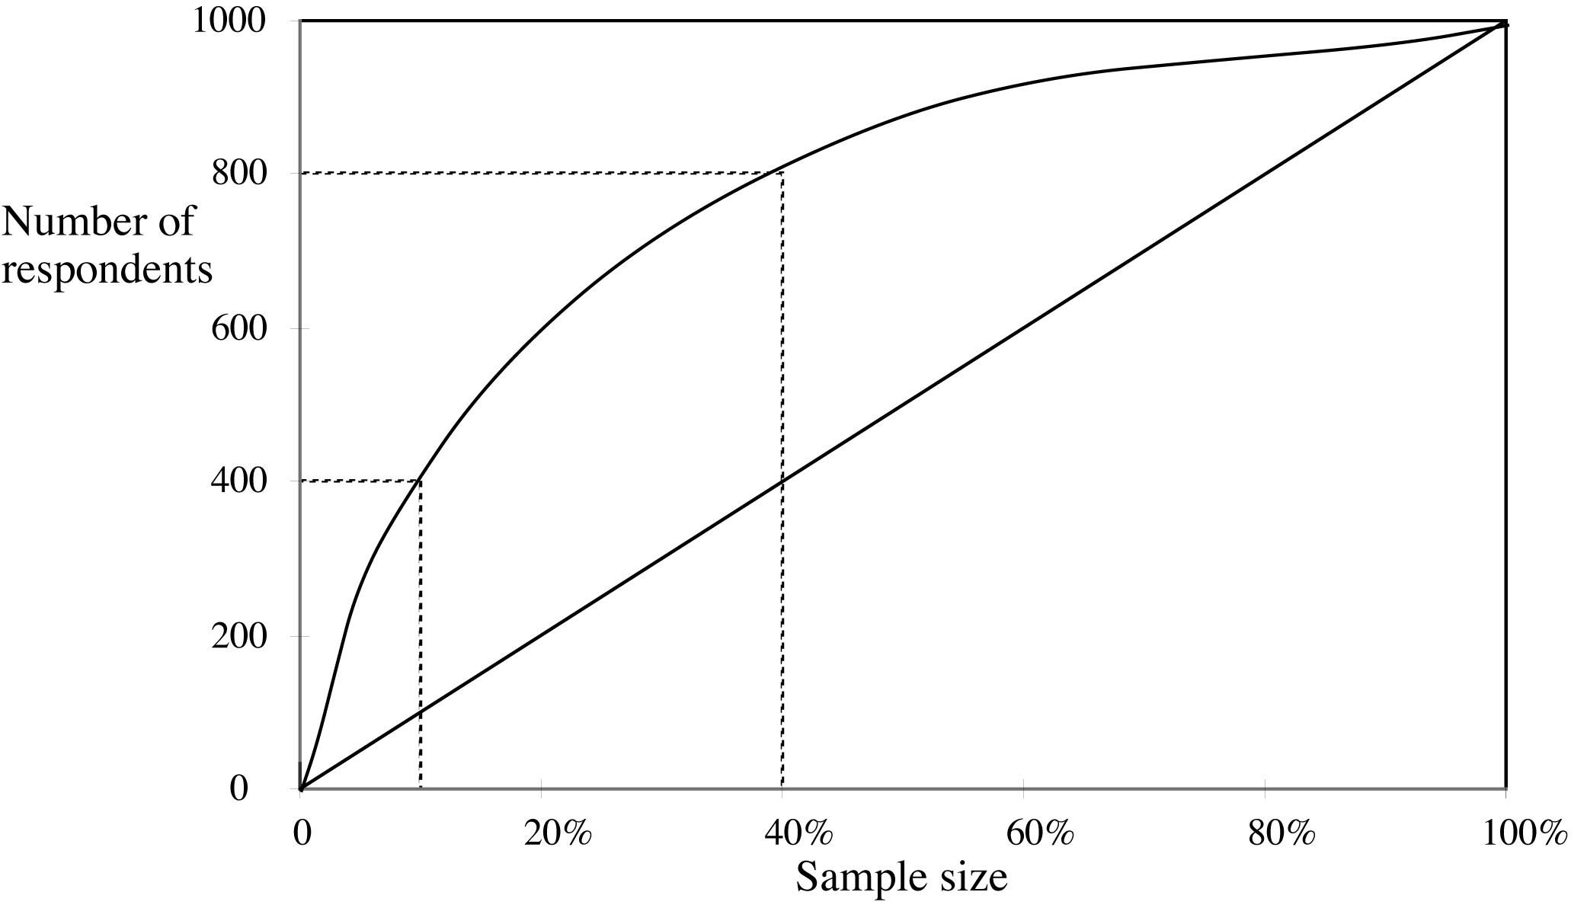
A hypothetical lift chart
40% of responses for 10% of cost
80% of responses for 40% of cost
Notes:
Looking at the previous example, the lift chart is as follows. The x-axis is the sample size, and the y-axis is the number of respondents (the number of true positives). When the sample size is 100%, there are 1000 and 800 respondents, respectively, of the 10% and 40% samples that they believe will respond using data mining tools. If you draw it, it is drawn as follows. Using 10% and 40% of the total cost of sending the advertisement, the response rate was higher than doing nothing. What would you do? Also, will you only send advertising mail to 10%? Or will you mail it to 40% or other sample households? Efficiency is about 10% better, but will vary depending on the situation. What you can see here is that the importance depends on the cost of each instance (i.e. each household) depending on the sample size.

Slide 26
ROC curves
ROC curves are similar to lift charts
Stands for “receiver operating characteristic”
Used in signal detection to show tradeoff between hit rate and false alarm rate over noisy channel
Differences to lift chart:
y axis shows percentage of true positives in sample rather than absolute number
x axis shows percentage of false positives in sample rather than sample size
Notes:
The ROC curve is similar to the lift chart, except that the x-axis is the false positive ratio and the y-axis is the true positive ratio.

Slide 27
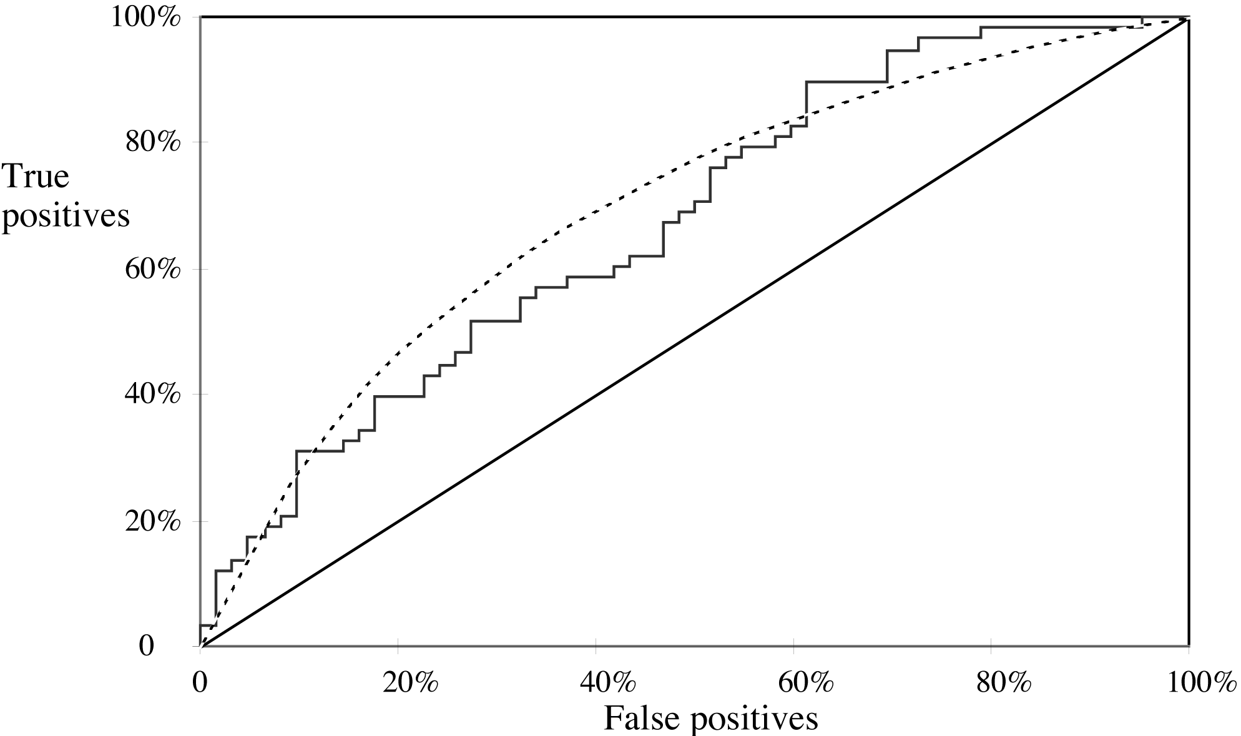
A sample ROC curve
Jagged curve—one set of test data
Smooth curve—use cross-validation
Notes:
Here, in the ROC curve, the Jagged curve represents the evaluation result in one test data set, and the Smooth curve represents the result of cross-validation by dividing the same data set and testing multiple times. From this, it can be said that the more the curve is tilted upward, the better the predictive power of the model.

Slide 28
Cross-validation and ROC curves
Simple method of getting a ROC curve using cross-validation:
Collect probabilities for instances in test folds
Sort instances according to probabilities
This method is implemented in WEKA
However, this is just one possibility
The method described in the book generates an ROC curve for each fold and averages them
Notes:
Drawing a curve chart is similar to a lift chart.

Slide 29
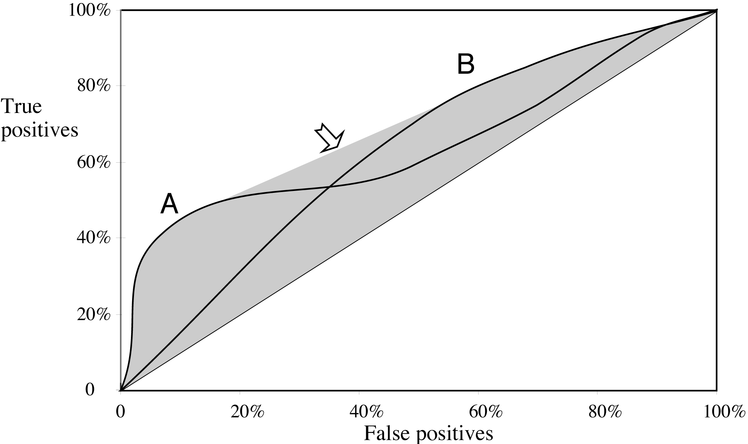
ROC curves for two schemes
For a small, focused sample, use method A
For a larger one, use method B
In between, choose between A and B with appropriate probabilities
Notes:
The above ROC curve plot compares the two data mining models. Both A and B models show meaningful results. However, it shows that model A is more effective when the ratio of false positives is small, and model B is more effective when large.

Slide 30
Cost Sensitive Learning
Have used cost information to evaluate learning
Better: use cost information to learn
Simple idea:
Increase instances that demonstrate important behavior (e.g., classified as exceptions)
Applies for any learning algorithm
Notes:
Cost-sensitive learning is a method of using cost information to evaluate learning results. Of course, it would be better to use prior information rather than post-evaluation. The method is to learn using cost information. The simplest way is to increase the number of instances that exhibit significant (e.g. classified as exception) behavior (Over Sampling). This method is applicable to any learning algorithm.

Slide 31
Engineering the Output
Prediction based on one model
Model performs well on one training set, but poorly on others
New data becomes available → new model
Combine models
Bagging
Boosting
Stacking
}
Improve prediction but complicate structure
Notes:
So far, we have covered predictions based on one model. Such predictions show good results in one training dataset, but are often not so in other test data or real-world situations. The effect is that when new data is created, a new model is created. So how about combining multiple models? There are ways out of that idea. These are Bagging, Boosting, and Stacking methods. It has a complicated structure although it improves prediction.

Slide 32
Bagging
Bias: error despite all the data in the world!
Variance: error due to limited data
Intuitive idea of bagging:
Assume we have several data sets
Apply learning algorithm to each set
Vote on the prediction (classification/numeric)
What type of error does this reduce?
When is this beneficial?
Notes:
Before we go into bagging, let's talk about bias. If you get an error despite using all the data in the world, this is a model that is skewed to one side. On the one hand, since there is little data, error errors can occur a lot. This is called dispersion. Therefore, bagging is used as a method to reduce such bias and dispersion. We assume there are multiple datasets. Different or the same learning algorithm is applied to each dataset to establish a model to perform classification or numerical prediction. At this time, the more predicted result among several results is used as the final result. This will help reduce bias. Of course, it is a method that can be applied only if there is enough data available.

Slide 33
Bootstrap Aggregating
In practice: only one training data set
Create many sets from one
Sample with replacement (remember the bootstrap)
Does this work?
Often given improvements in predictive performance
Never degeneration in performance
Notes:
However, in reality, there is often only one learning dataset. Therefore, multiple datasets are created by performing sampling with replacement from one dataset. Just think of the Bootstrap method. This will help improve predictive power and will not deteriorate further in terms of performance.

Slide 34
Boosting
Assume a stable learning procedure
Low variance
Bagging does very little
Combine structurally different models
Intuitive motivation:
Any given model may be good for a subset of the training data
Encourage models to explain part of the data
Notes:
Boosting is used when there is low variance and bagging does not work assuming a stable learning process. The boosting method refers to a method of improving the performance of the model by setting new classification rules by focusing on problems that the previous weak classifier did not fit well when creating the next weak classifier by weighting them according to the results of using the classifier. In other words, the error of the previous classifier is transferred to the next classifier.

Slide 35
AdaBoost.M1
Generate models:
Assign equal weight to each training instance
Iterate:
Apply learning algorithm and store model
e ¬ error
If e = 0 or e > 0.5 terminate
For every instance:
If classified correctly multiply weight by e/(1-e)
Normalize weight
Until STOP
Notes:
A simple classification is performed using Week Classifier (WC), and the better the classification result of WC, the higher the Amount of say. Initially, the sample weight that was distributed at a uniform rate is recalculated in a manner that increases as the Amount of say increases. Perform bootstrapping according to sample weight. At this time, the sampling probability is weighted according to the sample weight of each sample. Through this method, a sampler having a high sample weight (ie, a sample not well classified by WC) is included in the bootstrap data set at a higher frequency, and a classifier is used to improve errors in a manner in which a suitable WC is newly learned. Learned. For this reason, it is named Adaptive.

Slide 36
AdaBoost.M1
Classification:
Assign zero weight to each class
For every model:
Add
to class predicted by model
Return class with highest weight
Notes:
It is a way to increase performance by weighting what did not produce good results in all models. In this approach, all models are sequential rather than parallelism, such as bagging, because they affect the performance of the next model. In addition, in the final evaluation, not only the last trained model, but also all the trained models are considered and applied.
This method of weighting errors is very helpful in improving accuracy, but it can be vulnerable to outliers.

Slide 37
A toy example
Training set: 10 points (represented by plus or minus) Original Status: Equal Weights for all training samples
Notes:
This is an example for explaining Adaboost.

Slide 38
A toy example(cont’d)
Round 1: Three “plus” points are not correctly classified; They are given higher weights.

Slide 39
A toy example(cont’d)
Round 2: Three “minus” points are not correctly classified; They are given higher weights.

Slide 40
A toy example(cont’d)
Round 3: One “minus” and two “plus” points are not correctly classified; They are given higher weights.

Slide 41
A toy example(cont’d)
Final Classifier: integrate the three “weak” classifiers and obtain a final strong classifier.

Slide 42
Performance Analysis
Error of combined classifier converges to zero at an exponential rate (very fast)
Questionable value due to possible overfitting
Must use independent test data
Fails on test data if
Classifier more complex than training data justifies
Training error become too large too quickly
Must achieve balance between model complexity and the fit to the data
Notes:
Adaboost is an exponential ratio with errors converging to zero. This can have a lot of potential for overfitting. Therefore, in order to prevent this as much as possible, the test data must be independent. It is important to achieve a balance between model complexity and data fit.

Slide 43
Fitting versus Overfitting
Overfitting very difficult to assess here
Assume we have reached zero error
May be beneficial to continue boosting!
Occam's razor?
Build complex models from simple ones
Boosting offers very significant improvement
Can hope for more improvement than bagging
Can degenerate performance
Never happens with bagging
Notes:
The boosting technique combines simple models to create a complex but highly predictable model. This is especially true because the error rate shows the ability to converge to zero. This is the biggest advantage of boosting. Also, performance may sometimes be worse than that of a simple model. So you have to think about the balance between fitting and overfitting

Slide 44
Stacking
Models of different types
Meta learner:
Learn which learning algorithms are good
Combine learning algorithms intelligently
Level-0 Models
Level-1 Model
Decision Tree
Naïve Bayes
Instance-Based
Meta Learner
Notes:
The stacking method is automatically learned to derive the final result by synthesizing the results learned by various learning algorithms.

Slide 45
Meta Learning
Holdout part of the training set
Use remaining data for training level-0 methods
Use holdout data to train level-1 learning
Retrain level-0 algorithms with all the data
Comments:
Level-1 learning: use very simple algorithm (e.g., linear model)
Can use cross-validation to allow level-1 algorithms to train on all the data

Slide 46
Supervised Learning
Two types of learning
Classification
Numerical prediction
Classification learning algorithms
Decision trees
Naïve Bayes
Instance-based learning
Many others are part of Weka, browse!

