Slide 1


EPL PREDICTION
Using Machine Learning
Group 006
May 18 2023
1

Slide 2

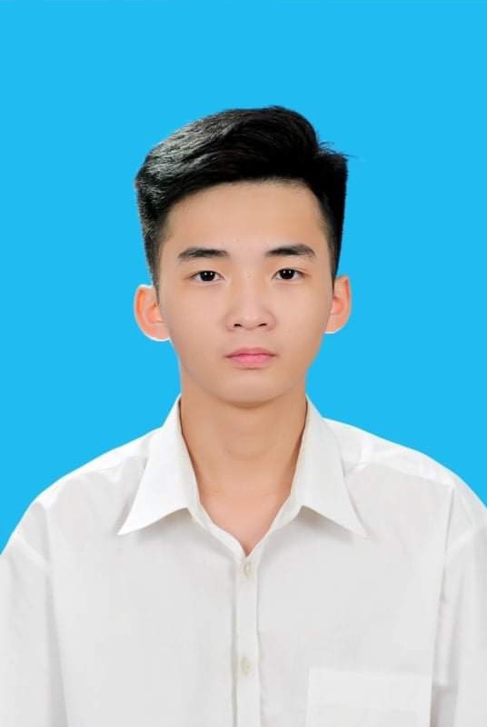

Huy Duong Tran
Hoang Viet Nguyen
2
2

Slide 3
1
PROBLEM
2
DATA EXPLORING
CONTENT
3
MODEL
4
RESULT & EVALUATE
5
DEMO
© Copyright FPT Software – Level of Confidentiality
© Copyright FPT Software – Level of Confidentiality
3

Slide 4
PIPELINE
PROBLEM
DATA PREPROCESSING
DATA COLLECTING
DEPLOY
EVALUTATING
MODEL TRAINING
MODEL TUNIING
© Copyright FPT Software – Level of Confidentiality
4

Slide 5
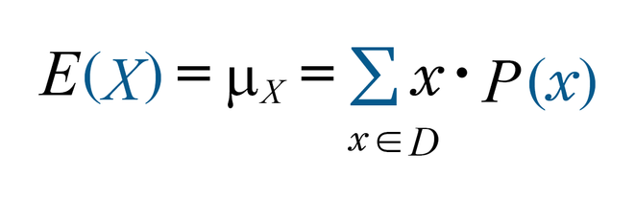
1. PROBLEM
The need to analyze football match data and then study tactics depending on the opponent.
Research the factors that affect the outcome of a football match.
Increase the mean/expected value of bets (optional).
© Copyright FPT Software – Level of Confidentiality
5

Slide 6
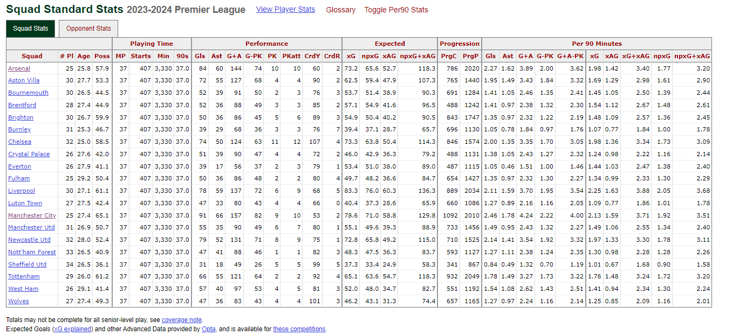
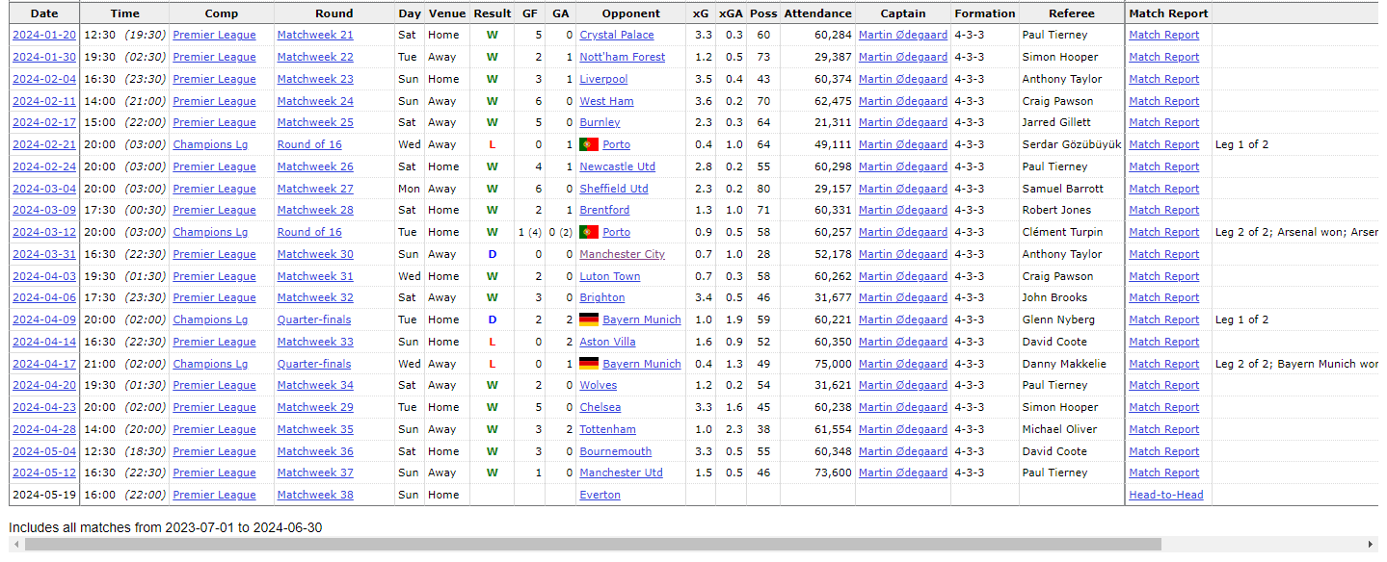
2. DATA EXPLORING
(from: https://fbref.com/en/comps/9/Premier-League-Stats)
6

Slide 7
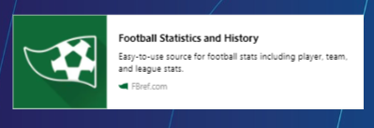
2. DATA EXPLORING
2.1 DATA COLLECTING
IDENTIFY
SCRAPING
SAVING
REQUEST
BS4 BEAUTIFULSOUP
PANDAS
RESULT: SCRAPED ALL EPL 23/24 MATCHES DATA AND SAVED IT IN matches.csv
DATA .shape = (518,28)
7

Slide 8
2. DATA EXPLORING
2.1 DATA PREPROCESSING
CHOOSE PREDICTORS
CATEGORY COLS: FLATTEN IT (ORDINARY+ONEHOT DECODING)
DATETIME COLS: CONVERT TO NUMBER
TARGET
W | 1
D | 0
L | -1
MAPPING RESULT TO NUMBER
SPLITTING: (TRAIN/TEST : 0.8/0.2)
8

Slide 9
3. MODELS
RANDOMFORESTCLASSIFIER ALGORITHM | Used for classification tasks, to predict categories or labels for instances based on input characteristics
PARAMETER | n_estimators = 100, min_samples_split = 5, random_state = 0
INPUT | team_code, opp_code, hour, day_code, venue_code
OUTPUT | accuracy of win, draw, loss and overall
(Source: Interdisciplinary Studies Research Center (ISRC), Polytechnic of Porto - School of Engineering, Porto, Portugal
Polytechnic of Porto - School of Engineering, Rua Dr. António Bernardino de Almeida, Porto, Portugal)
9

Slide 10
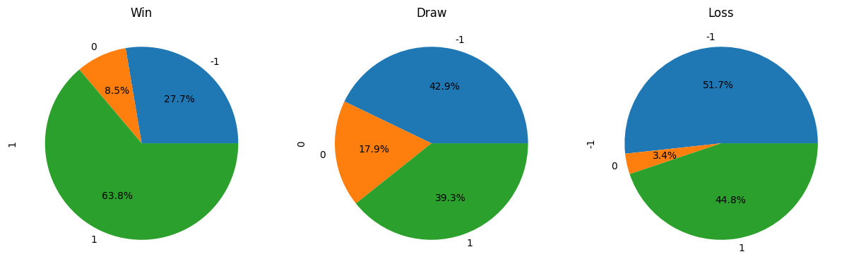
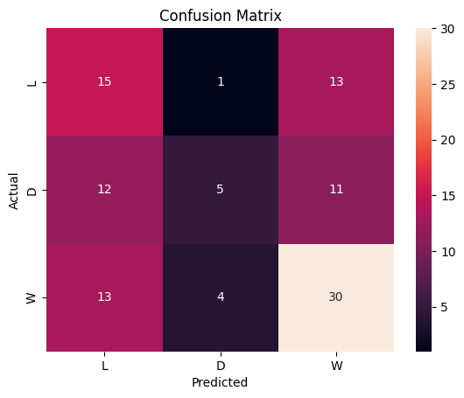
4. RESULT & EVALUATE
Win accuracy = 30/(13 + 4 + 30) ≈ 63.8%
Draw accuracy = 5/(5+ 12 + 11) ≈ 17.9%
Loss accuracy = 15/(15 + 11 + 13) ≈ 51.7%
10

Slide 11
5. DEMO + REFERENCES
Premier League Stats
Predict Football Match Winners With Machine Learning And Python -
Dataquest
Prediction of football match results with Machine Learning - Fátima Rodrigues
Github Copilot + Claude AI
11

Slide 12

THANKS FOR WATCHING
12

