Slide 1


FINAL PROJECT
ADY201m
Hoang Viet Nguyen
July 2024
1

Slide 2

1
INTRODUCTION
2
TIMELINE
3
DATA EXPLORING
CONTENT
4
MODELING
5
DEPLOYMENT
6
DEMO & REFERENCES
© Copyright FPT Software – Level of Confidentiality
© Copyright FPT Software – Level of Confidentiality
2

Slide 3
1. INTRODUCTION
© Copyright FPT Software – Level of Confidentiality
3

Slide 4

1. INTRODUCTION
From the old car dataset, do some analysis, visualize, and process the data to find a clear insight into it.
After that, make a regression model to predict the car price, the expected R2 is more than 0.75. Using this model to deploy on a simple web app using Flask.
4

Slide 5
2. TIMELINE
© Copyright FPT Software – Level of Confidentiality
5

Slide 6

2. TIMELINE
01
02
03
04
7/15-7/17
7/18 - 7/20
7/21 - 7/23
7/24
Data Cleaning
Visualization
Model Training
Model Evaluating
Fine Tuning
Create modules
Build web app
Maintaining
Making Report Slide
© Copyright FPT Software – Level of Confidentiality
6

Slide 7
3. DATA EXPLORING
© Copyright FPT Software – Level of Confidentiality
7

Slide 8
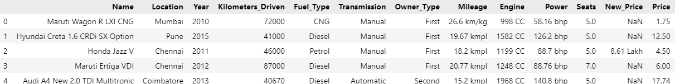
3. DATA EXPLORING
3.1. DATA CLEANING
OVERVIEW OF DATASET
The price of the used car in INR Lakhs (1 INR ~ 1,204.82$ ~ 30 554 235 VND)
There are 6019 rows and 13 columns in train-data.csv.
We can see that the data is not in a good format (ex: Many numerical columns have their unit which makes them object datatype instead of float)
© Copyright FPT Software – Level of Confidentiality
8

Slide 9
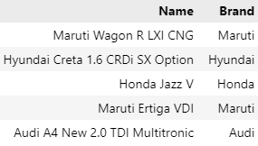
3. DATA EXPLORING
3.1. DATA CLEANING
Drop Null
Take Brand from the first word of Name
Split by space
then take the first word
© Copyright FPT Software – Level of Confidentiality
9

Slide 10
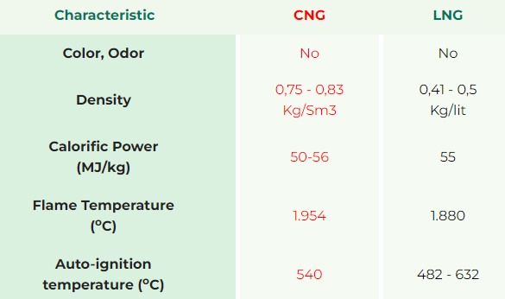
3. DATA EXPLORING
3.1. DATA CLEANING
NUMERICAL VARIABLES
Take Age using Age = 2019 - Year.
Delete the unit of Engine and Power (bhp and CC).
Convert Mileage from Km/kg into Kmpl
then delete the unit Kmpl.
(https://pgs.com.vn/en/compressed-natural-gas-cng)
© Copyright FPT Software – Level of Confidentiality
10

Slide 11
3. DATA EXPLORING
3.1. DATA CLEANING
CATEGORICAL VARIABLES
Transform Owner_type into numeric.
With all categorical columns, one hot encoding them
using OneHotEncoder from sklearn.
Drop no-need columns and outliers.
© Copyright FPT Software – Level of Confidentiality
11

Slide 12
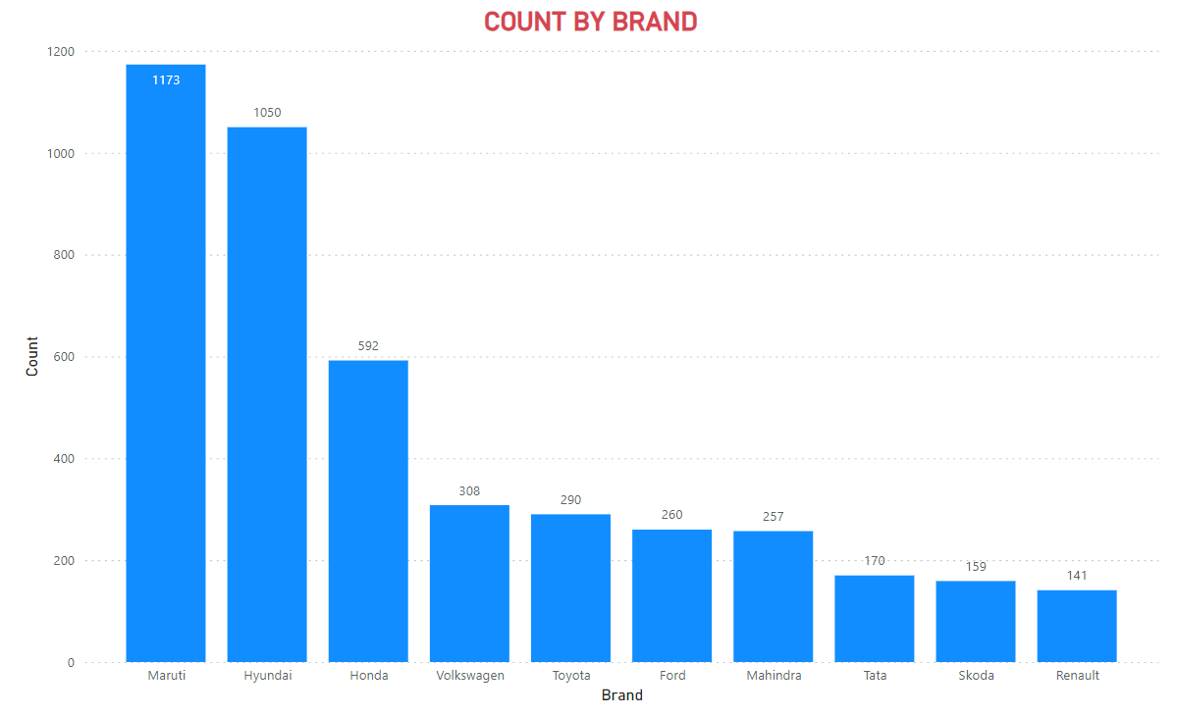
3. DATA EXPLORING
3.2. DATA VISUALIZING
Maruti, Hyundai, and Honda are the 3 most popular car brands in the data.
Maybe Indians prefer these brands or because of the cost of accessing these brands.
© Copyright FPT Software – Level of Confidentiality
12

Slide 13
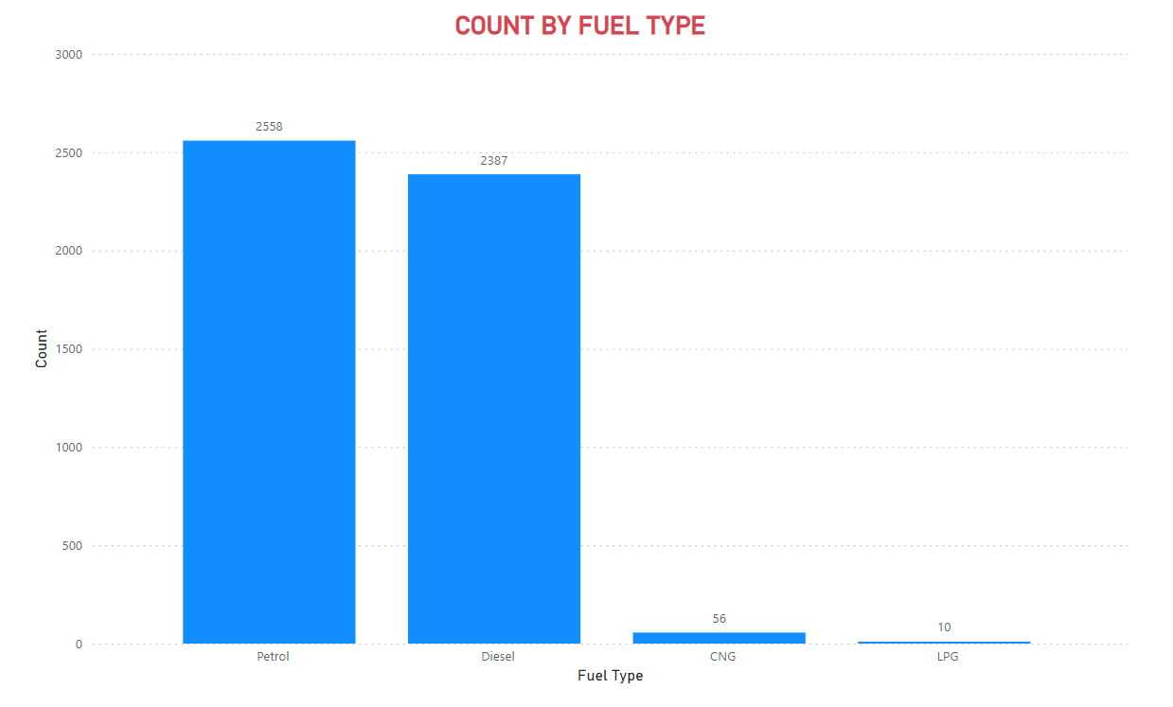
3. DATA EXPLORING
3.2. DATA VISUALIZING
Petrol and Diesel have significantly higher counts than LPG and CNG.
From there, we can know that the model will predict better prices of cars using these materials.
© Copyright FPT Software – Level of Confidentiality
13

Slide 14
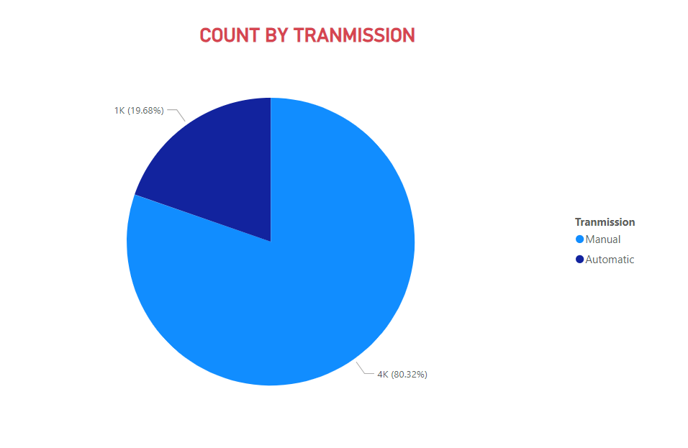
3. DATA EXPLORING
3.2. DATA VISUALIZING
Manual transmissions are much more common than automatic transmissions in this dataset. (8/2)
It could be because the dataset was collected in 2019 or because Indians prefer to drive manual cars.
© Copyright FPT Software – Level of Confidentiality
14

Slide 15
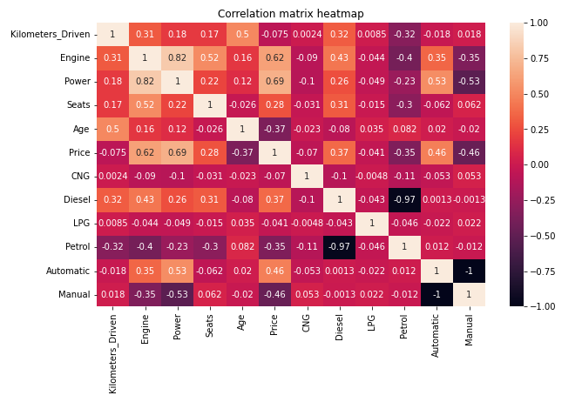
3. DATA EXPLORING
3.2. DATA VISUALIZING
The 3 factors that most impact the old car price are Power (0.69), Engine (0.62), and Tranmission (0.46).
Car buyers often pay attention to the car's performance to evaluate how much they will pay.
© Copyright FPT Software – Level of Confidentiality
15

Slide 16
4. MODELING
© Copyright FPT Software – Level of Confidentiality
16

Slide 17
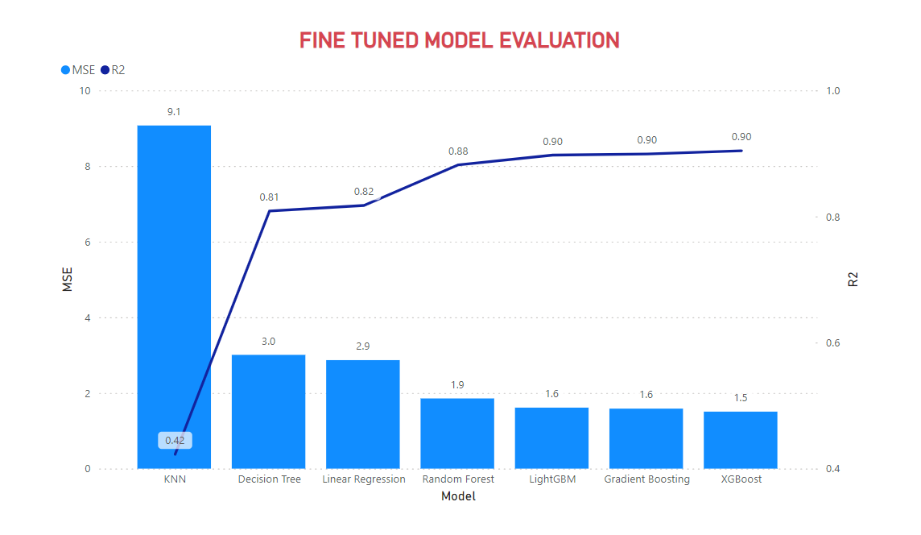
4. MODELING
7 models have been trained in the same dataset (SQL Database) in Google Colab.
They have been fine-tuned by using GridCV
XGboost brings the best performance (R2 ~ 0.9) with parameter: {'learning_rate': 0.3, 'max_depth': 3, 'n_estimators': 300}.
© Copyright FPT Software – Level of Confidentiality
17

Slide 18
4. MODELING
After training, the XGBoost model has been saved in .pkl format (Using pickle)
Then, I make a module with the simple class PredictModule to call in the web app.
Constructor:
__init__: load model
Methods:
to_df: convert user input to a pandas DataFrame
predict: predict and return a result (float)
© Copyright FPT Software – Level of Confidentiality
18

Slide 19
5. DEPLOYMENT
© Copyright FPT Software – Level of Confidentiality
19

Slide 20




5. DEPLOYMENT
REQUIREMENTS
Module to run predict with user input correctly
To make the user interface
and render template.
Python file: predict_module.py
Python file: run.py
HTML file: master.html & go.html
© Copyright FPT Software – Level of Confidentiality
20

Slide 21

5. DEPLOYMENT
PROCESS FLOW
MASTER.HTML
MODEL.PKL
PREDICT_MODULE.PY
Run file run.py, render master.html.
© Copyright FPT Software – Level of Confidentiality
21

Slide 22
5. DEPLOYMENT
PROCESS FLOW
MASTER.HTML
MODEL.PKL
PREDICT_MODULE.PY
GO.HTML
When the user clicks predict, render go.html with the predicted price.
© Copyright FPT Software – Level of Confidentiality
22

Slide 23
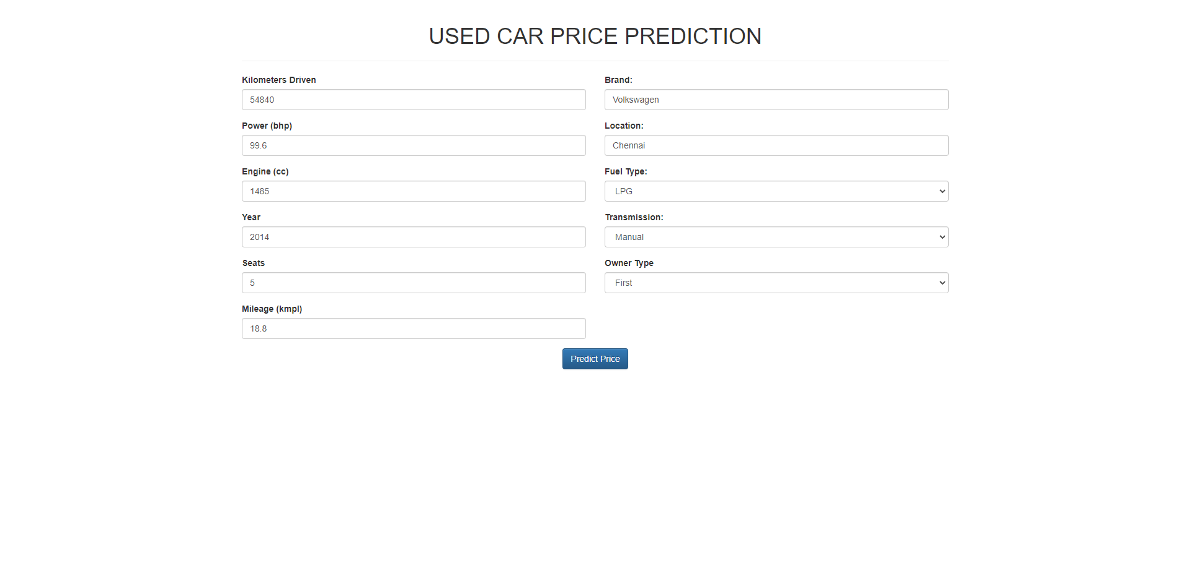
6. DEMO + REFERENCES
NUMERICAL
CATEGORY
23

Slide 24
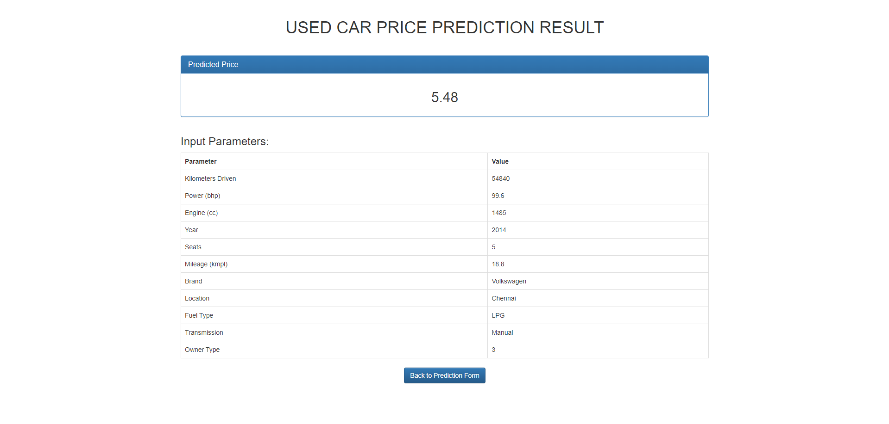
6. DEMO + REFERENCES
Show the predicted price in INR Lakhs
(1 INR ~ 1,204.82$ ~ 30 554 235 VND)
24

Slide 25
6. DEMO + REFERENCES
FUTURE DEVELOPMENT
Predict for more features (the full name of the car).
Improve the interface (easier to use, maybe show the popular cars).
Real-time price converter for a variety of users.
Use AI model to guess car names based on images, after that predict that car price. (optional).
25

Slide 26
sinhvienfpt/UsedCarPricePrediction
6. DEMO + REFERENCES
Used Cars Price Prediction Dataset
Car Price Prediction - MOHAMED-EL HADDAD
Used car price estimation - Huynh Dong Nguyen
Thank you to Github Copilot + Claude AI
Visit the GitHub repository of this project
26

Slide 27

THANKS FOR WATCHING
27

