Slide 1
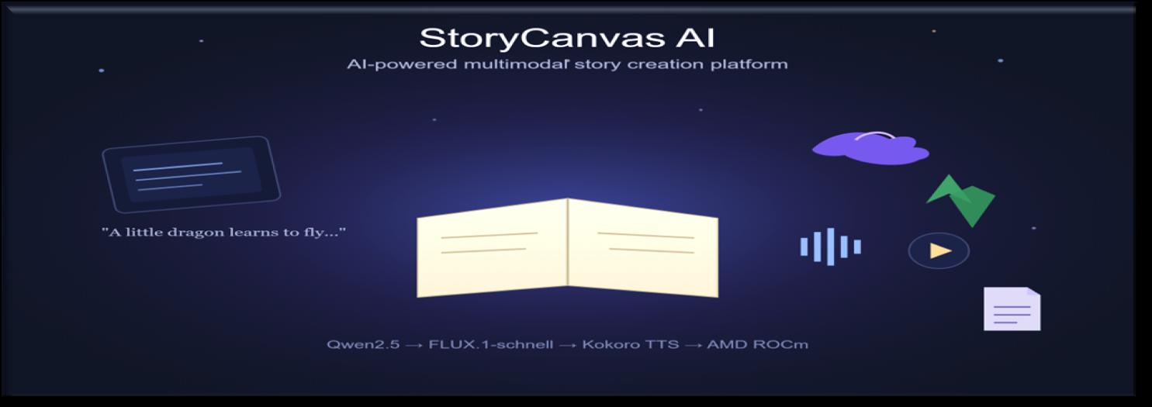
StoryCanvas AI
AI-Powered Multimodal Story Generation Platform
Team Sinifive
Mallikanti Bharath Kumar
AMD AI DevMaster Hackathon 2026 • Track 1: Multimodal Content Creation
1 / 10

Slide 2
THE PROBLEM
Why StoryCanvas AI?
Current Challenges
Today's Fragmented Workflow
Requires separate tools for writing, art, and audio
Write Story
Time-consuming, often taking hours per story
Design Illustrations
High production cost for professional results
Record Narration
Demands artistic & technical expertise
Format PDF
Inaccessible for educators & parents on a budget
Edit Video
Existing AI tools each solve only one piece of this puzzle — none deliver a complete storybook.
2 / 10

Slide 3




THE SOLUTION
One Prompt. A Complete Storybook.
User Prompt
What This Unlocks
Single natural-language prompt
Qwen2.5 → Story
Fully automated multimodal pipeline
FLUX.1-schnell → Images
Interactive React story viewer
One-click PDF export
Kokoro → Narration
One-click narrated MP4 export
PDF + MP4 Export
GPU-accelerated on AMD Radeon + ROCm
3 / 10

Slide 4
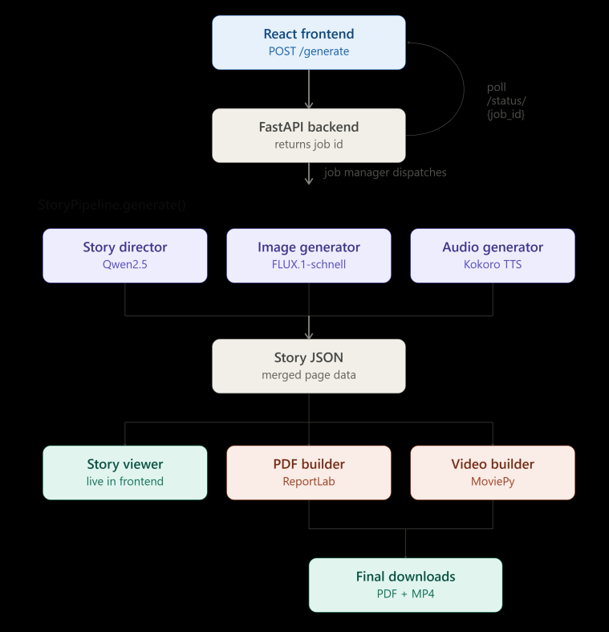
UNDER THE HOOD
System Architecture
Frontend → FastAPI → Job Manager
→ StoryPipeline (Qwen2.5 + FLUX + Kokoro)
→ Story JSON → Viewer / PDF / Video
4 / 10

Slide 5
THE ENGINE ROOM
AI Models
Model | Purpose
Qwen2.5 | Story generation (title, genre, multi-page narrative)
FLUX.1-schnell | Page-by-page illustration generation
Kokoro TTS | Natural-sounding narration synthesis
Qwen2.5
Structured multi-page story
FLUX.1-schnell
Context-aware illustrations
Why These Models?
Fast inference speed
High output quality
Kokoro TTS
Modular & swappable
ROCm-compatible on AMD GPUs
Page-wise narration
5 / 10

Slide 6



THE MOST IMPORTANT SLIDE
AMD Radeon + ROCm Optimization
Executed entirely on AMD Radeon Cloud using ROCm-enabled PyTorch
Optimization | Benefit
ROCm PyTorch | GPU-accelerated inference
Persistent model loading | No reload overhead per request
FP16 half-precision | Lower VRAM, higher throughput
Async job pipeline | No HTTP timeouts
AMD Radeon Cloud | High-performance GPU deployment
47.98 GB
Total VRAM
41.68 GB
GPU Memory Used
72 sec
End-to-End Pipeline
PyTorch 2.9.1 • AMD Radeon Graphics • ROCm runtime
6 / 10

Slide 7

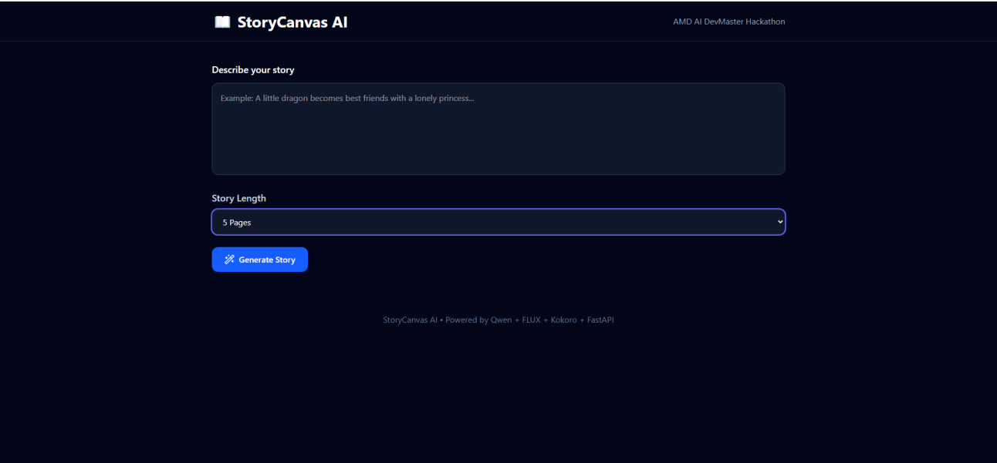
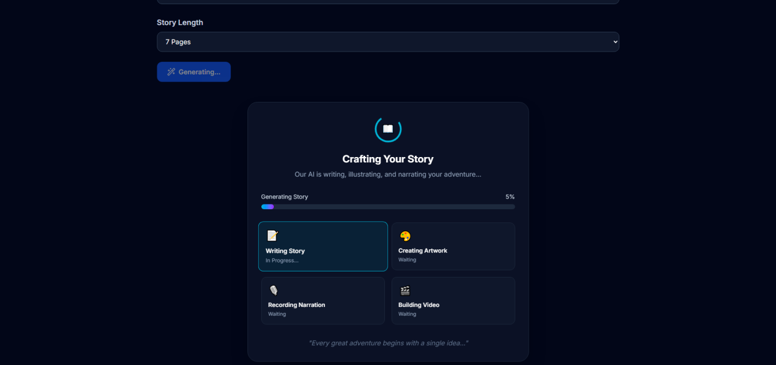
SEE IT IN ACTION
Live Demo Walkthrough
1 · Home Page
2 · Generating Screen
3 · Illustrated Page
6 · PDF + Video Export
5 · Narrated Audio
4 · Story Viewer
Prompt → Story → Illustrations → Narration → PDF & MP4 — all in one flow.
7 / 10

Slide 8
THE NUMBERS
Performance Benchmarks
All AI models execute within a single multimodal pipeline while maintaining GPU-resident model loading and asynchronous execution.
Metric | Value
Story Generation | 3 s
Image Generation | 3 s / page
Audio Generation | 4 s / page
Video Generation | 62 s
Total Pipeline | 72 s
Complete Illustrated Storybook Generated in 72 Seconds
8 / 10

Slide 9





WHO IT HELPS
Practical Impact
Reduces multimedia story creation from hours of manual work to approximately one minute through an automated AI pipeline.
Educators
Parents
Publishers
Accessibility
Creators
One Prompt → Complete Storybook
9 / 10

Slide 10






WHAT'S NEXT
Future Scope
Multilingual
Character Consistency
Animation
Cloud Scaling
Collaboration
Mobile App
Thank You
GitHub: github.com/sinifive/StoryCanvasAI • Demo Link in README • Team Sinifive
10 / 10

