Slide 1

Foodly A Project On Digital Canteen Pre-Ordering System
Submitted by Under the guidance of
Shruti Bhargav (23048985) Mr. Amrit Sagar Gupta
Janvi Sahni (23048927) Ms. Neha Arora
B.C.A 6th Semester

Slide 2
Introduction
Traditional canteen system is manual
Current canteen operations rely entirely on manual processes, leading to inefficiency and human errors.
Students face long queues and delays
Students lose valuable time waiting in long lines, disrupting their academic schedules.
No proper order tracking system
The absence of a tracking mechanism leaves students with no visibility into their order status.
Food wastage due to poor planning
Without demand forecasting, excess food is prepared daily, resulting in significant wastage.
Need for a digital solution
A smart, digital canteen system is essential to streamline operations and enhance the overall student experience.

Slide 3
Problem Statement
Overcrowding during peak hours
Rush hours create chaos, making the canteen unmanageable.
Time wastage in queues
Long waits cut into students' valuable break time.
Manual errors in order handling
Human handling leads to frequent wrong or missed orders.
No accountability for unpicked orders
Uncollected orders cause waste and financial loss.
Lack of data analytics
No insights means poor planning and uninformed decisions.

Slide 4
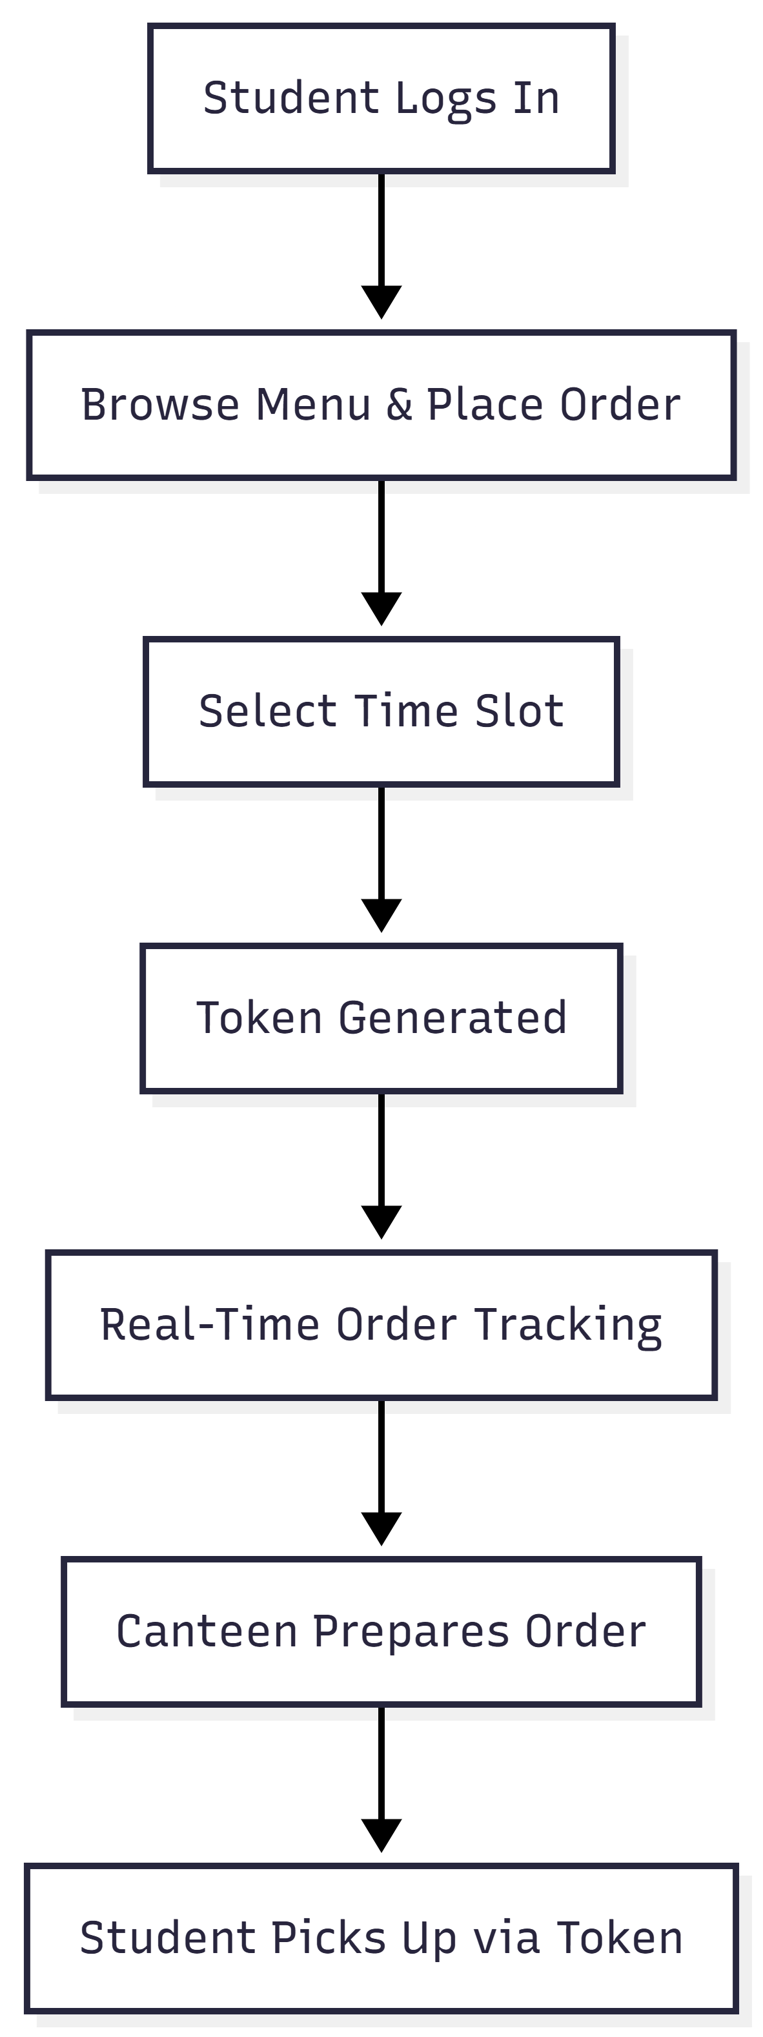
Proposed Solution
Web-based canteen pre-ordering system
Students can order food in advance
Time-slot based pickup system
Token-based order management
Real-time order tracking

Slide 5
Objectives
Reduce congestion and waiting time
Improve order management
Enable time-slot based pickup
Provide real-time order tracking
Minimize food wastage
Improve operational efficiency

Slide 6
System Overview
User-friendly web application
Simple and intuitive interface for easy navigation by all users.
Two modules: Student & AdminDatabase-driven system
Separate panels for students to order and admins to manage operations.
Responsive design (mobile + desktop)
Fully accessible across all devices without compromising usability.
Database-driven System
All data is stored and retrieved efficiently using a structured database.
Real-time updates using AJAX
Orders and status updates reflect instantly without page refresh.

Slide 7
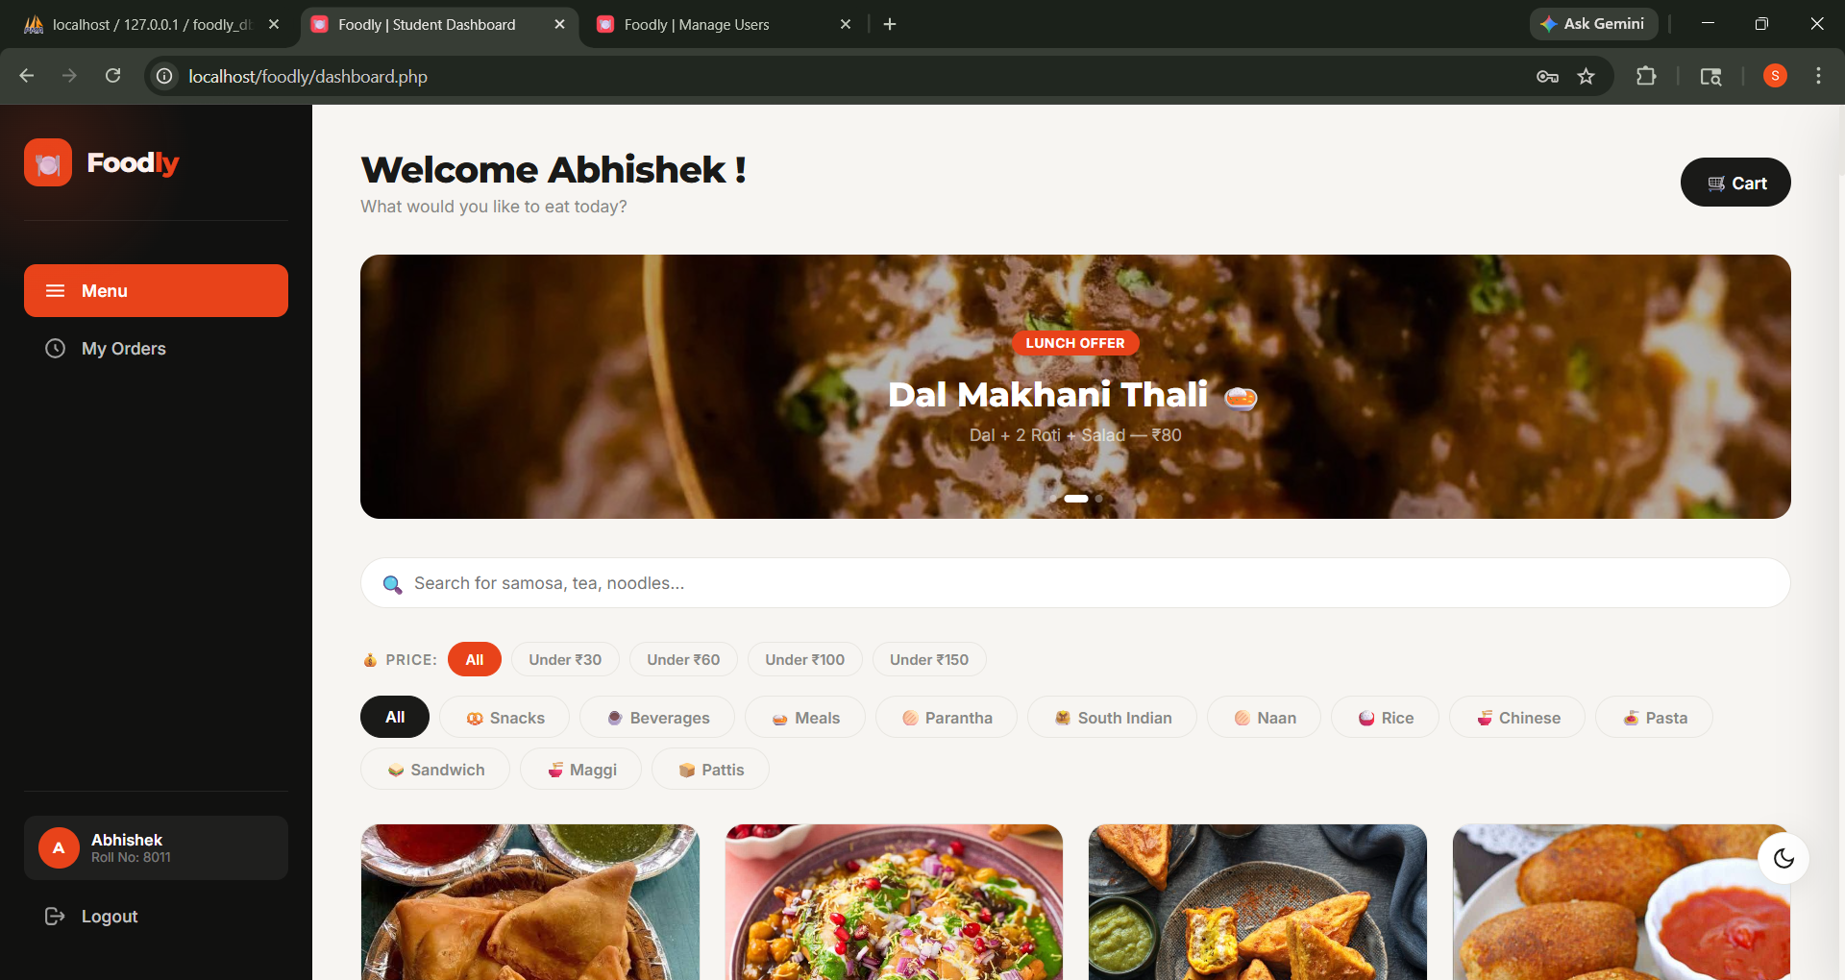
Student Module
Registration & Login
Secure sign-up and login to access personalized ordering features.
View Menu Items
Browse available food items with details and pricing in real-time.
Add to Cart
Easily select and manage desired items before placing the order.
Select Time Slot
Choose a preferred pickup time to avoid queues and crowding.
Place Order & Get Token
Confirm the order and receive a unique token for pickup identification.
Track Order Status
Monitor order progress in real-time from placed to ready.

Slide 8
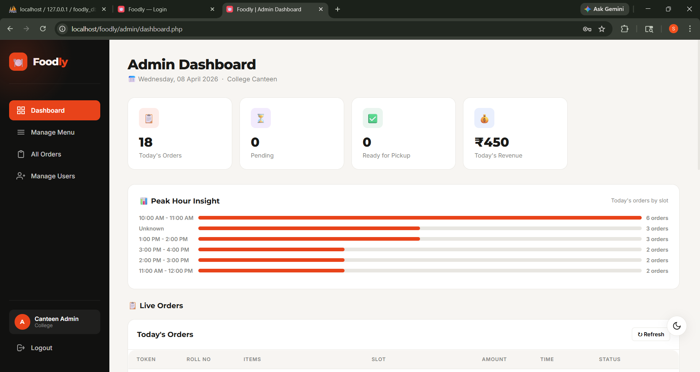
Admin Module
Manage Menu Items
Add, edit, or remove food items and update pricing effortlessly.
Manage Time Slots
Configure and control available pickup slots to regulate crowd flow.
Update Order Status
Mark orders as preparing, ready, or completed in real-time.
View Daily Orders & Revenue
Access summarized reports of orders and earnings for the day.
Track Unpicked Orders
Monitor and flag uncollected orders to reduce waste and loss.

Slide 9
Key Features
Time-slot based ordering
Automatic token generation
Real-time status tracking
Slot capacity control
“Forgot Anything?” timer
Duplicate order prevention

Slide 10
Technology used
Frontend | HTML, CSS, Bootstrap, JavaScript, jQuery
Backend | PHP
Database | MySQL
Server | XAMPP (Apache)

Slide 11
Hardware and Software requirements
Hardware:
Computer/Laptop
Minimum 4GB RAM
Internet access
Software:
XAMPP
Web Browser (Chrome)
Code Editor (VS Code)

Slide 12
Feasibility Study
Technical
The system is built on reliable web technologies with a secure, scalable, and responsive architecture suitable for institutional use.
Economical
Low-cost development and minimal infrastructure requirements make it an affordable solution for any canteen.
Operational
Streamlines day-to-day canteen activities, reducing manual effort and improving overall efficiency and order accuracy.

Slide 13
Database Overview
Core Tables
Users, Menu, Categories, Time Slots
Transaction Tables
Orders, Order Items
Relationships
Ensure data integrity & dynamic operations

Slide 14
Results & Advantages
Reduced waiting time
Organized order handling
Better user experience
Reduced food wastage
Easy monitoring for admin

Slide 15
Conclusion & Future Scope
Conclusion:
Efficient digital canteen system
Improves time and resource management
Future Scope
Online payment integration
Mobile application
Multi-canteen support
Advanced analytics

