Slide 1
Attendance application (aa)
Problem statement and Project Details
Presented by-
Utsav basu (20cs30057)
Anamitra mukhopadhyay (20cs30064)
Spandan haldEr (20cs10063)
Mentored by-
Karanam tejendhar
Prof. Sourangshu bhattacharya
Prof. Abir das

Slide 2
outline
The Problem Statement
Problems and Challenges
Project Design
Screenshots
Assumption
Reviewing Challenging Use Cases
Next Steps

Slide 3
Problem statement
It is proposed to develop a software to be used to save time while taking attendance. A unique code is to be generated by the attendance taker and will be announced to the attendees.

Slide 4
Salient Details of the problem in brief
Teacher generates a unique code which will be given in class
Students enter the code given by the teacher in class to mark their attendance.
Teacher get possible proxies
Both teacher and student can view their attendance statistics
Admin can create/delete/modify a course from the database

Slide 5
Programming language(s)
Frontend & Backend C++: Given the time constraint, it would have been really difficult for us to learn one or more new languages and implement the required features. So, we decided to do everything in C++ and invest the limited time we had to learn new libraries for implementing the desired functionalities.

Slide 6
Challenges
Most of the libraries we used were not well documented.
Solution: We had to browse through FAQ section of the GitHub repository and Stack Overflow.
Notes:
Now, let us talk about a few challenges we faced during the development of our application. Read slide, explain a bit

Slide 7
Challenges
Since the frontend and the backend were prepared separately, it was required to pass data back and forth through a communication channel. However, we did not have much idea of networking or data transmission protocols.
Solution: We spent some time on the internet and found a good library that used the Asio library and provided easy-to-use APIs that helped us handle the communication part.
Notes:
Read slide… explain a bit.

Slide 8
Project design
A Database Diagram and a Use Case Diagram were created during the design phase. These roughly represent the design principles that are adhered to during implementation of the Attendance Application.
Notes:
Read slide

Slide 9
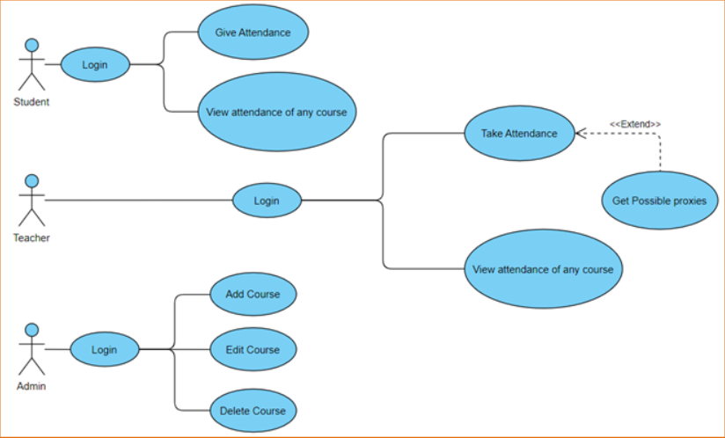
Use case diagram
Notes:
Explain

Slide 10
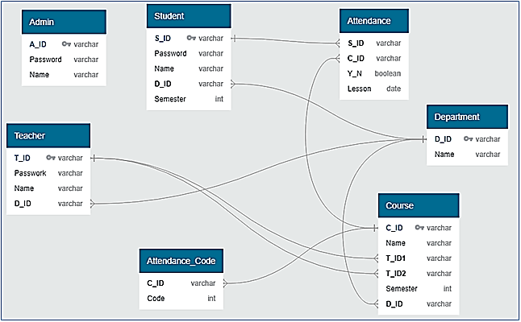
Database diagram
Notes:
Explain

Slide 11
Screenshots

Slide 12
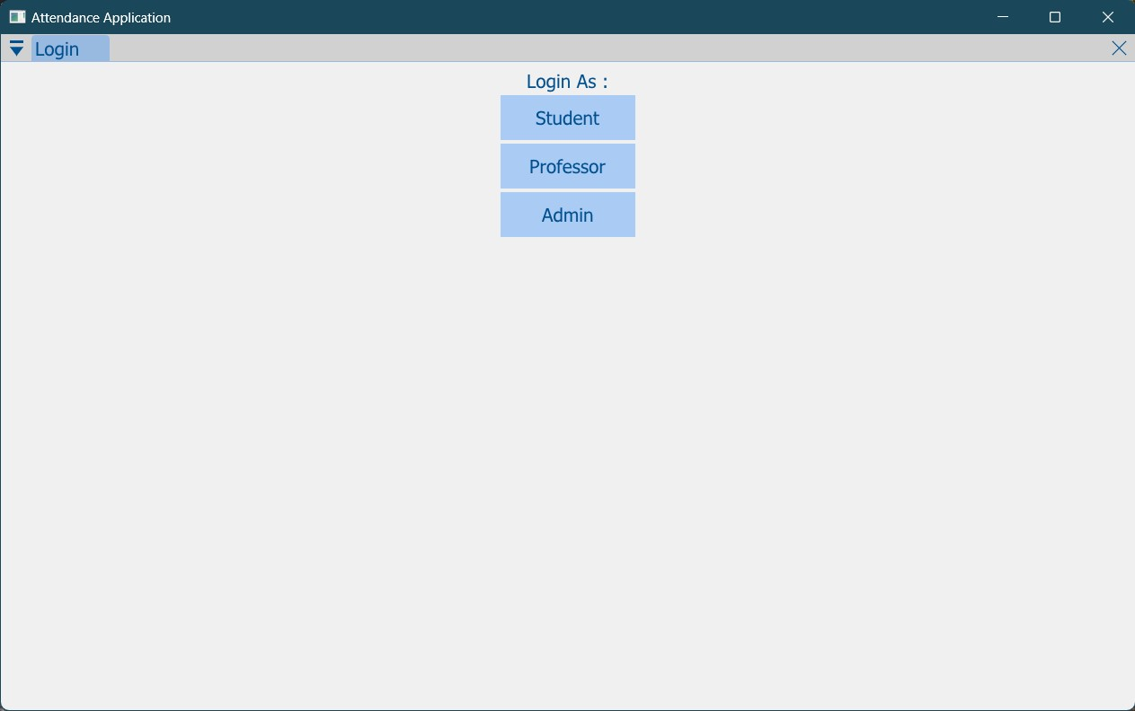
HOME PAGE
Notes:
This is the home page in the GUI Application. As we can see, there are three buttons for login as different users. Clicking on the any button directs to a new window where the user has to provide username and password to login. Then the user is directed to the login page ->

Slide 13
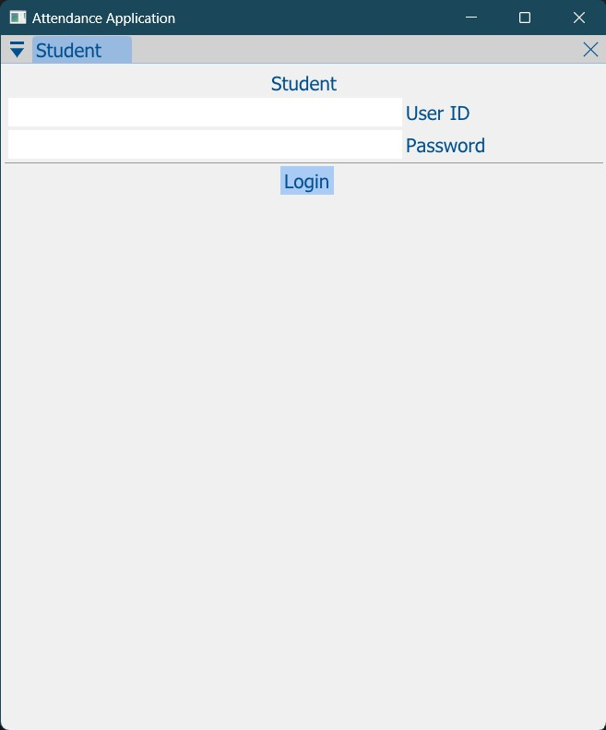
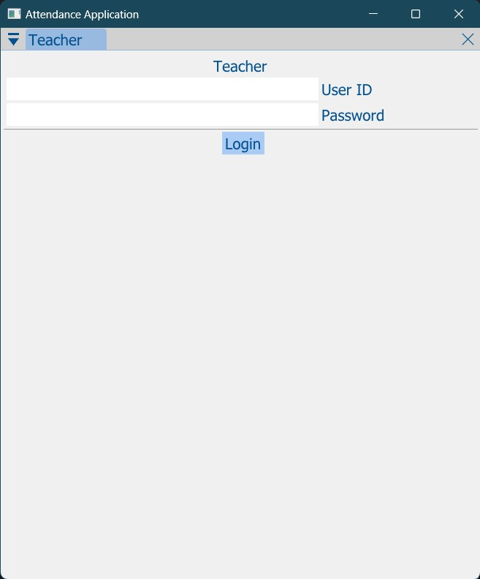
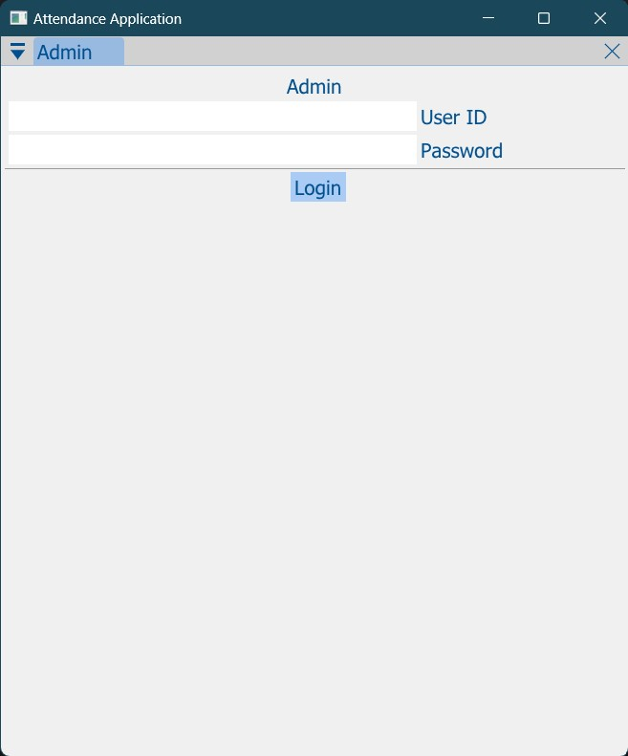
LOGIN WINDOW
Student Login
Teacher Login
Admin Login
Notes:
This is how the login window looks like for Student, Teacher and Admin users. If the correct username is provided with the correct password, and the Login button is clicked, the user is able to login, else, an error message is displayed as a pop up ->

Slide 14
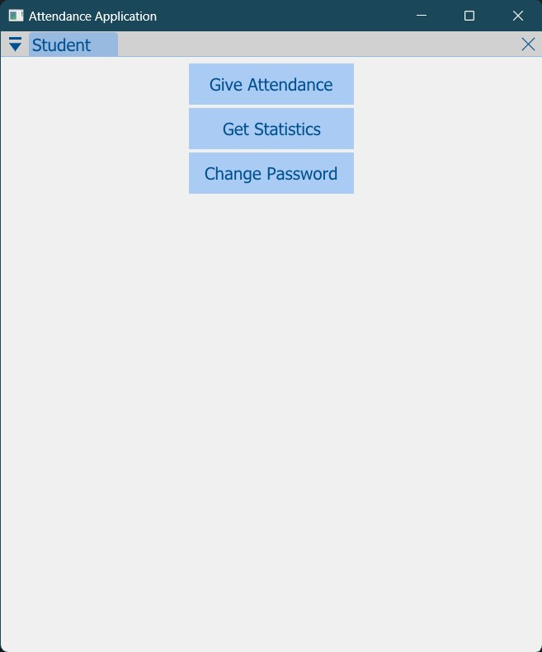
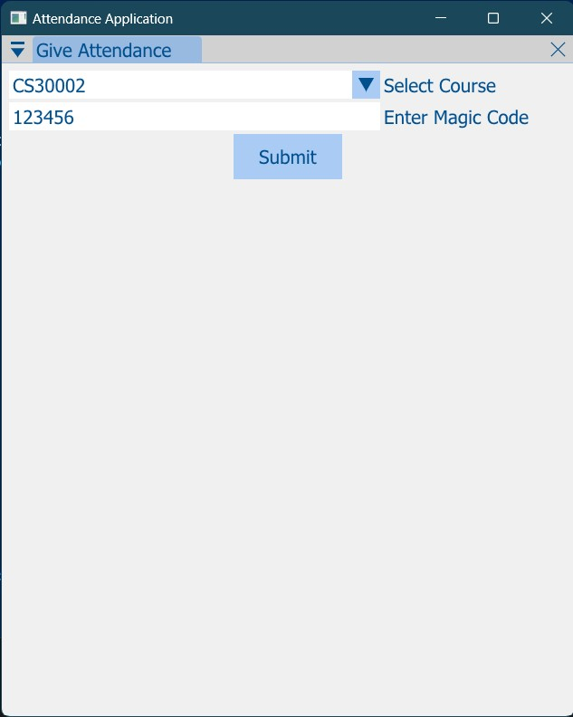
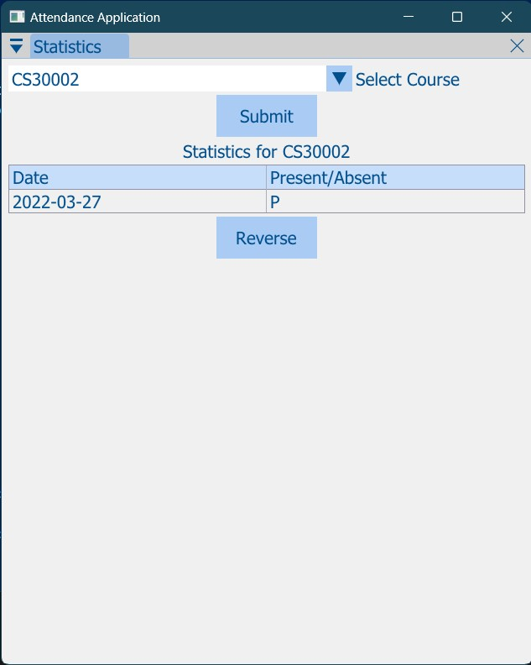
STUDENT LOGIN
Student Login Home
Give Attendance
View Attendance Statistics
Notes:
Let us look at the Student login window, this window opens after successfully logging in as a Student. There are three buttons- Give Attendance, Get Statistics and Change Password. Clicking on the Give Attendance button

Slide 15
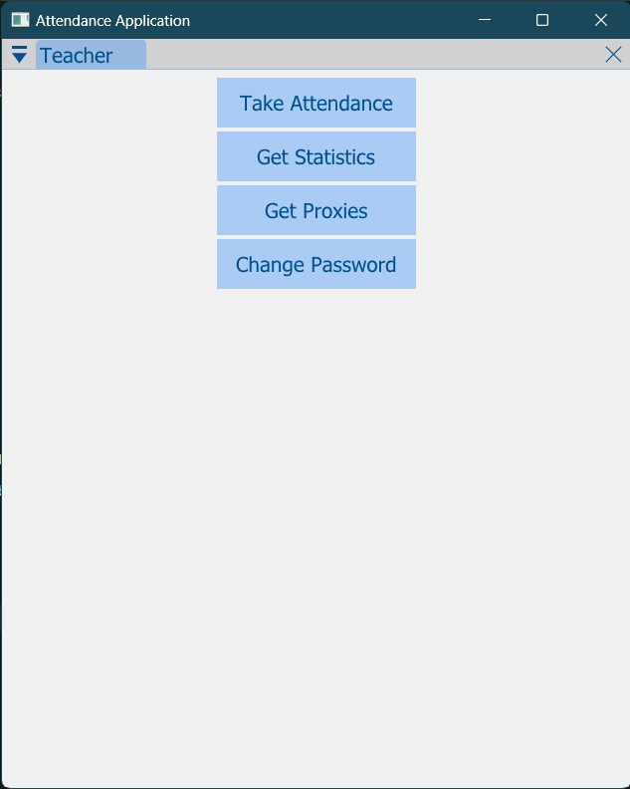
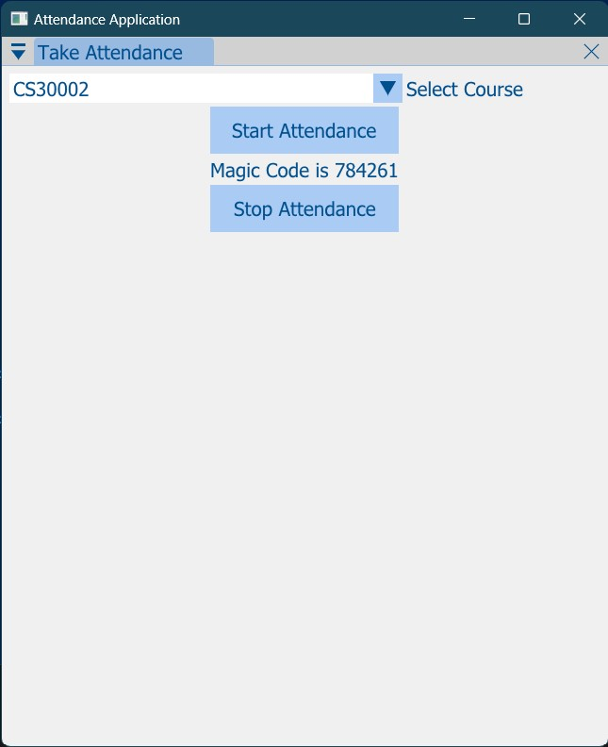
TEACHER LOGIN – Home/Take Attendance
Teacher Login Home
Take Attendance
Notes:
Next, we move to the teacher login page. There are four buttons. Clicking on Take Attendance opens this window. The course is to be selected from drop down list. Start Attendance -> Magic code generated->Stop Attendance

Slide 16
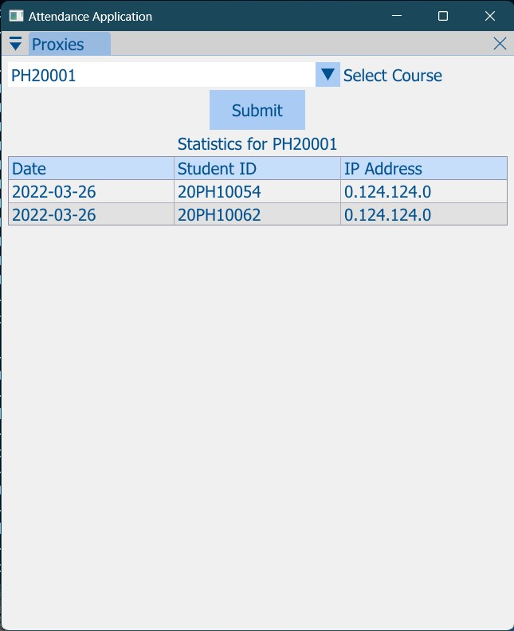
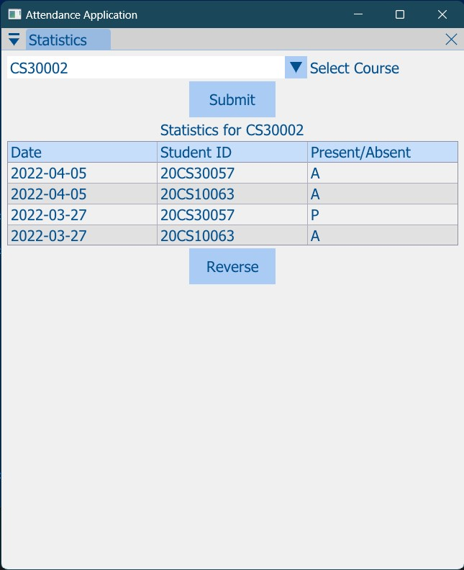
TEACHER LOGIN – Get Attendance/Proxies
Get Proxies
View Attendance Statistics
Notes:
The other two buttons- Get Statistics and Get Proxies opens these windows. Here, all what is required to do is choosing the course from the dropdown menu and click on submit.

Slide 17
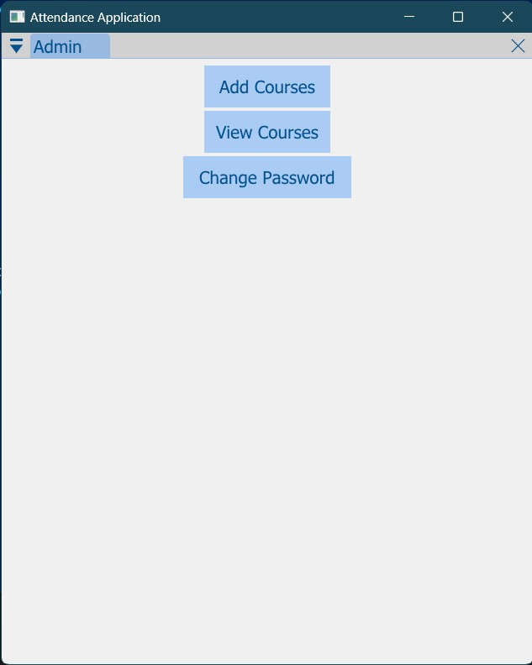
ADMIN LOGIN - Home
Notes:
This is the Admin Login page. There are 3 buttons ->

Slide 18
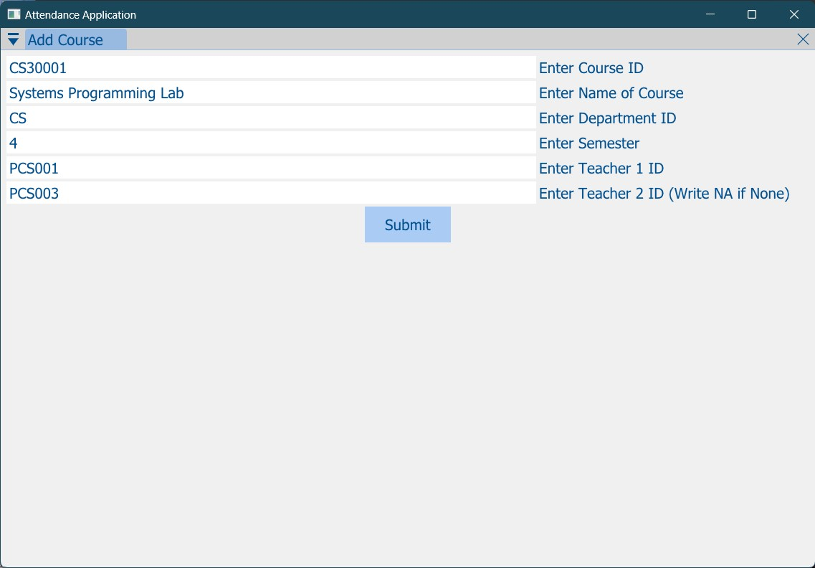
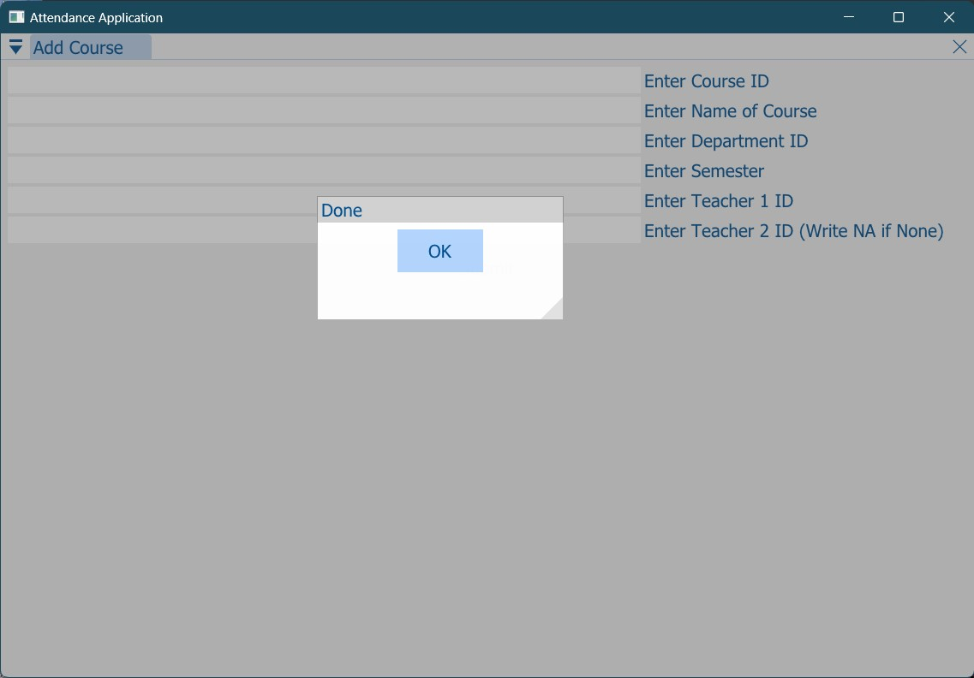
ADMIN LOGIN - Add Course
Notes:
The Add Course button opens a window like this, where the details of the course is to be entered. A successful entry displays a pop up message like this which means the course has been added.

Slide 19
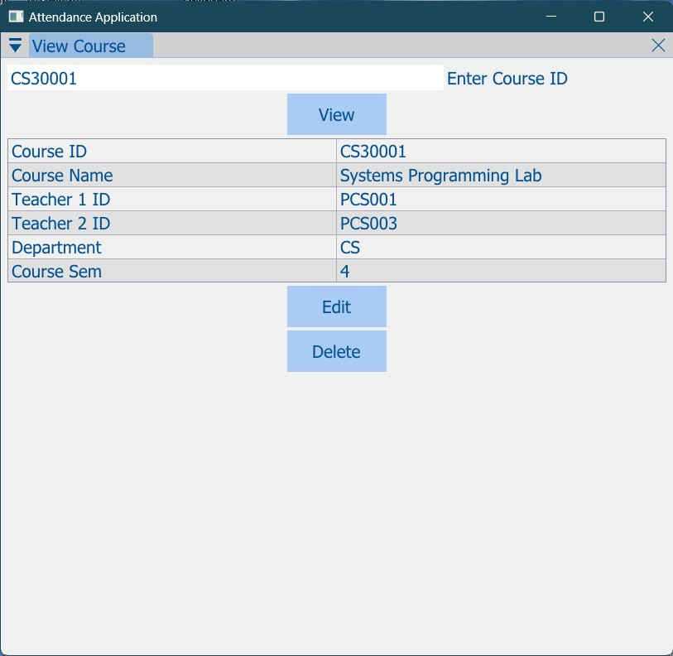
ADMIN LOGIN - View Course
Notes:
This is the view course window, where the admin has to enter the course ID and then the details of the course is displayed. After that, the admin is allowed to edit or delete that course.

Slide 20
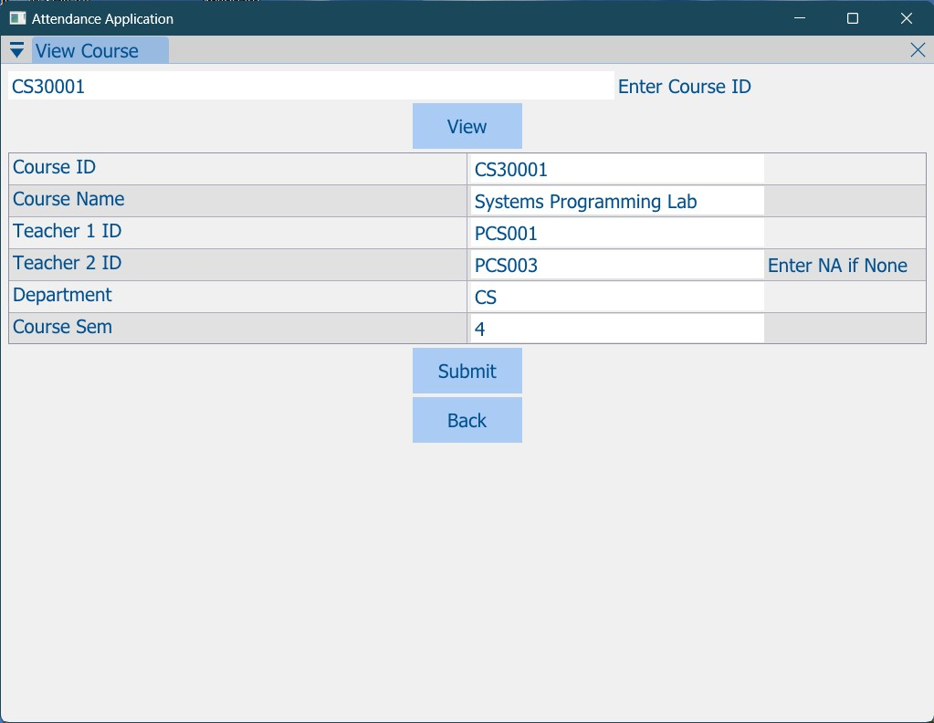
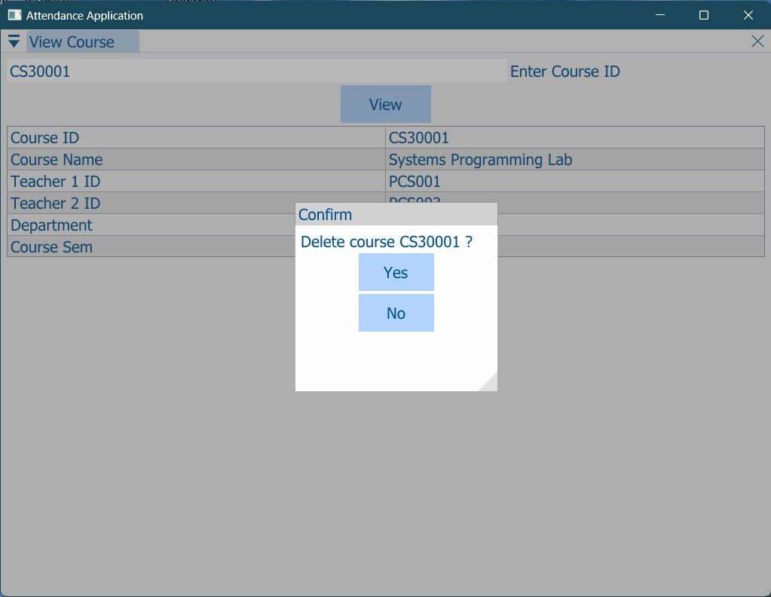
ADMIN LOGIN - Edit/Delete Course
Edit Course
Delete Course
Notes:
Here, in the edit course window, the admin has to re-enter the details of that course. The delete button opens a pop up window to confirm the deletion of the course.

Slide 21
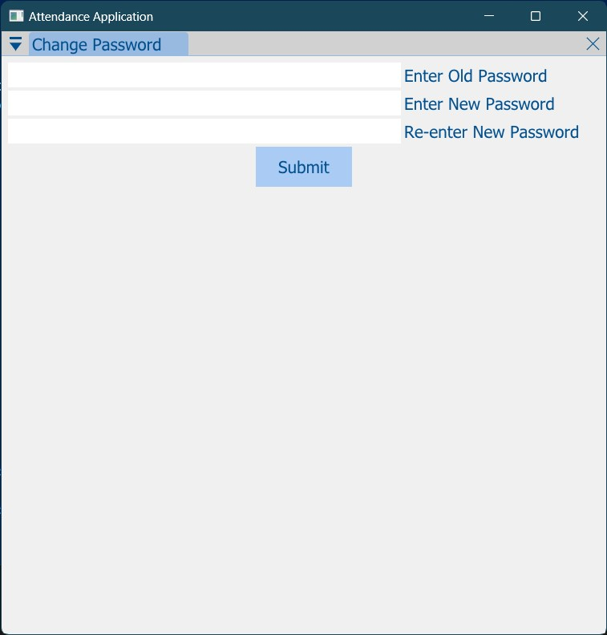
CHANGE PASSWORD
Notes:
This button is common to every user, the institute opens the account for everyone with some password, the user later changes his/her password after login. Here, the old and the new passwords need to be entered. If the credentials are correct, the password gets changed, else an error message is displayed.

Slide 22
ASSUMPTIONS
It is expected that the institute that is using the application will provide the database of Students, Teachers, Admins, Courses and Departments.
All the accounts for the users must be created by the institute and provided in the database.
The database should not be drastically changed in between the semesters unless specifically done by the institute.
At the end of semester, the database must be updated, so that there are no erroneous records.

Slide 23
Challenging use cases
Storing the password of the users ( student/teacher/admin ) inside the database is not safe. So, we used hashing. We hashed the passwords using a C++ bcrypt library which we found on the internet.

Slide 24
Next steps
Many small improvements can be made
GUI can be made smoother, more attractive, easier to use
A notification feature can be introduced, to intimate students when any teacher starts the attendance.
The server can be hosted on the web from a dedicated host.
Notes:
Read slide.. We, thus intend to develop this software further, and make it much better. A mobile app extension may also be developed for the same.

Slide 25
QUESTIONS

Slide 26
THANK YOU

