Slide 1
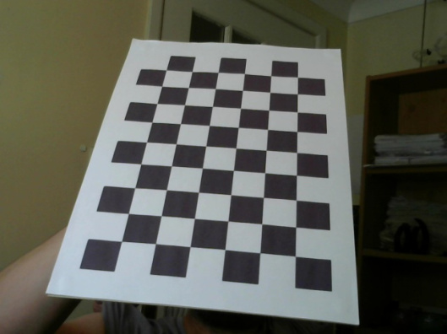
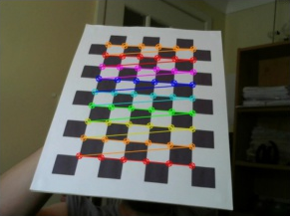
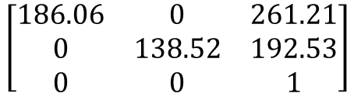
系級：統計碩二
姓名：林澤慶
電腦視覺作業二
目標：利用圖片進行實作相機校準
原圖如下：
經過校準得到圖形如下：
其中：
Lens distortion coefficients
Camera Intrinsic Matrix
[0.00963,-0.0415,0.01891,0.0007,0.0325]
$$\left[\begin{matrix}186.06 & 0 & 261.21 \\ 0 & 138.52 & 192.53 \\ 0 & 0 & 1\end{matrix}\right]$$
Rotation specified as a 3×1 vector.
[-0.0190,-0.22528,-3.0363]
3×1 Translation vector.
[2.1040,3.4870,4.5498]

