Slide 1
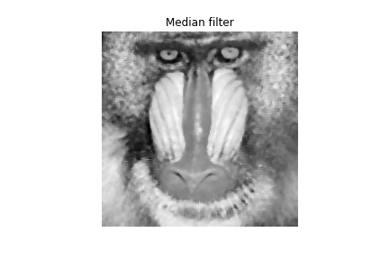
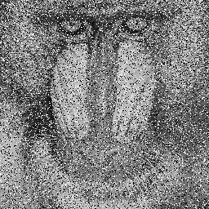
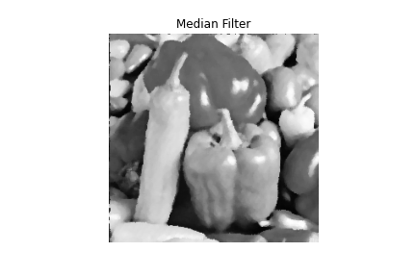
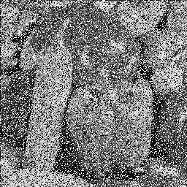
影像處理 Image processing
系級：統碩二
姓名：林澤慶
作業3
1. Remove salt-and-pepper noise
(20%) Write a routine that performs two-dimensional 5x5 median filtering to try to clean up the noise of ‘bab_noise.bmp’ and ‘peppers_noise.’ You need to exclude the noise pixels before applying median filtering and report PSNR before and after denoising as the table below shows.
PSNR | Before denoising | After denoising
Baboon | 28.994 | 20.027
Peppers | 29.673 | 24.641
發現兩張圖片經過 denoising後，圖片的PSNR皆下降，但圖片相較清楚了。

Slide 2
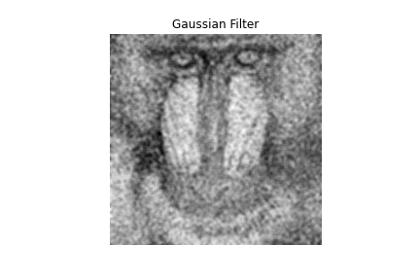
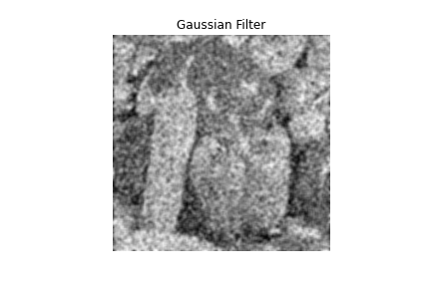
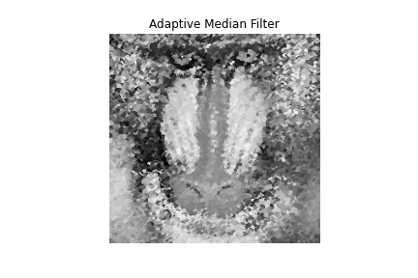
b. (20%) Following the previous question, use two-dimensional 5x5 Gaussian filtering with its kernel as below and report the PSNR results:
PSNR | Before denoising | After denoising
Baboon | 28.994 | 19.140
Peppers | 29.673 | 18.418
發現兩張圖片經過 denoising後，圖片的PSNR皆下降，但圖片相較清楚了。
c. (10%) Write a rotine that performs two-dimensional median filtering with an adaptive kernel size on bab_noise_90.bmp. For each noise pixel “p”, the adaptive kernel size needs to be the same as the smallest size of the sliding window centered at “p” with at least one non-noise pixel. Please also report the PSNR results in the table format like Q1.a.
PSNR | Before denoising | After denoising
Baboon | 28.524 | 17.519
由於之前的雜訊點實在過多，經過denoising過後有稍微清楚了。

Slide 3
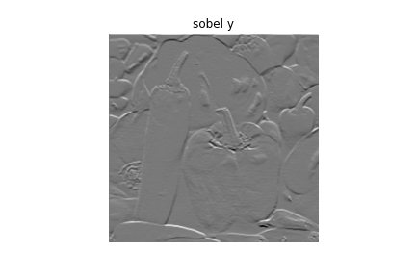
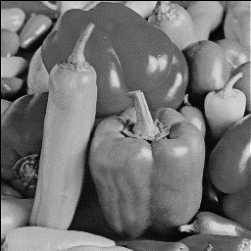
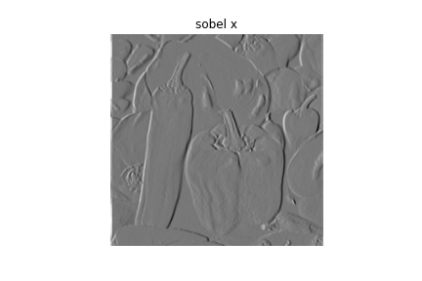
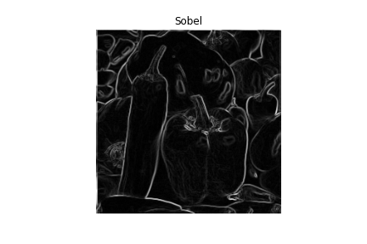
2. Edge Detection
(25%) Please implement Sobel filtering to find the edge map for ‘pepper.bmp’, whose result should look like https://www.mathworks.com/discovery/edge-detection.html (please implement the Sobel filter by yourself)
G x
G y
-1 | 0 | 1
-2 | 0 | 2
-1 | 0 | 1
-1 | -2 | -1
0 | 0 | 0
1 | 2 | 1
用來偵測 vertical edge
用來偵測 horizontal edge

Slide 4
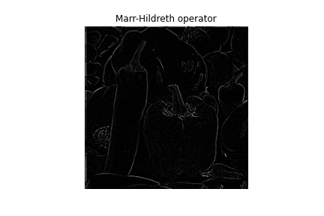
b. (25%) Following the previous question, please use 5x5 Marr-Hildreth operator (shown below) to find the edge map.

