Slide 1
PHP - PDO & Basic CRUD Operation
By Kudakwashe Siziva & Trevor Maseleme

Slide 2
What is PDO?

Slide 3
Why use PDO
PDO (PHP Data Objects) is an abstraction layer for your database queries and is an awesome alternative to MySQLi
Supports 12 different database drivers(mysql, postgresql, firebird.. etc)
Easy to use security features - named parameters

Slide 4
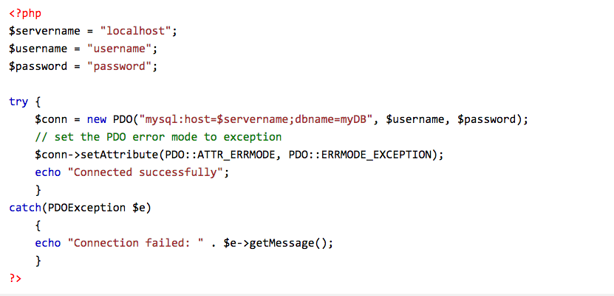
Creating a PDO Connection

Slide 5

CRUD
Create
Read
Update
Delete

Slide 6
Create

Slide 7

Create

Slide 8
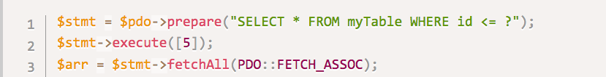
Read

Slide 9
Update

Slide 10
Delete

Slide 11
Fetch Modes
fetch()
fetchAll()
PDO::FETCH_ASSOC
Useful functions
rowCount() - returns an integer indicating the number of rows affected by an operation

Slide 12
How PDO Prepared statements work.

Slide 13
Prepare an SQL query with empty values as placeholders with either a question mark or a variable name with a colon preceding it for each value
Bind values or variables to the placeholders
Execute query simultaneously

Slide 14
Security

Slide 15
bindValue() / bindParam (SQL injection)
filter_vars() - Filters a variable with a specified filter
htmlspecialcharacters() - Convert special characters to HTML entities (XSS Attack)

Slide 16
Resources
https://websitebeaver.com/php-pdo-prepared-statements-to-prevent-sql-injection
http://php.net/manual/en/function.htmlspecialchars.php
http://php.net/manual/en/function.filter-var.php
experience

