Slide 1
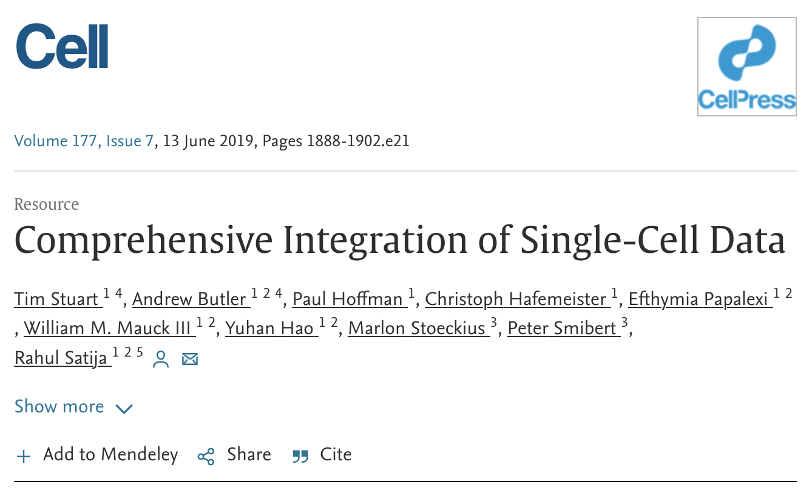
Practical session: 13-09-2023

Slide 2
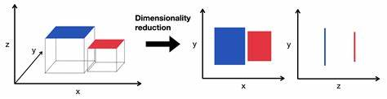
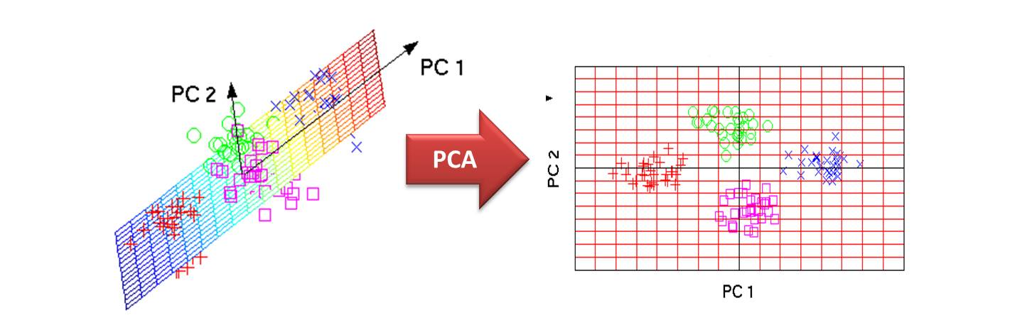
A bite of terminology
Feature reduction: also known as dimensionality reduction, is a process used in machine learning to reduce the number of input variables or features in a dataset. The primary goal is to simplify the dataset while retaining its essential characteristics, which can help improve the performance of machine learning models. Datasets often contain a large number of features, some of which may be irrelevant, redundant, or noisy

Slide 3
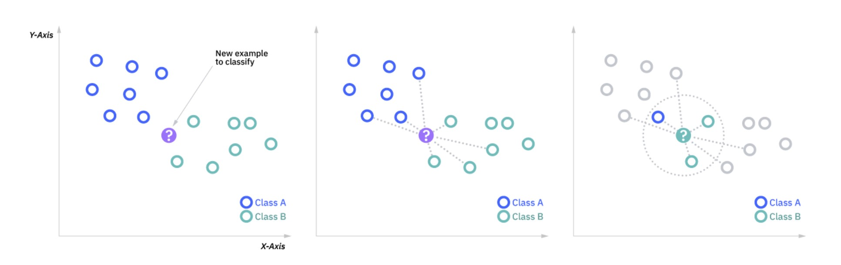
A bite of terminology
Clustering: is an unsupervised machine learning task. Using a clustering algorithm means you're going to give the algorithm a lot of input data with no labels and let it find any groupings in the data it can. Those groupings are called clusters. A cluster is a group of data points that are similar to each other based on their relation to surrounding data point
k-nearest neighbors (KNN) algorithm
K=number of neighbors=3

Slide 4
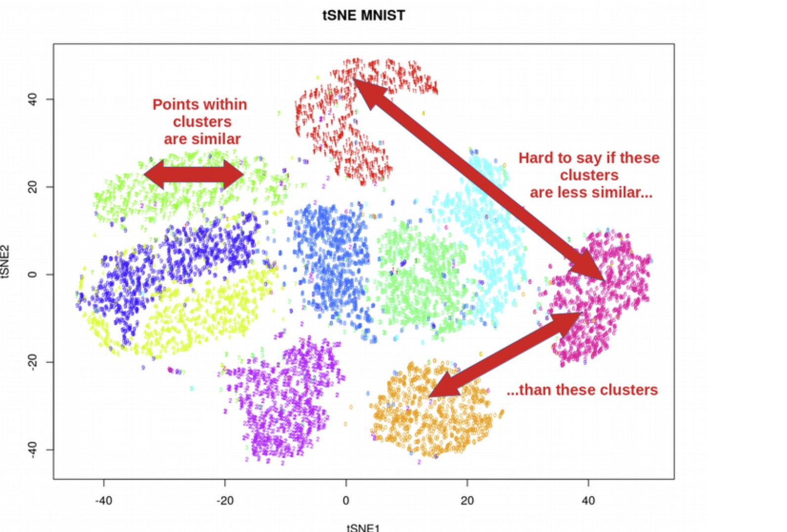
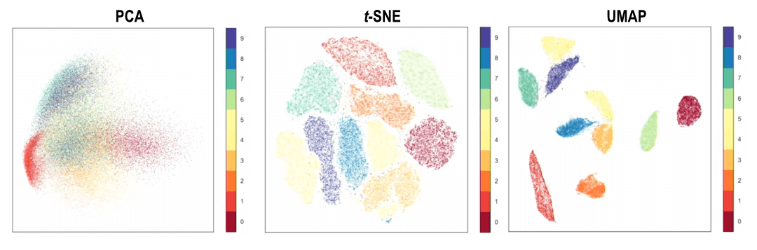

Slide 5
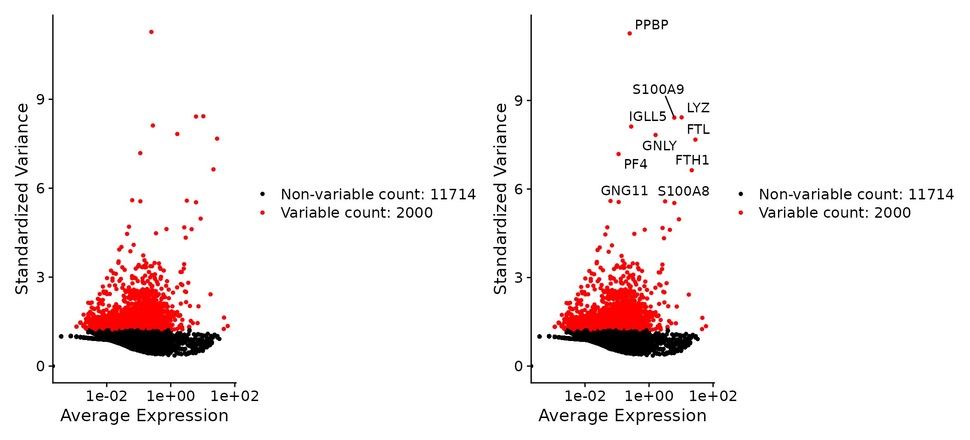
1. Identification of highly variable features (feature selection)
Estimation of a subset of features that exhibit high cell-to-cell variation in the dataset

Slide 6
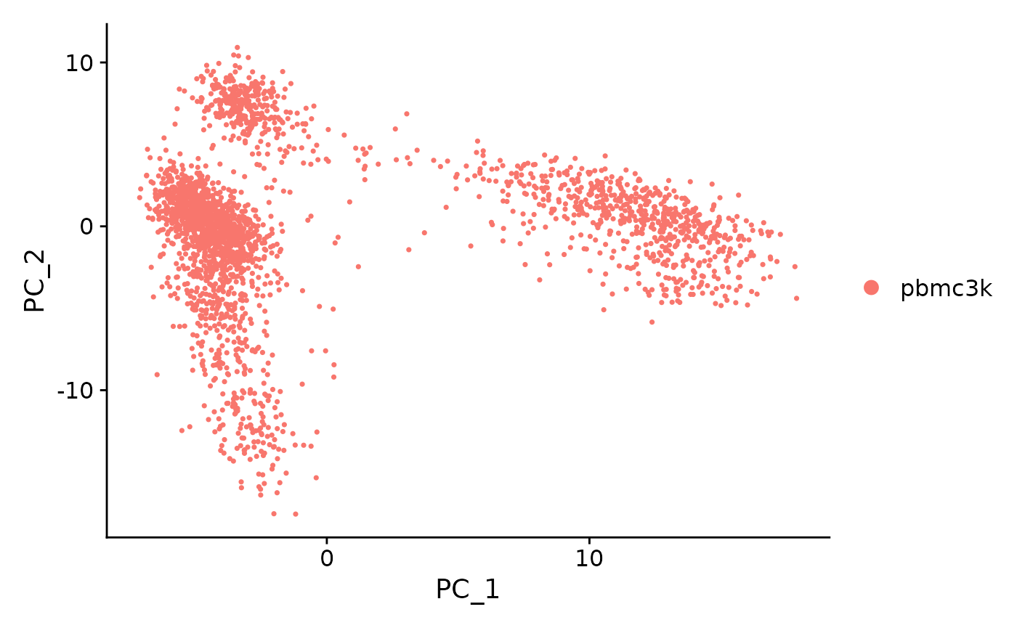
2. Scaling the data
The ScaleData() function:
Shifts the expression of each gene, so that the mean expression across cells is 0
Scales the expression of each gene, so that the variance across cells is 1
This step gives equal weight in downstream analyses, so that highly-expressed
genes do not dominate
The results of this are stored in pbmc[["RNA"]]@scale.data
3. Perform linear dimensional reduction
By default, only the previously determined variable features are used as input

Slide 7
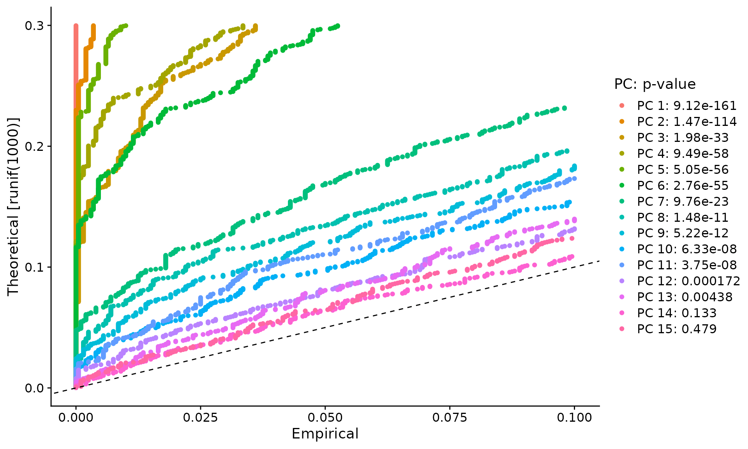
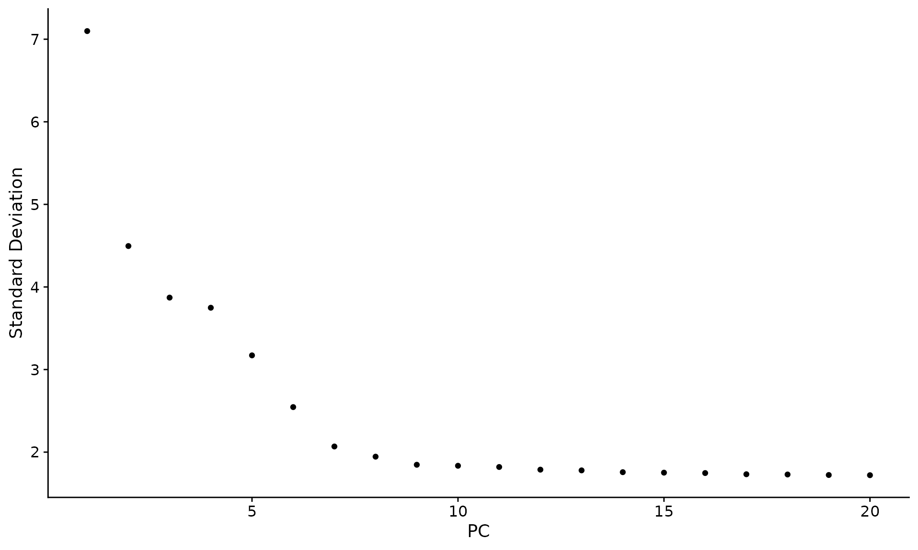
4. Determine the ‘dimensionality’ of the dataset
The JackStrawPlot() function provides a visualization tool for comparing the distribution of p-values
for each PC. An alternative heuristic method generates an ‘Elbow plot’: a ranking of principle
components based on the percentage of variance explained by each one (ElbowPlot() function)
5. Cluster the cells
The methods embed cells in a graph structure - for example a K-nearest neighbor (KNN) graph, with edges drawn between cells with similar feature expression patterns, and then attempt to partition this graph into highly interconnected ‘quasi-cliques’ or ‘communities’.
-FindNeighbors() function → it creates a KNN graph based on the euclidean distance in PCA space
- FindClusters() function → it iteratively groups cells together using a resolution parameter that sets the ‘granularity’ of the downstream clustering

Slide 8
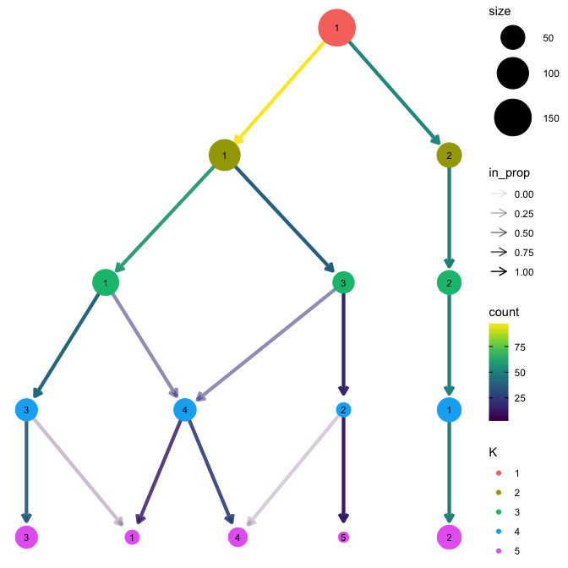
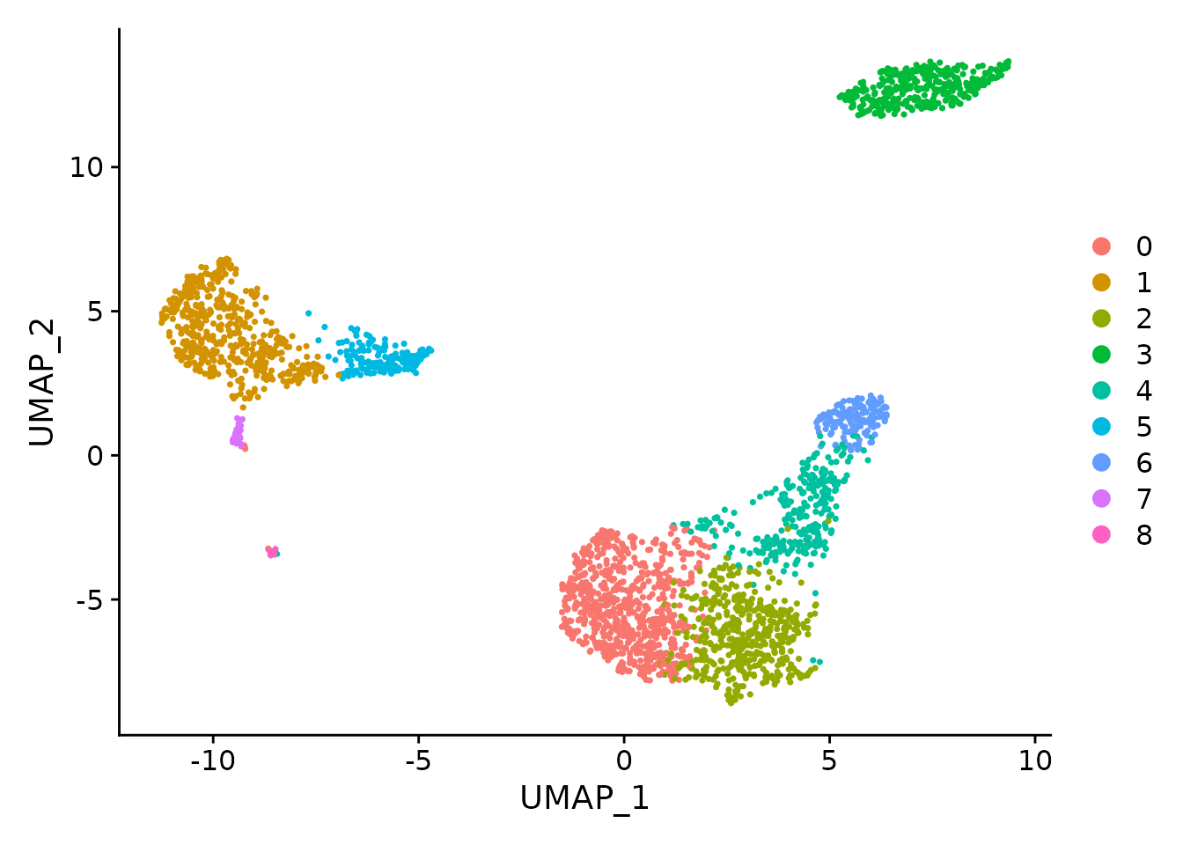
6.Determine the resolution level (Clustree)
To build a clustering tree we need to look at how cells move as the clustering resolution is increased.
Each cluster forms a node in the tree and edges are constructed by considering the cells in a cluster at a
lower resolution that end up in a cluster at the next highest resolution.
7.Run non-linear dimensional reduction (UMAP/tSNE)
The goal of these algorithms is to learn the underlying manifold of the data in order to place similar
cells together in low-dimensional space

Slide 9
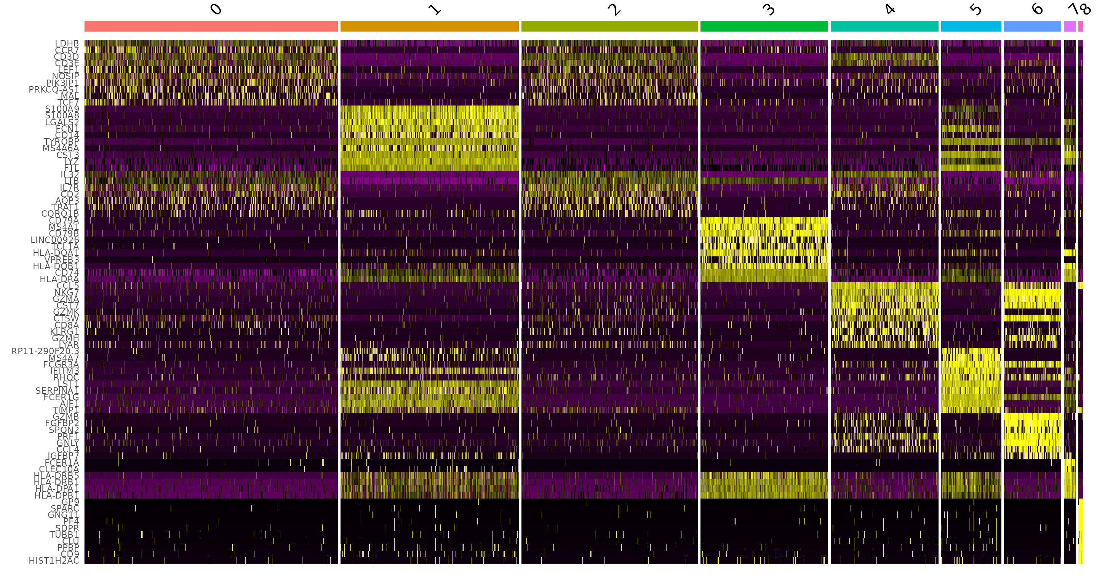
8. Finding differentially expressed features
(cluster biomarkers)
Seurat can help you find markers that define clusters via differential expression. By default, it identifies positive
and negative markers of a single cluster (specified in ident.1), compared to all other cells. FindAllMarkers()
automates this process for all clusters, but you can also test groups of clusters vs. each other, or against all cells.

