Slide 1
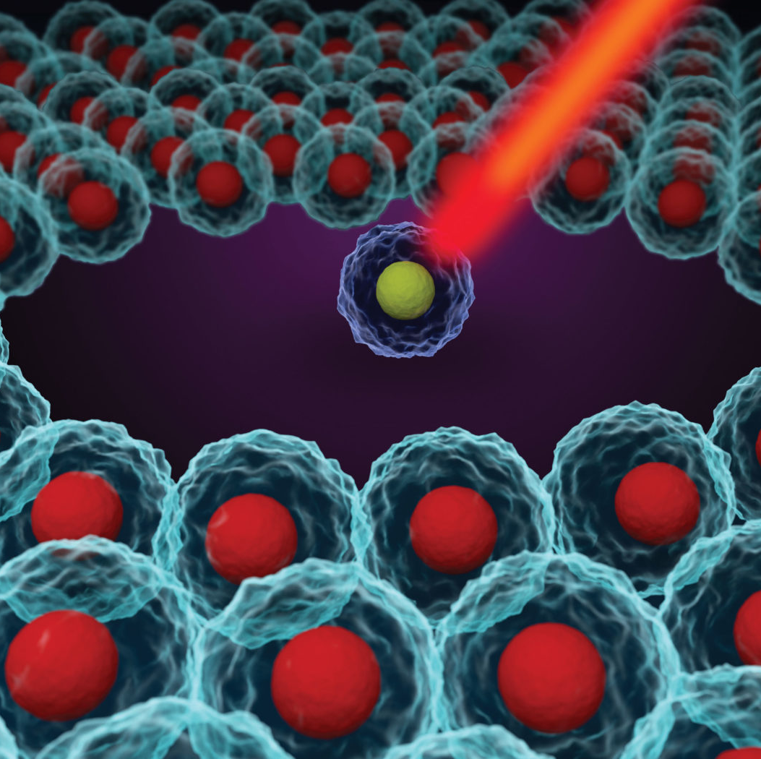
Exploring the world of Single Cell Technology
Single Cell Analysis Boot Camp
Day 2
September 2023

Slide 2
Normalization

Slide 3
scRNA-seq analysis workflow
reads / UMIs
quality control
normalization
feature selection scaling / regression data integration
noise filtering
graph construction visualization cell clustering
diff. expression cell ordering cell identification diff. expression

Slide 4
scRNA-seq normalization
bulk
𝑐𝑜𝑢𝑛𝑡𝑠
Count normalization (UMI and read counts) for uneven sequencing depth
CPM - log[CP10K+1]
𝑪𝑷𝑴 = log( _{𝑙𝑖𝑏𝑟𝑎𝑟𝑦}
10^{𝟔} + 1 )
𝑠i𝑧𝑒
single-cell
𝑐𝑜𝑢𝑛𝑡𝑠
𝑙𝑜𝑔[𝑇𝑃10𝐾 + 1] = log( _{𝑙𝑖𝑏𝑟𝑎𝑟𝑦}
10% + 1 )
Gene length normalization (read counts)
for differences in gene detection due to gene length
TPM (closer to UMI counts)
FPKM
𝑠i𝑧𝑒
Most common for UMI data / fast
𝐹𝑃𝐾𝑀 = log(
𝑐𝑜𝑢𝑛𝑡𝑠
10% + 1 )
Drop-out rate normalization (UMI and read counts) for differences in RNA content / drop-out rates
Deconvolution/Scran(Pooling-Across-Cells)
SCnorm(Expression-DepthRelation)
SCTransform
Census
Linnorm
ZINB-WaVE
…
𝑙𝑖𝑏𝑟𝑎𝑟𝑦_{𝑠i𝑧𝑒} ; 𝑡𝑟𝑎𝑛𝑠𝑐𝑟𝑖𝑝𝑡_{𝑙𝑒𝑛)𝑡+}
𝑐𝑜𝑢𝑛𝑡𝑠
;
10%
^{𝑇𝑃𝑀 = log(} 𝑡𝑟𝑎𝑛𝑠𝑐𝑟𝑖𝑝𝑡
𝑙𝑒𝑛)𝑡+
𝑐𝑜𝑢𝑛𝑡𝑠 ⁺ ¹ ⁾
∑ 𝑡𝑟𝑎𝑛𝑠𝑐𝑟𝑖𝑝𝑡
𝑙𝑒𝑛)𝑡+
Notes:
The drop-out rate in single-cell RNA sequencing (scRNA-seq) refers to the phenomenon where the expression of certain genes is not detected or is significantly underestimated in individual cells. It occurs due to technical limitations in capturing and measuring gene expression at the single-cell level.
The drop-out rate in single-cell RNA sequencing (scRNA-seq) refers to the phenomenon where the expression of certain genes is not detected or is significantly underestimated in individual cells. It occurs due to technical limitations in capturing and measuring gene expression at the single-cell level.
The drop-out rate affects downstream analysis and interpretation of scRNA-seq data. It can impact the accuracy of cell clustering, identification of rare cell types, and estimation of gene expression levels. Furthermore, drop-out events may introduce biases in the identification of differentially expressed genes and hinder the detection of important biological signals.
To address the drop-out issue, various computational methods have been developed. These methods aim to impute or model the missing expression values, accounting for the drop-out events. Techniques such as zero-inflation models, probabilistic modeling, and statistical algorithms have been employed to mitigate the impact of drop-outs on downstream analysis.
It's important to note that the drop-out rate varies depending on the scRNA-seq protocol, experimental conditions, and the specific cell type or tissue being studied. Advances in scRNA-seq technologies, library preparation methods, and data analysis techniques continue to improve sensitivity and reduce the drop-out rate, enabling more accurate profiling of gene expression at the single-cell level.

Slide 5
scRNA-seq analysis workflow
reads / UMIs
quality control normalization
feature selection scaling / regression data integration
noise filtering
graph construction visualization cell clustering
diff. expression cell ordering cell identification diff. expression

Slide 6
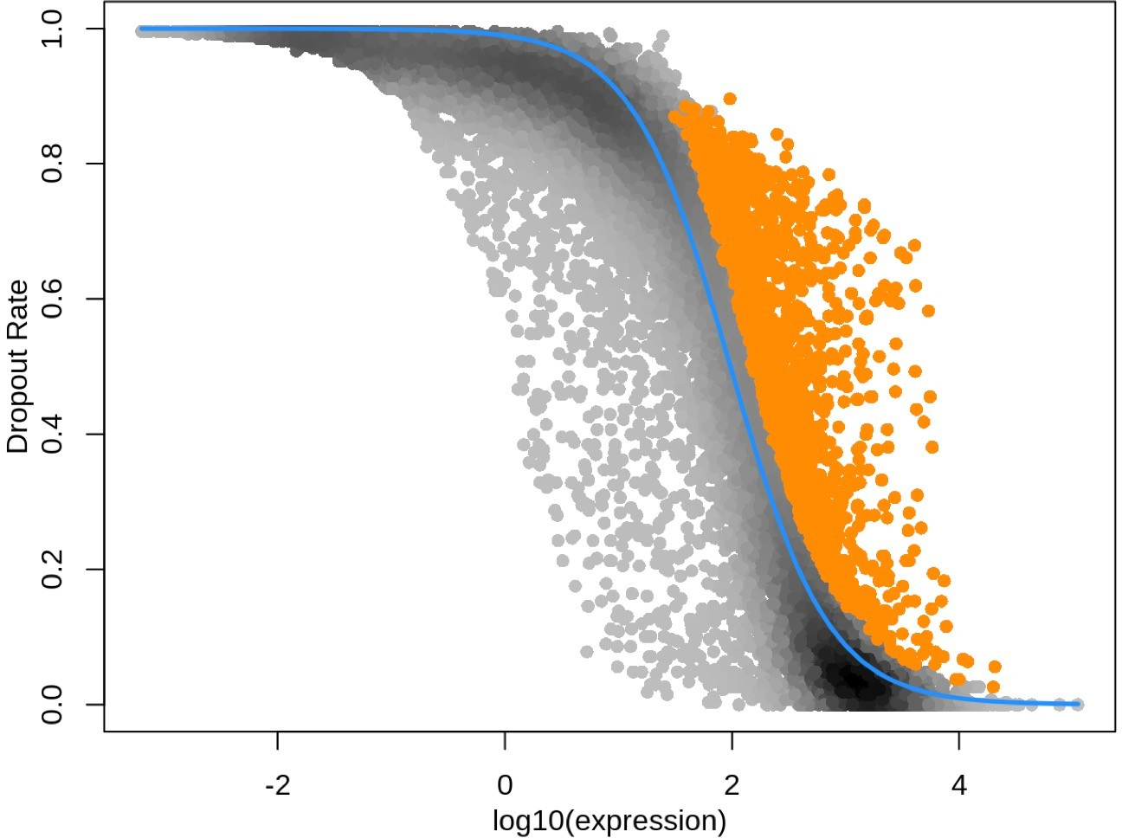
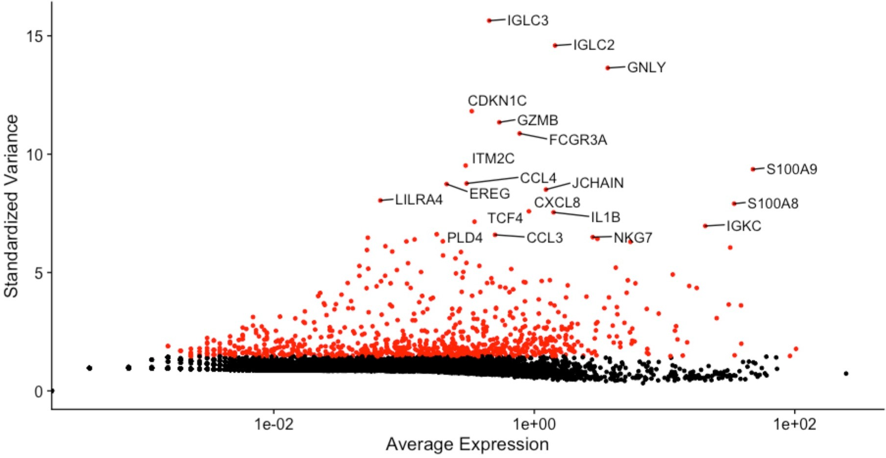
scRNA-seq feature selection
Not all genes are important to define you cell types
Hyper-variable genes are typically characterized by large differences in expression levels between cells, indicating distinct functional roles or cellular states. They can reflect diverse biological processes such as cell cycle stages, cell type-specific markers, or genes associated with cellular responses and regulatory networks.
𝐻𝑉𝐺 =
𝑣𝑎𝑟𝑖𝑎𝑛𝑐𝑒
log(𝑚𝑒𝑎𝑛𝐸𝑥𝑝𝑟𝑒𝑠𝑠𝑖𝑜𝑛)
𝐻𝑉𝐺 =
log(𝑚𝑒𝑎𝑛𝐸𝑥𝑝𝑟𝑒𝑠𝑠𝑖𝑜𝑛)
𝑑𝑟𝑜𝑝𝑜𝑢𝑡_{𝑟𝑎𝑡𝑒}
Notes:
Several statistical methods are employed to detect hyper-variable genes in scRNA-seq data. These methods assess the variability in gene expression across cells while accounting for technical factors, such as library size effects or batch effects. Commonly used metrics for assessing variability include the coefficient of variation (CV), mean-variance relationship, or statistical tests based on dispersion estimation.
Furthermore, hyper-variable gene analysis allows the identification of gene signatures associated with specific cell types, states, or experimental conditions. These signatures can serve as biomarkers or targets for further investigation and may contribute to our understanding of cellular heterogeneity, development, disease mechanisms, and therapeutic interventions.

Slide 7
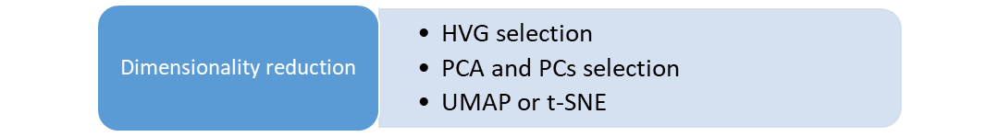
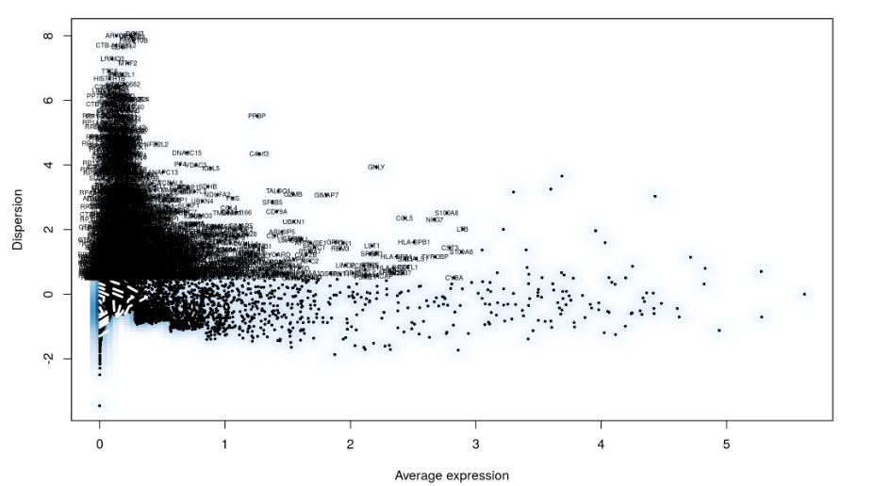
scRNAseq – Dimensionality Reduction: Feature selection
The first step of reducing the dimensionality of scRNA-seq datasets commonly is feature selection.
In this step, the dataset is filtered to keep only genes that are “informative” of the variability in the data.
Thus, highly variable genes (HVGs) are often used.
Depending on the task and the complexity of the dataset, typically between 1,000 and 5,000 HVGs are selected for downstream analysis.
Calculates the average expression and dispersion for each gene, places these genes into bins, and then calculates a z-score for dispersion within each bin. This helps control for the relationship between variability and average expression.

Slide 8
Dimensionality Reduction

Slide 9
Dimensional reduction compared
 | t-SNE (2018) | UMAP (2018) | PCA (1901)
Type | Non-Linear | Non-Linear | Linear
Suitability for Cytometry | Good | Good | Poor
Can make prediction on new data | No | Yes | Yes
Calculation Speed | Slow | Medium | Extremely Fast
Interpret the axex? | No Preserve local, rather than global structures | Sometimes Preserve local and global structures | Yes Impact of new variable on the new axes can be quantified
Interpret distance between clusters | No | Yes | Yes
Hyperparameters | Perplexity | Number of neighbours | Scale
 | Distance Metrics | Distance metric | Center
 | Maximum iterations | Maximum distance
 | Theta (for Barnes Hut) | Minimum distance
Notes:
For a long time PCA was the preferred method to perform dimension reduction.
It’s well known, having been around 1901 and is still robust for many uses.
But it it does not perform particularly well in the case of flow cytometry because of the way populations are distributed in a single channel.
To meet this challenge some new algorithm have been developed , tSNE in 2008 and more recently UMAP.
The reason why tSNE and UMAP are preferred for flow cytometry because they use a non-linear projection technique unlike PCA which calculates in straight lines
Principal Component Analysis (PCA) and Uniform Manifold Approximation and Projection (UMAP) are both dimension reduction techniques commonly used in data analysis, but they have some fundamental differences:
Algorithm:
PCA: PCA is a linear dimension reduction technique that identifies orthogonal axes (principal components) that capture the maximum variance in the data.
UMAP: UMAP is a non-linear dimension reduction technique that uses a graph-based approach to create a low-dimensional representation of the data, preserving both local and global structure.
Preserving Data Structure:
PCA: PCA aims to preserve the overall variance in the data but may not capture complex non-linear relationships or preserve local structure well.
UMAP: UMAP is designed to preserve both local and global structure in the data, making it particularly useful for visualizing and exploring complex datasets.
Interpretability:
PCA: The principal components in PCA have clear interpretations as linear combinations of the original variables, which can be useful for understanding the dominant patterns in the data.
UMAP: UMAP does not have direct interpretability of its dimensions, as they are derived from a complex non-linear transformation. UMAP is primarily used for visualization and exploration rather than interpretation.
Computational Efficiency:
PCA: PCA is computationally efficient and scales well to large datasets.
UMAP: UMAP is more computationally intensive, especially for large datasets. It can require more time and memory resources compared to PCA.
Parameter Sensitivity:
PCA: PCA is relatively robust and less sensitive to parameter settings.
UMAP: UMAP has a few important parameters, such as the number of nearest neighbors and the minimum distance, which can significantly affect the results. Appropriate parameter tuning is required for optimal UMAP performance.
Both PCA and UMAP have their strengths and weaknesses, and the choice between them depends on the specific data and analysis goals. PCA is widely used for linear dimension reduction and pattern identification, while UMAP is favored for non-linear structure preservation and visualization.

Slide 10
Dimension Reduction
Linear Populations projected to a linear calculation
A
Dimension reduction discards
redundant information
D
Y-Axis
C
The Population progression through X and Y axes is the redundant information
F
E
B
Degree of Separation from each other is the relevant information
X-Axis
B
C
A
E
F
D
Clear separation
Notes:
This graphs shows how a linear reduction technique like PCA draws a projection through the data where it is most variable.
It reduced the data to single dimension which retain he information that is the most interesting to us, that is the separation of the populations from each other.

Slide 11
Linear vs Non Linear
Linear Populations projected to a linear calculation
A
Flow cytometry population tend to clump in spiral formation
D
Y-Axis
C
F
Linear Dimension reduction techniques (e.g PCA) can struggle o separate these.
E
B
X-Axis
D
E
F
B
C
A
No Clear separation
Notes:
But PCA linear reduction technique became problematic when confronted which population which clumps clump closely together as they do in Cytometry.
In this example PCA is not able to separate populations that take a spiral formation

Slide 12
Linear vs Non Linear
Spiral Populations projected to a non-linear calculation
D
A
tSNE and UMAP make non-linear
calculations to project onto
Y-Axis
C
F
They are most suited to perform dimension reduction on Flow Cytometry
Data
E
B
X-Axis
B
C
A
D
F
E
Clear separation
Notes:
For this we need modern techniques, such us tSNE and UMAP, that are not linear.
Non linear techniques are capable of calculating curved representation of data variation which can have closely aligned projected onto them without overlapping

Slide 13
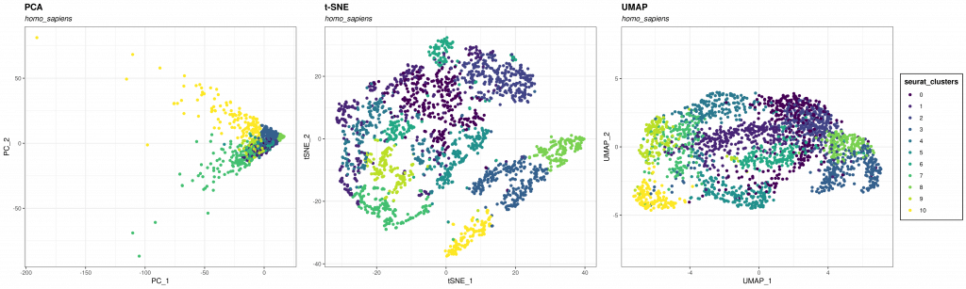
Dimension Reduction
PCA, t-SNE and UMAP create representations of data
Data is de-formed to make t easier to visualise
Notes:
It is important o remember that Dimension Reduction techniques create a “representation” of your data but is not your “actual” data.
Your data has been change in order to reduce the high dimensions into something that human can visualize.
This change bring a loss of information and while the algorithms are designed to keep as much important information as they can, they are not perfect.
The advantage of non-linear calculations is that they are better at maintaining the structure of data as they reduce the dimensions.
Therefor they are better at making visualization so human can spot correlation.
Later we will see in more datail in crusty

Slide 14
Dimension Reduction
PCA, t-SNE and UMAP create representations of data
Data is de-formed to make t easier to visualise
Notes:
It is important o remember that Dimension Reduction techniques create a “representation” of your data but is not your “actual” data.
Your data has been change in order to reduce the high dimensions into something that human can visualize.
This change bring a loss of information and while the algorithms are designed to keep as much important information as they can, they are not perfect.
The advantage of non-linear calculations is that they are better at maintaining the structure of data as they reduce the dimensions.
Therefor they are better at making visualization so human can spot correlation.
Later we will see in more datail in crusty

Slide 15
Data Integration

Slide 16
scRNA-seq analysis workflow
reads / UMIs
quality control normalization
feature selection scaling / regression
data integration
noise filtering
graph construction visualization cell clustering
diff. expression cell ordering cell identification diff. expression

Slide 17
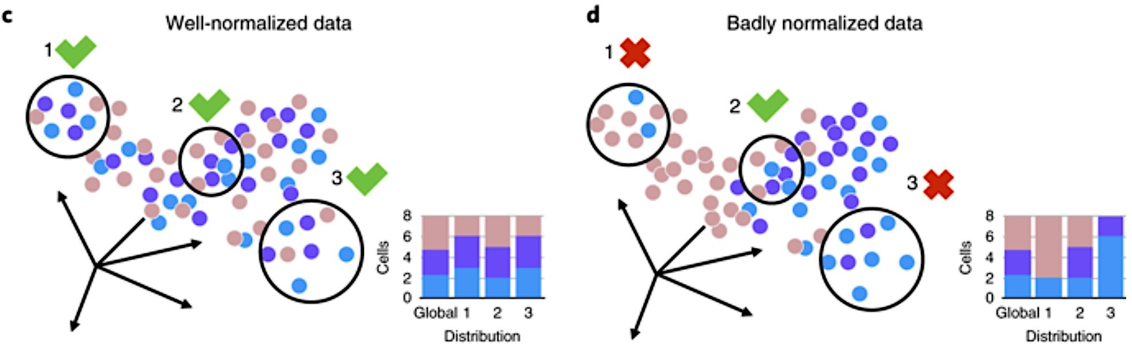
scRNA-seq data integration
We wish to obtain corrected data where the following goals are met:
Goal:
1.The batch-originating variance is erased 2.Meaningful heterogeneity is preserved
3.No artefactual variance is introduced
What it practically means:
Similar cell types are intermixed across batches
We are not mixing distinct cell types (across or within batches) We do not separate similar cells within batches
Büttner, et al (2019) Nat Methods

Slide 18
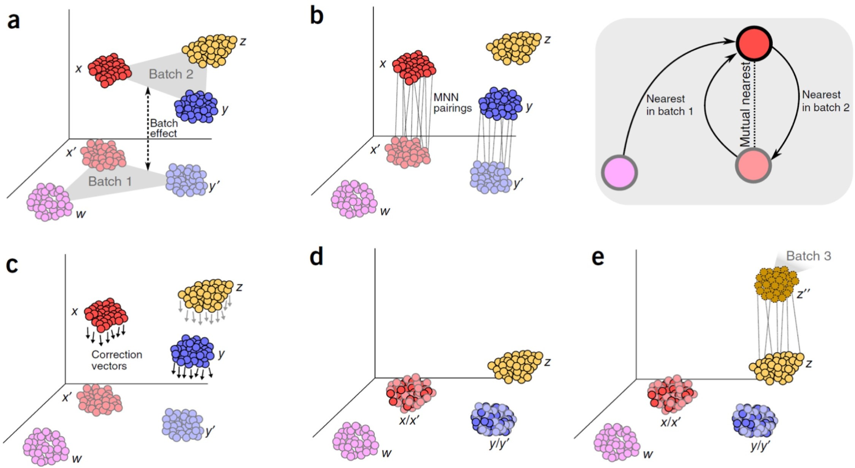
scRNA-seq analysis workflow
Regression based bulk-RNAseq batch correction methods are slow and assume the batch is constant across cells
Modern data integration methods are based on the same principle:
find MNN (mutual nearest neighbours) across datasets and correct each cell individually
Done on a graph: much faster
Haghverdi et al (2017) Nat Biotechnology

Slide 19
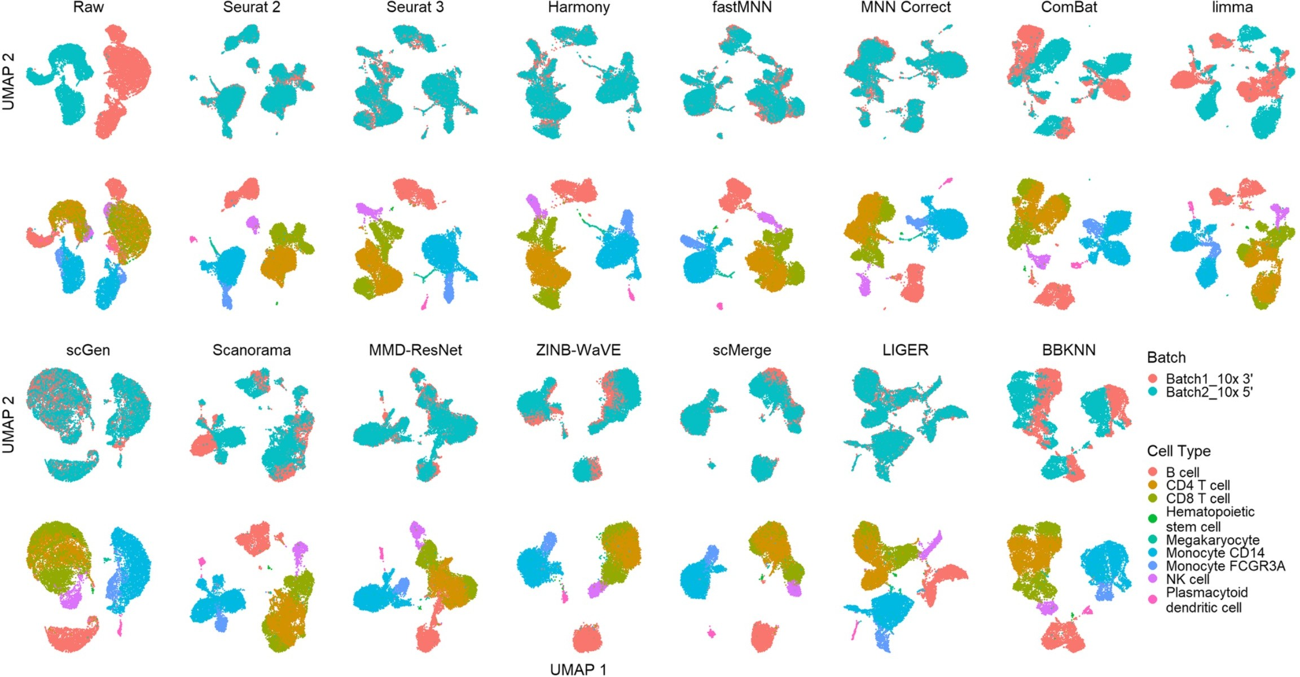
scRNA-seq analysis workflow
MNN
regression
matrix factorization
Tran et al (2020) Genome Biology

