Slide 1
Body Fat Predictor
Group 13 Module 2 STAT 628 UW-Madison
Member: Hanlin Tang, Yuhan Zhou, Robin Ji

Slide 2
Backgrounds
The percentage of body fat is an important indicator of personal health.
However, it is hard to implement the accurate way of measurement of body fat.
Thus, here we are trying to discover a model to answer this question with other measurements that are much easier to get.

Slide 3
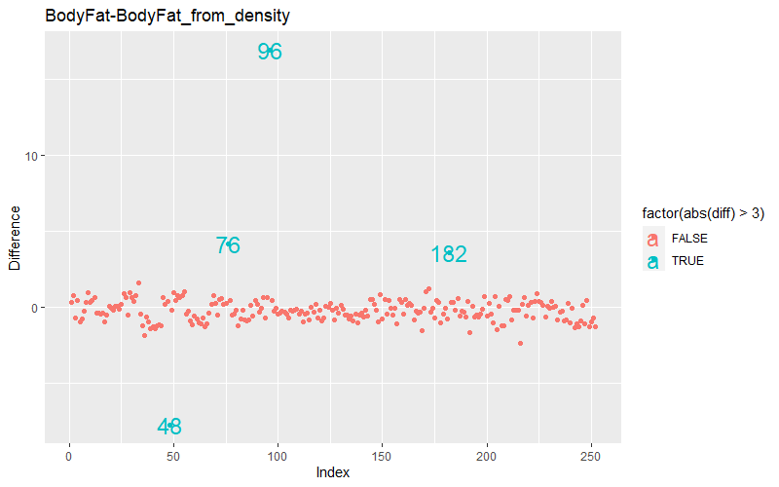
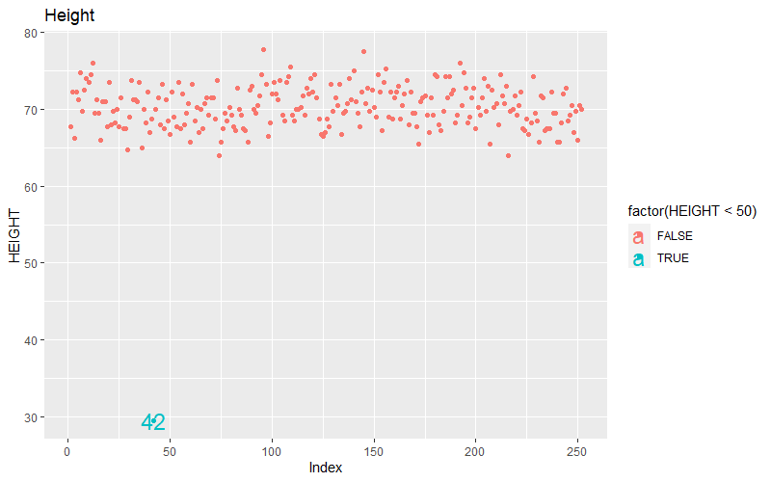
Data Cleaning
Shape: 252*17, from men.
The Y, body fat percentage, range from 0 to 45.10, has a mean 18.94 and median 19.
Suspicious data points:
bodyfat that is calculated from the density differ from bodyfat provided. we drop these data points. (48, 76, 182, 96)
Point 42 only has a height of 30. So it can be deleted (yet since we didn’t use height, we kept it).
There are also some points (e.g., 39 and 41) that have measure values away from the majority. However, after look deep into those data, we think the data is reasonable and can be explained with extremely obsess.

Slide 4
Model Selection
Metric for Model Performance:
We used multiple criteria during our analysis. Including R^2, AIC, BIC, etc. However, since we’ll need a rule-of-thumb and we don’t want to simply set a cap for the number of predictors. Thus we take all of them into consideration and combine with our judging on simplicity. In the end, for the comparison of our final models, we used 12-fold CV R-squared.
Candidate Models:
Linear models with at most first level interaction
We used greedy stepwise with both AIC and BIC, and some manual selected candidates and evaluated each candidate model’s performance

Slide 5
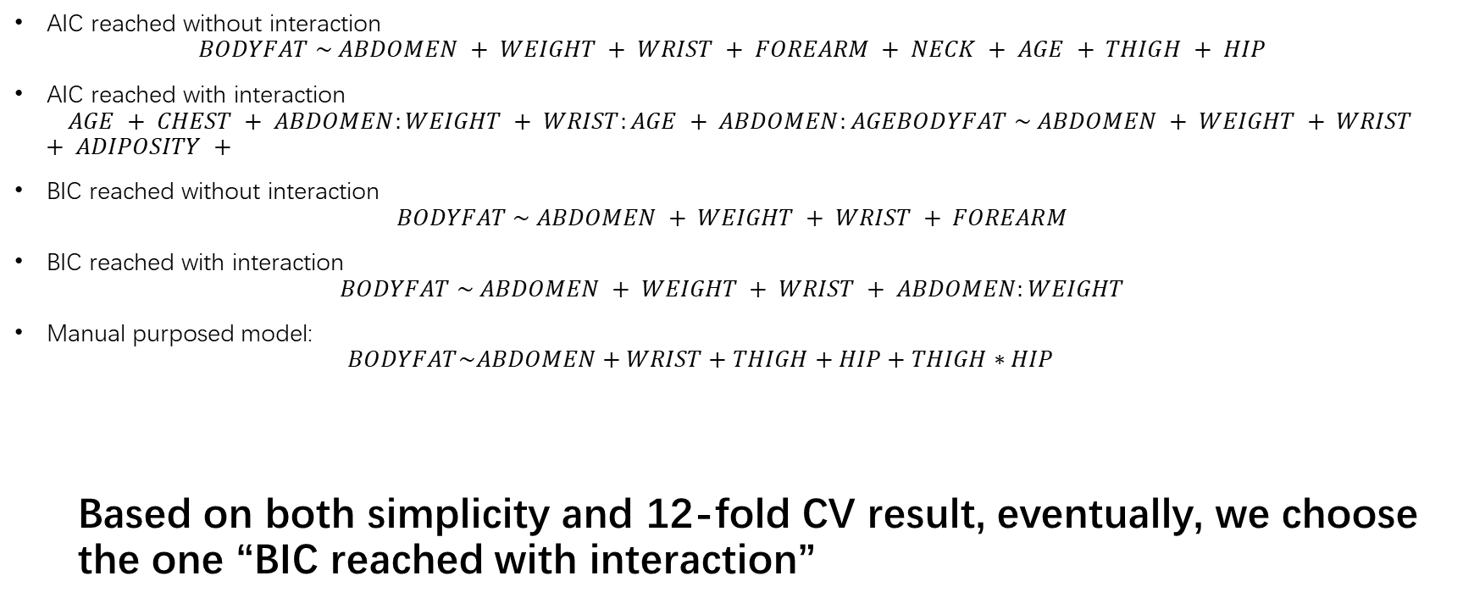
Results
AIC reached without interaction
$$BODYFAT \sim ABDOMEN + WEIGHT + WRIST + FOREARM + NECK + AGE + THIGH + HIP$$
AIC reached with interaction
$$AGE + CHEST + ABDOMEN:WEIGHT + WRIST:AGE + ABDOMEN:AGEBODYFAT \sim ABDOMEN + WEIGHT + WRIST + ADIPOSITY +$$
BIC reached without interaction
$$BODYFAT \sim ABDOMEN + WEIGHT + WRIST + FOREARM$$
BIC reached with interaction
$$BODYFAT \sim ABDOMEN + WEIGHT + WRIST + ABDOMEN:WEIGHT$$
Manual purposed model:
$$BODYFAT\sim ABDOMEN+WRIST+THIGH+HIP+THIGH∗HIP$$
Based on both simplicity and 12-fold CV result, eventually, we choose the one “BIC reached with interaction”

Slide 6
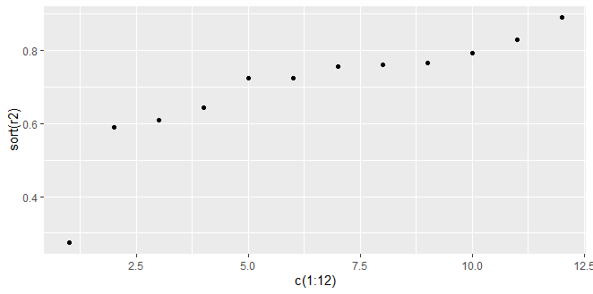
Results
Average R-squared:
0.708

Slide 7
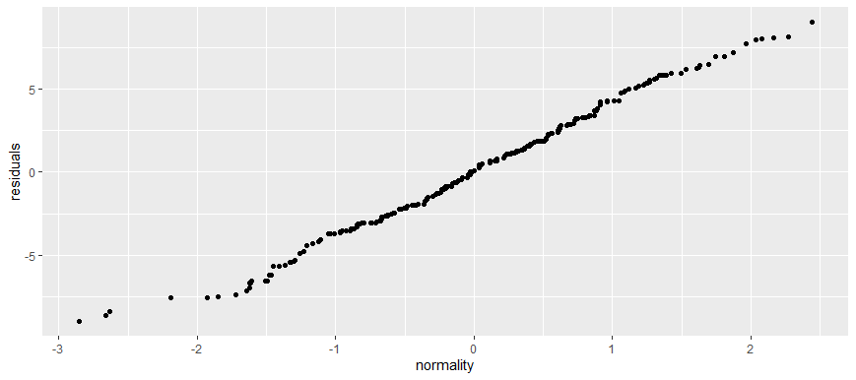
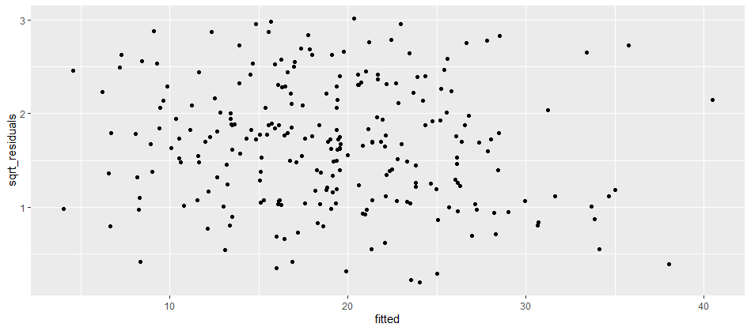
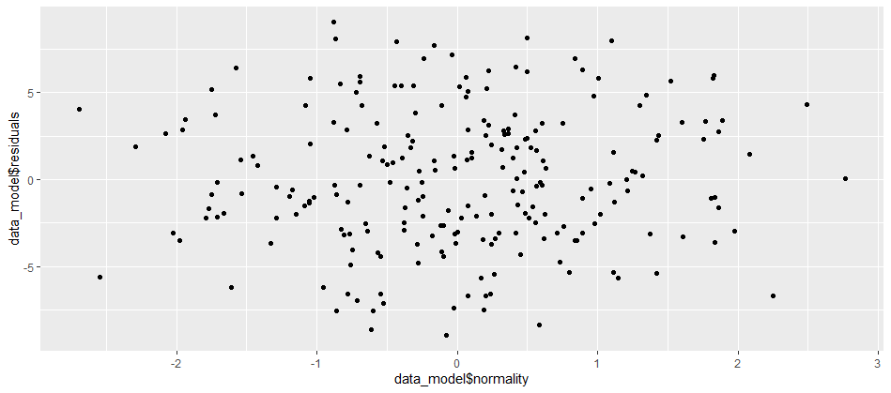
Resilts

Slide 8
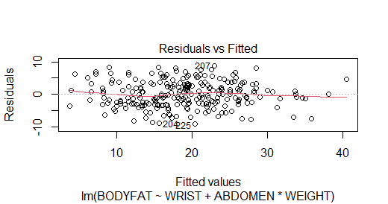
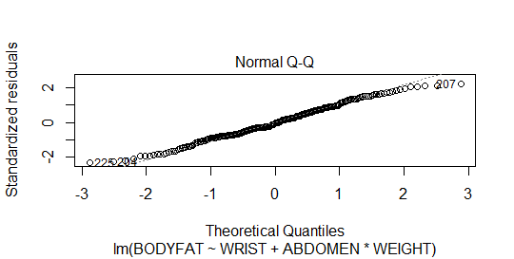
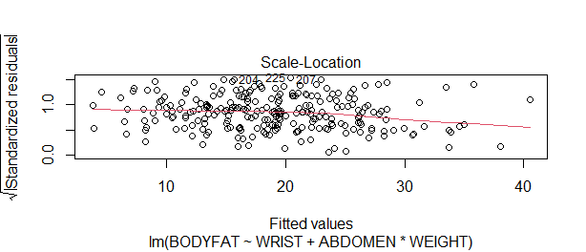
Resilts

Slide 9
Hypothesis Testing
 | Estimate | Std.Error | t value | Pr(>|t|)
Intercept | -4.770e+01 | 9.007e+00 | -5.296 | 2.80e-07
WRIST | -1.621e+00 | 4.250e-01 | -3.814 | 1.76e-04
ABDOMEN | 1.181e+00 | 8.822e-02 | 13.392 | <2e-16
WEIGHT | 8.205e-02 | 4.919e-02 | 1.668 | 0.096
ABDOMEN:WEIGHT | -1.647e-03 | 3.999e-04 | -4.118 | 5.35e-05

Slide 10
Hypothesis Testing
 | Value
Pr(>|F|) | 2.2e-16
R Square | 74.8%

Slide 11
Pros and Cons
Pros:
1.Easy to use;
2.relatively stable performance;
Cons:
1.Weak prediction power

