Slide 1


SNS越来越流行
社交网站(Social Networking Site)如今非常流行
早在2008年， FB就成为了最流行的一个软件之一，几乎90%的大学生都会用FB(Steinfield, Ellison, & Lampe, 2008).
2/23
Notes:
Steinfield, C., Ellison, N. B., & Lampe, C. (2008). Social capital, self-esteem, and use of online social network sites: A longitudinal analysis. Journal of applied developmental psychology, 29(6), 434-445.

Slide 2

容易发布自己的信息
Post
社交媒体的出现，让人们有更多机会发布和自己相关的东西，增加了社会比较的机会(Haferkamp & Krämer, 2011; Vogel, Rose, Roberts, & Eckles, 2015).
2/23
Notes:
Haferkamp, N., & Krämer, N. C. (2011). Social comparison 2.0: Examining the effects of online profiles on social-networking sites. Cyberpsychology, Behavior, and Social Networking, 14(5), 309-314.
Vogel, E. A., Rose, J. P., Roberts, L. R., & Eckles, K. (2014). Social comparison, social media, and self-esteem. Psychology of popular media culture, 3(4), 206.

Slide 3

容易接收他人的信息
Receive
在社交媒体上，获取信息变得更容易(Acar, 2008 ; Vogel, Rose, Roberts, & Eckles, 2015)
网络让人们可以分享自己的照片，信息(Manago et al. 2012) 。这让人们可以不断接收到来自朋友们的评价，从而进行社会比较(Manago et al. 2008)
通过看他人的推文和照片，人们在社交媒体的使用中发生了社会比较(Lee, 2014)
2/23
Notes:
Acar, A. (2008). Antecedents and consequences of online social networking behavior: The case of Facebook. Journal of website promotion, 3(1-2), 62-83.
Vogel, E. A., Rose, J. P., Roberts, L. R., & Eckles, K. (2014). Social comparison, social media, and self-esteem. Psychology of popular media culture, 3(4), 206.
Manago, A. M., Taylor, T., & Greenfield, P. M. (2012). Me and my 400 friends: the anatomy of college students' Facebook networks, their communication patterns, and well-being. Developmental psychology, 48(2), 369.
Manago, A. M., Graham, M. B., Greenfield, P. M., & Salimkhan, G. (2008). Self-presentation and gender on MySpace. Journal of Applied Developmental Psychology, 29(6), 446-458.
Lee, S. Y. (2014). How do people compare themselves with others on social network sites?: The case of Facebook. Computers in human behavior, 32, 253-260.

Slide 4
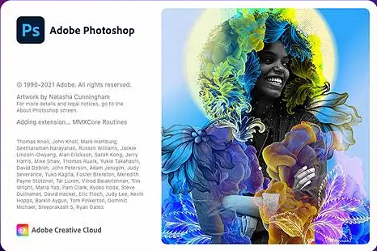

异步社交
在社交媒体上，你有充足的时间为你的post润色，发表相较于原始素材更好的文章或照片。这让人们可以以更讨人喜欢的样子出现。(Barash, Ducheneaut, Isaacs, & Bellotti, 2010; Kross et al., 2013; Mehdizadeh, 2010; Newman, Lauterbach, Munson, Resnick, & Morris, 2011; Verduyn et al., 2015)
2/23
Notes:
Barash, V., Ducheneaut, N., Isaacs, E., & Bellotti, V. (2010, May). Faceplant: Impression (mis) management in Facebook status updates. In Fourth International AAAI Conference on Weblogs and Social Media.
Kross, E., Verduyn, P., Demiralp, E., Park, J., Lee, D. S., Lin, N., ... & Ybarra, O. (2013). Facebook use predicts declines in subjective well-being in young adults. PloS one, 8(8), e69841.
Mehdizadeh, S. (2010). Self-presentation 2.0: Narcissism and self-esteem on Facebook. Cyberpsychology, behavior, and social networking, 13(4), 357-364.
Newman, M. W., Lauterbach, D., Munson, S. A., Resnick, P., & Morris, M. E. (2011, March). It's not that I don't have problems, I'm just not putting them on Facebook: challenges and opportunities in using online social networks for health. In Proceedings of the ACM 2011 conference on Computer supported cooperative work (pp. 341-350).
Verduyn, P., Lee, D. S., Park, J., Shablack, H., Orvell, A., Bayer, J., ... & Kross, E. (2015). Passive Facebook usage undermines affective well-being: Experimental and longitudinal evidence. Journal of Experimental Psychology: General, 144(2), 480.

Slide 5
展现最好的自己
社交媒体上人们的样子，通常都是最好的样子(e.g., Nadkarni & Hofmann, 2012; Rosenberg & Egbert, 2011)
在网络上，人们更倾向于将自己表现得光鲜亮丽(Chou & Edge, 2012; Ellison, Heino, & Gibbs, 2006; Gonzales & Hancock, 2011).
2/23
Notes:
Nadkarni, A., & Hofmann, S. G. (2012). Why do people use Facebook?. Personality and individual differences, 52(3), 243-249.
Rosenberg, J., & Egbert, N. (2011). Online impression management: Personality traits and concerns for secondary goals as predictors of self-presentation tactics on Facebook. Journal of computer-mediated communication, 17(1), 1-18.
Chou, H. T. G., & Edge, N. (2012). “They are happier and having better lives than I am”: The impact of using Facebook on perceptions of others' lives. Cyberpsychology, behavior, and social networking, 15(2), 117-121.
Ellison, N., Heino, R., & Gibbs, J. (2006). Managing impressions online: Self-presentation processes in the online dating environment. Journal of computer-mediated communication, 11(2), 415-441.
Gonzales, A. L., & Hancock, J. T. (2011). Mirror, mirror on my Facebook wall: Effects of exposure to Facebook on self-esteem. Cyberpsychology, behavior, and social networking, 14(1-2), 79-83.

Slide 6
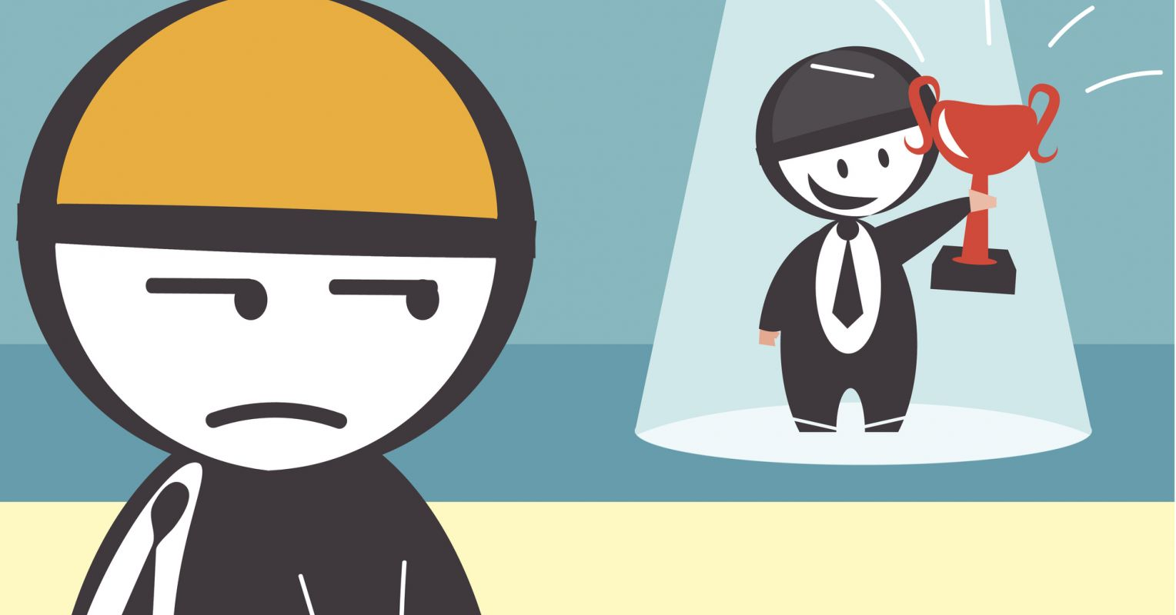
更容易出现向上比较
因此，在社交媒体上，相较于向下比较，人们更容易发生向上比较——自己与一个比自己更好的人进行比较(Feinstein et al., 2013; Haferkamp & Krämer, 2011; Lee, 2014; Vogel, Rose, Roberts, & Eckles, 2014; Vogel et al., 2015)
2/23
Notes:
Feinstein, B. A., Hershenberg, R., Bhatia, V., Latack, J. A., Meuwly, N., & Davila, J. (2013). Negative social comparison on Facebook and depressive symptoms: Rumination as a mechanism. Psychology of Popular Media Culture, 2(3), 161.
Haferkamp, N., & Krämer, N. C. (2011). Social comparison 2.0: Examining the effects of online profiles on social-networking sites. Cyberpsychology, Behavior, and Social Networking, 14(5), 309-314.
Lee, S. Y. (2014). How do people compare themselves with others on social network sites?: The case of Facebook. Computers in human behavior, 32, 253-260.
Vogel, E. A., Rose, J. P., Roberts, L. R., & Eckles, K. (2014). Social comparison, social media, and self-esteem. Psychology of popular media culture, 3(4), 206.
Vogel, E. A., Rose, J. P., Okdie, B. M., Eckles, K., & Franz, B. (2015). Who compares and despairs? The effect of social comparison orientation on social media use and its outcomes. Personality and Individual Differences, 86, 249-256.

Slide 7

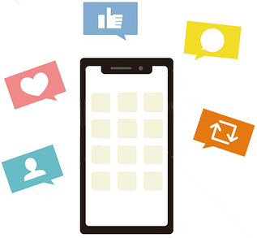
向上比较产生相对剥夺感
在网络上的向上比较，常常会带来消极的后果，比如抑郁(Feinstein et al., 2013; Liu et al., 2017),、自尊降低(Kalpidou, Costin, & Morris, 2011; Lee, 2014; Vogel et al., 2014; Liu et al., 2017)、自我评估降低(Haferkamp & Krämer, 2011)、幸福感降低(Kross et al., 2013)
Upward
Social Comparison
2/23
Notes:
Feinstein, B. A., Hershenberg, R., Bhatia, V., Latack, J. A., Meuwly, N., & Davila, J. (2013). Negative social comparison on Facebook and depressive symptoms: Rumination as a mechanism. Psychology of Popular Media Culture, 2(3), 161.
Liu, Q. Q., Zhou, Z. K., Yang, X. J., Niu, G. F., Tian, Y., & Fan, C. Y. (2017). Upward social comparison on social network sites and depressive symptoms: A moderated mediation model of self-esteem and optimism. Personality and Individual Differences, 113, 223-228.
Kalpidou, M., Costin, D., & Morris, J. (2011). The relationship between Facebook and the well-being of undergraduate college students. CyberPsychology, behavior, and social networking, 14(4), 183-189.
Lee, S. Y. (2014). How do people compare themselves with others on social network sites?: The case of Facebook. Computers in human behavior, 32, 253-260.
Vogel, E. A., Rose, J. P., Roberts, L. R., & Eckles, K. (2014). Social comparison, social media, and self-esteem. Psychology of popular media culture, 3(4), 206.
Liu, Q. Q., Zhou, Z. K., Yang, X. J., Niu, G. F., Tian, Y., & Fan, C. Y. (2017). Upward social comparison on social network sites and depressive symptoms: A moderated mediation model of self-esteem and optimism. Personality and Individual Differences, 113, 223-228.
Haferkamp, N., & Krämer, N. C. (2011). Social comparison 2.0: Examining the effects of online profiles on social-networking sites. Cyberpsychology, Behavior, and Social Networking, 14(5), 309-314.
Kross, E., Verduyn, P., Demiralp, E., Park, J., Lee, D. S., Lin, N., ... & Ybarra, O. (2013). Facebook use predicts declines in subjective well-being in young adults. PloS one, 8(8), e69841.

Slide 8
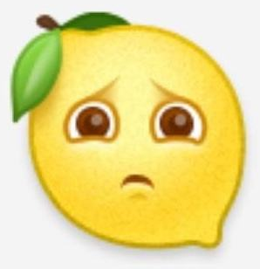
向上比较产生相对剥夺感
以往的研究，大多从情绪的角度——嫉妒，来解释这个过程。已有研究发现，在FB上的社会比较，是引起人们嫉妒的原因之一，这种嫉妒的情绪会促进人们对自己的事业做出不成功的评价(Pera, 2018).
Upward
Social Comparison
2/23
Notes:
Pera, A. (2018). Psychopathological processes involved in social comparison, depression, and envy on Facebook. Frontiers in Psychology, 9, 22.

Slide 9
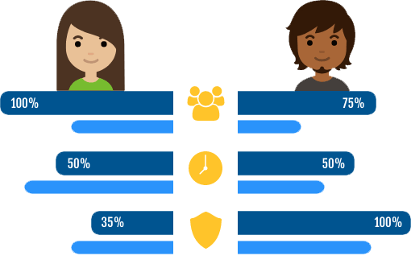
向上比较产生相对剥夺感
Upward
Social Comparison
认知情绪理论认为，情绪不会无缘无故的产生，他产生于对于压力事件的评价。是这种评价，而不是压力事件本身，导致了消极情绪(Frijda, 1986; Lazarus, 1991; Ortony, Clore, & Collins, 1988; Roseman, 1984; Scherer, 1984; Smith & Ellsworth, 1985; Weiner, 2012).
基于该理论，我们认为，相对剥夺感就在压力事件（社会比较）和消极情绪（嫉妒）之间，扮演了这样一个认知评价的过程
2/23
Notes:
Frijda, N. H. (1986). The emotions. Cambridge University Press.
Lazarus, R. S. (1991). Emotion and adaptation. Oxford University Press.
Ortony, A., Clore, G. L., & Collins, A. (1988). The cognitive structure of emotions Cambridge. UK: Cambridge University Press9.
Roseman, I. J. (1984). Cognitive determinants of emotion: A structural theory. Review of personality & social psychology.
Scherer, K. R. (1984). Emotion as a multicomponent process: a model and some cross-cultural data. Review of personality & social psychology.
Smith, C. A., & Ellsworth, P. C. (1985). Patterns of cognitive appraisal in emotion. Journal of personality and social psychology, 48(4), 813.
Weiner, B. (2012). An attributional theory of motivation and emotion. Springer Science & Business Media.

Slide 10
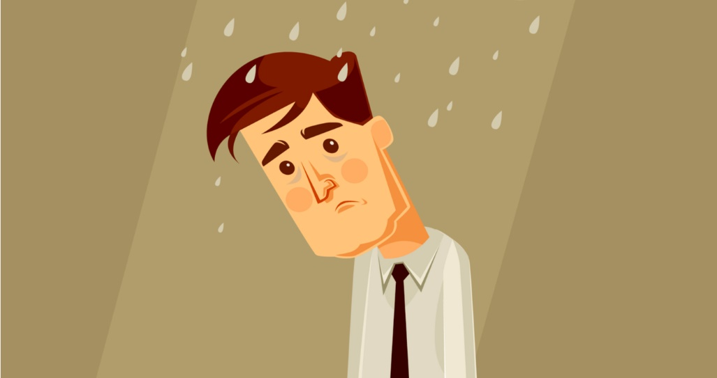
向上比较产生相对剥夺感
Upward
Social Comparison
当一个人有权利得到某样东西，却得不到时，会产生相对剥夺感(Feather, 1999; 2015; Olson and Hazlewood, 1986)
相对剥夺感被认为是很多消极结果的源头(Callan, Shead, & Olson, 2011).
已有很多研究指出，向上比较会产生相对剥夺感(e.g. Kim, Callan, Gheorghiu & Skylark, 2018; Seo & Park, 2018; Buunk, Zurriaga, Gonzalez-Roma, & Subirats, 2003)
我们提出假设1：当人们进行向上比较的时候，会产生相对剥夺感
2/23
Notes:
Feather, N. T. (1999). Judgments of deservingness: Studies in the psychology of justice and achievement. Personality and Social Psychology Review, 3(2), 86-107.
Olson, J. M., & Hazlewood, J. D. (1986). Relative deprivation and social comparison: An integrative perspective. In Relative deprivation and social comparison: The Ontario symposium (Vol. 4, pp. 1-15). Lawrence Erlbaum.
Callan, M. J., Shead, N. W., & Olson, J. M. (2011). Personal relative deprivation, delay discounting, and gambling. Journal of personality and social psychology, 101(5), 955.
Kim, H., Callan, M. J., Gheorghiu, A. I., & Skylark, W. J. (2018). Social comparison processes in the experience of personal relative deprivation. Journal of Applied Social Psychology, 48(9), 519-532.
Seo, H. G., & Park, H. W. (2018). Design and Implementation of Potential Advertisement Keyword Extraction System Using SNS. Journal of the Korea Convergence Society, 9(7), 17-24.
Buunk, B. P., Zurriaga, R., Gonzalez-Roma, V., & Subirats, M. (2003). Engaging in upward and downward comparisons as a determinant of relative deprivation at work: A longitudinal study. Journal of Vocational Behavior, 62(2), 370-388.

Slide 11
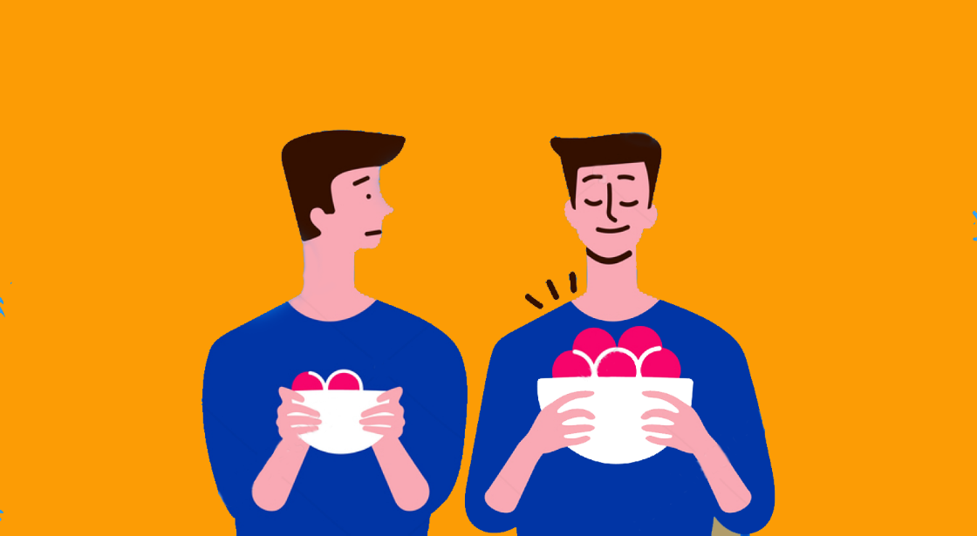

相对剥夺感降低生活满意度
Relative
Deprivation
已有很多研究发现当人们体验到相对剥夺感时，其心理或生理健康都会受到一定程度的影响(Beshai, Mishra, Mishra, & Carleton, 2017; Callan, Kim, & Matthews, 2015; Adjaye-Gbewonyo & Kawachi, 2012; Osborne, Smith, & Huo, 2012).
2/23
Notes:
Beshai, S., Mishra, S., Mishra, S., & Carleton, R. N. (2017). Personal relative deprivation associated with functional disorders via stress: An examination of fibromyalgia and gastrointestinal symptoms. PLoS One, 12(12), e0189666.
Callan, M. J., Kim, H., & Matthews, W. J. (2015). Predicting self-rated mental and physical health: The contributions of subjective socioeconomic status and personal relative deprivation. Frontiers in psychology, 6, 1415.
Adjaye-Gbewonyo, K., & Kawachi, I. (2012). Use of the Yitzhaki Index as a test of relative deprivation for health outcomes: a review of recent literature. Social science & medicine, 75(1), 129-137.
Osborne, D., Smith, H. J., & Huo, Y. J. (2012). More than a feeling: Discrete emotions mediate the relationship between relative deprivation and reactions to workplace furloughs. Personality and Social Psychology Bulletin, 38(5), 628-641.

Slide 12
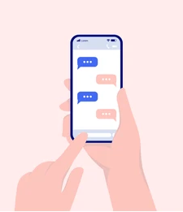
相对剥夺感降低生活满意度
而这些负性影响，可能与社交媒体的使用时，发生的社会比较相关(Lee, 2014; Vogel et al,. 2015; Jang, Park, & Song, 2016; de Vries et al., 2018; Kim & Florack, 2021; Robinson et al., 2019),
与我们的假设类似，已经有研究通过相对剥夺感解释了这一过程，Seo and Hyun (2018). 发现，越倾向于在社交媒体上和名人进行比较，人们越容易体验到相对剥夺感，从而对生活满意度的评价降低
Relative
Deprivation
2/23
Notes:
Lee, S. Y. (2014). How do people compare themselves with others on social network sites?: The case of Facebook. Computers in human behavior, 32, 253-260.
Vogel, E. A., Rose, J. P., Okdie, B. M., Eckles, K., & Franz, B. (2015). Who compares and despairs? The effect of social comparison orientation on social media use and its outcomes. Personality and Individual Differences, 86, 249-256.
Jang, K., Park, N., & Song, H. (2016). Social comparison on Facebook: Its antecedents and psychological outcomes. Computers in Human Behavior, 62, 147-154.
de Vries, D. A., Möller, A. M., Wieringa, M. S., Eigenraam, A. W., & Hamelink, K. (2018). Social comparison as the thief of joy: Emotional consequences of viewing strangers’ Instagram posts. Media psychology, 21(2), 222-245.
Kim, H., & Florack, A. (2021). When social interaction backfires: Frequent social interaction during the COVID-19 pandemic is associated with decreased well-being and higher panic buying. Frontiers in psychology, 12.
Robinson, A., Bonnette, A., Howard, K., Ceballos, N., Dailey, S., Lu, Y., & Grimes, T. (2019). Social comparisons, social media addiction, and social interaction: An examination of specific social media behaviors related to major depressive disorder in a millennial population. Journal of Applied Biobehavioral Research, 24(1), e12158.
Seo, M., & Hyun, K. D. (2018). The effects of following celebrities’ lives via SNSs on life satisfaction: The palliative function of system justification and the moderating role of materialism. New Media & Society, 20(9), 3479-3497.

Slide 13
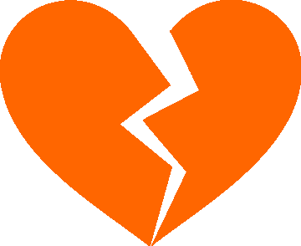

相对剥夺感降低生活满意度
Upward
Social Comparison
Relative Deprivation
Life Satisfaction
+
-
Relative
Deprivation
向上比较
相对剥夺感
生活满意度
在此基础上我们认为，这种社交媒体上的向上比较，不仅仅是发生在普通人和名人之间，在普通人与普通人之间，也可能发生，而且应该更加普遍
因此，我们提出假设2：人们在向上比较时会产生相对剥夺感，这种相对剥夺感越高，则对自己的生活满意度评价越低
2/23

Slide 14

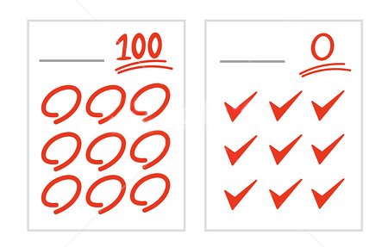
向下比较产生优越感
向上比较，可能会让人有一种受到威胁的感觉，因此人们会避免这样的比较(Brickman and Bulman, 1977)
在考试中考得不好的人，会尽力回避考得好的人的信息（向上比较），而考得好的人则不会（平行比较）(Friend and Gilbert, 1973; Wilson & Benner, 1971).
Downward
Social Comparison
2/23
Notes:
Brickman, P., & Bulman, R. J. (1977). Pleasure and pain in social comparison. Social comparison processes: Theoretical and empirical perspectives, 149, 186.
Friend, R. M., & Gilbert, J. (1973). Threat and fear of negative evaluation as determinants of locus of social comparison. Journal of personality.
Wilson, S. R., & Benner, L. A. (1971). The effects of self-esteem and situation upon comparison choices during ability evaluation. Sociometry, 381-397.

Slide 15
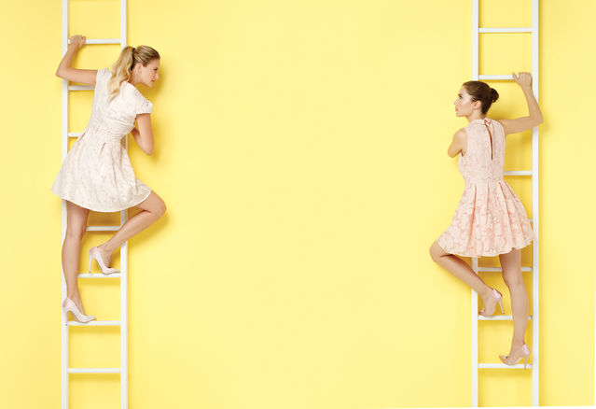
向下比较产生优越感
因此，并不是所有人都希望进行向上比较，人们有时也会进行向下比较——自己与一个比自己更差的人进行比较(Wilson & Benner, 1971).
向下比较常常会带来积极的效果，比如，增加人们的自尊，产生自豪感(e.g., Gibbons, 1986; Gilbert, Giesler, & Morris, 1995; Klein, 1997; Kulik & Gump, 1997; Morse & Gergen, 1970; Wills, 1981)
Downward
Social Comparison
2/23
Notes:
Wilson, S. R., & Benner, L. A. (1971). The effects of self-esteem and situation upon comparison choices during ability evaluation. Sociometry, 381-397.
Buunk, B. P., & Ybema, J. F. (1995). Selective evaluation and coping with stress: Making one's situation cognitively more livable. Journal of Applied Social Psychology, 25(17), 1499-1517.
Buunk, B. P., & Ybema, J. F. (1997). Social comparisons and occupational stress: The identification-contrast model. Health, coping, and well-being: Perspectives from social comparison theory, 359-388.
Gerrard, M., & Gibbons, F. X. (2013). Health images and their effects on health behavior. Health, coping, and well-being: Perspectives from social comparison theory, 63.
Taylor, S. E., Wood, J. V., & Lichtman, R. R. (1983). It could be worse: Selective evaluation as a response to victimization. Journal of social issues, 39(2), 19-40.
VanderZee, K. I., Buunk, B. P., & Sanderman, R. (1995). Social comparison as a mediator between health problems and subjective health evaluations. british Journal of social Psychology, 34(1), 53-65.
Wills, T. A. (1997). Modes and families of coping: An analysis of downward comparison in the structure of other cognitive and behavioral mechanisms. Health, coping, and well-being: Perspectives from social comparison theory, 167-193.

Slide 16
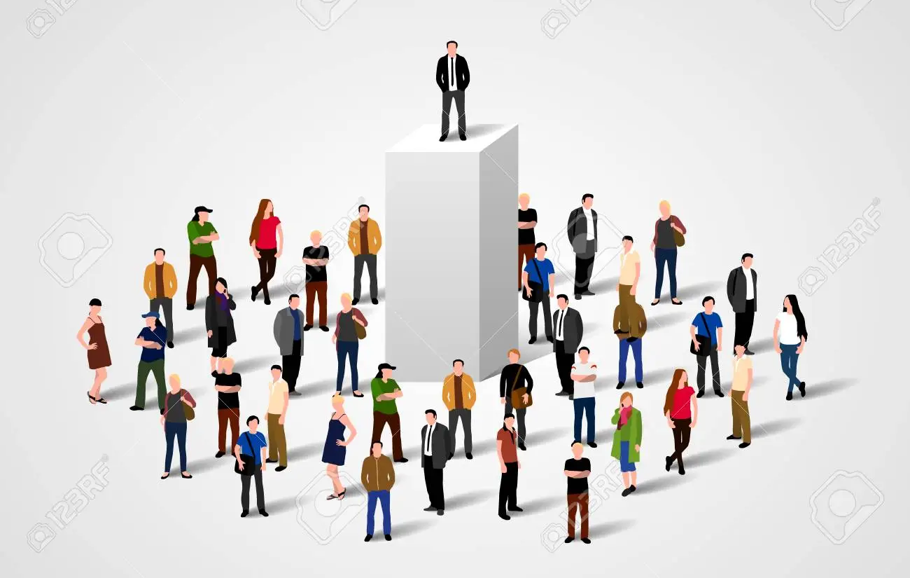
向下比较产生优越感
Downward
Social Comparison
以往很少有研究讨论，为什么向下比较会产生这些积极的效果
我们提出假设3：当人们进行向下比较的时候，会产生优越感
2/23

Slide 17
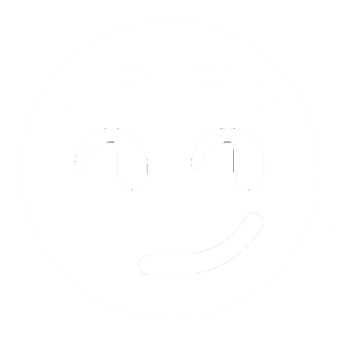
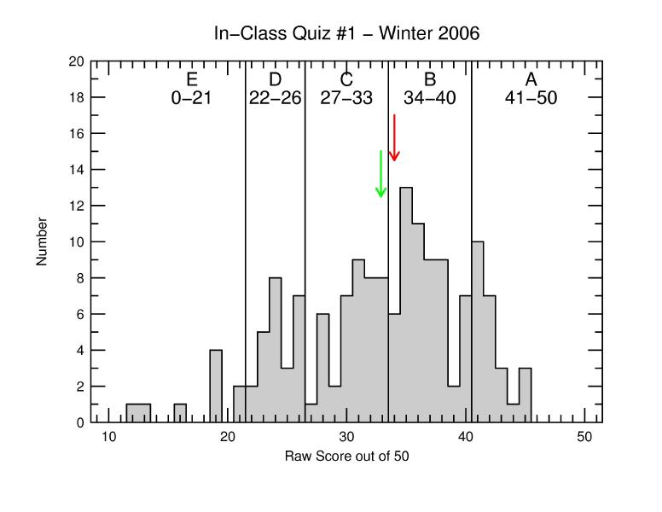
优越感提升生活满意度
一个经验研究中发现，大多数人会认为自己处于平均值以上，即认为自己相较于大多数人是更优越的，这种优越感被认为是一个人产生主观幸福感的关键(Headey & Wearing, 1988).
perceptions of Superiority
2/23
Notes:
Headey, B., & Wearing, A. (1988). The sense of relative superiority—central to well-being. Social Indicators Research, 20(5), 497-516.

Slide 18
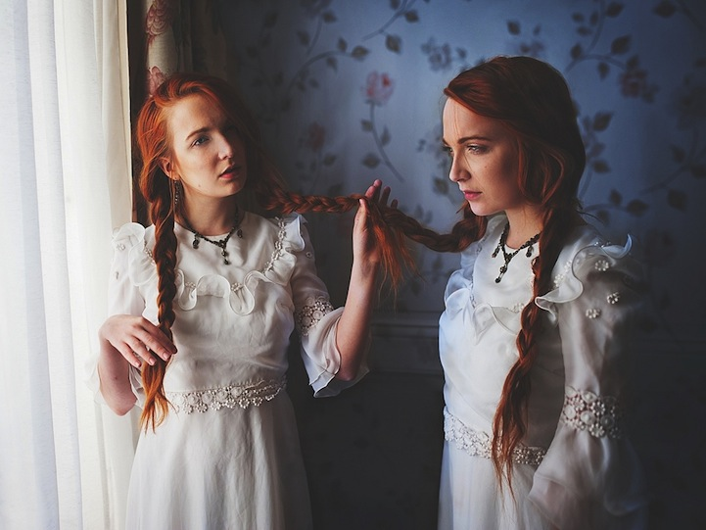
优越感提升生活满意度
人们在和比自己优秀的人比较时，常常会想到自己比他强的方面。更有甚者，会在比较时，想象一个比他自己糟糕的人，作为比较对象(e.g. Buunk & Ybema, 1995, 1997; Gerrard & Gibbons, 2013; Taylor, Wood, & Lichtman, 1983; Van der Zee, Buunk, & Sanderman, 1995; Wills, 1997).
perceptions of Superiority
2/23
Notes:
Buunk, B. P., & Ybema, J. F. (1995). Selective evaluation and coping with stress: Making one's situation cognitively more livable. Journal of Applied Social Psychology, 25(17), 1499-1517.
Buunk, B. P., & Ybema, J. F. (1997). Social comparisons and occupational stress: The identification-contrast model. Health, coping, and well-being: Perspectives from social comparison theory, 359-388.
Gerrard, M., & Gibbons, F. X. (2013). Health images and their effects on health behavior. Health, coping, and well-being: Perspectives from social comparison theory, 63.
Taylor, S. E., Wood, J. V., & Lichtman, R. R. (1983). It could be worse: Selective evaluation as a response to victimization. Journal of social issues, 39(2), 19-40.
VanderZee, K. I., Buunk, B. P., & Sanderman, R. (1995). Social comparison as a mediator between health problems and subjective health evaluations. british Journal of social Psychology, 34(1), 53-65.
Wills, T. A. (1997). Modes and families of coping: An analysis of downward comparison in the structure of other cognitive and behavioral mechanisms. Health, coping, and well-being: Perspectives from social comparison theory, 167-193.

Slide 19
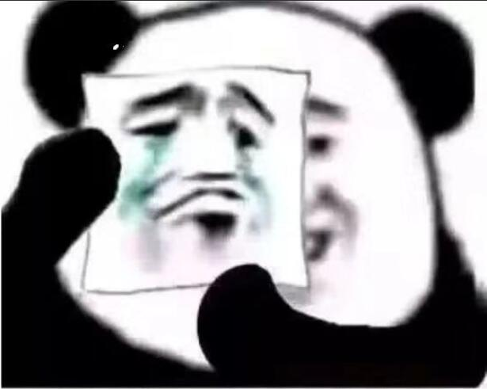
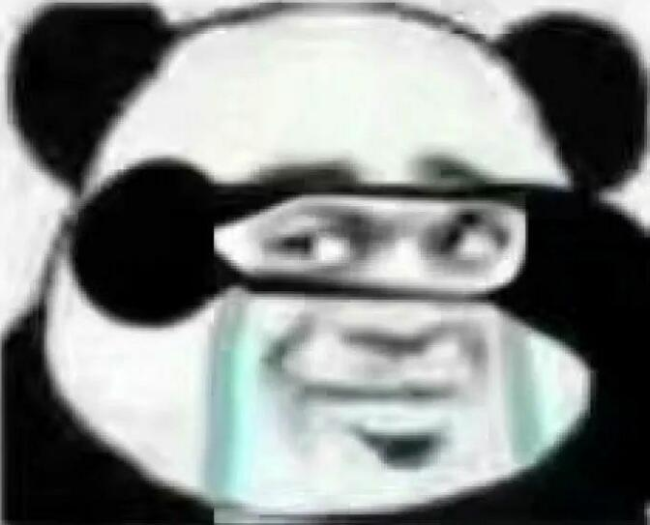
优越感提升生活满意度
perceptions of Superiority
人们是乐于进行向下比较的，这可能不仅仅是因为向上比较常常会带来不好的结果，也可能是因为，在向下比较中，人们可以获得积极的反馈
优越理论（三种幽默理论中的一种）认为，我们为什么会发笑，是因为我们在和某个对象的比较中，产生了优越感 (Lintott, 2016).
亚里士多德说也曾经说过，我们会嘲笑劣等或丑陋的人，是因为我们在和他们的比较中，感到了优越，从而觉得高兴
2/23
Notes:
Lintott, S. (2016). Superiority in humor theory. The Journal of Aesthetics and Art Criticism, 74(4), 347-358.
Poetics, 1449, p. 34-35.

Slide 20
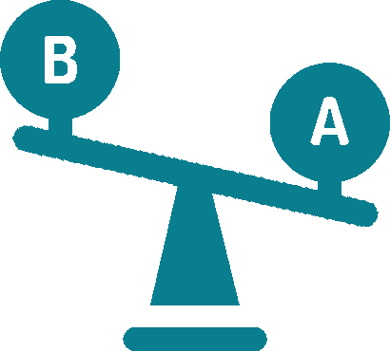

相对剥夺感降低生活满意度
Upward
Social Comparison
Perceptions of Superiority
Life Satisfaction
+
+
perceptions of Superiority
向下比较
优越感
生活满意度
假设4：人们在向下比较时会产生优越感，这种优越感越高，则对自己的生活满意度评价越高
2/23

Slide 21

目前的模型
H2
+
向上比较
相对剥夺感
-
H1
生活满意度
H3
+
向下比较
优越感
+
H4
2/23

Slide 22
社会比较倾向
社会比较倾向指的是，人们多么倾向于和其他人进行社会比较。
社会比较可能是体现个体差异的人格特质变量(Hemphill & Lehman, 1991)
Gibbons. & Buunk (1999)第一次提出了SCO，并且建立了INCOM (Iowa-Netherlands Comparison Orientation Measure) 量表
社会比较倾向分为
基于能力的社会比较倾向(ability-based social comparison orientation)：倾向于通过比较而得知“我做的怎么样”
基于观点的社会比较倾向(opinion-based social comparison orientation)：倾向于通过比较而得知“我应该怎样思考或感受”
倾向
Social Comparison
Orientation
我做的怎么样？
我应该怎样思考或感受？
2/23
Notes:
Hemphill, K. J., & Lehman, D. R. (1991). Social comparisons and their affective consequences: The importance of comparison dimension and individual difference variables. Journal of Social and Clinical Psychology, 10(4), 372-394.
Gibbons, F. X., & Buunk, B. P. (1999). Individual differences in social comparison: development of a scale of social comparison orientation. Journal of personality and social psychology, 76(1), 129.

Slide 23
社会比较倾向
尽管已经有文章讨论了社会比较倾向越高的人，越容易体验到相对剥夺感。
Callan, Kim & Watthews (2015) 发现年龄越大的人社会比较倾向越低，社会比较倾向越低，感受到的相对剥夺感越少。
Kim et al (2017) 和 Kim, Schlicht, Schardt and Florack (2021)的结果与Callan, Kim & Watthews (2015)的结果类似
但很少有文章讨论社会比较方向和社会比较倾向之间的交互作用
倾向
Social Comparison
Orientation
社会比较倾向 X 社会比较方向
2/23
Notes:
Callan, M. J., Kim, H., & Matthews, W. J. (2015). Age differences in social comparison tendency and personal relative deprivation. Personality and individual differences, 87, 196-199.
Kim, H., Callan, M. J., Gheorghiu, A. I., & Matthews, W. J. (2017). Social comparison, personal relative deprivation, and materialism. British Journal of Social Psychology, 56(2), 373-392.
Kim, H., Schlicht, R., Schardt, M., & Florack, A. (2021). The contributions of social comparison to social network site addiction. PloS one, 16(10), e0257795.

Slide 24
社会比较倾向
相对剥夺感
Buunk, Zurriaga, Gonzalez-Roma, & Subirats (2003)
社会比较倾向 高
社会比较倾向 低
没有讨论向下比较，
也没有讨论相对剥夺感对生活满意度的影响
倾向
Social Comparison
Orientation
向上比较频率
生活满意度
Buunk, Groothof, & Siero, (2007).
向上比较
向下比较
没有引入相对剥夺感和优越感作为中介变量
2/23
社会比较倾向
Notes:
Buunk, B. P., Zurriaga, R., Gonzalez-Roma, V., & Subirats, M. (2003). Engaging in upward and downward comparisons as a determinant of relative deprivation at work: A longitudinal study. Journal of Vocational Behavior, 62(2), 370-388.
Buunk, A. P., Groothof, H. A., & Siero, F. W. (2007). Social comparison and satisfaction with one's social life. Journal of Social and Personal Relationships, 24(2), 197-205.

Slide 25
社会比较倾向
向上比较
相对剥夺感
-
+
倾向
Social Comparison
Orientation
社会比较倾向
生活满意度
+
+
优越感
向下比较
假设5：社会比较方向调节了社会比较倾向和相对剥夺感以及和优越感之间的关系，具体而言当人们进行向上比较时，他的社会比较倾向越高，则体验到的相对剥夺感越高；当人们进行向下比较时，他的社会比较倾向越高，则体验到的优越感越高
2/23

Slide 26

社会比较策略
策略
Social Comparison
Strategies
但是，也有研究发现，人们进行向上比较的时候，可能会体验到积极效果，进行向下比较时，可能会体验到消极效果(e.g., Buunk, Collins, Taylor, VanYperen, & Dakof, 1990; Hemphill & Lehman, 1991) 这与之前的研究结论产生了矛盾
2/23
Notes:
Buunk, B. P., Collins, R. L., Taylor, S. E., VanYperen, N. W., & Dakof, G. A. (1990). The affective consequences of social comparison: either direction has its ups and downs. Journal of personality and social psychology, 59(6), 1238.
Hemphill, K. J., & Lehman, D. R. (1991). Social comparisons and their affective consequences: The importance of comparison dimension and individual difference variables. Journal of Social and Clinical Psychology, 10(4), 372-394.

Slide 27
社会比较策略
策略
Social Comparison
Strategies
Buunk and Ybema (1997) 解释了这种矛盾
如果人们将被比较对象识别为竞争对象，那么在向下比较中，人们会觉得自己做的更好，在向上比较中，觉得自己做的更糟(see also Buunk, Collins, Taylor, VanYperen, & Dakof, 1990).
如果人们将被比较对象视作自己未来可能的样子，那么向下比较会让人感觉更糟(e.g. Ybema, & Buunk, 1995; Buunk, & Ybema, 1997; see also Collins, 1996)
2/23
Notes:
Buunk, B. P., & Ybema, J. F. (1997). Social comparisons and occupational stress: The identification-contrast model. Health, coping, and well-being: Perspectives from social comparison theory, 359-388.
Buunk, B. P., Collins, R. L., Taylor, S. E., VanYperen, N. W., & Dakof, G. A. (1990). The affective consequences of social comparison: either direction has its ups and downs. Journal of personality and social psychology, 59(6), 1238.
Ybema, J. F., & Buunk, B. P. (1995). Affective responses to social comparison: A study among disabled individuals. British Journal of Social Psychology, 34(3), 279-292.
Buunk, B. P., & Ybema, J. F. (1997). Social comparisons and occupational stress: The identification-contrast model. Health, coping, and well-being: Perspectives from social comparison theory, 359-388.
Collins, R. L. (1996). For better or worse: The impact of upward social comparison on self-evaluations. Psychological bulletin, 119(1), 51.

Slide 28
社会比较策略
向上
认同
向上
对比
策略
Social Comparison
Strategies
向下认同
向下对比
Van der Zee, Buunk, Sanderman, Botke, & Van den Bergh, (2000). 发展了这个理论，将社会比较方向——向上或向下，和社会比较策略——认同或对比，结合起来，将社会比较细分为四种情况，向上-对比、向上-认同、向下-对比、向下-认同
尽管已有元分析总结道 “向上-对比”和“向下-认同”会降低幸福感，“向下-对比”和“向上-认同”会提高幸福感(Gerber, Wheeler, & Suls, 2018). ，但他们并没有解释其中的心理机制。
2/23
Notes:
Van der Zee, K., Buunk, B., Sanderman, R., Botke, G., & Van den Bergh, F. (2000). Social comparison and coping with cancer treatment. Personality and Individual differences, 28(1), 17-34.
Gerber, J. P., Wheeler, L., & Suls, J. (2018). A social comparison theory meta-analysis 60+ years on. Psychological bulletin, 144(2), 177.

Slide 29
社会比较策略
向上对比
相对剥夺感
-
+
策略
Social Comparison
Strategies
社会比较倾向
生活满意度
+
+
优越感
向下对比
假设6：在向上对比时，社会比较倾向越高，体会到越多的相对剥夺感，从而对生活满意度评价降低；在向下对比时，社会比较倾向越高，体会到越多的优越感，从而对生活满意度评价升高。在向上或向下认同时，不会产生这些效应。
2/23

Slide 30
理论贡献
1.尽管已经有文章讨论了社会比较倾向越高的人，越容易体验到相对剥夺感。但他们的研究中，并没有考虑，这样的社会比较是向上比较，还是向下比较。亦或者，只从社会比较方向的角度触发，讨论向上比较和向下比较产生积极或消极的结果，而不涉及社会比较倾向。
2.以往的研究中，也很少涉及讨论，社会比较是将被比较对象视作了竞争对手，还是视作了自己未来可能成为的目标
3.此外，以往的研究中，以往的研究也没有讨论过向下比较是如何产生积极效果的。因此，本研究假设这一过程是被优越感所中介的。由于人们在向下比较中产生了优越感，因此对自己的生活满意度评价有所上升。
2/23

Slide 31
理论贡献
Thanks
2/23
https://github.com/sinnyuki/SCO

