Slide 1
STM32Cube简介
北京中聚高科有限公司

Slide 2
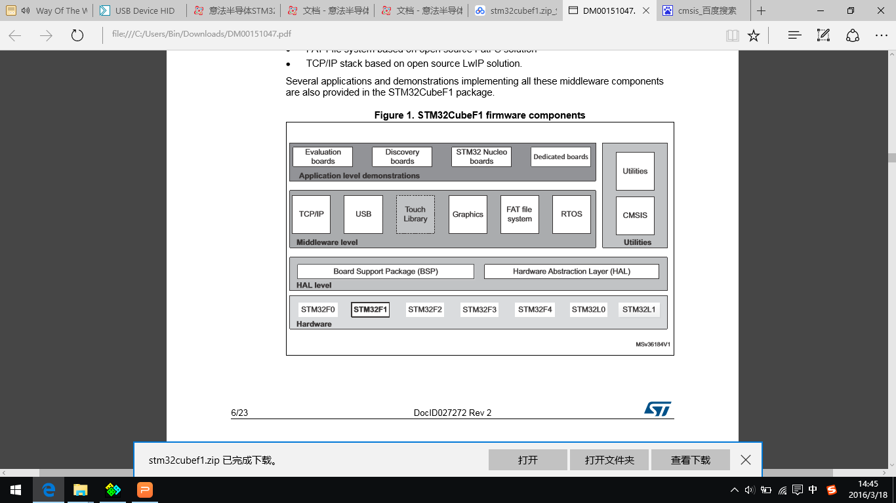

Slide 3
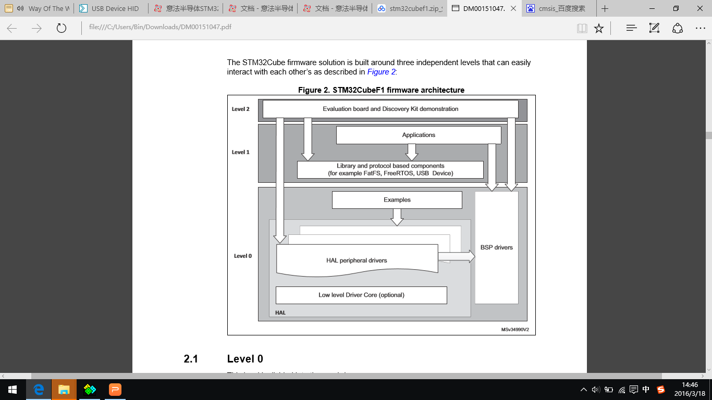

Slide 4
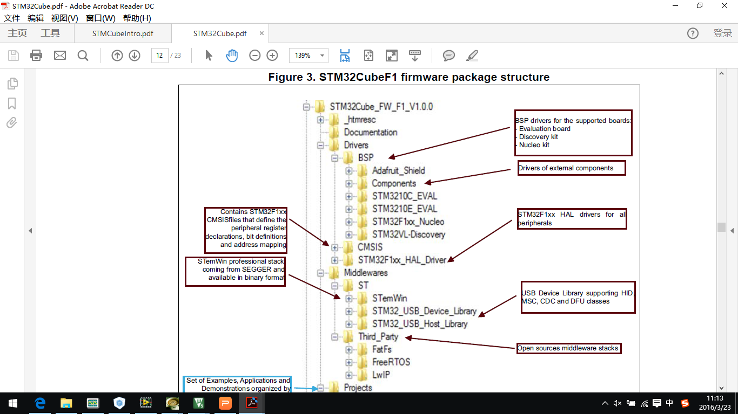

Slide 5
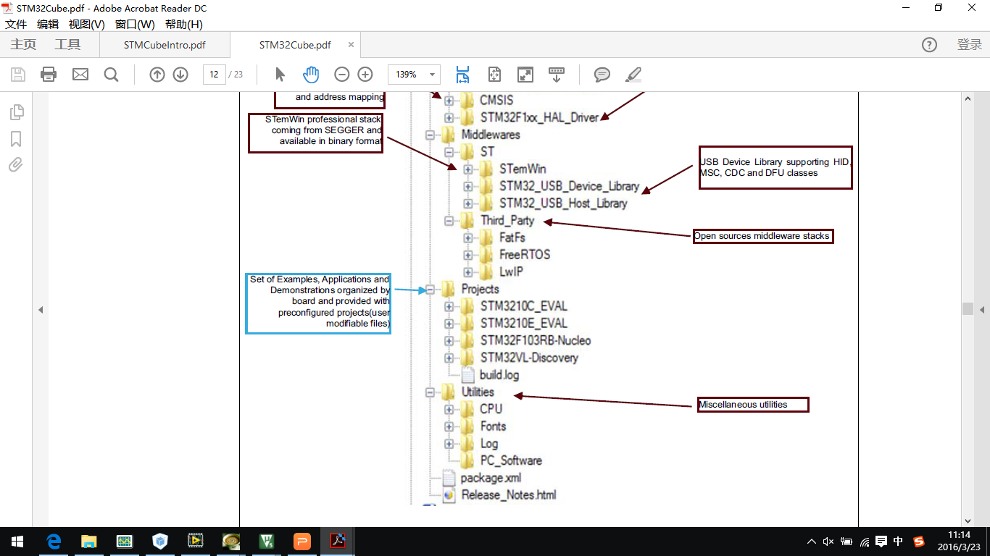

Slide 6
STM32CubeMX
1. MCU or BOARD selection
2. Select Settings of middlewares and peripherals
3. Pinout configuration
4. CLOCK tree Config. Usually an auto-configuration will do
5. Configuration of middlewares and peripherals
6. Code generation settings

Slide 7
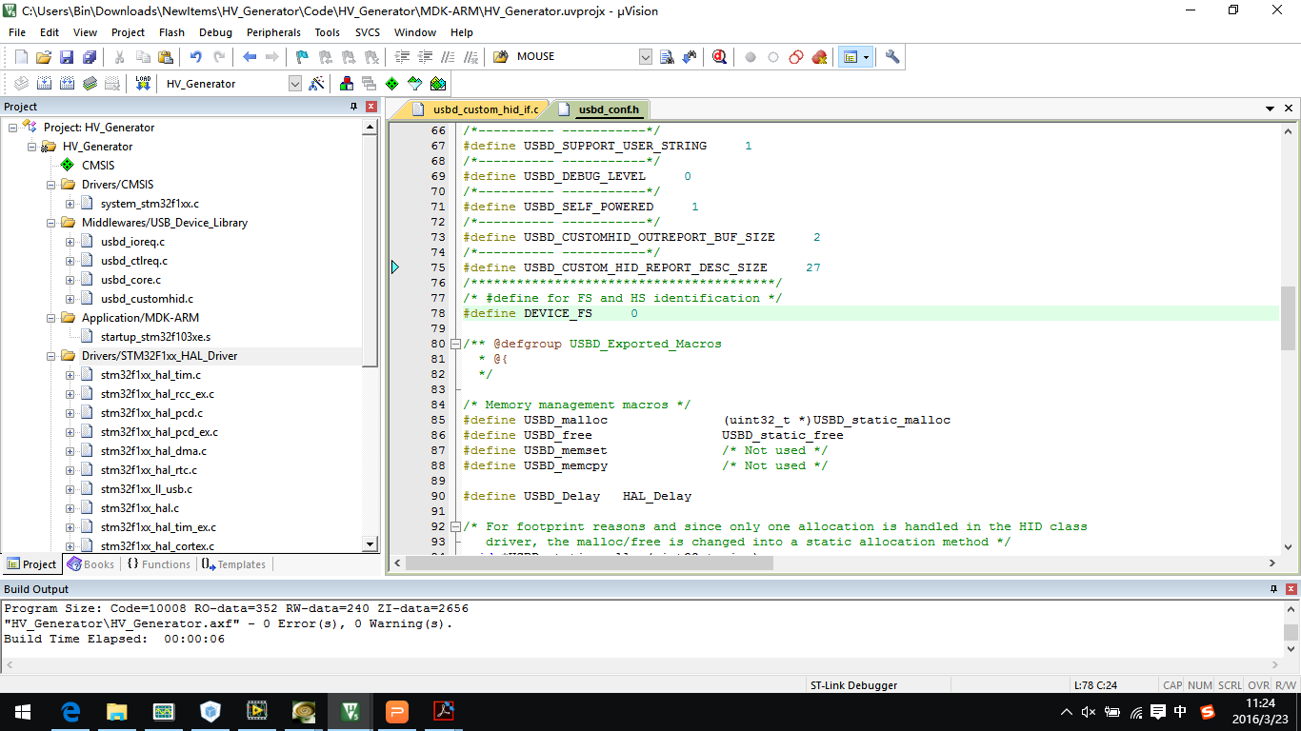

Slide 8
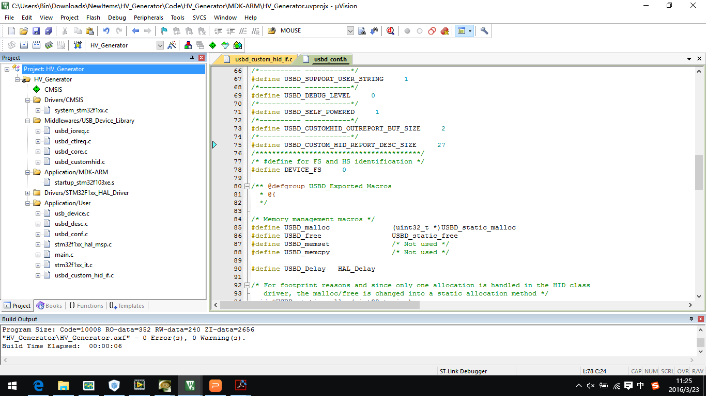

Slide 9
