Slide 1

What’s New in C++ 11?
Sasha Goldshtein
CTO, Sela Group

Slide 2
Agenda
C++ 11 status and compiler support
New language features
Best practices for modern C++
What’s up with C++ 14?
  We won’t cover every language feature in this talk, e.g. variadic templates; consult Wikipedia :-}

Slide 3
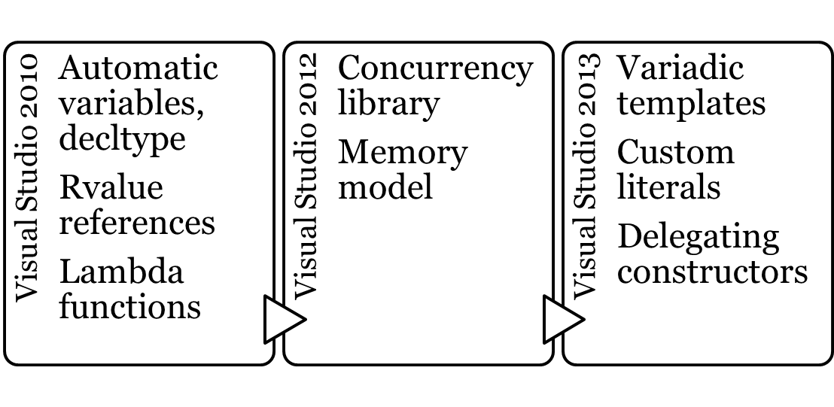
C++11 Compiler Support
Support for most language features arriving in Visual Studio 2010, 2012, 2013
  Comparison chart: http://s.sashag.net/rpST0u

Slide 4
auto Variables
Implicit variable declaration: the compiler knows what you mean
  (Almost) necessary for anonymous types
  Very convenient for complex templates
  Easily abused by lazy programmers!
std::map<int, std::list<string>> M;
auto iter = M.begin(); //what’s the type of iter?
auto pair = std::make_pair(iter, M.key_range(...));
auto ptr = condition ? new class1 : new class2; //ERROR
auto x = 15; auto s = (string)"Hello";

Slide 5
Range-Based for Loop
Automatic iterator over arrays and STL collections
  Your collection will work – provide begin(), end(), and an input iterator over the elements
  Can also specialize global std::begin(), std::end() if you don’t control the collection class
int numbers[] = ...;
for (int n : numbers) std::cout << n;
std::map<std::string,std::list<int>> M;
for (const auto& pair : M)
for (auto n : pair.second)
std::cout << pair.first << ' ' << pair.second;
Notes:
Note that when using (auto x : coll), there is a good chance that x will be a copy.
Therefore, writing (const auto& x : coll) should be muscle memory.

Slide 6
Initializer Lists
Initialize arrays, lists, vectors, other containers—and your own containers—with a natural syntax
Also applies to structs/classes!
vector<int> v { 1, 2, 3, 4 };
list<string> l = { “Tel-Aviv”, “London” };
my_cont c { 42, 43, 44 };
point origin { 0, 0 }; //not a container, but has ctor taking two ints
class my_cont {
public: my_cont(std::initializer_list<int> list) {
for (auto it = list.begin(); it != list.end(); ++it) . . .
}
};
Notes:
Only Visual Studio 2013 supports uniform initialization and initializer lists (although there are still some small bugs to flesh out).
More examples for uniform initialization:
struct X { X(int i, int j); };
void f(X);
f({1,2});
std::complex<double> c {1.0,1.0};

Slide 7

Taking It Further…
Some people now use auto exclusively
  Beauty is in the eyes of the beholder…
auto flags = DWORD { FILE_FLAG_NO_BUFFERING };
auto numbers = std::vector<int> { 1, 2, 3 };
auto event_handle = HANDLE {};
// You can consistenly use “auto” with functions, too:
auto is_prime(unsigned n) -> bool;
auto read_async(HANDLE h, unsigned count) -> vector<char>;

Slide 8
Lambda Functions
int main() {
[](){}();
[]{}();
} //this is legal C++,
//although not useful

Slide 9
Lambda Functions
Inline methods in other methods
std::list<int> ns = ...;
auto print_num = [](int n) { std::cout << n; };
std::for_each(ns.begin(), ns.end(), print_num);
int even = std::count_if(ns.begin(), ns.end(),
[](int n) { return n&1==0; });
// Print squares
std::transform(ns.begin(), ns.end(), std::ostream_iterator<int>(std::cout, '\n'),
[](int n) { return n*n; });

Slide 10
More Fun With Lambdas
Capturing external local variables
  Compiled to a function object with fields
int fib1 = 1, fib2 = 1;
auto next_step = [&]() { //capture by reference
int temp = fib2; fib2 = fib2 + fib1; fib1 = temp;
};
for (int i = 0; i < 20; ++i) next_step();
std::thread t([=]() { // capture by value
std::cout << fib1 << std::endl;
});
t.join();

Slide 11
Applying Lambdas
Design your APIs with lambdas in mind
  Usually through template parameters
Invest in re-learning STL algorithms
template <typename Callback>
void enum_windows(const string& title, Callback callback) {
. . . callback(current_window);
}
template <typename RAIter, typename Comparer>
void superfast_sort(RAIter from, RAIter to, Comparer cmp);

Slide 12
Lambdas and Function Pointers
Stateless lambdas are convertible to function pointers!
  Useful for interop with C-style APIs that take function pointers (e.g., Win32)
ReadFileEx(file, buffer, 4096, &overlapped,
[](DWORD ec, DWORD count, LPOVERLAPPED overlapped) {
// process the results
}
);

Slide 13
Modern C++ Style
Use auto, for, initializer lists ubiquitously
OK to design algorithms that require predicates, projections, and other functors
  They will be easy to use—with lambda functions
Use STL algorithms more widely with lambdas

Slide 14
Rvalues and Lvalues—Reminder
Lvalues are values that have a name
  Can appear on the l.h.s. of an assignment
Rvalues are the rest
int x;
x = 42; //OK, x has a name, it’s an lvalue
x + 2 = 42; //Wrong, x + 2 returns an rvalue
x++ = 42; //Also wrong, x++ is an rvalue
int& foo();
int* goo();
--foo(); //OK, foo() returns an lvalue
++(*goo()); //OK, a dereferenced pointer is an lvalue

Slide 15
Who Cares?
Observation: rvalues are unnamed, and are destroyed promptly
template <typename Param> void func(Param p);
// The vector is destroyed after func is called
func(std::vector<int>());
// The result of operator+ is destroyed after func is called
func(matrixA + matrixB);

Slide 16
Who Cares?
The standard approach to references limits the performance of the language
// In “old” C++, this requires a string copy per iteration
// What’s worse, when the vector expands → more copies
std::vector<std::string> strings;
for (int i = 0; i < 100000; ++i)
{
strings.push_back(“Hello”);
}

Slide 17
&& Enable Move Construction
my_array(const my_array& other) { //copy ctor
dataptr_ = new T[size_ = other.size_];
memcpy_s(dataptr_, size_*sizeof(T), other.dataptr_,
size_*sizeof(T));
}
my_array& operator=(const my_array& other) { /*same deal*/ }
my_array& operator=(my_array&& other) { //move assignment
dataptr_ = other.dataptr_; size_ = other.size_;
other.dataptr_ = nullptr; other.size_ = 0;
}
my_array(my_array&& other) { //move ctor
*this = std::move(other); //NOTE: other is an lvalue :-{
}
Notes:
There is a slightly complicated point in the move constructor here. If the move constructor were to use the assignment directly, e.g. *this = other, then the standard operator= would be called. The reason is that rvalue references are treated as lvalues as long as they have a name. What std::move does is pass its parameter through, and by doing that it removes its name so the caller treats it as an unnamed object, and hence an rvalue. (The reason for this quirk, in turn, is to prevent accidental moves that will destroy the object. E.g. you could move from other, and then attempt to use other later in your method.)
After we have a container that works like this, we can also have an std::swap that works appropriately—it will simply use std::move instead of just the assignment operator to move the swapped data around (through a temporary variable), i.e.: temp = move(a); a = move(b); b = move(temp); — and no copies of the contents are required.

Slide 18
Guidelines for Move Semantics
Don’t be afraid to return moveable objects by value
  Best case: RVO/NRVO kicks in to optimize completely
  Worst case: the object is moved, almost no overhead
Pass objects by value to sinks
  In other words, move them to sinks
Non-copyable objects might be still suitable for moving
  E.g., unique_ptr<T>, std::thread, lambdas, …

Slide 19
Deleted and Defaulted Functions
Disallow a certain function or use its default implementation
  Usually used with ctors and operator=
class thread {
public:
template <typename Fn> thread(Fn&& fn);
thread(const thread&) = delete;
thread(thread&&) = delete;
~thread() = default;
// ...
};

Slide 20
Delegating Constructors
No more “init” functions! You can now call a constructor from another constructor
class file {
public:
file(string filename) : file(filename.c_str()) {}
file(const char* filename) : file(open(filename)) {}
file(int fd) {
// Actual initialization goes here
}
};

Slide 21
Alias Templates
“Typedefs” can now be templates
The using keyword can replace typedef completely
template <typename K, typename V, typename Alloc>
class map;
template <typename T>
using simple_set<T> = map<T, bool, DefaultAllocator>;
using thread_func = DWORD(*)(LPVOID);

Slide 22
Non-Static Data Member Initializers
Data members can be initialized inline
The compiler adds the appropriate code prior to each constructor
class counter {
int count = 0;
SRWLOCK lock { SRWLOCK_INIT };
public:
// ...
};

Slide 23
More Miscellaneous Features
Explicit conversion operators
Raw string literals
Custom literals
auto utf8string = u8"Hello";
auto utf16string = u"Hello";
auto utf32string = U"Hello";
auto raw = R"(I can put " here and also \)";
auto break_time = 5min; // in the STL as of C++14

Slide 24
New Smart Pointers
STL now has three types of smart pointers, eliminating the need to ever use delete
  If you are the sole owner of the object, use unique_ptr to make sure it’s deleted when the pointer dies (RAII)
  If you want to share the object with others, use shared_ptr—it will perform smart reference counting
  If you got yourself a cycle, use weak_ptr to break it!

Slide 25
unique_ptr
Sole owner of an object
  Moveable, not copyable
  Replaces auto_ptr (which can’t move!)
unique_ptr<expensive_thing> create() {
unique_ptr<expensive_thing> p(new expensive_thing);
// ...do some initialization, exceptions are covered by RAII
return p;
}
unique_ptr<expensive_thing> p = create(); // move constructor used!
//another example is storing pointers in containers:
vector<unique_ptr<string>> v = { new string(“A”), new string(“B”) };

Slide 26
shared_ptr
Thread-safe reference-counted pointer to an object with shared ownership
  When the last pointer dies, the object is deleted
struct file_handle {
HANDLE handle;
file_handle(const string& filename) ...
~file_handle() ... //closes the handle
};
class file {
shared_ptr<file_handle> _handle;
public:
file(const string& filename) : _handle(new file_handle(filename)) {}
file(shared_ptr<file_handle> fh) : _handle(fh) {}
}; //can have multiple file objects over the same file_handle

Slide 27
weak_ptr
Points to a shared object but does not keep it alive (does not affect reference count)
Breaks cycles between shared_ptrs
class employee {
weak_ptr<employee> _manager;
vector<shared_ptr<employee>> _direct_reports;
public:
void beg_for_vacation(int days) {
if (auto mgr = _manager.lock()) { mgr->beg(days); }
else { /* your manager has been eliminated :-) */ }
}
};

Slide 28
Guidance for Smart Pointers
Own memory with smart pointers: don’t delete
Allocate shared pointers with make_shared
Most owners of pointers can use unique_ptr, which is more efficient than shared_ptr
Don’t use smart pointers for passing parameters if the usage lifetime is a subset of the function call’s lifetime
Pass unique_ptr<T> by value to a sink that retains the object pointer and will destroy it
Pass shared_ptr<T> by value to express taking shared ownership of the object
Notes:
More guidance on smart pointers from Herb Sutter, Chairman of the ISO C++ committee: http://herbsutter.com/2013/06/05/gotw-91-solution-smart-pointer-parameters/

Slide 29
Guidance for Smart Pointers: Examples
struct window {
// Okay – takes ownership of the window, will destroy it.
void set_owned_child(unique_ptr<window> window) {
child = std::move(window);
}
unique_ptr<window> child;
};
// Weird – use plain & or * instead.
currency calculate_tax(const unique_ptr<employee>& emp);
// Okay – takes shared ownership of the callback,
// lifetime has to be extended past the call site
void set_callback(shared_ptr<callback> cb);

Slide 30
In C++ 14…
In C++ 14, you write
auto auto(auto auto) { auto; }
and the compiler infers the rest from context.

Slide 31
Generic Lambdas
Lambda parameters can be declared with the auto specifier
This is not type deduction – this is a template!
auto lambda = [](auto f) { f.foo(); };
// equivalent to:
struct __unnamed__ {
template <typename S>
void operator()(S f) const { f.foo(); }
};
auto lambda = __unnamed__();

Slide 32
Lambda Capture Extensions
Lambdas can now capture arbitrary expressions, which enables renaming and capture-by-move semantics
std::async([tid = std::this_thread::get_id()]() {
cout << “called from thread “ << tid << endl;
});
unique_ptr<window> top_level = ...;
auto f = [top = std::move(top_level)]() {
// access ‘top’
};

Slide 33
Function Return Type Deduction
Functions can be declared as returning auto, and the compiler deduces the return type (if consistent)
// Not okay, return type unknown at recursive call:
auto fibonacci(int n) {
if (n != 1 && n != 2) return fibonacci(n-1) + fibonacci(n-2);
return 1;
}
auto fibonacci(int n) { // Okay, return type deduced to be int
if (n == 1 || n == 2) return 1;
return fibonacci(n-1) + fibonacci(n-2);
}

Slide 34
Miscellaneous Language Features
Variable templates
template <typename T> T MATH_PI;
Runtime-sized arrays
Binary literals 0b10011101

Slide 35
Library Features
Shared mutex (reader-writer lock)
User-defined literals for std::strings (s”hello”) and duration (3h, 50min, 10ms, and others)
Optional type optional<T>

Slide 36
Summary
Modern C++ is nothing like the 1990’s
Things are looking up for C++ developers
Lots of language and library changes
Faster library evolution going forward

Slide 37
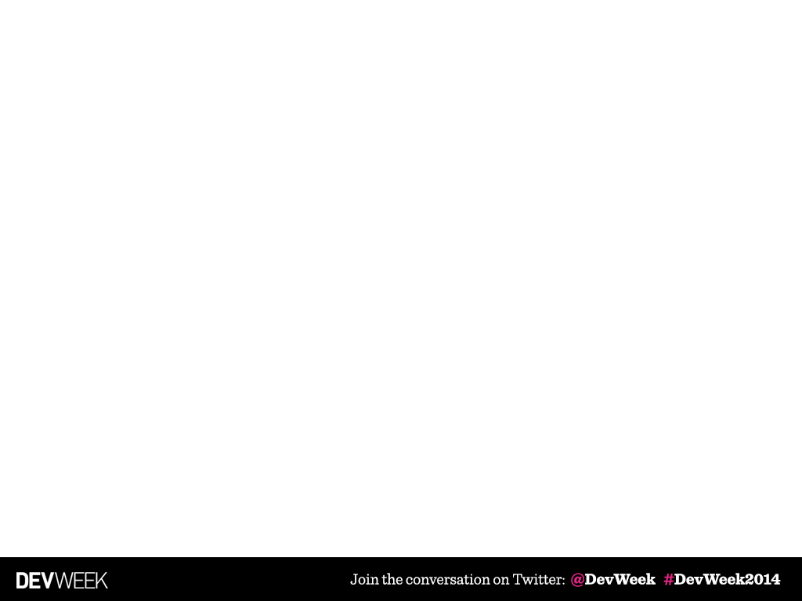
THANK YOU!
Sasha Goldshtein
CTO, Sela Group
blog.sashag.net
@goldshtn

