Slide 1
Linux and Script programming
Freeman Feng

Slide 2
History
Date | Version | Change | Author
2012.05.17 | PA1 | Created Version, Lack of Script part | Freeman Feng

Slide 3
Agenda
Linux Shell
Kernel / User Mode and System Call
ltrace, strace
Core dump debugging
Valgrind
Traceroute

Slide 4
Linux Shell
Variable | Meaning
$# | Numbers of arguments
$* | “$1 $2 $3…$n”, all the arguments in a char string
$$ | Process ID of current running script
$! | Last background process ID
$@ | Similar to $* but need “”, $*=“$1””$2”…”$n”
$- | Options of current shell
$? | Exit state of the last command, 0 means no error

Slide 5
Linux Shell
Command 1 && Command 2
  Only when Command 1 succeeds, Command 2 will be executed
Command 1 || Command 2
  Only when Command 1 fails, Command 2 will be executed
(Command 1; Command 2; ...)
  Run bunch of commands in current shell
{Command 1; Command 2; ...}
  Run bunch of commands in child shell if the result will be piped
i.e. cp file1 file2 || (echo “cp failed”| mail zaf; exit)

Slide 6
Linux Shell – Cut
-c m-n According to char, begin with 1
  m means the m char
  m- means from the m char to the end
  m-n means from the m to n chars
  -n means from the 1 to n chars
-f m-n According to column, using tab as division by default
-d defined division char used to split the input
echo SDAFDSAFSDFSADFADS | cut -c 1-5,8-10
echo AB:CD:EF:GH | cut -d : -f 2-3
echo AB-CD-EF-GH | cut -d \- -f 1,3-4

Slide 7
Linux Shell – Paste
paste file1 file2 > file3
-d defined division char
paste -d : file1 file2 > file3
  Will use “:” as division for file1 content and file2 content
ls | paste -d : - - -
  Space between -, one – indicating one column
  i.e.
  [freeman@devlnx ~]$ ls | paste -d : - - -
  bin:boost:codes
  Desktop:download:env

Slide 8

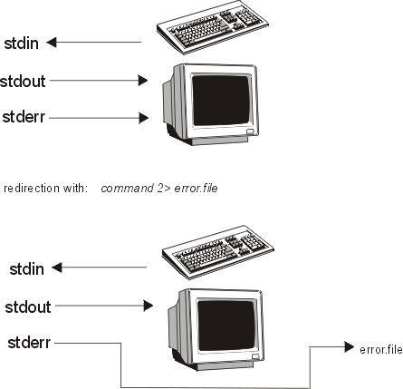
Linux Shell – Pipe and Redirection
sort < names | head
sort names | head
ls | sort | cat
ls /bin /jimmo > /tmp/junk 2>&1
  2>&1 says that file descriptor 2 (stderr) should go to the same place as file descriptor 1 (stdout)
ls /bin /jimmo > /tmp/junk 2>/tmp/errors
Notes:
“sort names | head” equal to “sort < names | head”
Note that this command does not work as you would think:
ls /bin /jimmo 2>&1 > /tmp/junk
The reason is that we redirect stderr to the same place as stdout before we redirect stdout. So, stderr goes to the screen, but stdout goes to the file specified.

Slide 9
Linux Shell – tail head more less
tail -2 readme.txt (last 2 lines)
tail -n 2 readme.txt (last 2 lines)
head -3 readme.txt (first 3 lines)
head -n 3 readme.txt (first 3 lines)
tail -f /var/log/messages (refresh frequently, Ctrl+c to exit)
sed -n '5,8p' readme.txt (print line 5 to 8 of file readme.txt)
less file (could page up/down)
more file (use space to scroll, could not page up)

Slide 10
Linux Shell – sed sort uniq tr
sed -n '1,3p' readme.txt (print line 1~3 of readme.txt)
sed '1,3d' readme.txt (not display line 1~3 of readme.txt)
sed -i s/qt/Qt/g readme.txt (replace qt to Qt in readme.txt)
sed -i '1d' new.txt (delete line 1 in new.txt)
sed -e s/qt/Qt/g readme.txt > new.txt (generate new.txt)
sort -u file (sort the file, remove the duplicate lines)
uniq file (only continuous duplicated lines will be removed)
sort -o file1 file (write the sort result of file to file1)
echo "AAB" | tr -d "A" (remove “A” from “AAB”)
echo "adcfghg" | tr -cd fgca (result: acfgg, removed dh which is not in string fgca)
echo "adcfghg" | tr adcgw vbnle (result: vbnflhl, a->v, d->b..)
Notes:
[freeman@devlnx ~]$ cat test.txt
BB
AA
AA
BB
[freeman@devlnx ~]$ sort test.txt
AA
AA
BB
BB
[freeman@devlnx ~]$ sort -u test.txt
AA
BB
[freeman@devlnx ~]$ uniq test.txt
BB
AA
BB

Slide 11
Shell/awk Example: Configure Multi IP
ADDRESS=`ifconfig eth1 | grep Bcast`
ETH1IP=`echo ${ADDRESS} | awk '{print $2}' | awk -F : '{print $2}'`
ETH1IP_FIRST=`echo ${ETH1IP} | awk -F . '{print $1"."$2"."$3"."}'`
ETH1IP_LAST=`echo ${ETH1IP} | awk -F . '{print $4}'`
for n in `seq 1 10`;do
LAST=`expr ${n} "+" ${ETH1IP_LAST}`
IP=${ETH1IP_FIRST}${LAST}
ifconfig eth1:${n} ${IP}/24 up
done
Notes:
Edit /etc/rc.local
#!/bin/sh

Slide 12
Kernel Mode
Execution code has complete and unrestricted access to
  Underlying hardware
  Any CPU instruction
  Reference any memory address
Reserved for Lowest-level, most trusted functions of the operating system
Crashes in kernel mode are catastrophic; they will halt the entire PC

Slide 13
User Mode
No ability to directly access hardware or reference memory
Code running in user mode must delegate to system APIs to access hardware or memory
Due to the protection afforded by this sort of isolation, crashes in user mode are always recoverable

Slide 14
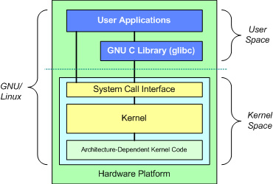
System Call
The interface between user programs and kernel

Slide 15
Example
Application
  Calls printf()
C library (glibc)
  printf() function issues write() system call.
Kernel
  write() system call manages output.
  sets global errno variable if an error occurs.
  returns to user application
cat >hello.c
#include <stdio.h>
int main(int argc, char *argv[]) {
printf("Hello world!\n");
return 0;
}

Slide 16
ltrace
Monitor the library calls used by a program and all the signals it receives
Show system calls, used by a program
ltrace ./hello
__libc_start_main(0x8048394, 1, 0xbffff914, 0x80483b8, 0x8048400 <unfinished ...>
printf("Hello world!\n"Hello world!
) = 13
+++ exited (status 0) +++

Slide 17
strace
Monitor system calls and all the signals it receives
strace ./hello
execve("./hello", ["./hello"], [/* 40 vars */]) = 0
uname({sys="Linux", node="tara", ...}) = 0
brk(0) = 0x804a000
access("/etc/ld.so.nohwcap", F_OK) = -1 ENOENT (No such file or directory)
old_mmap(NULL, 8192, PROT_READ|PROT_WRITE, MAP_PRIVATE|MAP_ANONYMOUS, -1, 0) = 0xb7fe9000
open("/etc/ld.so.preload", O_RDONLY) = -1 ENOENT (No such file or directory)
open("/etc/ld.so.cache", O_RDONLY) = 3
fstat64(3, {st_mode=S_IFREG|0644, st_size=50648, ...}) = 0
old_mmap(NULL, 50648, PROT_READ, MAP_PRIVATE, 3, 0) = 0xb7fdc000
close(3) = 0
access("/etc/ld.so.nohwcap", F_OK) = -1 ENOENT (No such file or directory)
open("/lib/tls/i686/cmov/libc.so.6", O_RDONLY) = 3
read(3, "\177ELF\1\1\1\0\0\0\0\0\0\0\0\0\3\0\3\0\1\0\0\0\215Y\1"..., 512) = 512
fstat64(3, {st_mode=S_IFREG|0644, st_size=1222116, ...}) = 0

Slide 18
strace
old_mmap(NULL, 1232428, PROT_READ|PROT_EXEC, MAP_PRIVATE, 3, 0) = 0xb7eaf000
old_mmap(0xb7fd1000, 36864, PROT_READ|PROT_WRITE, MAP_PRIVATE|MAP_FIXED, 3, 0x121000) = 0xb7fd1000
old_mmap(0xb7fda000, 7724, PROT_READ|PROT_WRITE, MAP_PRIVATE|MAP_FIXED|MAP_ANONYMOUS, -1, 0) = 0xb7fda000
close(3) = 0
old_mmap(NULL, 4096, PROT_READ|PROT_WRITE, MAP_PRIVATE|MAP_ANONYMOUS, -1, 0) = 0xb7eae000
set_thread_area({entry_number:-1 -> 6, base_addr:0xb7eae080, limit:1048575, seg_32bit:1, contents:0, read_exec_only:0, limit_in_pages:1, seg_not_present:0, useable:1}) = 0
munmap(0xb7fdc000, 50648) = 0
fstat64(1, {st_mode=S_IFCHR|0620, st_rdev=makedev(136, 3), ...}) = 0
mmap2(NULL, 4096, PROT_READ|PROT_WRITE, MAP_PRIVATE|MAP_ANONYMOUS, -1, 0) = 0xb7fe8000
write(1, "Hello world!\n", 13Hello world!) = 13
munmap(0xb7fe8000, 4096) = 0
exit_group(0) = ?

Slide 19
Core dump debugging
ulimit -a
ulimit -c 0 (No coredump)
ulimit -c unlimited (Generate coredump)
Add -g option in CCFLAG in GCC compilation
gdb -c <core dump file> <binary>
  where
  bt
core file size (blocks, -c) 0
…

Slide 20
Valgrind
A GPL licensed programming tool for memory debugging, memory leak detection, and profiling
Finding Memory Leaks
  Compile using the -g option of gcc and use valgrind to check
#include <stdlib.h>
int main()
{
char *x = malloc(100); /* or, in C++, "char *x = new char[100] */
return 0;
}
valgrind --tool=memcheck --leak-check=yes example1
==2330== 100 bytes in 1 blocks are definitely lost in loss record 1 of 1 ==2330== at 0x1B900DD0: malloc (vg_replace_malloc.c:131)
==2330== by 0x804840F: main (example1.c:5)

Slide 21
Valgrind
Finding Invalid Pointer
#include <stdlib.h>
int main()
{
char *x = malloc(10);
x[10] = 'a';
return 0;
}
valgrind --tool=memcheck --leak-check=yes example2
==9814== Invalid write of size 1
==9814== at 0x804841E: main (example2.c:6)
==9814== Address 0x1BA3607A is 0 bytes after a block of size 10 alloc'd
==9814== at 0x1B900DD0: malloc (vg_replace_malloc.c:131)
==9814== by 0x804840F: main (example2.c:5)

Slide 22
Valgrind
Detecting The Use Of Uninitialized Variables
#include <stdio.h>
int main()
{
int x;
if(x == 0)
{
printf("X is zero"); /* replace with cout and include
iostream for C++ */
}
return 0;
}
==17943== Conditional jump or move depends on uninitialised value(s)
==17943== at 0x804840A: main (example3.c:6)

Slide 23
Valgrind
Detecting The Use Of Uninitialized Variables
#include <stdio.h>
int foo(int x)
{
if(x < 10)
{
printf("x is less than 10\n");
}
}
int main()
{
int y;
foo(y);
}
==4827== Conditional jump or move depends on uninitialised value(s)
==4827== at 0x8048366: foo (example4.c:4)
==4827== by 0x8048394: main (example4.c:12)

Slide 24
Valgrind
Detect a few other improper uses of memory
  i.e. Call free twice on the same pointer value
  Valgrind will detect this for you; you'll get an error
Detects improperly chosen methods of freeing memory
  in C++ there are three basic options for freeing dynamic memory: free, delete, and delete[]
  free paired with malloc
  delete paired with new (for allocation of single objects)
  delete[] paired with new[] (for allocation of arrays)
  If you do trigger one of these problems, you'll get this error
Invalid free()
Mismatched free() / delete / delete []

Slide 25
Valgrind Example
valgrind --tool=memcheck --leak-check=full --log-file=mem.txt <binary>

Slide 26
What Won't Valgrind Find?
Doesn't perform bounds checking on static arrays (allocated on the stack)
  Valgrind won't alert you
int main()
{
char x[10];
x[11] = 'a';
}

Slide 27
A Few More Caveats of Valgrind
Consume more memory
  Up to twice as much as your program normally does
Take longer to run your code
Isn't going to detect every error you have
  If you don't test for buffer overflows by using long input strings, Valgrind won't tell you that your code is capable of writing over memory that it shouldn't be touching

Slide 28
Summary of Valgrind
Checks for unpaired calls to malloc
Uses of invalid memory (such as ininitialized memory)
Invalid memory operations (such as freeing a block of memory twice or calling the wrong deallocator function)
Does not check use of statically allocated arrays

Slide 29
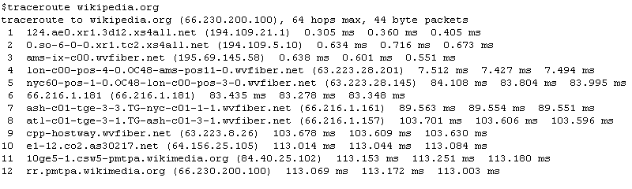
Traceroute
A computer network diagnostic tool
Displaying the route (path)
Measuring transit delays of packets across an IP network
  Only wait 3 seconds (instead of 5)
  Only send out 1 query to each hop (instead of 3)
  Limit the maximum number of hops to 16 before giving up (instead of 30) with the final host example.com
traceroute -w 3 -q 1 -m 16 example.com

