Slide 1

面向对象版计算器
第四十三章

Slide 2
本章目标
Parser类实现

Slide 3
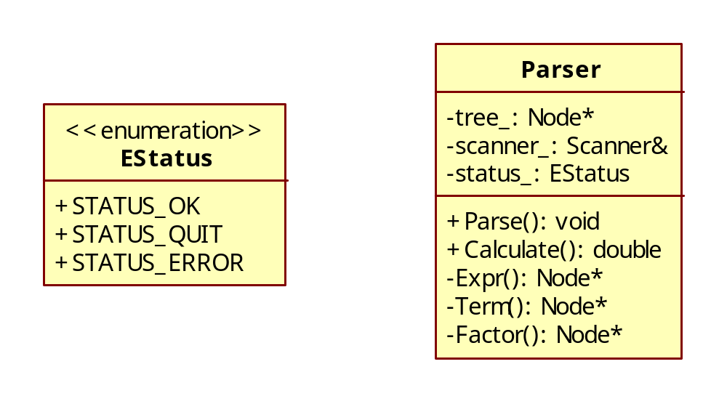
Parser

Slide 4
Parser
Expression is Term + Expression
or Term - Expression
or Term = Expression
or just Term

Slide 5
Parser
Term is Factor * Term
or Factor / Term
or just Factor

Slide 6
Parser
Factor is Number
or Identifier
or Identifier(Expression)
or -Factor
Or (Expression)

Slide 7
总结
Parser类实现

